Slide 1
Why’s my mum acting strange?
The story of the brain

Slide 2
This booklet explains the how the brain works and things that can go wrong with it.
It is aimed at the children (age 7-12, although it could be used with older children) of families who have experienced poor mental health, particularly parents being discharged from hospital to help them talk about what has happened.
In the booklet, it talks about ‘mum’ being unwell, but this could be dad, brother, sister, aunt uncle or anyone close to the family.

Slide 3
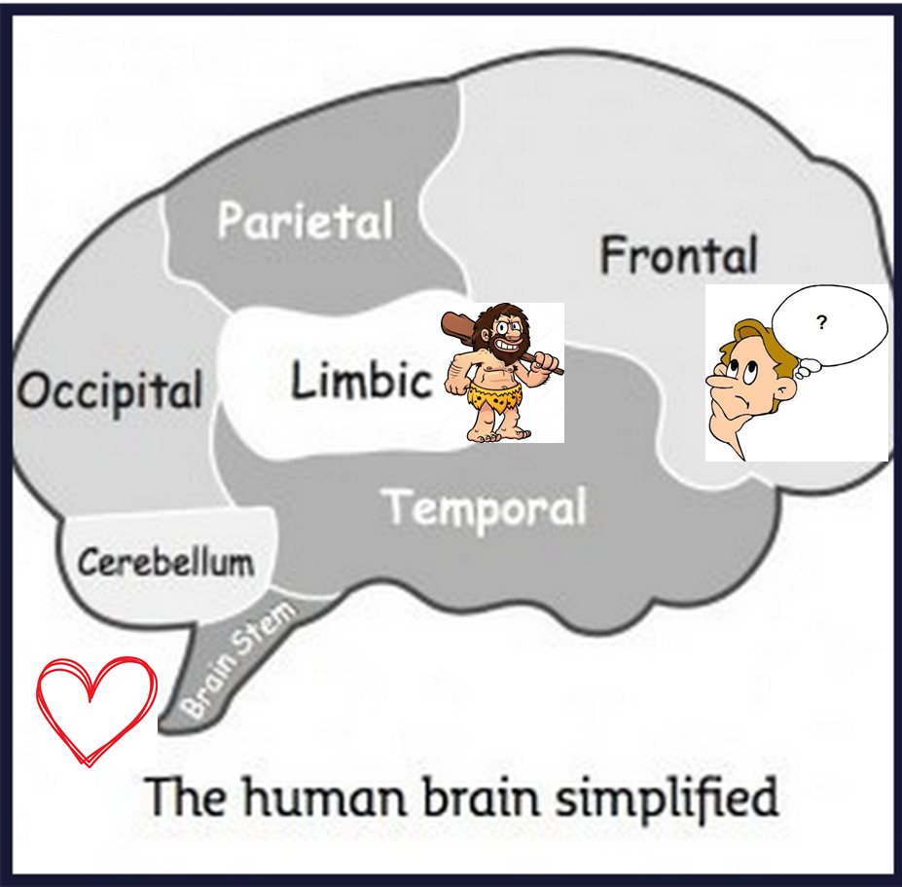
The Brain
The brain is an amazing place.
It has around 100 billion neurons which all carry messages back and forth and it has many different parts which all do different things. (The length of one hundred billion one dollar notes laid end-to-end would go around the earth 387 times!)
We are going to look at what it does and what can go wrong.

Slide 4
The Brain Stem
The brain stem is the first part of our brain to develop and is already formed when we are born.
This part of our brain connects to the rest of body through nerves that go down the spine and it controls our basic functions for living
Heart
Lungs
Muscles
stomach
This part of the brain is needed for us to stay alive which is why it is already formed when we are born.

Slide 5
The Limbic Brain
The limbic brain is our caveman or survival brain. This develops in the first year of our life. Its main function is survival which is why it is the first part of our brain to develop, to make sure we stay alive.
A caveman (or woman) didn’t have as complicated a life as we have today, he didn’t have to go to school, or do reading or spelling tests or homework or any of the things we have to do.
His job was simply to hunt food and to stay alive.

Slide 6
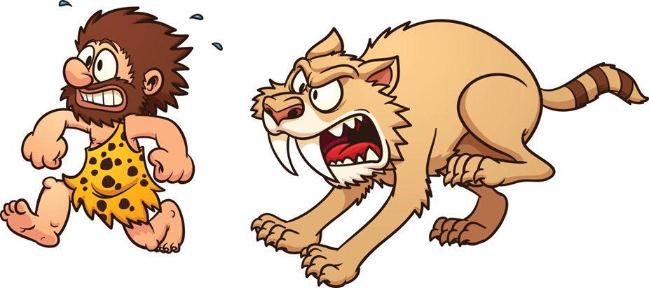
The Limbic Brain
The caveman’s main threat was animals who would hunt him for food, or from other cavemen who might steal his food.
When presented with danger, the caveman brain has 3 responses
Fight (another caveman trying to steal his food)
Flight (run away from the thing trying to eat him)
Freeze (and hope the threat doesn’t see him)
When in a dangerous situation, the brain releases the chemicals cortisol and adrenaline, which travels through the brain stem to our organs and gives us the energy and power to fight or run away.
This is why when you’re scared your heart rate increases, you breathe faster and you feel sick!

Slide 7
The Frontal Brain
The frontal brain is the last part of the brain to develop and it is our thinking brain. This part of our brain carries on developing until we are in our 20s, but we always have the ability to keep learning!
Unfortunately, when we are scared or worried or frightened, our caveman takes over and it is hard to get to the frontal brain, it is hard for us to think – our caveman is too busy jumping up and down shouting danger which cuts off all the pathways to the thinking part of our brain.

Slide 8
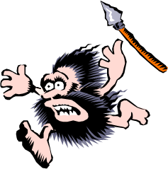
The Frontal Brain
Our brain hasn’t changed much since caveman times. When a caveman was faced with danger, the brain would fill up cortisol and adrenaline and he/she would use it up by fighting or running away, then things would go back to normal.
Unfortunately you can’t fight or run away from a spelling test, but the caveman brain doesn’t know this and so it doesn’t know how to get rid of those chemicals. This can cause problems for the brain.

Slide 9
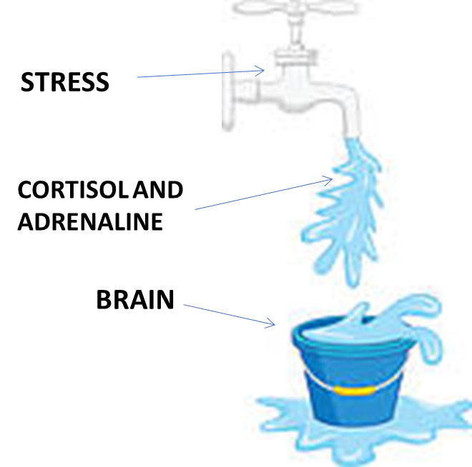
When things go wrong
Adrenaline and cortisol are important in keeping us alert and giving us energy. However, if we are stressed, more and more is produced and if we can’t find a way of releasing these chemicals, they stay in the brain. The more stress we have, the more gets added and our brain starts to get flooded.
If this happens then we become mentally unwell. Too much stress is known to cause illnesses like depression, anxiety, memory problems, headaches, weight gain and other physical health problems. This is why it is important to talk to someone if you are stressed and worried. Talking helps empty some of the bucket.

Slide 10
How this feels
When our brain is too full of cortisol and adrenaline, it is constantly telling our body that there is danger so we feel worried all the time, sometimes we don’t even know what about.
Imagine all the things that you are worried about are like extra bouncy balls, someone has just emptied a bucket and it is your job to catch them. If there was just one or two, you’d probably cope, but the more there are, the harder it is to control, until it gets to the point, it’s just too much, it’s too confusing so you can’t even catch one.
That can be how it feels when all your worries are bouncing around your brain.

Slide 11
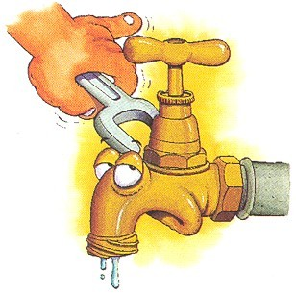
When things go wrong
Sometimes when our brain gets too full of adrenaline and cortisol, the tap turns off to protect the brain. This means that all the energy and alertness we need to stay alive, stops and the important messages that go through our brain stem to our organs and muscles slows down.
One time, I had been very, very stressed about lots of things that I had no control over, I had totally lost control of my bouncing balls. My brain started to shut down in a big way and I couldn’t walk, or talk or do anything properly. My friend had to take me to A&E to get help.
This was an extreme reaction to a lot of stress, a sign we haven’t enough adrenaline or cortisol and that our brain is struggling is we stare into space and find it difficult to concentrate.

Slide 12
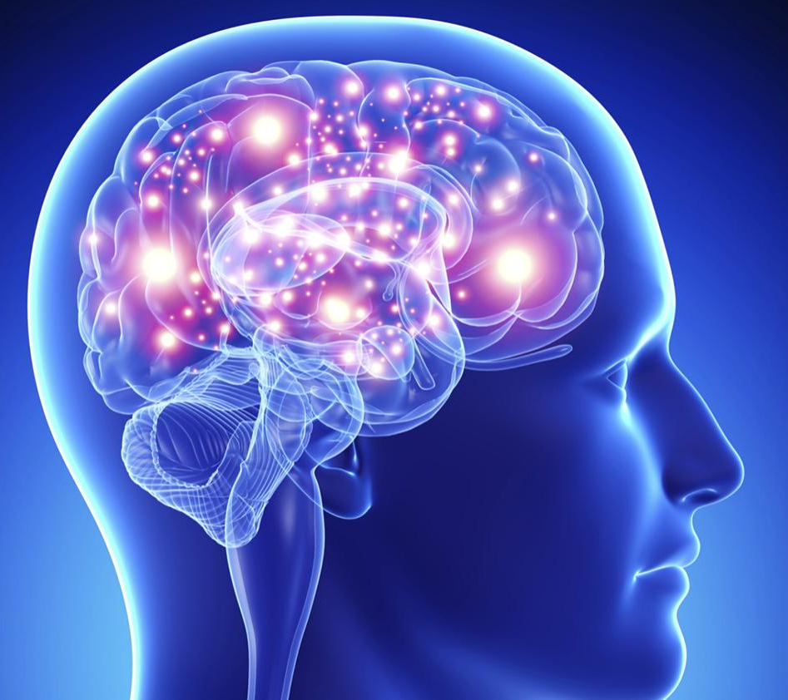
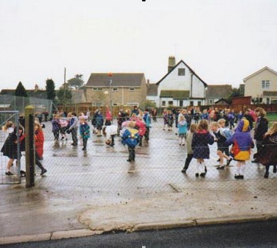
Neurons are amazing – there are about 100 billion in the brain!!!
Their job is to carry messages backwards and forwards, a bit like a game of Chinese whispers where you whisper a message to one person, they pass it onto the next person, and they pass it on to the next until all the people in the room have the message.
Neurons
Imagine you’re playing Chinese whispers in a quiet class room where everybody is paying attention. Do you think the correct message would get to the last person?
Now imagine trying to play Chinese whispers in a busy playground where everybody is busy playing their own game. Do you think the correct message would get to everyone?
Probably not. That’s a bit like neurons trying to pass on information when there’s lots of worries getting in the way.

Slide 13
When things go wrong
When there are lots of things going on, and there is too much stress, the brain can start to go wrong. Because the cortisol and adrenaline keep telling the brain there is danger and because the neurons get confused, strange things can start to happen.
A person can become very anxious and on edge and start shouting about things that would normally be okay which can be confusing and seem unfair.
The wrong messages can get through, a bit like Chinese whispers gone wrong – so someone might start to believe something that isn’t true, it’s because the neurons are delivering the wrong information. This can be very scary and confusing for the person and the people around them.

Slide 14
When things go wrong
Not only can the neurons send the wrong messages, when someone is in their caveman brain, they literally can not get to their thinking brain – the pathways have shut down and gone away for the weekend!! This can look like the person is being deliberately mean or nasty, they’re not, they can not think like they normally would – their caveman is having a tantrum!!
But it’s not all bad. The brain IS amazing, whilst things can go wrong, it can also recover and get better. The way things are now are never the way things will always be. Things always change, and things can improve.

Slide 15
What can help?
When someone we love and care about starts acting in a way that is unusual, it is scary and hard to cope with. It can make us feel:
Upset
Confused
Scared
Angry
Worried
Frightened
Selfish
Jealous
Unsafe
Unloved
And lots more!
Understand that how you feel is normal, it is not wrong to feel any of these emotions, even an adult feels this way when they don’t understand why a person is acting different to normal.

Slide 16
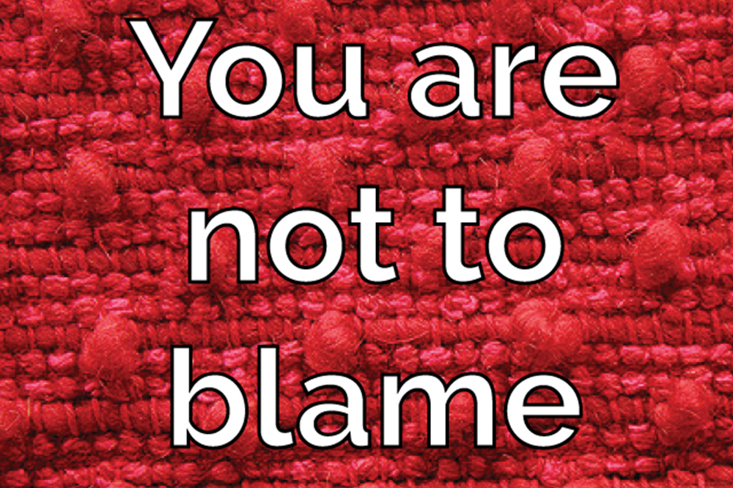
What can help?
Know that this is absolutely 100% NOT your fault. There is nothing that you have or haven’t said, done or thought that has caused this to happen.
You are not perfect, nobody is perfect. Remember all the things you have been feeling have meant your caveman has probably been having a tantrum too, which means you may not have been on your best behaviour. That is NORMAL, it is not your fault, it has been a very scary and confusing time for everyone.

Slide 17
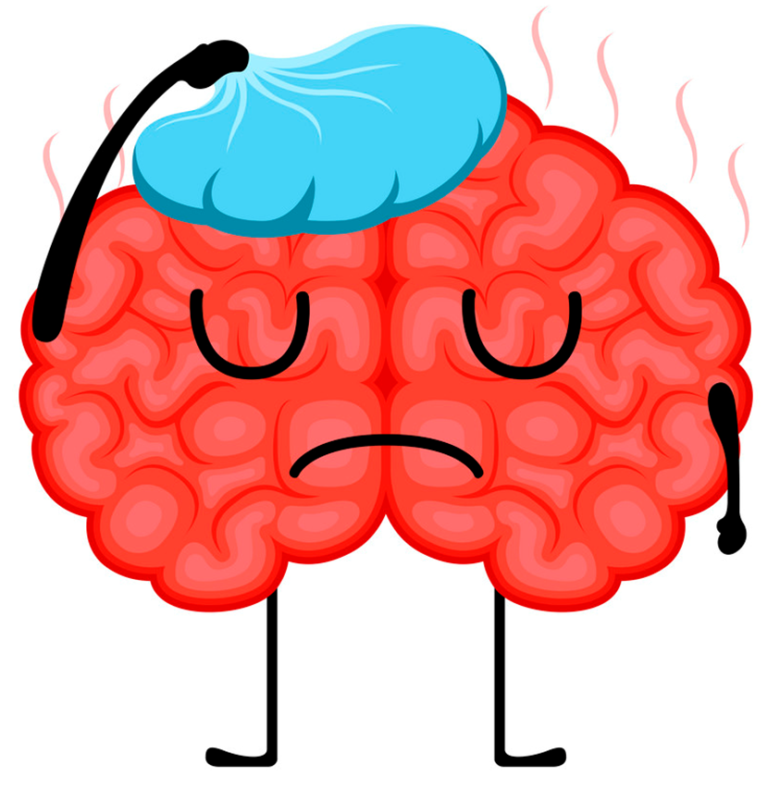
What can help?
Understand that the person is ill. The brain is not working as well as it could because it is sick, it is not something that they have chosen.
Unfortunately because it’s the brain and we have to use it all the time, it can make getting well again more difficult. If you broke your leg, you’d stop walking on it whilst it got better, if you had trouble with breathing, you’d go to bed and rest. You can’t not use your brain, even when you’re asleep it’s working by creating dreams.
Medicine can help
Talking to the right people can help
Other things such as exercise or mindfulness can help.
There is no simple answer but the doctors and nurses will help work out what works best for each person.

Slide 18
What can help?
You being you.
You are very a special, and unique person who is loved very very much. You are, funny, clever, kind, caring, talented, annoying, loving, frustrating, determined, brave and amazingly special. You are you. Just by being yourself, you already are, and will continue to help.
When I have been mentally ill, I have often thought things that don’t really make any sense, things like ‘I’m a bad person’, ‘I’m stupid’, ‘I don’t deserve it when people are nice to me’, and other things that I know are wrong. When I’m ill I believe them and it makes me do things I wouldn’t do if I was well. My son, just by being him, even though he is a pain and annoying at times, has kept me going and has been my reason for getting well. You are the same. You mean everything to your mum, even if she doesn’t seem to show it at times.

Slide 19
What can help?
Looking after yourself
You must make sure you look after your own mental health because it is a very scary and confusing time for everyone. You can do this by:
Being honest with each other and telling each other how you feel.
Having ‘safe adults’ who you know you can ring or contact if you do feel worried or scared. This could be a relative or a family friend you feel you can trust, who you talk to and who knows that they are your safe person.
Going out, having fun with your friends and knowing that your mum is going to be okay – there are people looking out for her and people looking out for you.
The childline website (www.childline.org.uk) has lots of ideas and games to help you stay calm and in control of your own caveman. Have a look at it together with your family and decide which ideas you like.

Slide 20
Be Patient
Having someone in the family who is mentally unwell is hard. It is easy to forget that they are unwell because there is nothing obviously wrong with them, so when they behave differently to normal, it is scary, upsetting and annoying.
It takes a little time to get well again and get things back to how they were. It’s very easy to rush things and try and do things too quickly. However it is important to have patience. By rushing things the brain can quickly get confused again.
It’s a bit like being on a rollercoaster, things can be very up and down at first, but the more everyone talks and listens, the easier and less stressful things become for everyone.

Slide 21
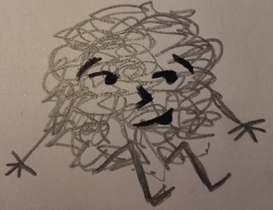
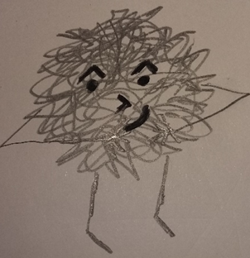
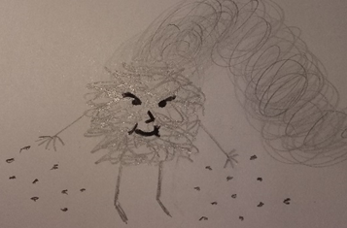
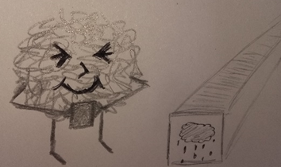
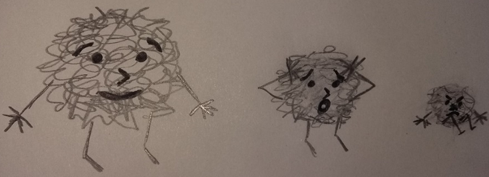
The Cautionary Tale of Mr D
This is the cautionary tale of, old Mr D,
Or depression, as he’s known to you and to me.
He squats beside ‘memories’, inside of your brain,
Silently waiting to cause sorrow and pain.
Old Mr D is a bullying tormentor,
Who feeds on bad memories right from the centre,
Of your brain; things long since forgotten,
He stacks them and stores them, he files and records them.
He lurks until times get a little bit tough,
Then like a snake, he sneaks out from the rough.
A toxic fog, he creeps through your brain,
Worming and squirming till you feel insane.
He throws out his seeds, they quickly take root,
Turning good into bad, and bright into soot.
He slows down your thoughts, makes everything dull,
Bad memories resurface, good becomes null.
Things that had been, that you’d rather forget,
He shows you the picture, then watches you sweat.
Humiliation, regret, guilt and shame;
Mr D grows fat on your feelings of blame.
What is the point? I’m stupid, I’m fat,
I’m ugly, pathetic, useless, a brat!
Things can’t get better, these facts, they are certain,
Nobody likes me, I’m a horrible person.
But these thoughts are not facts, they’re not even yours,
They belong to another; whose voice is a roar.
Mr D, he grows stronger, feeds on all that is bad,
Seeping through thoughts, twisting happy to sad.
Is that the end of this sad tale, you wonder?
To tell of such sorrow, surely a blunder!
Mr D, I agree, he’s a spiteful, mean creature,
Why tell of a sorrow that makes life so much bleaker?
It’s true that the tale I tell is most sad,
But not telling about him, makes Mr D glad.
If you don’t know he exists, his power is legitimate,
And leaves the sufferer in an awful predicament.
You see there’s an antidote to Mr D’s power,
But first you must see that it’s HIS thoughts that flower.
He’s wrong when he says that you’re stupid and fat,
You’re not, you’re not ugly, not useless, or a brat.
These thoughts make you want to hide, not to walk,
Tall with your friends, afraid people will gawk,
Afraid that they’ll guess, you’re a failure, a fraud,
But the antidote to Mr D’s power is to … TALK.
Keep Mr D’s thoughts to yourself and they’ll grow,
Leave you playing the villain, your true thoughts all froze.
But talk to your friends, they’ll tell you the truth,
Not perfect, they know, but his lies they’ll uproot.
If a friend’s not available, then talk to a teacher,
A parent, a doctor, a help line, a preacher.
The more that you talk, the more you will see,
The lies Mr D told are really quite beastly.
And as you talk, a curious thing happens,
Mr D starts to shrink, his grasp on thoughts slackens.
The fog that once had made thinking all fuzzy,
Slips softly away, the day break is sunny.

