Slide 1
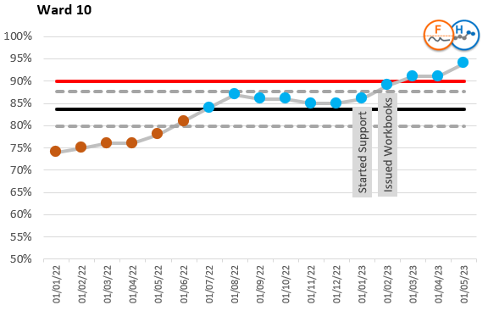
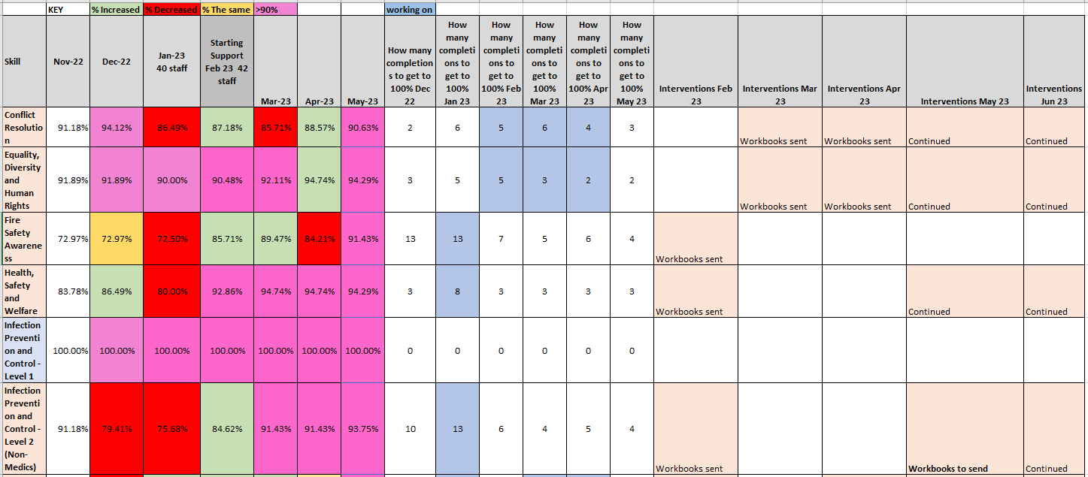
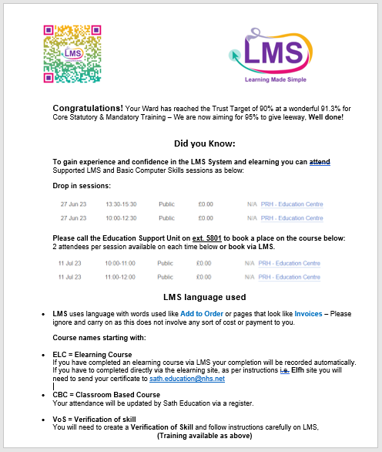
Improving Training Compliance
Ward 10 PRH - Core Training Compliance Percentage
Produced by Kathryn McCormick
07/06/2023
Back in March 2022 Ward 10’s statutory and mandatory training had been 76%. The team have found it a challenge in the last few months to complete their mandatory training. In August, their compliance increased to 87.19% but decreased ever since. The decreased in compliance appeared to coincide with the introduction of the Learning Made Simple (LMS) Platform. The plan was to conduct root cause analysis to understand if the introduction of LMS or other factors had caused the compliance decrease. The plan was to test various solutions to increase compliance.
To increase training compliance for the CSTF modules to 90% (Trust Target) for the Ward 10 at PRH by 8th May 2023.
PLAN
A meeting was arranged with the Ward 10 Manager Gary Francis to discuss the statutory and mandatory training compliance. During the meeting we discussed the blockers to staff completing their statutory and mandatory training modules. It was felt that the introduction of the Learning Made Simple platform and the reduction in completion of paper-based workbooks and a fear of the new LMS system had led to the decline in overall training. It was felt that the reintroduction of the workbooks would help increase the training compliance percentage. We would tackle a few subjects a month starting from February 2023. We also talked about education and information regarding computer IT skills and in turn increasing confidence and morale amongst the staff around using technology to raise their training compliance. A training report would be produced each month until the department has reached the Trust target of 90 % aiming for 8th May’s 2023 report. Workbooks and assessments would be printed out and sent to Ward 10 to be completed by staff and Jo Fothergill would mark the workbooks and send declarations electronically to the Education Team to input completions onto to the LMS system.
DO
The training report would be manipulated each month to show all outstanding statutory training for staff. Named Workbooks and assessments would be printed out and sent over to ward 10, completed by staff and the manager would mark the workbooks. The completed workbooks will then be added to the LMS by the Education Team. We plan to supply this breakdown of data each month following each report run until 90% compliance is reached. The manager can also print out workbooks in the department if required to save time. Emails were sent out to individuals and a poster was also created for the Ward’s noticeboard to advertise assisted eLearning sessions and computer IT skills in order to improve staff’s confidence in the using the LMS system for future training. The poster included some LMS tips and information regarding the language used which contributed to the fear of the system and also a congratulations on the 91.3% compliance achievement.
STUDY
Breaking the report data down in this way and providing it in a manner that was clear, concise and colour coded has ensured that managers/supervisors and staff know exactly what training needs to be completed. It takes about half an hour to produce but saves a lot of time for the teams when they are trying to manipulate it. The team have needed no support in marking the workbooks, so this has all been down to their hard work. This system is working well and has been well received Ward 10 have had an 8.2 % increase in training compliance since January 2023. Training compliance now stands at 93.68%
The percentages was also translated into the number of staff outstanding per subject in order to reach 100%, as the percentage can sometimes appear worse than it really is, all dependant on how many staff are in the department and who must complete each subject; for example, a subject may be showing as 80%, but only means that 2 staff members need to complete to get 100%. This can give a totally different outlook and help maintain morale and motivation. In the three-month period since the support started and the workbooks were introduced, the compliance has gone up over the 90% target as per SPC chart below:
ACT
In conclusion this support has been well received and adopted we will be carrying out the same support following each report run until 95% compliance is met. Support will still be provided if required and will involve liaising with the ward manager and business partner. We have provided details on assisted eLearning sessions and basic computer skills to enable staff to move forward and use the LMS online training with confidence.
Poster
Bunkley, Nick (March 3, 2008). "Joseph Juran, 103, Pioneer in Quality Control, Dies". The New York Times.

