Slide 1



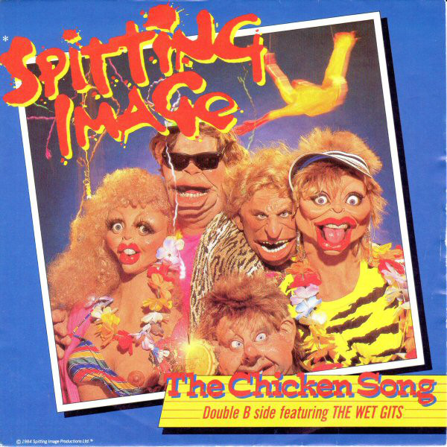
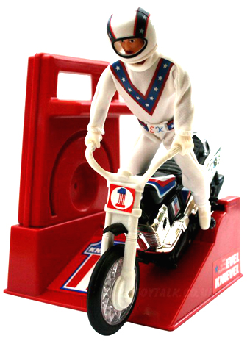
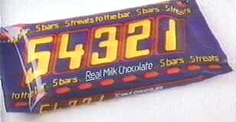




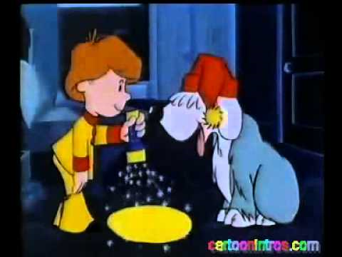

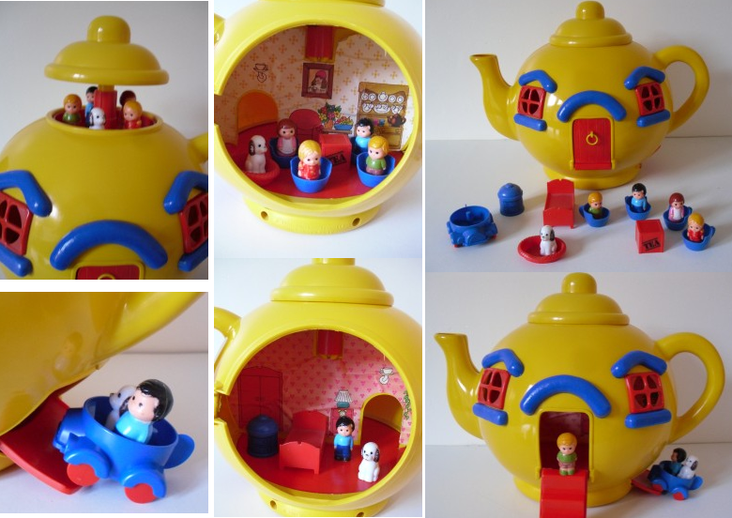

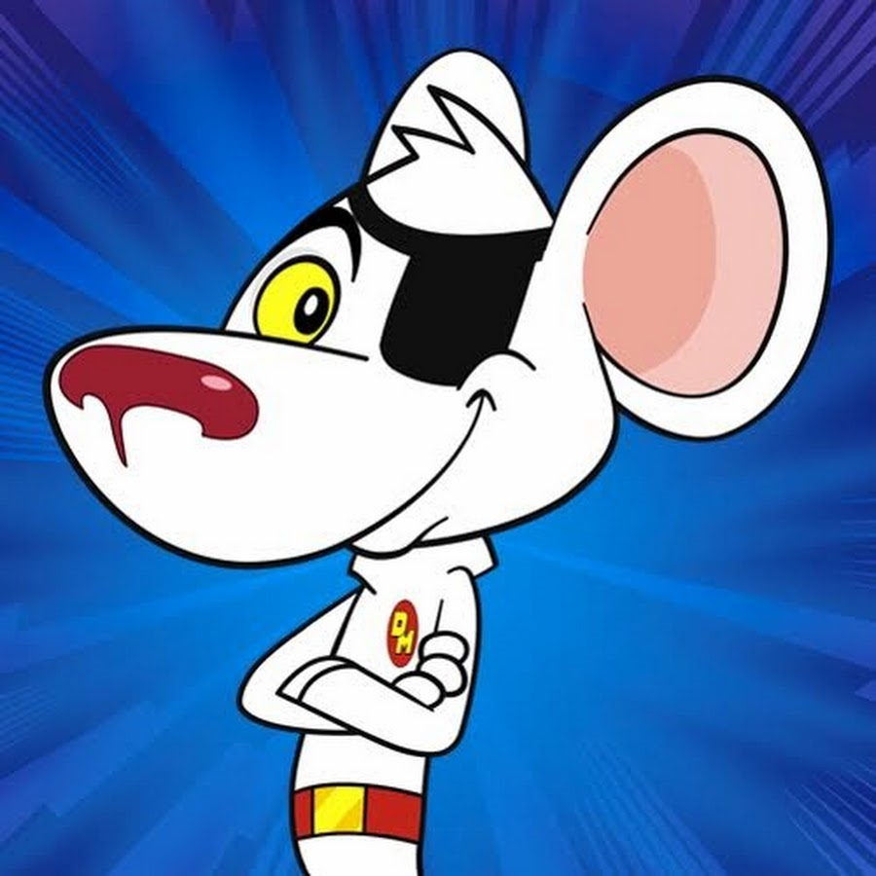
Starter: Travel back to the eighties!!
Click to play
Click to play
Click to play
Notes:
If possible, the presenter should go shopping for some retro sweets (Home Bargains is a good place to look) and have them ready on tables for people to help themselves when they enter the room. Don’t explain anything, have the slide up on the screen or one of the clips playing and let the conversations take place naturally.

Slide 2
Starter: Travel back to the eighties!!
Click to play
Click to play
We will return to nostalgia city later!!
Click to play

Slide 3


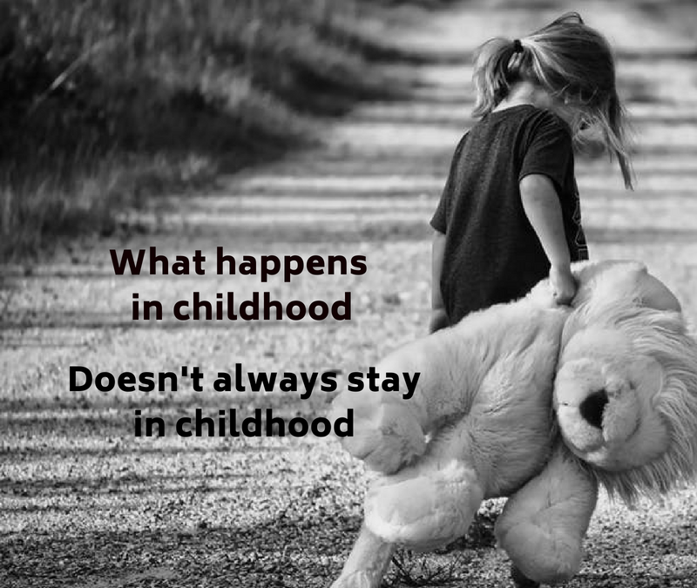
Trauma Informed Care
This PowerPoint is a presentation designed to explain:
What is meant by the term ‘trauma informed’ by examining ACEs.
The long term impact of ACEs and how they effect patients.
How care can become trauma informed.
(Liverpool CAMHS, n.d.)
It is recommended that an hour and half inset is devoted to the presentation, with extra time given within teams, to discuss appropriate policies/ procedures in light of the information.
Please Note
Please Note: This presentation will be looking at a number of sensitive issues including self harm and abuse. If at any point you feel uncomfortable with the content, feel free to leave the room.
The information contained in this PowerPoint is a result of my own experience of adverse childhood experiences, poor mental health, extensive reading and 20 years teaching experience; it is not based on medical qualifications or experience.
(Davies Maxon, 2018)

Slide 4
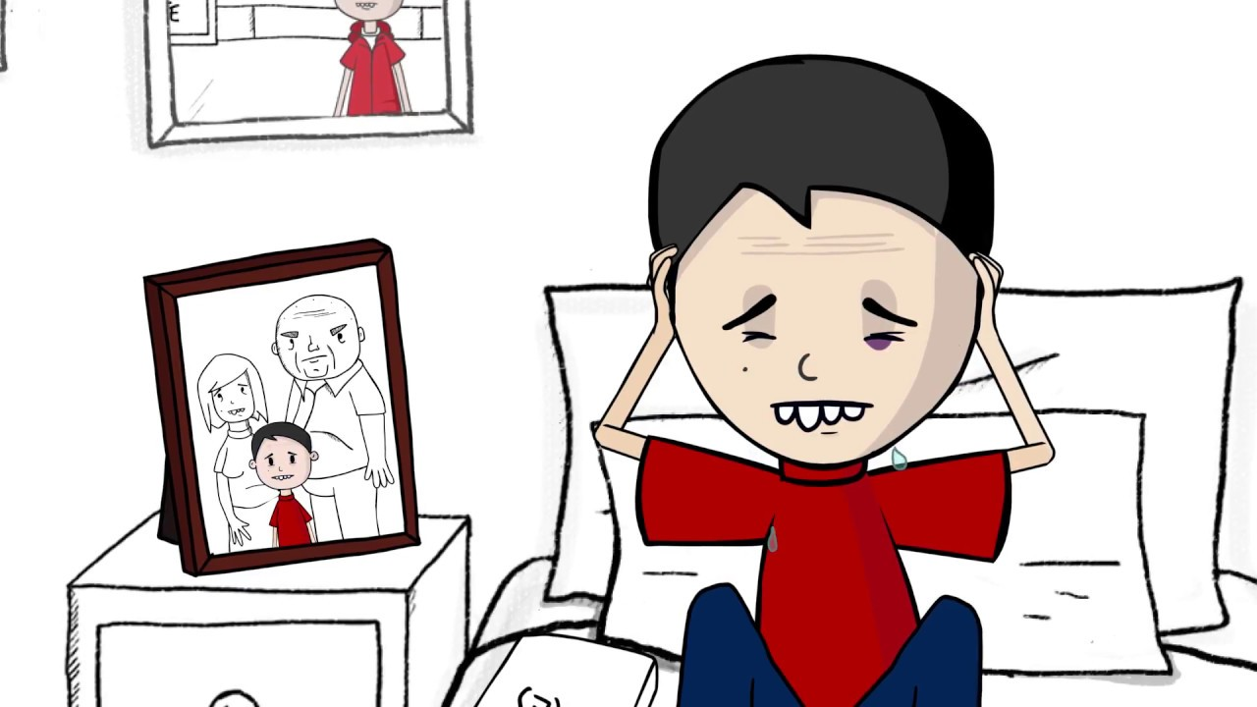
What do we mean by Adverse Childhood Experience?
ACEs are traumatic experiences that children experience that can then go on to effect their mental health and their future prospects in life.
(Liverpool CAMHS, n.d.)
It is vital that, as professionals, we understand not just what they are, but how they impact on development future prospects.
Watch the clip to find out more:
The more ACEs a child experiences, the greater the risk of long term impact.
https://www.youtube.com/watch?v=YiMjTzCnbNQ
(Public Health Wales & Blackburn with Darwin Borough Council, 2017)

Slide 5
What do we mean by Adverse Childhood Experience?
The most widely recognised ACES are:
Abuse:
physical
sexual
verbal
Neglect:
emotional
physical
(Liverpool CAMHS, n.d.)
Growing up in a household where:
there are adults with alcohol and drug use problems
there are adults with mental health problems
there is domestic violence
there are adults who have spent time in prison
parents have separated
(Davies Maxon, 2018)
Other types of childhood adversity that can have long term implications include bereavement, bullying, poverty and community adversities such as living in a deprived area, neighbourhood violence.
(Liverpool CAMHS, n.d.)

Slide 6
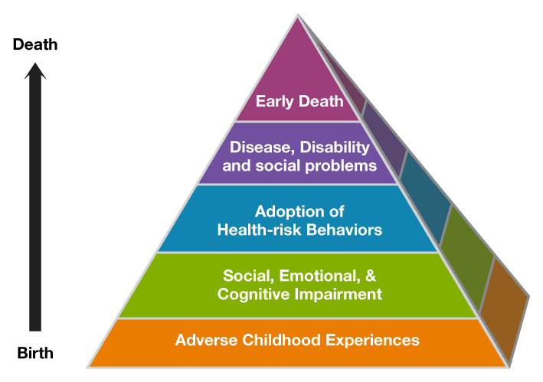
The impact of Adverse Childhood Experiences
67% of the population has at least one ACE;
12.5% of the population has more than 4. (70/30 Campaign, 2017)
Adverse Childhood Experiences aren’t just something that effect the child whilst they’re happening, they can have an impact on their whole life.
The higher the number of ACEs you experience in childhood the higher your chances of
Impaired neurological development
Lower academic performance
Exclusion from school
Increased risk of anti-social behaviour
Increased risk of poor health
Increased socioeconomic problems
Increased risk of health problems
Increased risk of early death.
Perry & Szalavitz, 2010; Van der Kolk, 2014)
(70/30 Campaign, 2017)

Slide 7
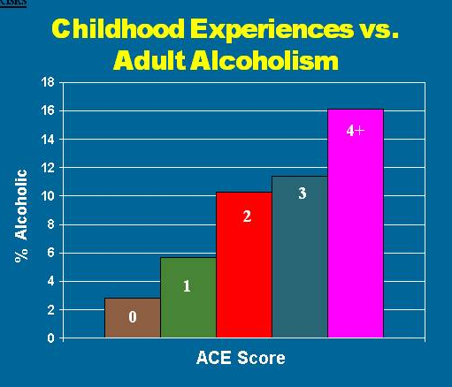
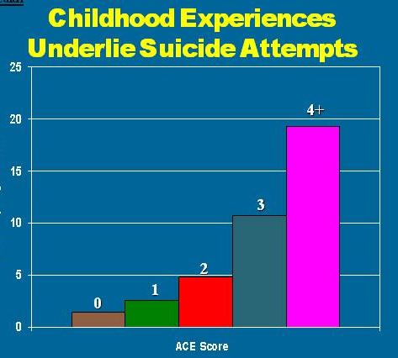
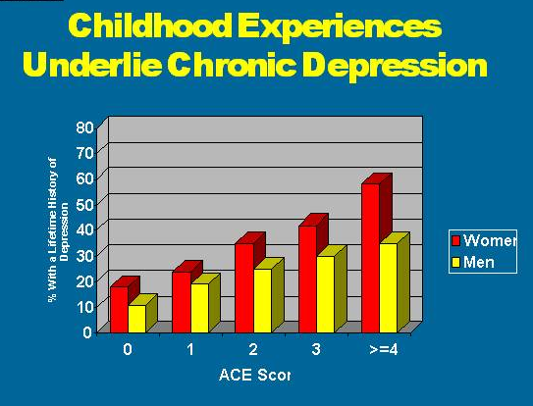
The impact of Adverse Childhood Experiences
(ACES Too High, n.d.)

Slide 8
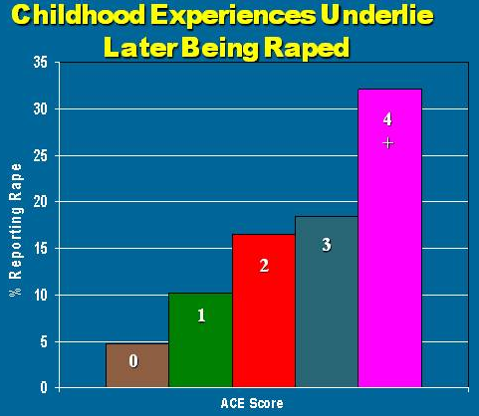
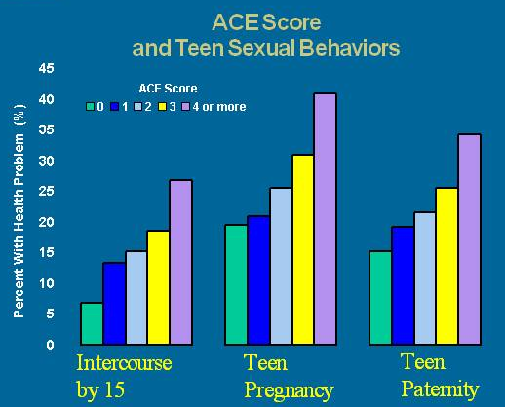
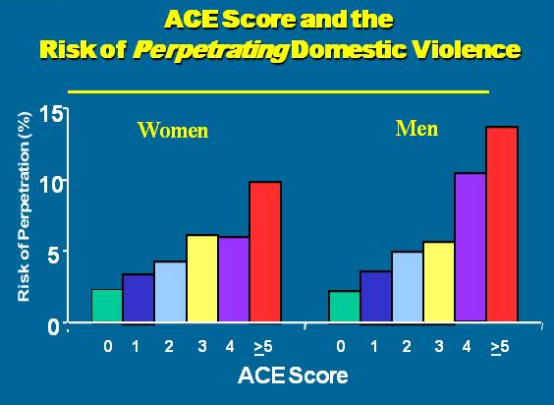
The impact of Adverse Childhood Experiences
(ACES Too High, n.d.)

Slide 9
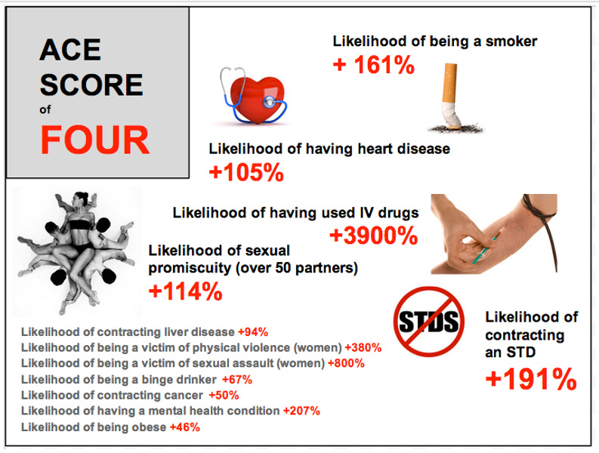
Impact on health
(Patton, 2016)

Slide 10

Now for something completely different
To understand why childhood trauma has such a negative impact on children’s development, we need to understand more about the development of the brain. In order to do this, we’re gong to try something different:
I am going to take you on a journey but before we begin I need you to:
Stand up and take one step backwards from your chair.
Spread your legs so that they are shoulder width apart– this will help you keep your balance.
Now close your eyes. Do not open them again until you are told, unless you feel unhappy in which case, simply open them.
I need you to really listen to what is about to be read and try and visualise it. Start by taking a deep breath in through your nose – feel your tummy rise like a balloon, and out through your mouth, imagine the balloon deflating. And again, in through your nose, feel the balloon growing, and out, let the balloon deflate.
Keep your eyes closed, we are ready to begin.

Slide 11
The person reading this should read calmly and steadily, giving the listener time to imagine what you are reading. Try reading out loud a few times before delivering the session so that the flow isn’t interrupted .
The engine hum dies as your car pulls softly to stand still. You take a deep breath, the air is cold as it fills your nose and lungs; your chest rises then falls as you exhale. As you look out of the window fat drops of rain begin to splosh sporadically onto the windscreen. The sky is magnificent in its greys, blues, blacks and white, it looks almost like a water colour painting; a stormy sky set against the edge of dramatic cliffs.
Your hand pulls the door leaver and your feet swing round to crunch on the gravel car park, the rain is cool on your skin. You push the door to a squeaky close and stand for a while, face up turned to the cleansing water as it falls softly on your forehead. It runs down your face, drips off your eyebrows onto your lips, leaving the taste of salt from the sea. Taking a deep breath once again, you set off; your feet leave the hard crunch of gravel and move onto the soft squelch of what had once been green grass. As you look to the edge of the cliffs, you feel the wet creeping into you trainers, working its way through your socks, coming to rest against your skin. Your feet sink into the squelching mud, feeling thick and heavy as you speed up to get to drier land.
You continue towards the cliff’s edge, getting closer to the vastness of the sea beyond. You can see the tips of the waves, they look like white horses racing, bending gracefully then lifting their white heads once more, this time closer, as they pace their way towards the shore. The race becomes faster and more aggressive the closer they get. The competition ends dramatically as the tips of the waves crash violently up against the jagged edges of rocks, spewing foam angrily back into the blue expanse.
You near the edge and your stride alters, as your foot knocks a stone off the side. You watch it bound off the rocks as it enters oblivion below. You carefully ensure your feet remain the right side of safety.
(Continues onto the next slide)

Slide 12
As you stand looking to the horizon where the sky merges seamlessly with the sea, the rain stops. The sun slides out from behind the silver lined clouds, rays hit the smooth grey rocky cliffs like a spotlight, turning the cold grey into a magical glistening purple. You feel the new warmth soaking into the wetness of your bare arms.
Staring down, you notice a jagged shelf of rock jutting out, home to a nest of chicks, their scrawny mouths squawk for the return of their parents, their balding bodies huddled together for warmth. Looking down further, the vertical rock continues for an eternity before levelling out into rough boulders that are swallowed up whole by the hungry sea, swush, swush, swush.
You feel small and insignificant standing high above the world, the sea, miles below is just a step away. The swish of the sea starts to blur, and become fuzzy as the thumping of blood schwirling through your brain becomes the dominant sound . You feel yourself melt into the background, swallowed up in the tumultuous sky, the tempestuous sea. The world becomes surreal and blurred as it starts spinning. You feel caught up in a merry-go-round of danger; sea, white horses, vertical cliffs, boulders, white horses, sky, cliffs, rocks jutting, vertical cliffs, sea …
Purposefully, you take a step forward…
Keeping your eyes closed, I want everybody to take a step forward.
[Wait 5 seconds]
Keep your eyes closed, you’re in the classroom, it is safe, take a step forward.
[Wait 5 seconds]
Open your eyes and take a seat.
This part should be read clearly as instructions, not as part of the story.

Slide 13
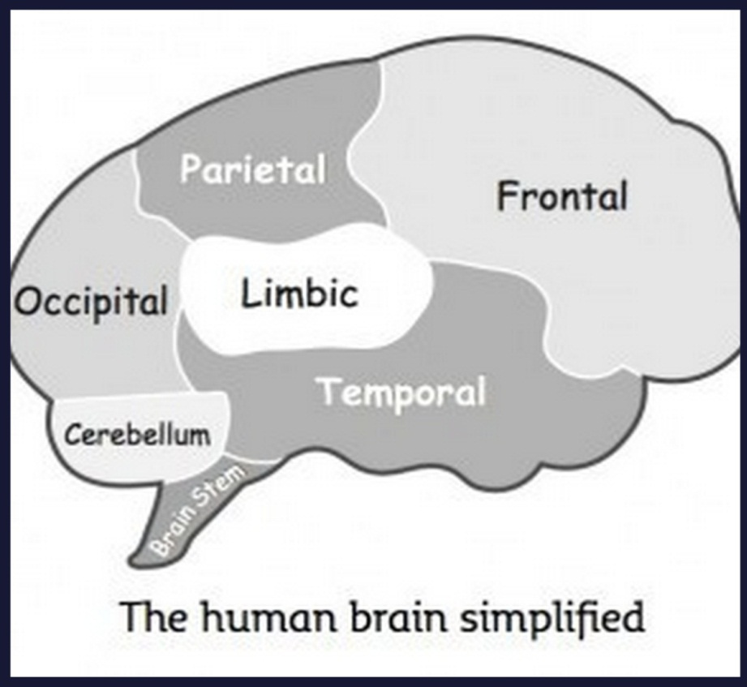
A Journey into Mental Illness
Hands up:
Who was unable to take a step forward when asked?
Who was still reluctant to take a step forward when reminded where they were?
Who was unable to move until they opened their eyes?
Explanation:
Your brain has been immersed into a world where taking a step forward would be incredibly dangerous, leading to almost certain death. The primary function of our brain is to keep us alive hence it wanted to stop you moving.
The brain is an incredible, complicated organ with around 100 billion neurons sending and receiving information back and forth.
For the purpose of this exercise we are going to think about just 2 parts:
The Limbic
The Frontal or Pre-Frontal Cortex
(Peters, 2012)

Slide 14



Our inner caveman
The Limbic
The limbic lobe is our caveman brain. The limbic’s main function is survival; it also governs our emotions.
When presented with stress or dangerous situations, the limbic automatically takes over to keep us alive. It has 3 responses:
Fight
Flight
Freeze
The Frontal
The frontal lobe carries out many different functions, but for the purpose of this exercise, it is our thinking brain.
When our limbic lobe has been engaged, we are not able to reach our thinking brain.
This is why, even though you knew you were safe, your caveman didn’t and wanted to keep you safe so took over and stopped you from moving.
When our brain perceives danger, the limbic system takes over to keep us alive. Think about how difficult it was to move forward after listening to the story and that should give you an indication of its strength.
(Peters, 2012)
When we get this response the brain fills up with cortisol
and adrenaline which acts to speed up our breathing and reactions. This is to give us the energy and power to fight or run. This response is automatic and something we have little conscious control over.

Slide 15

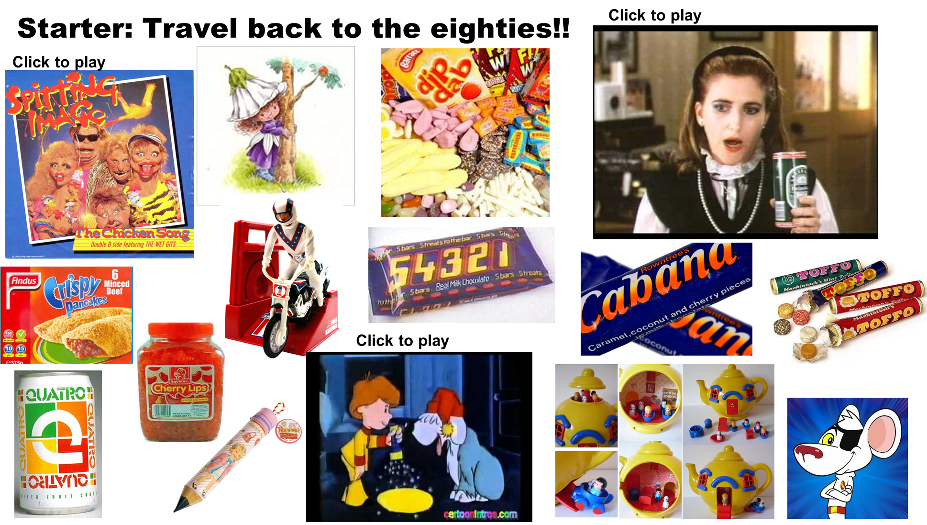
So what’s the point of all this?
Your reaction of being unable to move was totally predictable when we understand that our limbic brain is programmed to keep us safe. When this happens, it takes time to re-engage the pre-frontal cortex.
But what if it wasn’t so easy to re-engage the pre-frontal cortex?
Think back to the starter
You were given images and sounds that your brain associated with things from your youth. On seeing them, you were triggered to remember the words, tastes, places, people etc associated with them. We then moved on, and you forgot all about them.
Now imagine if these triggers were so deeply ingrained in your life experience, it wasn’t possible to just move on, that in effect, you remained on the edge of that cliff without a way back.
This is what happens with ACEs

Slide 16
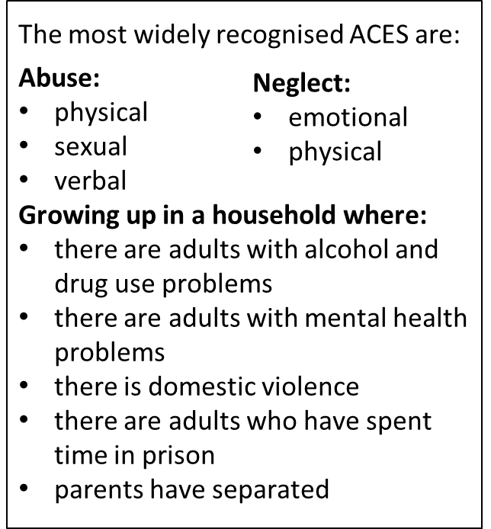

Long term impact of ACEs
There are many reasons why a child may experience an adverse experience; sometimes it is deliberate abuse but often it can be unintentional, the result, for example, of parental depression/ ill health or lack of knowledge of how to parent.
For people who experienced abuse in their first year of life, their long term outcomes are worse than for babies that experienced adverse experiences in later on, however, as they will have no memory of this, they probably won’t make the connection.
(Perry & Szalavitz, 2010).
The damage caused by ACEs, through the maladapted development of the stress response, is subconscious and long lasting. Knowing this will help you better understand the needs of some of your patients.
The poem on the next slide describes the legacy. NB: Trigger Warning

Slide 17
Return to Default
I know I hate me.
Too loud, too brash with a mouth that won’t shush
“Shut up you bitch, no one’s interested in your stupid stuff”
Too arrogant, too rude, too desperate to prove
“Never amount to anything, too thick to improve”
I know I hate me.
Always on the outside, never truly belonging
“Get up to your room… not welcome… stop stalling.”
“Don’t deserve… not good enough… a total waste of space,
Too greedy… too selfish… a fucking disgrace.”
I know I hate me.
Desperate to be alone, to stop people getting too close,
“Who’d want to be friends with someone so utterly gross?”
“Who’d want to lie beside a thing of your size and shape?
Can’t even look at you to fuck!” Don’t, you mean rape?
I know I hate me.
Too compliant to fight, just praying you won’t appear,
Lying silent in the dark, immobilised by fear.
Doing as instructed, won’t pay to make you angry,
Instead of responding, I just stare at you blankly.
I know I hate me, I even know the reason.
Hating is safe, it protects what’s inside,
It keeps closed the barrier, all feelings have died.
Too dangerous to trust, “pride is a sin”
Better off alone than to let the wolves in.
I know the real me remains locked up and hurt,
I know she is waiting, needing love to reverse
Past damage that was caused, bring to the here and the now.
I know I need change. What I don’t know is … how?
(NB: The poem is called ‘Return to Default’ as stressful situations re-trigger these feelings of self disgust and worthlessness.)

Slide 18
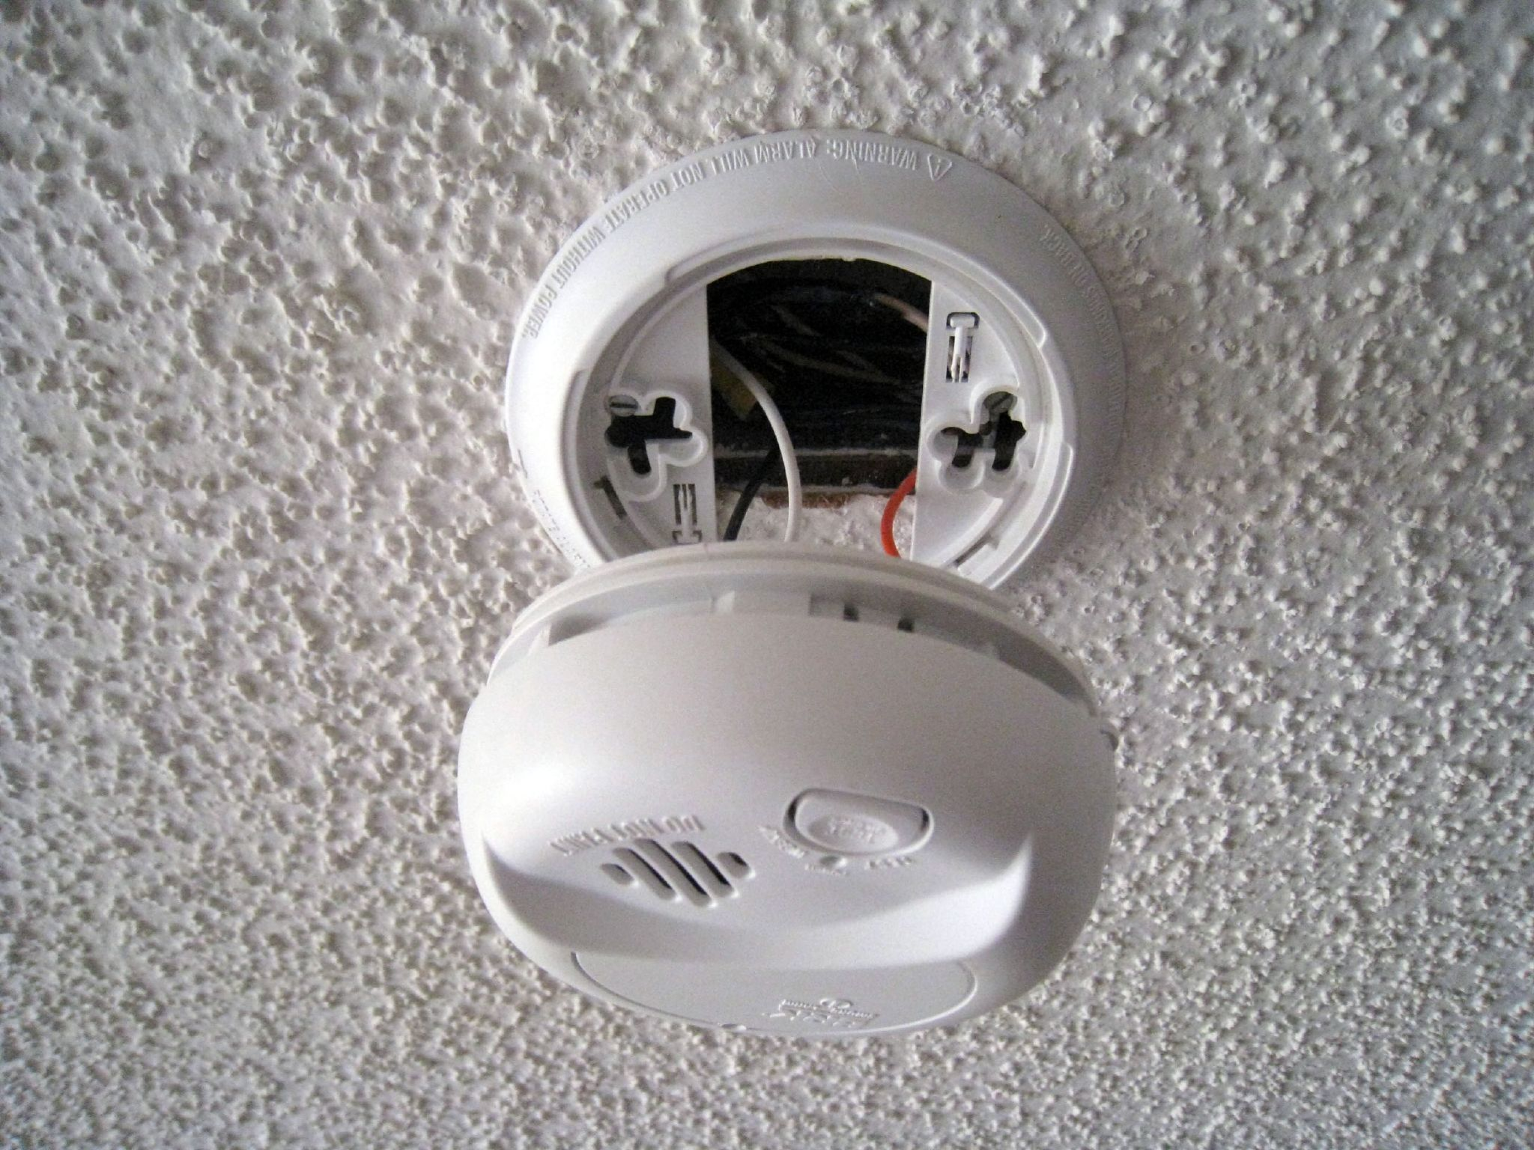
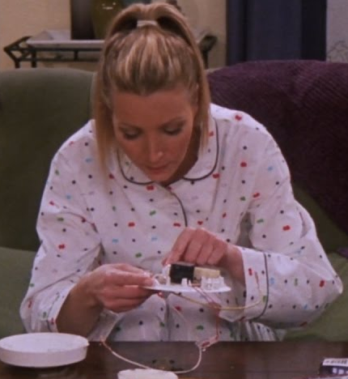
Self Harming – Why does it happen?
The poem describes the brain experiencing distressing noises and thoughts. We all have background noise or thoughts, but usually we don’t notice them. If you think about a time when you have been anxious, a job for example, distressing thoughts and feelings become stronger. But why does this happen?
Think of the diagram of the brain. We are going to look at 3 parts – the amygdala (part of the limbic system) and the medial pre-frontal cortex (is part of the frontal cortex) and the brainstem.
Amygdala (or smoke alarm)
This is like the smoke alarm within our brains, it works unconsciously. This is what makes you stop suddenly when crossing a road, then you see a car approaching. For people who have experienced past trauma, their smoke alarm can be broken, so they are constantly being alerted to danger, it’s like the smoke alarm is constantly bleeping, even when the battery has been removed.
(Peters, 2012)
(Van der Kolk, 2014).
https://www.youtube.com/watch?v=x-tgoXncKh4

Slide 19
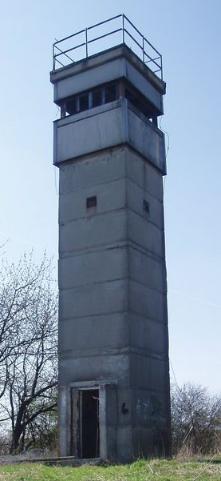

Self Harming – Why does it happen?
Medial Prefrontal Cortex (or The watch tower.
The purpose of this part of our brain is watch out for potential threats – it does this by noticing when things are slightly different to normal – a different person is around, the temperature is hotter than usual, a door that is usually shut is open, etc.
The problem for people who have a broken smoke alarm is that they’re constantly been told to look out for a threat. Because that part of the brain is so over active, it means they see everything as a threat, therefore are less likely to spot real threats, which is why victims of abuse often become victims again, it is harder for them to spot the danger. It’s a bit like trying to spot where’s Wally.
(Van der Kolk, 2014).

Slide 20
Disjointed thoughts,
Invade the mind,
March rough shod
Over all original thought,
Stirring up memories, doubt,
Useless, useless, USELESS.
As the vice gets tighter,
Scratch, screech, drip, useless.
A boa constrictor suffocates the chest,
Scratch, screech, drip, useless.
Gets tighter,
Scratch, screech, drip, useless.
Can’t breathe,
Scratch, screech, drip, useless.
Feel sick. Pathetic.
The silver point of a hard, cold blade,
Scratchscreechdripuselesspathetic.
Pierces deep into soft relenting flesh.
Scratchscreechdripuselesspathetic.
Blood trickles across clammy skin.
A welcome sting, that brings relief.
A mark to demonstrate the pain.
Silence.
  It’s okay to
breathe.
For now.
Breathe
*TRIGGER WARNING*
Imagine.
A deep and searing pain,
No mark to act as proof,
No swelling or temperature
Or sickness or heat.
No sign of any kind.
Fraud.
Inside, the pain is constant,
It’s one that cannot be described.
Nails scratching across an everlasting blackboard,
The incessant screeching of a wheel,
A tap dripping into an empty tin pot,
The echo rebounding as in meets the next,
Drip, drip, drip. Unrelenting.
All played out together,
As the vice like grip
on the exhausted brain
Gets tighter, scratch,
And tighter, screech,
And tighter, drip.
Unceasing.
Scratch.
Unremitting.
Screech.
Unending.
Drip.
(Symons, 2019)

Slide 21
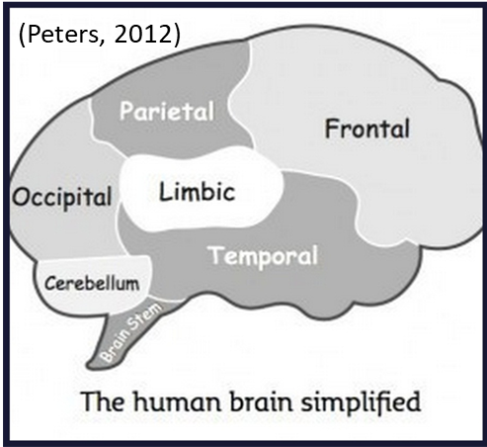
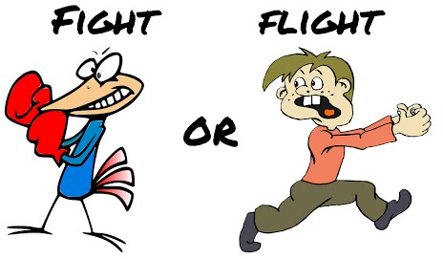
The Brainstem (Polyvagal Theory)
The final part of the puzzle is the brainstem, this is the part of the brain than links the brain with the rest of the body and turns our thoughts into actions.
Stephen Porges, American professor in psychiatry developed the Polyvagal Theory to explain how our brainstem sends messages to our body when the brain believes there is a threat:
1. Ventral Vagal Complex (VVC)
This is the nerve that links the brain to your main bodily functions – your heart, lungs, stomach etc. So long as there is no threat, everything works as it should.
2. Autonomic Nervous System (ANS)
When your brain detects danger, your ANS takes over, your heart rate speeds up, your blood pressure increases and your digestive system is deactivated. This is to help us ‘fight or flight’.
Once the danger has passed, we return to our Ventral Vagal Complex and things return to normal.
(Van der Kolk, 2014).
(Learning Junction, 2014)
(Van der Kolk, 2014).

Slide 22

Polyvagal Theory
3. Dorsal Vagal Complex (DVC)
If the threat is ongoing (or smoke alarm is broken - usually due to past trauma) and we enter our Dorsal Vagal Complex. This means we are:
Hypervigilant. Everything is a threat so our brain is constantly in a distressed state, as was described at the start of the ‘Self Harm’ poem. Because the person is already stressed, their reactions (anger/ upset) to something may seem extreme.
(Grusovin, n.d.).
A person in this state is more likely become angry and violent. Look for the signs:
Physical symptoms such as, sweating, fast heart rate and shallow breathing.
Unable to sit still – very fidgety, getting up an walking around.
Unable to stick to the one topic when talking – they jump quickly from one thing to another.
Very defensive when answering questions, as if you are ‘attacking’ them, or being very guarded in their responses as if they don’t trust you. (The Healthline, 2017)
Freeze or dissociate. There is only so long the brain can cope with being in such a heightened state, so at times the brain will dissociate, this means that it will switch off and mentally and take the person to a totally different place (described in the next slide).
(Van der Kolk, 2014).

Slide 23
Dissociation
Nothing
A glass wall surrounds me.
Trapped in a vacuum of nothingness.
The daily actions continue as before
But they are nothing, they mean nothing.
The actions are robotic,
The feelings elusive.
I have become a mannequin,
An empty vessel who no one sees or regards.
A blank face in a nameless crowd
Of no more significance than
Yesterday’s torn up newspaper
Floating on the wind.
Redundant.
If I sit still enough,
Maybe I will
Become a statue.
Maybe I
will
fade
away.
Become
Noth
Dissociation is often a response learnt from trauma in which it was impossible to fight back or run away – the brain’s only option to cope with the trauma was to remove itself.
Many people describe dissociation as leaving their body, floating up and watching the trauma from a distance. For some people, they describe going to a ‘safe place’ totally away from the scene (Perry & Szalavitz, 2010). This is why people who have experienced trauma may be totally unable to remember it, and if they do, they only remember snippets rather than the full story.
My experience of dissociation is feeling my body becoming heavy and sinking out of it into the sofa or bed, hidden and safe but numb. At that point it’s possible to do or say anything to the body that remains, because Elvis has left the building!
The main problem is, that once this response has been learnt, the brain will often use it to cope even when it’s inappropriate, leaving the person feeling confused, frightened and numb.
(Perry & Szalavitz, 2010; Van der Kolk, 2014)
(Grusovin, n.d.).
(Symons, 2019)

Slide 24
Long term impact of ACEs
It doesn’t take much to spark an amygdala response, like many other people with ACEs, lack of control and predictability can cause the brain to go into hypervigilant mode, without them even knowing or understanding why that is, or what is happening.
Unpredictability for a person who has experienced childhood trauma could be:
We know that just looking at old pictures, or tasting childhood, can take us back and we remember things about childhood. How much more powerful then would the fears of someone who has experienced serious harm from being in a position of no control, be when placed in an extremely vulnerable position?
Am I going to get fed tonight?
Am I going to be acknowledged or spend the whole night alone in my room?
Am I going to be humiliated?
What mood is he going to be in when he gets home?
Is he going to come into my room?

Slide 25

Why this matters
There will be many people that you care for that will have experienced at least 1 ACE. For the majority of people with such experiences, control is everything as lack of control in the past has caused serious harm.
Being in hospital is scary because it takes away your control:
you are not free to get up and do what you want (even if it is your own body stopping you),
you are dependent on other people,
you have to share a ward with other people etc.
When you go down for an operation, you are given drugs that take away your ability to move, respond, or even know what is happening.
Telling the patient, “it’s not that bad,” or “don’t be silly, it’s only a simple procedure,” is not only unhelpful, it is patronising.
If, whilst your brain was still immersed in the story earlier, and you believed that you were on top of a cliff, someone had jokingly tried to push you, your response may seem irrational to someone unaware of the story.
It’s about the brain reacting in a very sensible way to perceived threat.

Slide 26
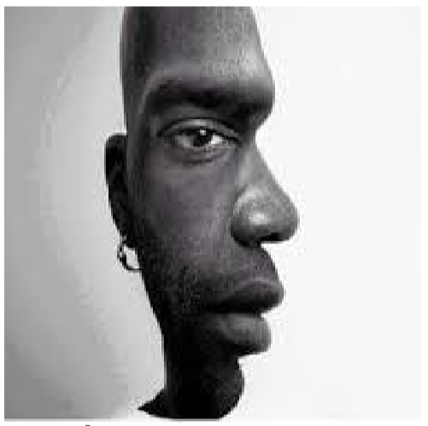
Is the patient who is afraid of being anesthetised afraid of not having control?
Changing Focus
Is the patient who is resisting taking medication afraid that it will effect their ability to respond to danger?
REALIZE the impact of trauma
RECOGNIZE the signs of trauma
RESPOND by integrating knowledge about trauma into practices, policies, procedures
RESIST re-traumatizing people (by shouting, belittling or insensitive comments)
Is the patient that asks a million questions that you’ve already answered, afraid of the unknown?
Is the patient who keeps pulling tubes out, scared of being ‘trapped’?
That patient kicking off about being on a ward with other patients, is it because something has happened in their past?
(Patton, 2016)

Slide 27
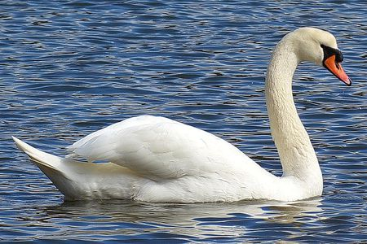
So what can I do about it?
Show patience and understanding
Ask and really listen to the patient’s perspective, identify with their experience and emotions. Find out from the patient what will help them feel like they have more control.
Communication is key!
Inform patients of exactly what is happening, what is going to happen, and details of how that will impact on them.
Take the time to sit down and talk, allow them to ask questions and provide written materials so they can go through things to reassure themselves. Realise, they are not being awkward.
Discuss a way for them to let you & colleagues know if there is a problem with procedure, and what they would like to happen,
Remain calm
If you are stressed and uptight, it will rub off on the patient. Be like a swan – calm and serene on top, but kicking like mad underneath! If you can project an appearance of calmness, it will rub off on your patients.

Slide 28

So what can I do about it?
Over to you
In your departments/ teams:
Think about the patient’s experience of your particular service. What parts of the service might a person with past trauma find difficult?
What practical things can you do to help reduce stress and increase predictability?
      Leaflets/ Displays
      Music
      Quiet room
      Arrangement of seats etc
In what areas of your service could you give the patient more control?

Slide 29
Final Thoughts
The impact of Adverse Childhood Experiences can be immense. You are a health care professional, the amount of time spent with each patient is limited and it is unrealistic to think that the damage caused by a lifetime of abuse can be undone in the short amount of time in your care. However, if we can be aware of ACEs and respond more appropriately, the patient will be better able to access the treatment, be more likely to stick to the recovery programme and will have less toxic stress chemicals hindering progress.
One of the most important components of recovery is positive relationships, never underestimate the power of the relationships that you enable as a natural part of your job.
“Just as a traumatic experience can alter a life in an instant, so too can a therapeutic encounter… The good news is that anyone can help with this part of ‘therapy’ – it merely requires being present in social settings and being, well, basically, kind. … The more we can provide each other these moment of simple, human connection – even a brief nod or a moment of eye contact – the more we’ll be able to heal those who have suffered traumatic experience.”
[Perry & Szalavitz, 2017; Shevrin-Venet, 2018]

Slide 31
References
70/30 Campaign. (2017). Adverse Childhood Experiences (ACEs). Retrieved from https://www.70-30.org.uk/18737-2/
ACES Too High. (n.d.). Got you ACE score? Retrieved from https://acestoohigh.com/got-your-ace-score/
Davies Maxon, A. (2018). The lingering effects of childhood trauma. Retrieved from http://allisondavismaxon.com/the-lingering-effects-of-childhood-trauma/
Gerhardt, S. (2015). Why love matters: how affection shapes a baby’s brain. London: Routledge, Taylor & Francis Group.
Grusovin, E. (n.d.). Dissociation. Retrieved from https://www.flickr.com/photos/emiliano-iko/
Kreisman, J. J., & Straus, H. (2010). I hate you--don't leave me: Understanding the borderline personality. Completely Revised and updated. New York, America: Pedigree, Penguin Group.
Liverpool CAMHS. (n.d.). Adverse childhood experiences (ACE). Retrieved from https://www.liverpoolcamhs.com/resources/adverse-childhood-conditions-ace/
Patton, L. (2016). Shifting the Paradigm: Asking “What Happened to You?” Instead of “What’s Wrong With You?” National CAP Conference 2016. Retrieved from http://files.constantcontact.com/d1b76d8c201/f0082df0-6e4b-4fc6-ae9a-bbc203fc25df.pdf?ver=1475262617000

Slide 32
Perry, B., & Szalavitz, M. (2010). Born for love. Why empathy is essential and endangered. New York, America: William Morrow Paperbacks.
Perry, B. D., Szalavitz, M. (2017). The Boy Who Was Raised as a Dog, 3rd Edition: And Other Stories from a Child Psychiatrist's Notebook--What Traumatized Children Can Teach Us About Loss, Love, and Healing. p 308-9 New York, USA: Basic Books.
Peters, S. (2012). The chimp paradox: The mind management programme for confidence, success and happiness. London, United Kingdom: Vermilion.
Porges, S. W. (1994). The polyvagal theory. Neurophysiological foundations of emotions, attachment, communication and self-regulation. London, United Kingdom: W.W. Norton & Company.
Public Health Wales & Blackburn with Darwin Borough Council. (2017). Adverse childhood experiences (ACEs) (Wales). Retrieved from https://www.youtube.com/watch?v=YiMjTzCnbNQ
Shevrin-Venet, A. (2018). What can one teacher really do about trauma? Retrieved from https://unconditionallearning.org/2018/01/15/what-can-one-teacher-really-do-about-trauma/
Symons, R. (2019). Nothing. Retrieved from www.thrivingfutures.co.uk
Symons, R. (2019). Self harm. Retrieved from www.thrivingfutures.co.uk
Van der Kolk, B.A. (2014). The Body Keeps the Score: Brain, Mind, and Body in the Healing of Trauma. New York, America: Viking.

