Slide 1
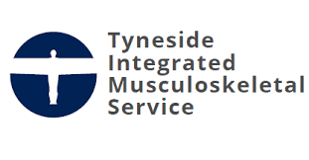
Quality Improvement Project
Implementing group consultations in a lower limb musculoskeletal outpatient service to improve efficiency and maintain positive patient outcomes
Aim
Our project aim was to introduce physiotherapist group consultations (GCs) for patients with lower limb problems, to help manage an anticipated increase in demand whilst maintaining patient satisfaction and ensuring clinically effective.
Measures/Results
Reduced physiotherapist time/patient from 45 mins to 22 mins for virtual GCs and 12 min for face-to-face GCs
Health-related quality of life scores significantly increased from the first to the second GC session
Levels of pain experienced by patients significantly improved from the first to the second GC session
Patient satisfaction was good
Methods / What we did
We introduced virtual group consultations and face-to-face GCs with musculoskeletal patients.
These two approaches were tested on common lower limb conditions: patellofemoral pain syndrome, Achilles tendinopathy, plantar fasciopathy and knee osteoarthritis.
The changes were tested and refined through three Plan-Do-Study-Act cycles.
Conclusion
This project has highlighted how to introduce group consultations for patients with lower limb MKS problems. It should be considered useful learning for other outpatient services.
Contributors: Lisa Wigham, Annette Richardson, Kathryn Moore, Michael Martin. Contact: Lisa Wigham email: lisa.wigham@nhs.net

