Slide 1
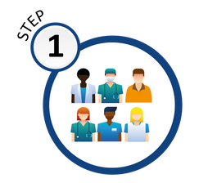
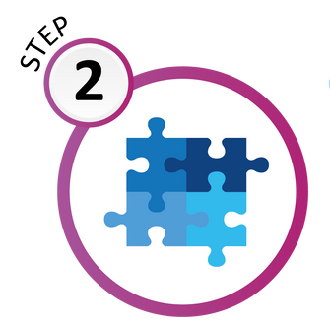
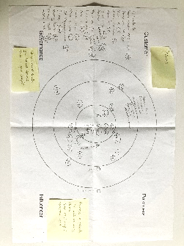
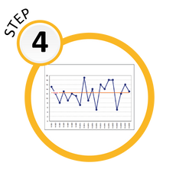
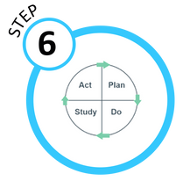
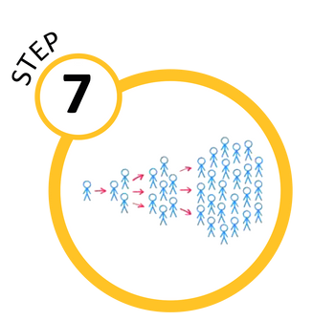
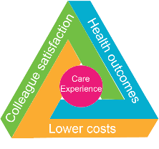
Transforming POAC
into Peri Assessment
7
STEPS
of Quality
Improvement
TEAM
Project Team: Annie Allen, Jacqui Wilson
Anaesthetic Leads: Tom Teare, Mark Abou-Samra
POAC: Amanda Newell, Ashraf Ahmed, Tracey Jenkins, Kim
Saunders, Sam Goss, Tracey Gunn, Di Vickery
Peri-Op: Louise Lewis, Martin Lever, Peri-Op Anaemia Nurse Specialist, Care Co-Ordinators, Project Support
Digital Nurse Lead: Shawn Whelan
Patient Partner: Joyce Strandring
The helter-skelter embodies our QI journey—a ride of anticipation, challenges, faith, and achievement.
PROBLEM
What was our problem
The POAC team are seeing elective surgical patients too close to surgery to enable optimisation causing last minute cancellations, increased rate of complication and LOS and / or readmissions.
How long had this been happening
This is a historic issue experienced by 100% of patients. Addressing this
Will improve patient experience
and outcomes
AIM
What was our aim?
To improve surgical outcomes we will increase screening from 0% to 80% of all patients who require elective major inpatient surgery at MPH. To improve surgical
outcomes we will
offer optimisation
to those with diabetes,
anaemia and to those
who smoke from
01/09/23 to 01/04/2024
MEASURES
Outcome measure:
Measure % of patients receiving Pathpoint questionnaire PLUS % of patients returning the form
Process measure:
Measure No. of patients being supported with Diabetes, Anaemia & Smoking PLUS accuracy of form
Balancing measure:
Setting our criteria too low could result in
more patients being identified than we have
capacity to optimise
CHANGE IDEAS
PRIMARY DRIVERS
SECONDARY DRIVERS
(SOME OF OUR) CHANGE IDEAS
Identify
patients
Pathpoint
Collect HB results for 1000 patients from POAC and identify most prevalent anaemic pathways
Assessment nurse
Referral pathways
Patient
engagement
Care Co-Ordinator
Raising awareness, OPD poster
Communications
Patient Involvement
TEST & LEARN
There were many PDSA cycles! 1 example ….
PLAN / DO
Put posters up in OPD clinic rooms and waiting rooms and inform clinicians to tell patients they will be receiving a Pathpoint Questionnaire via email/text.
STUDY
The poster increased the number
of questionnaires being returned
from 40% to 60%
ACT
Adopt! But continue to conduct
audit spot checks with OPD
departments(s)
Referral
Pathway(s)
Recruitment
Contact non-responders
Test Pathway(s)
Staff Engagement
SPREAD
Successfully secured 1st year funding to launch the Peri-Operative Service. The Quadruple Aim will be an integral focus of the next steps in our journey together with ensuring a standardised process, sustained planning
and embedded continuous learning
CLINICIANS
PLEASE INFORM ANY NEWLY
LISTED SURGICAL PATIENT THEY WILL RECEIVE A
‘PATHPOINT’ HEALTH QUESTIONNAIRE
(BY TEXT MESSAGE OR BY EMAIL)
FROM THE
PRE-OPERATIVE ASSESSMENT DEPARTMENT
FOR COMPLETION AND RETURN
Helping our surgical patients achieve their goals
 | 1 in 7 patients regret having surgery either because they didn’t achieve the outcomes they were hoping for or worse, surgery created complications they hadn’t been aware of
 | Peri-Operative services aims to optimise the health of patients, from the moment surgery is contemplated through to full recovery. We can help to identify areas where we can make improvements to the patient pathway by optimising long term health conditions, general health, exercise and wellbeing
 | You can help to encourage patient education by remembering our moto ‘Fitter, Better, Sooner’ for surgery
Contact the team for more information: peri.op@somersetft.nhs.uk

