Slide 1

NHS Great Place to Work
A unprecedented approach to creating a environment for our staff to flourish!
Paul Devlin - Creator NHS Great Place to Work
YouTube Webinar

Slide 2
Some people are stuck in jobs that they dislike working for people who don’t value them but are too frightened to leave.
How likely are they to provide excellent care or service?
Some people are in jobs that they love working for people who value them and genuinely look forward to coming to work.
How likely are they to provide excellent care or service?
So what’s our point?

Slide 3



Every patient & service user deserves the quality of care that we would expect for ourselves and our families.
For that to happen, we must create positive and supportive environments where our teams can perform at their best.
Make it a great place to work!

Slide 4
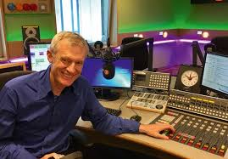

BBC Radio 2 Jeremy Vine show:
If the NHS recruited every school leaver for the next five years it still wouldn’t be able to fill its’ vacancy rate!

Slide 5

Strategy for attracting and retaining talented people diverse in background and thought.
Be Kind Be Positive Build Self-Esteem

Slide 6

How we behave towards each other is the single greatest factor in how well competent teams perform.
“Bullying and harassment in the NHS could be costing the health service more than £2 billion a year in England alone, research suggests”.
https://www.dailymail.co.uk/health/article-6321383/Bullying-costs-NHS-2-BILLION-year.html

Slide 7
Impact of Incivility
https://www.civilitysaveslives.com/
Recipients
80% lose time worrying about this
78% reduce their commitment to work
63% lose time avoiding the offender
48% reduce their time at work
38% reduce the quality of their work (deliberately)
25% take it out on patients/ service users
12% leave
Staff Onlookers
20% decrease in performance
50% reduction in willingness to help others
Patients & Relatives
75% less enthusiasm for the organisation
66% feel anxious dealing with employees

Slide 8
The Case for Kindness
Kindness can be defined as the quality of being friendly, generous, and considerate.
When you consider those traits, it starts to seem obvious that kindness should form the baseline of any civil workplace exchange.
However, it’s also obvious that this isn’t the case in practice.
But it should be!!

Slide 9
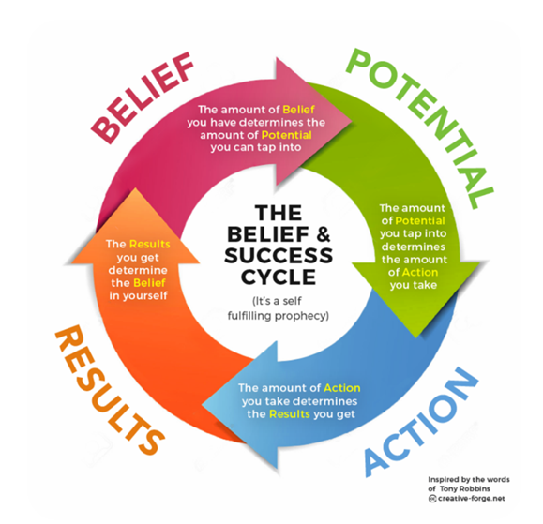
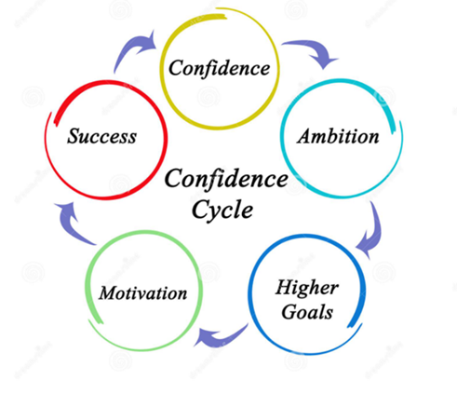
Kindness creates positivity
Positivity builds self esteem
Self esteem builds confidence
Confidence inspires action & fosters success

Slide 10
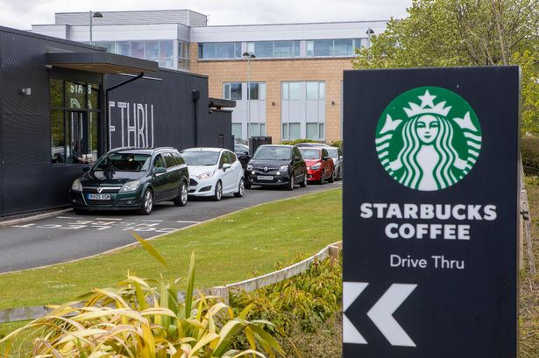
Kindness is, quite literally, contagious. Studies have found that this natural high makes people want to behave more altruistically towards other people.
One morning, a person in the drive-thru kindly paid for the next driver’s coffee along with their own order.
The next driver continued the gesture and so on. This act of kindness was repeated for over two and half hours (circa 150 cars).
Hyperdyadic spread = 60,000 people.
Moral elevation is a positive emotion experienced when witnessing a virtuous act, one that improves the welfare of others. It consists of a feeling of warmth, admiration and affection for the person(s) who performed the exemplary behaviour. (Algoe & Haidt, 2009).

Slide 11
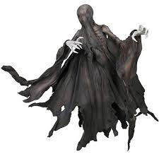

Mood hoovers and toxic people
Let’s value everyone but do not underestimate the damage they can cause if they are in positions where they can suck the living life force out of people.
‘Leaders should be leaders by the virtue of the fact that they can create a great place to work. The rest will follow’.

Slide 12
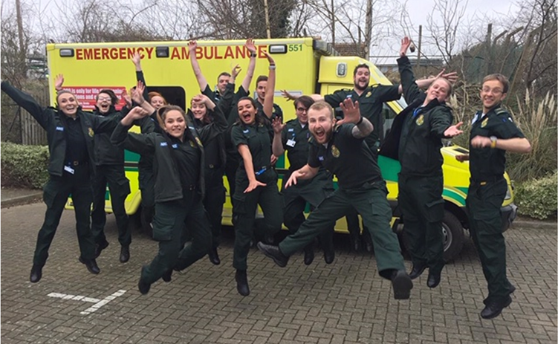
‘I love what I do and I do what I love brilliantly thanks to our great place to work’.

Slide 13
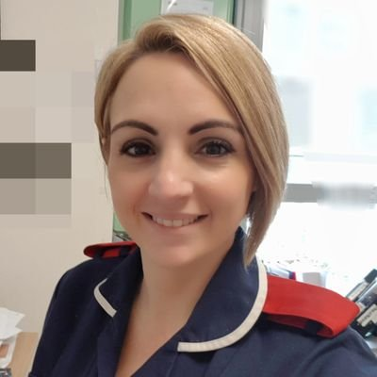
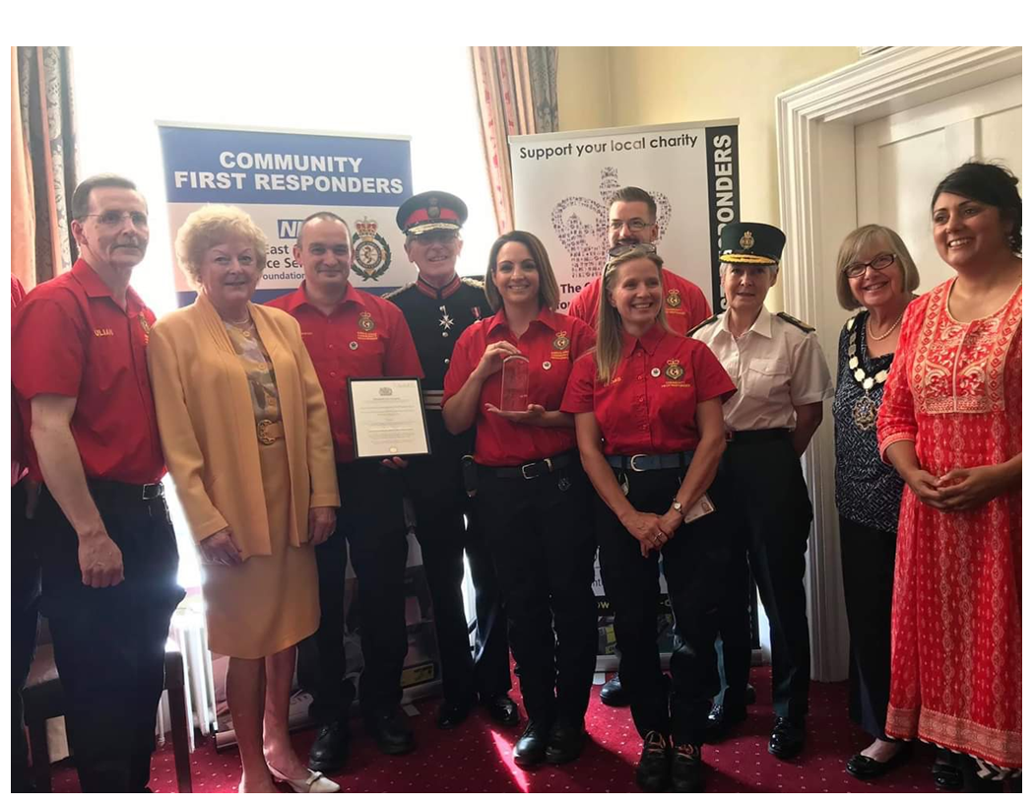
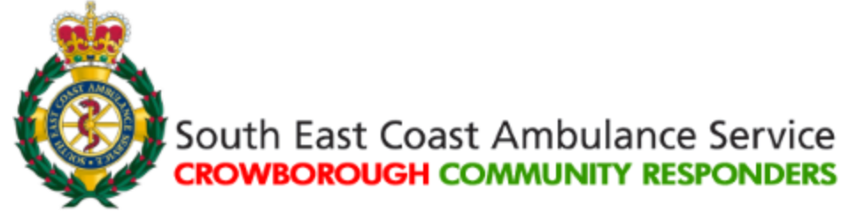
Happiness Hero's & Top 2%s
Let’s hunt out all the amazing people who create great places to work and get the very best from their teams. They need promoting so they can “positively infect as many people as possible”.
Nicki Pointer
Ward Manager Ward 33 Maidstone & Tunbridge Wells
NHS Trust @NickiAnn30
CFR Team Leader

Slide 14

Benefits of being happy at work
Happiness at work defined as ‘a mindset which enables action to maximise performance and achieve potential’1.
Take one tenth the sick-leave of their least happy colleagues
Are twice as productive
Twice as resilient
Twice as likely to be promoted
Stay twice as long in their organisations
Are six times more energised
1. Jessica Pryce-Jones Happiness at Work: Maximizing Your Psychological Capital for Success Paperback – 19 Feb 2010

Slide 15
GPTW is a continuous improvement tool designed to address the key constraints that prevent teams from performing at their best. It can be used at all levels of the organisation.
There’s no need to duplicate we can integrate the questions with staff pulse surveys.
Note: Typically a response rate of at least 90% is required. This increase the leverage for taking action and addressing key issues.

Slide 16
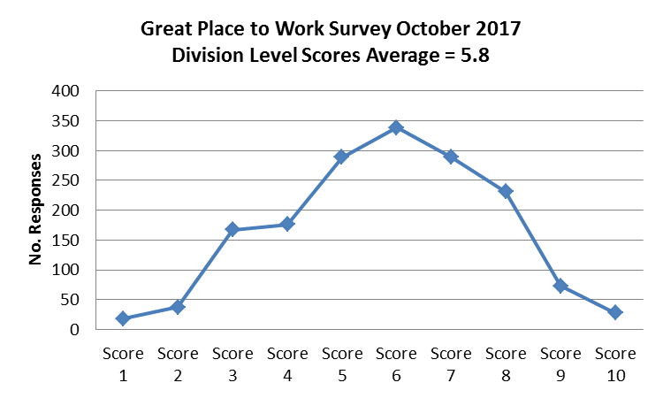
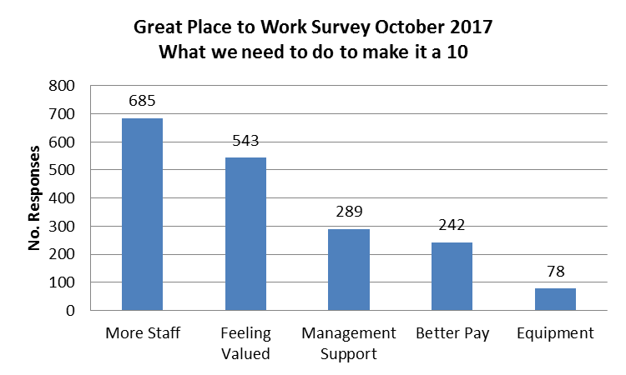

On a scale of 1 to 10 how great is it to work here?
If it’s not a 10 what do we need to do to make it a 10?
Great Place to Work Survey October 2018 Average Score = 6 out of 10
Great Place to Work Survey October 2018 What we need to do to make it a 10
Get this Resolve this
Leaders should be judged on their ability to create and maintain a positive and supportive environment evidenced through the Great Place to Work Score.

Slide 17
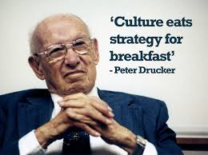
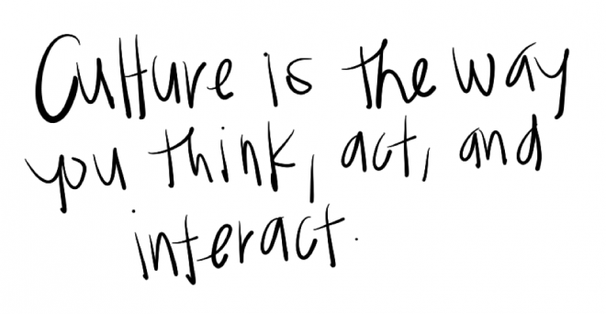

Transforming results by changing beliefs and behaviours
“Culture eats strategy for breakfast” is a famous quote from legendary management consultant and writer Peter Drucker.
To be clear he didn’t mean that strategy was unimportant – rather that a powerful and empowering culture was a surer route to organisational success.

Slide 18
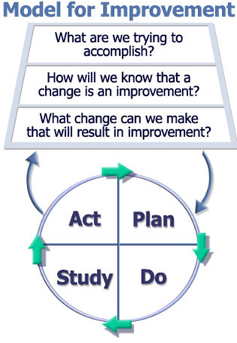
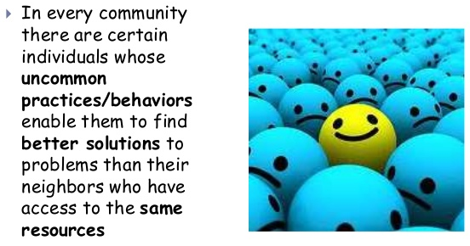
The Power of Positive Deviance
“People remember you by how you make them feel. Consider becoming the type of person that no matter where you go, you always add value to the lives of those around you“. (Paul Devlin)

Slide 19
How it Works
A minimum of 90% response rate is required in order to do great place to work. This is achieved by physically asking all team members to take part.
1. Staff are surveyed and asked on a scale of 1 to 10 how great is it to work here? | 2. A second question is asked if it’s not a 10 what do we need to do to make it a 10? | 3. Results are collated, themed and presented in Pareto format to highlight 80-20 rule issues.
6. Follow up sessions are held to check progress at 30, 60 and 90 days post survey to check progress and hold the gains. | 5. Rapid improvement events are commenced using the model of improvement and tests of change to address the most high impacting priorities. | 4. An mean average great place to work score is calculated for the organisation, directorates and teams.
The survey is repeated 4 to 6 monthly with the aim of evidencing resolution of key issues and a higher average great place to work score

Slide 20


People will forget what you said.
People will forget what you did.
But people will never forget how you make them feel.
Maya Angelou - American poet, memoirist, and civil rights activist.

Slide 21
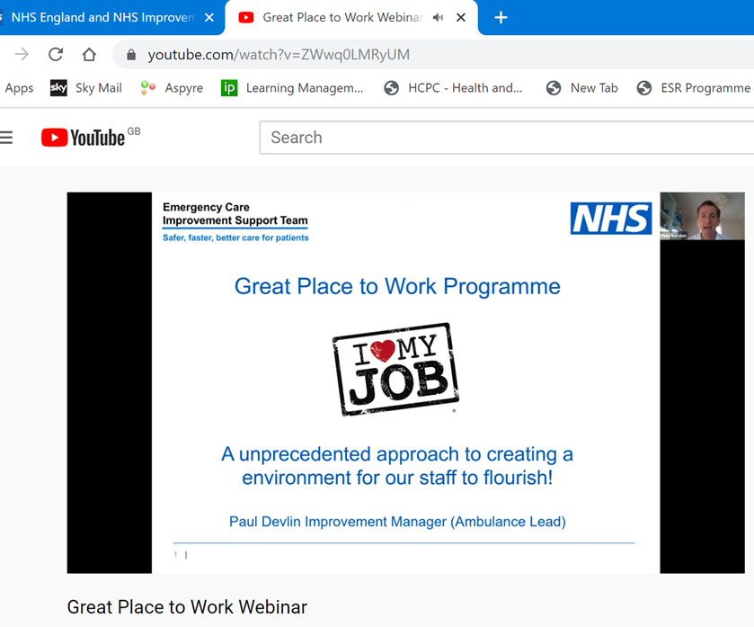
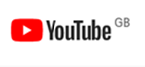
YouTube Webinar
https://youtu.be/ZWwq0LMRyUM

