Slide 1
Value of Neurodiversity Joan Pons Laplana @RoaringNurse

Slide 2
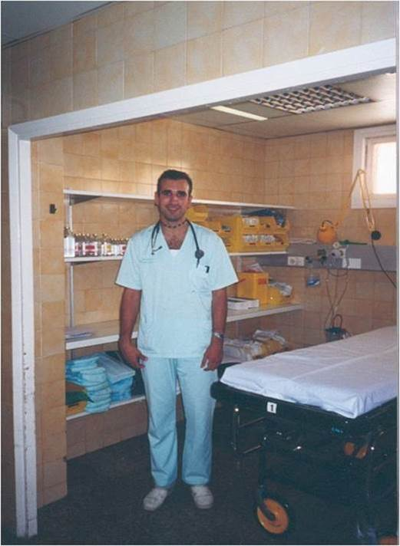

Slide 3
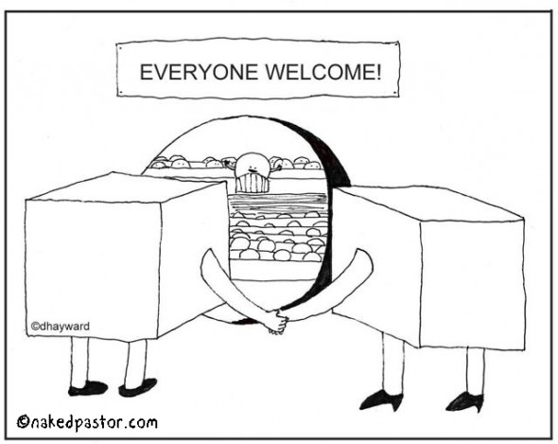

Slide 7
New website http://ndnursesuk.org/
Free Nuerodiversity Awareness Course
Social Media Accounts
Monthly Tweetchats ( 1st Wednesday every moths at 20.30h )

Slide 8
Increase visibility.
Expand Network.
Try improve data. (Campaign to change staff form)

Slide 9
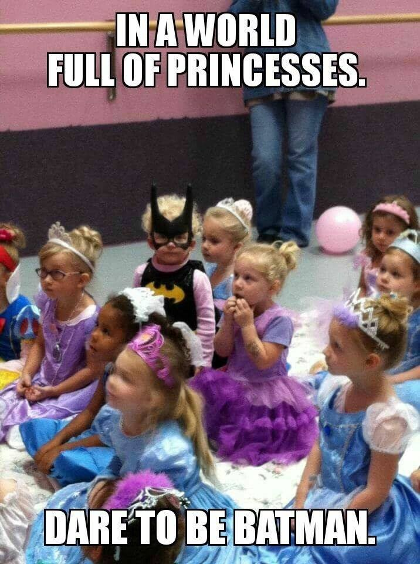

Slide 10
