Slide 1
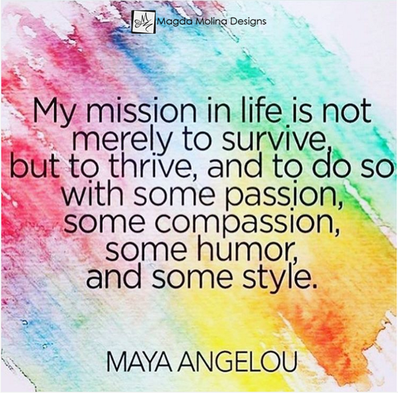
More than just a lanyard: Meeting the needs of LGBT+ patients
Rachel Symons
A two and half hour workshop exploring the experiences and needs of LGBT+ patients.
www.thrivingfutures.co.uk
Part One: Getting to grips with gender
This session explores the importance of addressing the needs of LGBT+ patients, what we mean by the term ‘gender’ and how this differs from ‘sex’. It also demystifies all the confusing terminology around transgender.
Part Two: Responding to the needs of LGBT+ patients
This session examines the experiences some LGBT+ patients have had within healthcare before looking at how services can be improved. The specific needs of older LGBT+ patients are also considered.

Slide 2
Part One: Getting to Grips with Gender
Resources:
Print out slides 42-77 as notes for participants - recommended 2 slides to a page.
This session explores the importance of addressing the specific needs of LGBT+ patients, what we mean by the term ‘gender’ and how this differs from ‘sex’. It also demystifies all the confusing terminology around transgender.
Learning Objectives:
To recognise the need to meet the specific healthcare needs of LGBT+ patients.
To understand what is meant by the terminology and ‘gender spectrum’.
To explore how society’s attitudes towards men, women and LGBT+ have changed over time.
NB: These timing are a rough guide.
Part One should take around 1 hour 25 minutes.
Slide | Time | Activity
5 | 5 min | Have slide 5 on screen as people are entering. Spend just a few minutes explaining the purpose of the workshop.
6-7 | 5 min | Impress the importance of exploring the needs of LGBT+ patients by examining and discussing the statistics on the 2 slides.
8-9 | 10 min | Read through the terminology and watch the clip on slide 8. Highlight that with gender identity, the way someone expresses themself can vary – a female for example my present as a woman but wear mainly jeans and jumpers whilst another may be ultra girly with makeup & jewellery.
10 | 5 mins | Read through and discuss the information about the difference between boys and girls. In case the topic is raised, the following info on biological variations may be helpful: Turner's syndrome - this occurs when females develop with only one X chromosome on chromosome 23 (1 in 5000 chance). This leads to a lack of maturity into a woman’s body at puberty. Klinefelter's syndrome (XXY) affects 1 in every 750 males. In addition to having a Y chromosome, these men also have an additional X on the 23rd chromosome, leading to the arrangement XXY. Physically they appear male, though the effect of the additional X chromosome causes less body hair and under-developed genitals.

Slide 3
Part 1: Getting to grips with gender?
Slide | Time | Activity
11-15 | 10 min | Use these slides to explore expectations and qualities valued in boys and girls.
16-18 | 10 mins | Examine where gender expectations come from by looking at the adverts and watching the Harry Enfiled clip on slide 18.
19-20 | 5 mins | Look at the gender spectrum on slide and the info about the 3 people on slide 20. Question what problems the examples reveal about the gender spectrum being a straight line.
21-23 | 10 mins | Read through slides 21&22, asking for thoughts and contributions. Highlight how all the attributes listed from examining children’s toys could all be used to make up the gender spectrum. Give time to think about own gender spectrum on slide 23.
24 | 5 min | Use the information to link the importance of acceptance to mental health and the statistics seen on slides 6 & 7.
25-26 | 15 mins | Use the poem on slide 26 to have small group discussions around gender expectations using the questions on slide 27.
 | 5 mins | Feed back thoughts and ideas from issues explored in the poem and session.
Break time

Slide 4
Part Two: Responding to the needs of LGBT+ patients
Learning Objectives:
To understand the experiences some LGBT+ patients have had within healthcare.
Explore how to improve services for LGBT+ patients.
Consider the specific needs of older LGBT+ patients.
This session examines the experiences that some LGBT+ patients have had within healthcare before looking at how services can be improved. The specific needs of older LGBT+ patients are also considered.
NB: These timing are a rough guide. Part Two should take around 1 hour 05 minutes.
Slide | Time | Activity
28 | 3min | Have the slide on the screen as people return from break. Spend a few mins going over the learning objectives
29 | 7 min | General Q&A. Discuss the questions on the slide – if participants don’t know of specific policies or aren’t aware of any particular signs aimed at LGBT then look at the significance of this and what can be done about it.
30-31 | 10 mins | You may wish to remind of the prevalence of poor mental heath on slides 6 & 7 before looking at these slides. Read through the statistics and quotes on these slides – general Q&A, is anything surprising, why do such attitudes exist?
32 – 34 | 10 mins | Read through the information and watch the clip on slide 32
35-36 | 20 min | In groups explore the timeline on slide 35 and write a list of implications LGBT history may have on the needs of older patients. Spend time discussing as a whole group.
37 | 10 min | Watch the clip and discuss what services are available in your local area – it may be helpful to have thought about this in advance in order to show some examples.
38 | 5 min | Recap what has been covered through the workshop by using the images.
Slides 42 – 77 are to be used to print out as notes for participants.

Slide 5
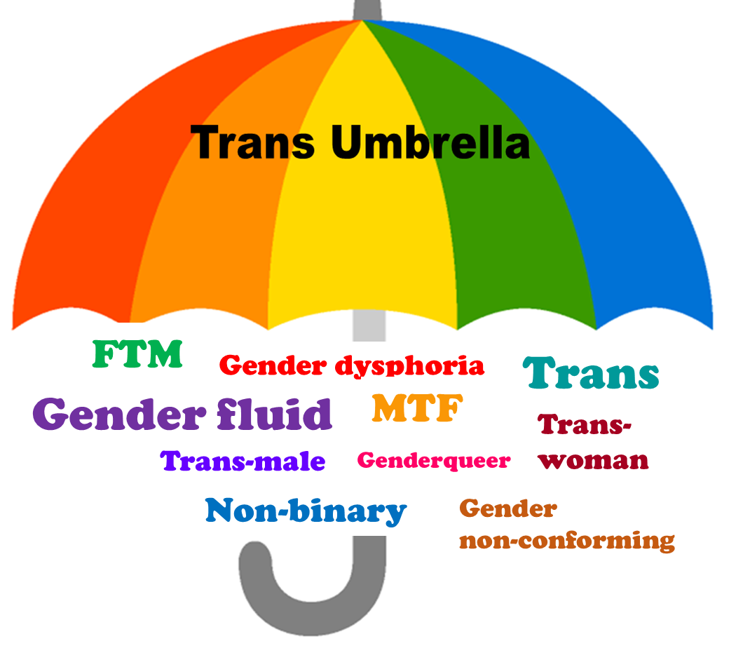
Part One: Getting to grips with gender
Most of the patients on your ward identify as cis-male (a person who was born as a male and identifies as a man) or cis-female (a person born as female and identifies as a woman). Some of your patients however will identify as:
Trans-Male
Trans-Female
Non-Binary
This session, is designed to help you understand:
Why it’s important to consider the specific needs of Lesbian, Gay, Bisexual, Transgender and other (LGBT+) patients.
What is meant by the terminology and ‘gender spectrum’.
Changing attitudes to gender.
Rachel Symons

Slide 6
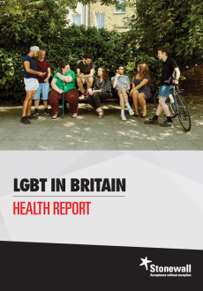
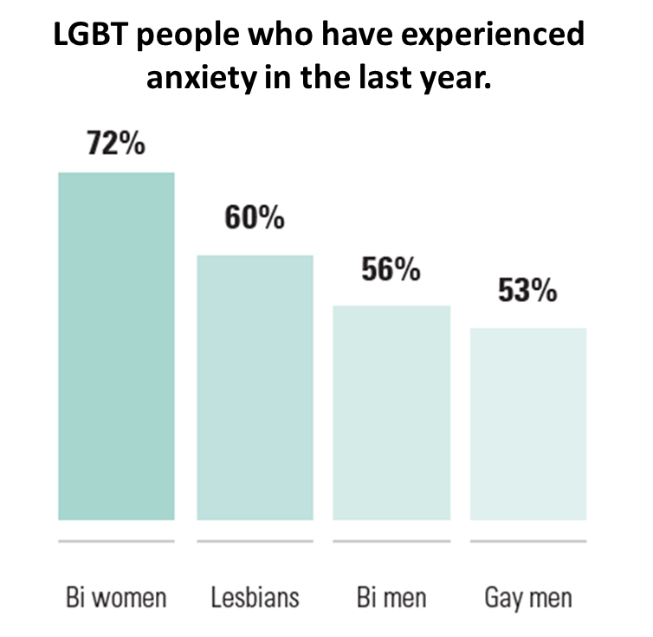
LGBT+ and Mental Health
Before starting, it’s important to think about why we need to explore LGBT+ as a distinct group so that we can better meet their needs. The statistics make for sobering thought.
52% of LGBT people said they’d experienced depression in the last year.
60% of LGBT people who’ve experienced a hate crime based on their sexual orientation and/or gender identity have also experienced depression.
46% trans people have thought about taking their own life in the last year, 31% of LGB people who aren’t trans said the same.
64% LGBT people in lower income households and 48% LGBT people in higher income households experience depression.
(Stonewall, 2017; Stonewall,2018)

Slide 7
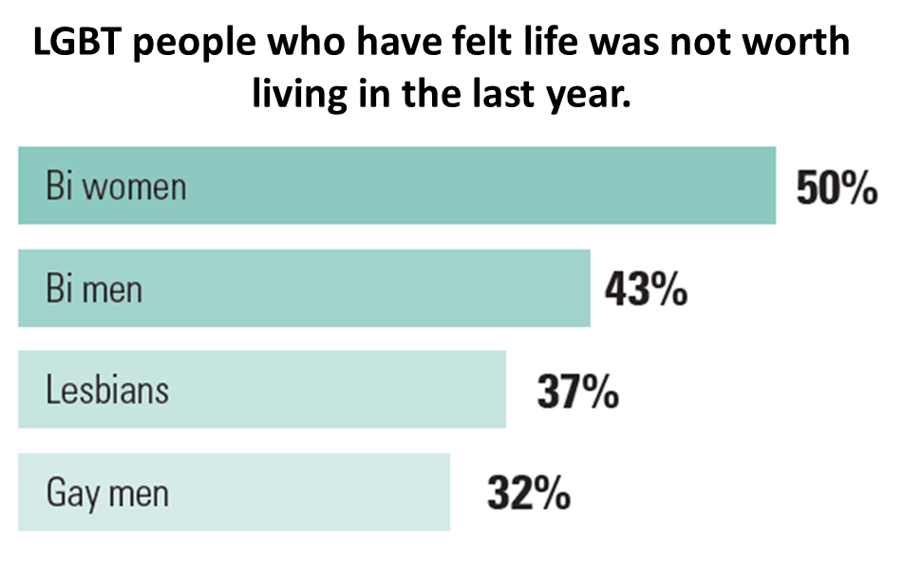
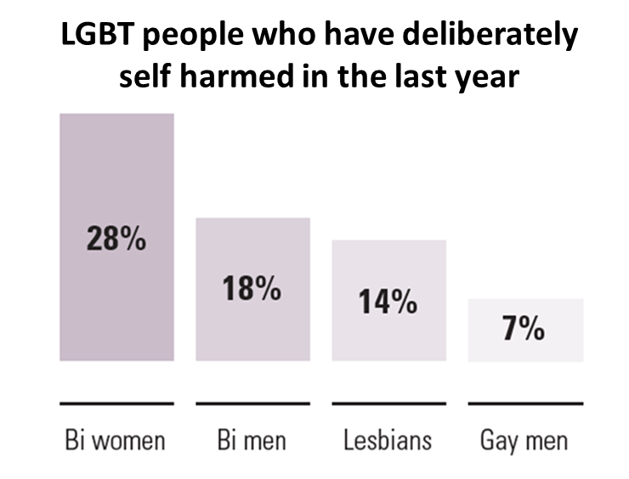
41% of non-binary people, 20% of LGBT women and 12% GBT men said they self harmed in the last year.
22% lesbian, gay and bi young people have attempted to take their own life.
61% lesbian, gay and bi young people have self-harmed.
45% trans young people have attempted to take their own life.
16% of LGBT people said they drank alcohol almost every day over the last year.
84% of young trans people have self-harmed.
(Stonewall, 2017; Stonewall,2018)

Slide 8
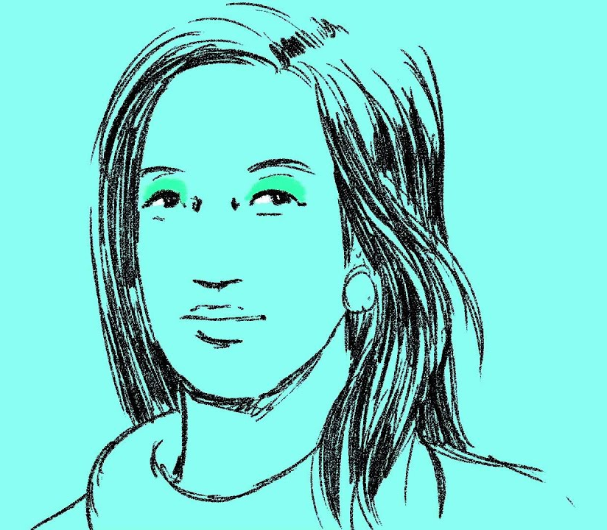
Terminology:
Trans: Short for trans-gender
Gender non-conforming: a man or woman who does not conform to society’s expectation of that gender, but do not identify as a different gender.
Transgender: a general term elating to a person whose sense of personal identity and gender does not correspond with their birth sex.
Genderqueer: A slang terms for a person who identifies as transgender.
Gender dysphoria: where your gender identity and sex assigned at birth don’t match up which causes distress, especially when looking at your body.
Trans-woman: A person assigned male at birth and who identifies as a girl or woman. Transwomen use the pronouns she/her.
MTF: Male to Female
(EACH UK, 2016)
Trans-male: A person assigned female at birth and who identifies as a boy or man. Transmen use the pronouns he/ him.
FTM: Female to Male
Non-binary: Where someone doesn’t identify as either male or female, where they don’t feel they meet the criteria for either. Non-binary people may use the pronoun ‘they’.
Gender fluid: Some people may feel that their gender isn’t fixed, that they move between male and female and want to express both these sides of themselves at different times.
Click the picture to find out more.

Slide 9
Gender Identity: Regardless of sex at birth – this is about whether you identify as male, female, both or neither.
2 people may identify on the same spectrum but at different levels. E.g. one may present as ultra feminine, whilst another less so.
Gender Expression/ Presentation: This is about how you show your gender identity through clothing, hairstyle, voice, body shape, etc.
(Pan & Moore, 2015).

Slide 10
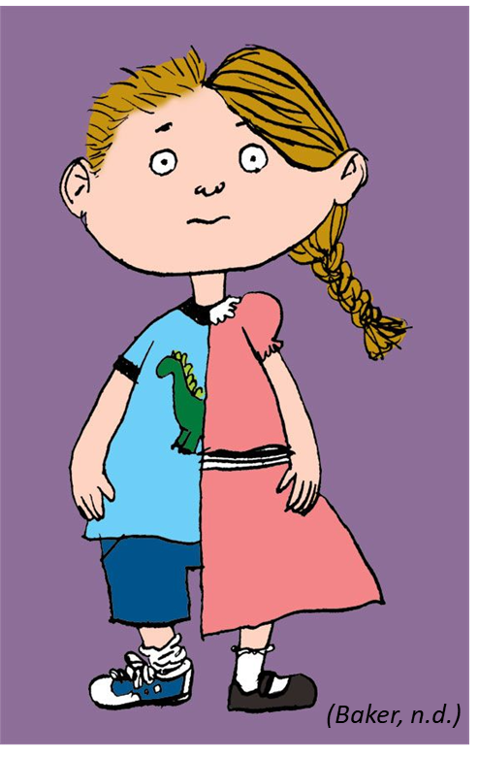
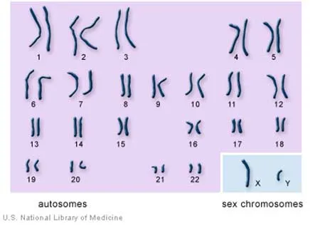
The difference between sex and gender
The sex of a baby is the first thing someone usually asks when someone has had a baby. Sex is determined by 2 factors:
Chromosomes
The normal human body contains 23 pairs of chromosomes, the 23rd pair determine whether a child is female (XX chromosome, or male (XY chromosomes)
At 6 weeks, the Y chromosomes causes the embryo (developing baby) to develop testes if it is to become a boy.
Hormones
If the embryo is male, testosterone is released to help develop the male genitalia, this also has an impact on the way the brain develops.
During adolescence it is these hormones that are responsible for puberty and the changes in the body that this creates.
(Simply Psychology, 2014)

Slide 11
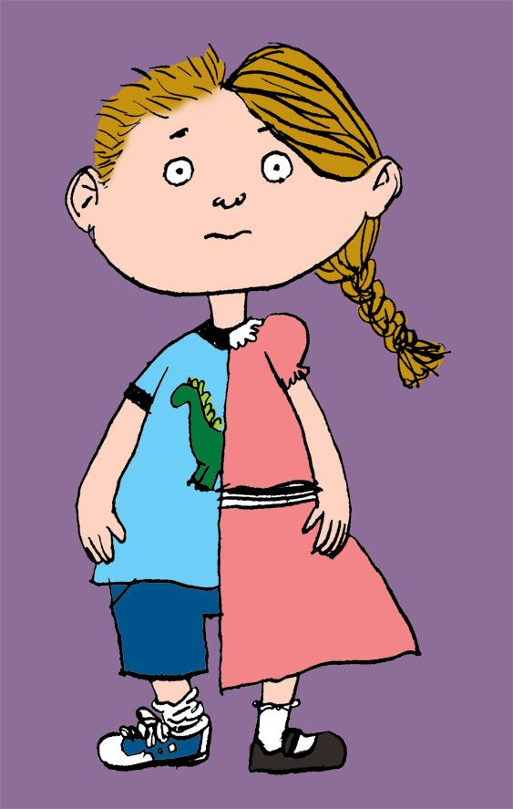
Gender expectations
Whilst a person’s sex is decided whilst still in the womb, the implications their gender has on a person’s life, is decided by parents and society.
The UK government defines gender as:
“a social construction relating to behaviours and attributes based on labels of masculinity and femininity”
(ONS, 2019)
Gender is based on how society/ culture view the roles of men and women.
Task
Toys are an excellent indicator of society’s expectations of men and women.
The next slide has been split in 2 with ‘boys’ on the top of one half, then ‘girls’ on the other.
You will be shown 2 slides with pictures of toys aimed at boys, then girls. Each slide will be on the screen for 3 minutes.
List the qualities that the toys reveal about what is expected of boys, then girls, e.g. adventurous, logical etc. You may work in pairs/ groups if you wish.

Slide 12
BOY
GIRL
Brave
Outdoors
Adventure…
Caring
Soft
Beauty…

Slide 13
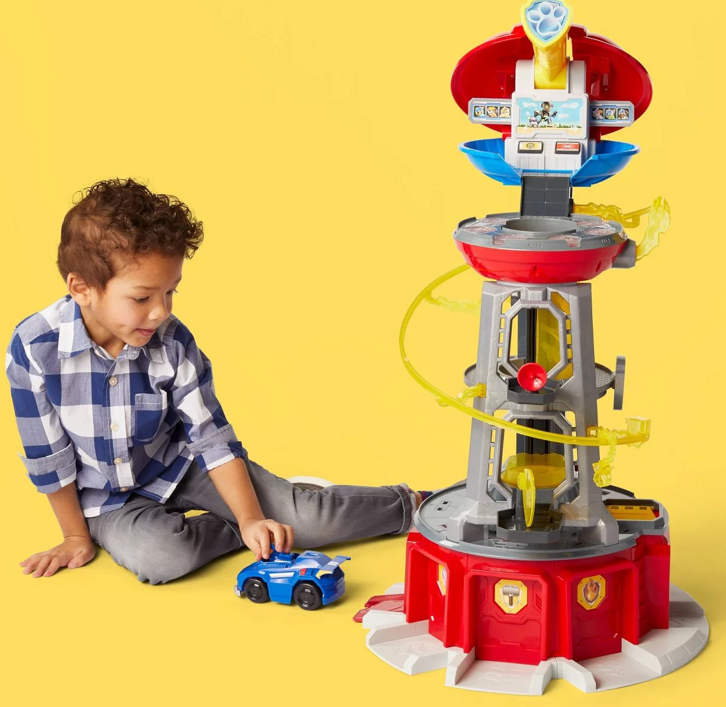

Slide 14
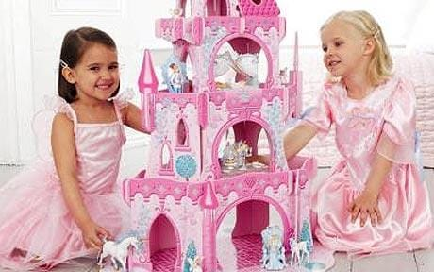
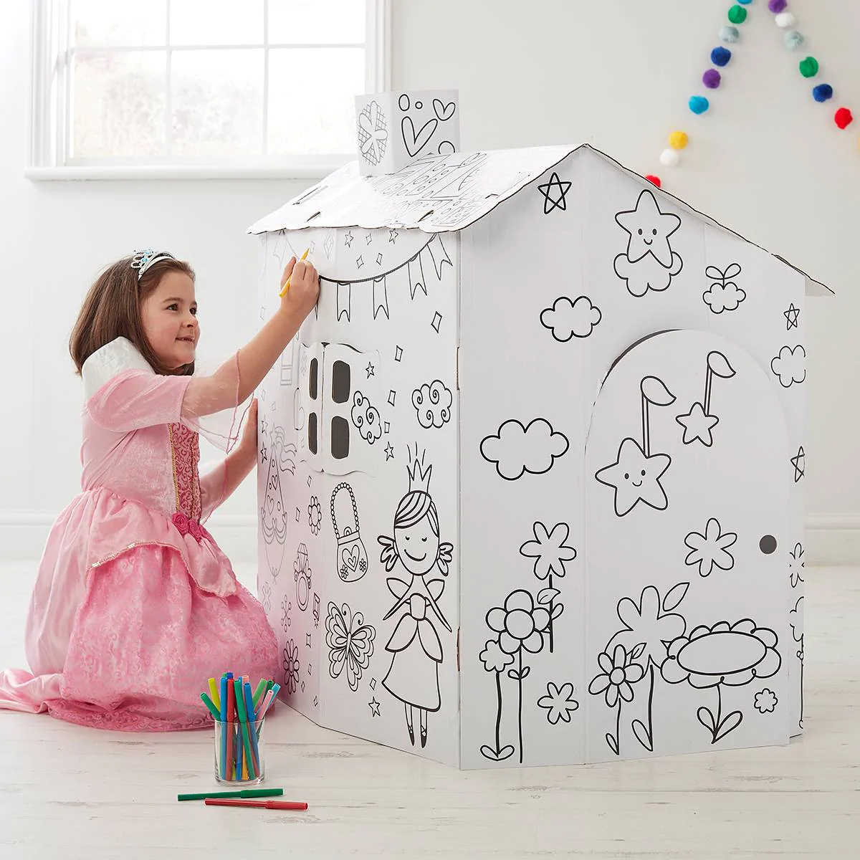
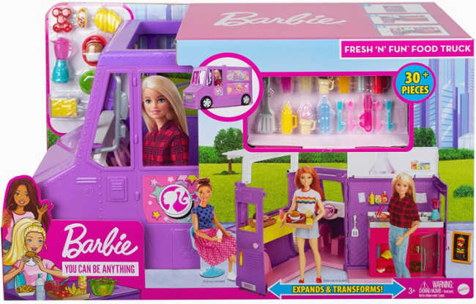
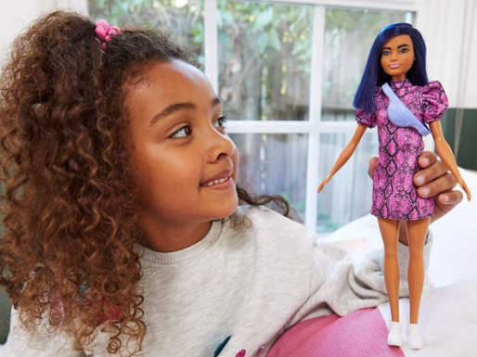
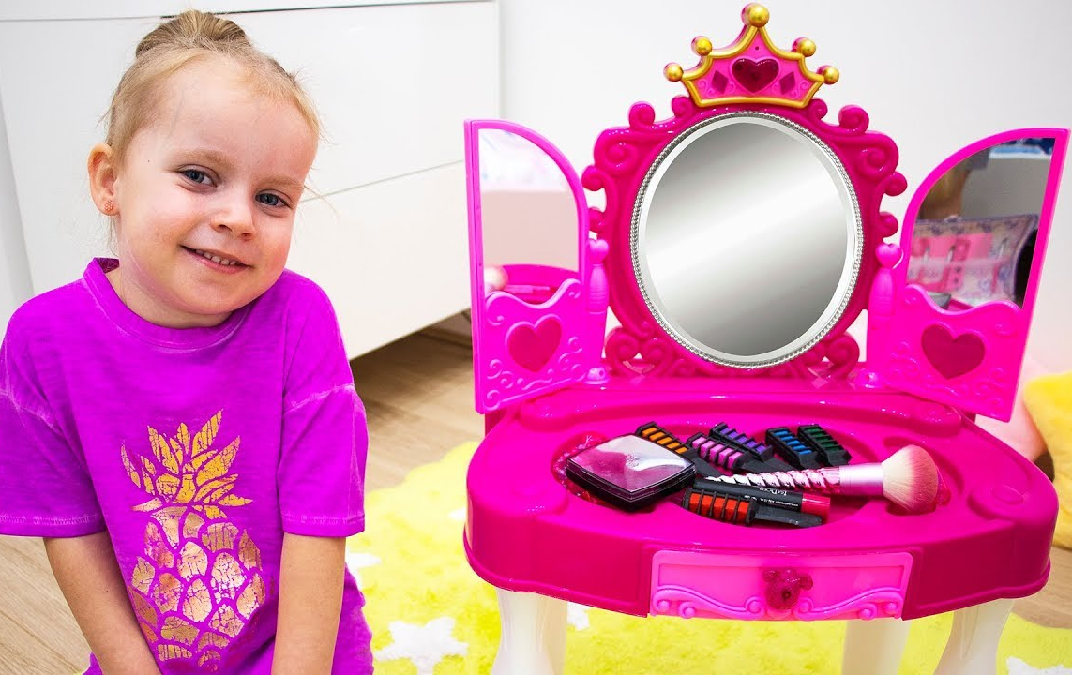
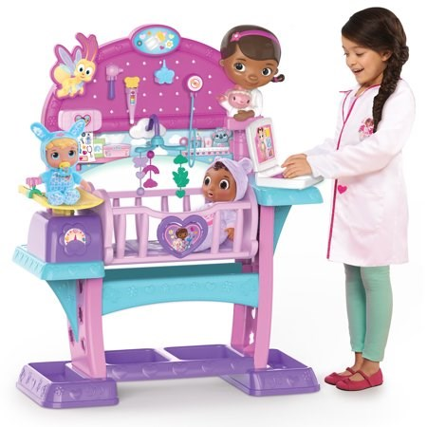

Slide 15
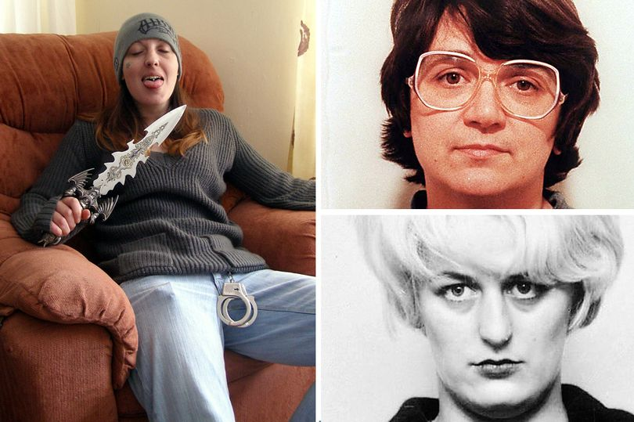
Do we judge men and women differently?
Perhaps one of the most noticeable differences in our expectations of gender, is in our attitudes to violent crime. The news is quick to report on anyone who is thought to have murdered more than one person, but especially so with women, and even more so should their victims be children.
The realities of a killer and the contrast between society’s expectations is greater for a woman than a man, therefore we are more fascinated by them and judge them more harshly.
Joanna Dennehy, mother of 2, brutally murdered three men in Peterborough in just ten days in 2013.
Rose West, together with her husband Fred West, tortured and murdered at least nine young women between 1973 and 1987.
Myra Hindley, together with her partner Ian Brady, raped and murdered five small children between July 1963 and October 1965

Slide 16
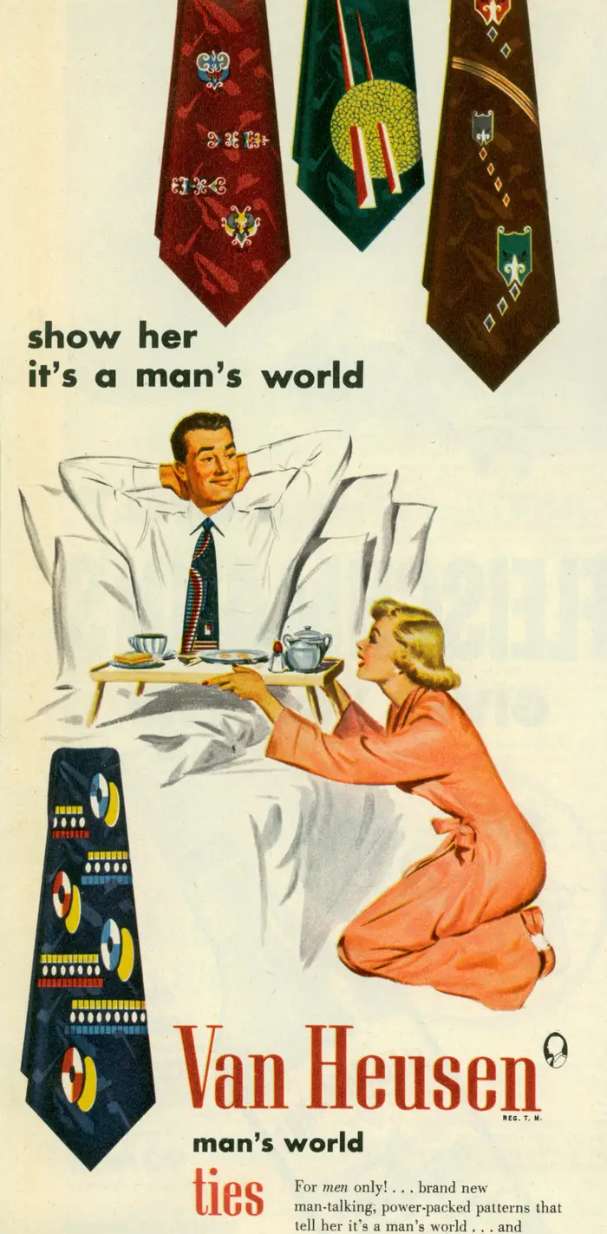
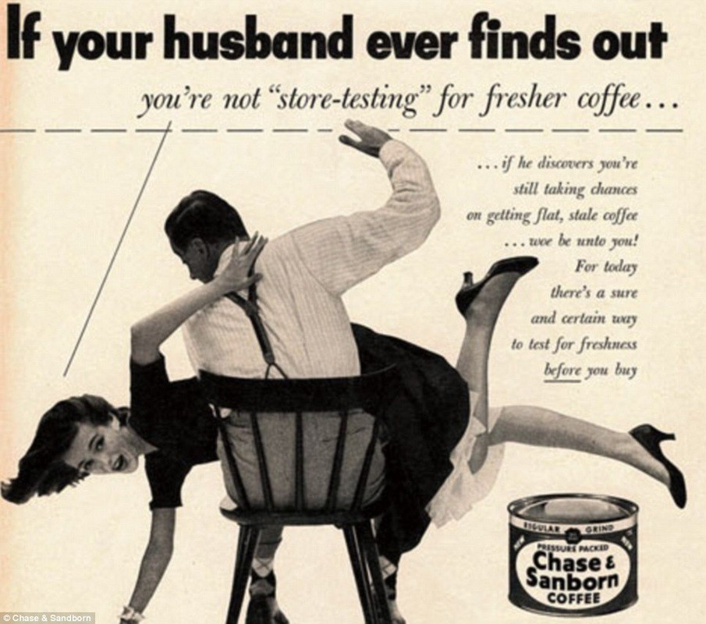
Where do our expectations and attitudes come from?
Gender roles are very much about what our society and culture expect.
We’ve already seen how targeted toys still shape boys and girls expectations, but thankfully things do change.
These adverts show how shocking old attitudes are today – what used to be considered ‘normal’ has changed.
(Business Insider, 2014)
Women haven’t changed but attitudes and expectations have.

Slide 17
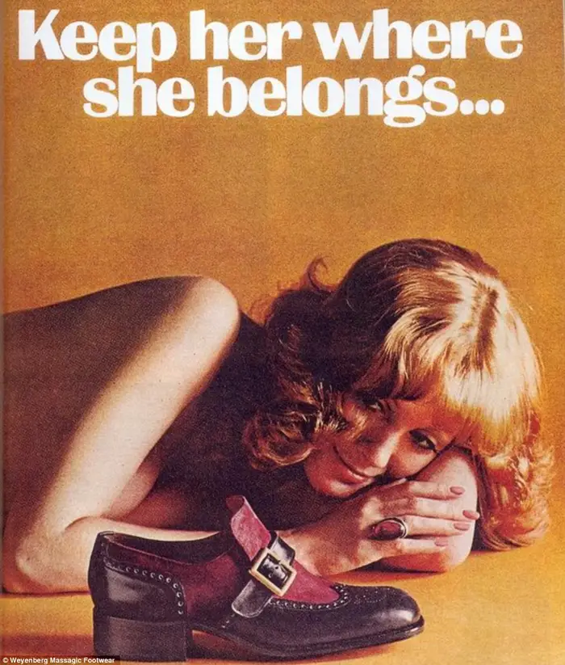
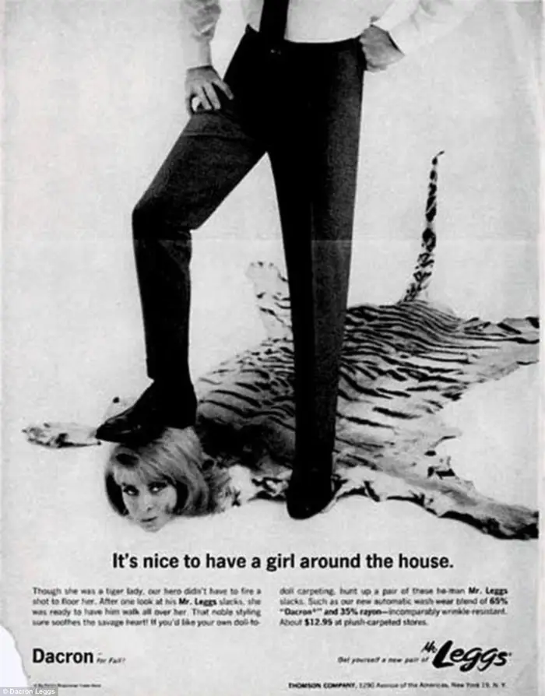
(Business Insider, 2014)

Slide 18
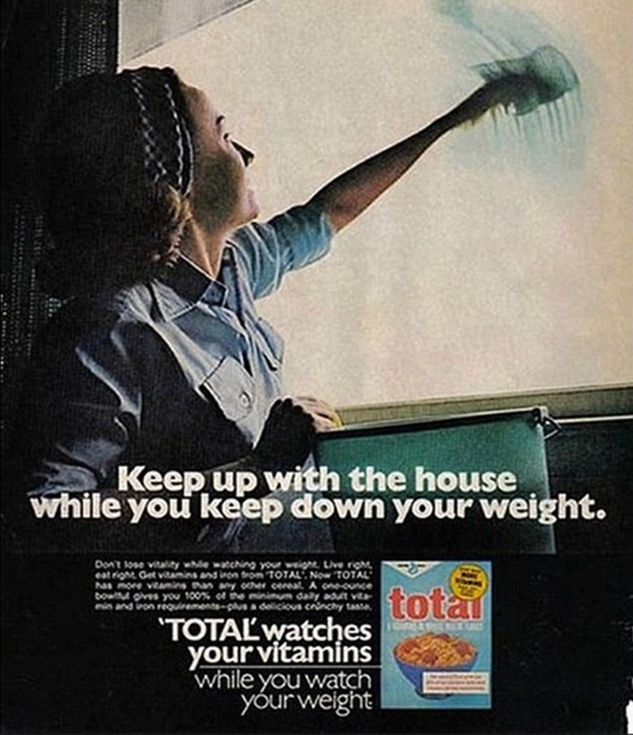
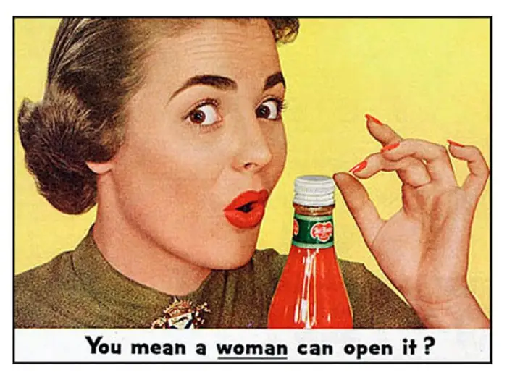
(Business Insider, 2014)
Harry Enfield summed up the attitude to women perfectly in this comedy clip
(Enfield, 2008)

Slide 19
The Gender Spectrum
In reality we know that not all men are hard & macho, and not all women are gentle & caring. We recognise that people are somewhere on a spectrum between ‘girly girl’ and ‘macho man’.
We tend to view this spectrum as a straight line.

Slide 20
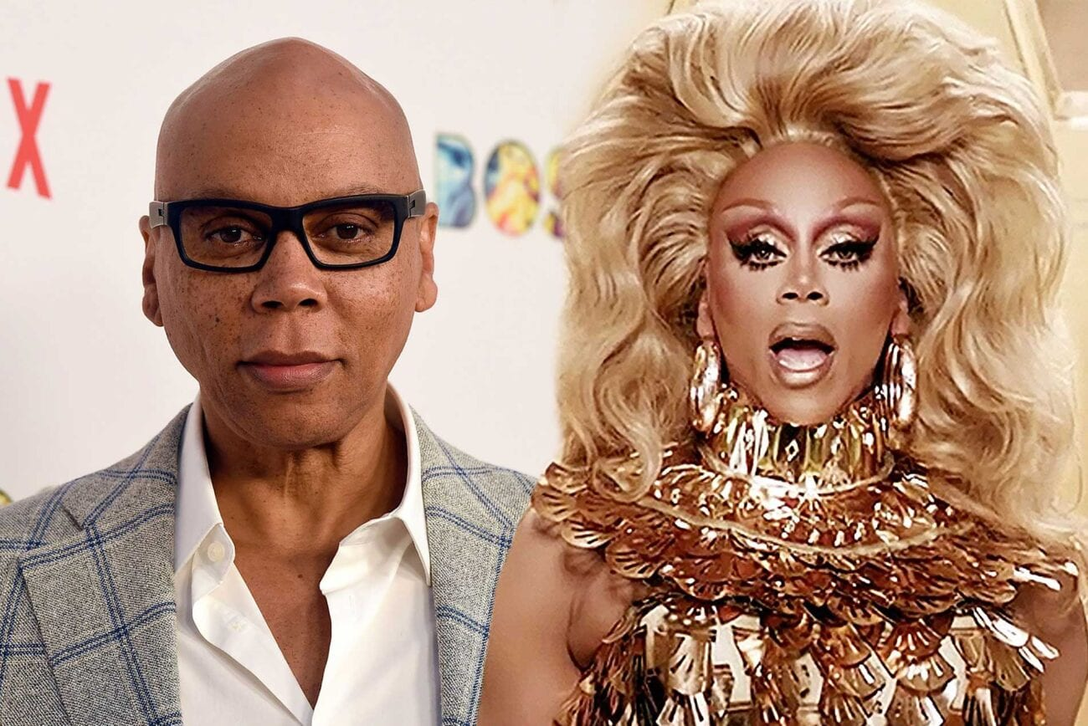
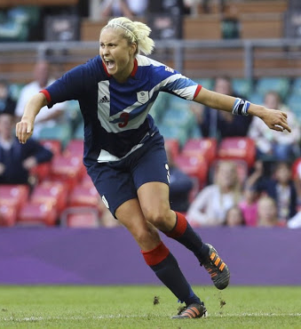
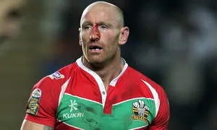
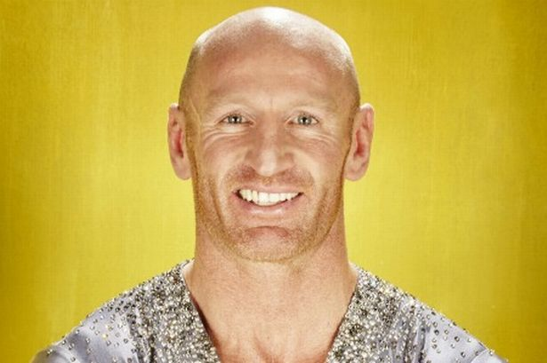
The Gender Spectrum
However, the gender spectrum is problematic as people don’t tend to fit neatly onto it:
Stephanie Houghton is the captain of Manchester City and the England football team.
There is a stereotype that women in sport, especially football, must be lesbian. However, Stephanie is married and has a son.
RuPaul is credited with being the first drag queen to host an American talk show. This shows bravery, changing the way things are done takes courage, something which contravenes the stereotype of men wearing clothes being ‘weird’ and ‘weak’.
Gareth Thomas is the former captain of the Welsh rugby team. He has played 100 test matches for Rugby Union. He led a double life for a sometime, he was married but he knew he was gay. He came out in 2009 whilst he was still playing rugby. He has since revealed he is HIV positive.

Slide 21
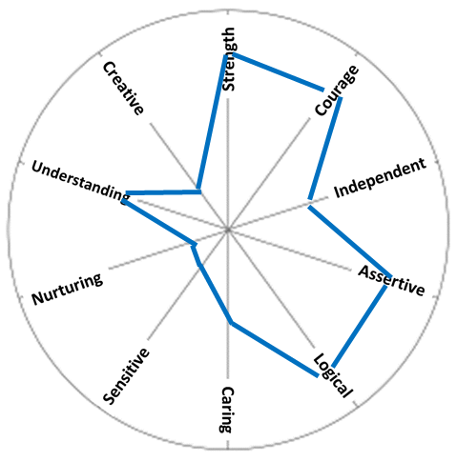
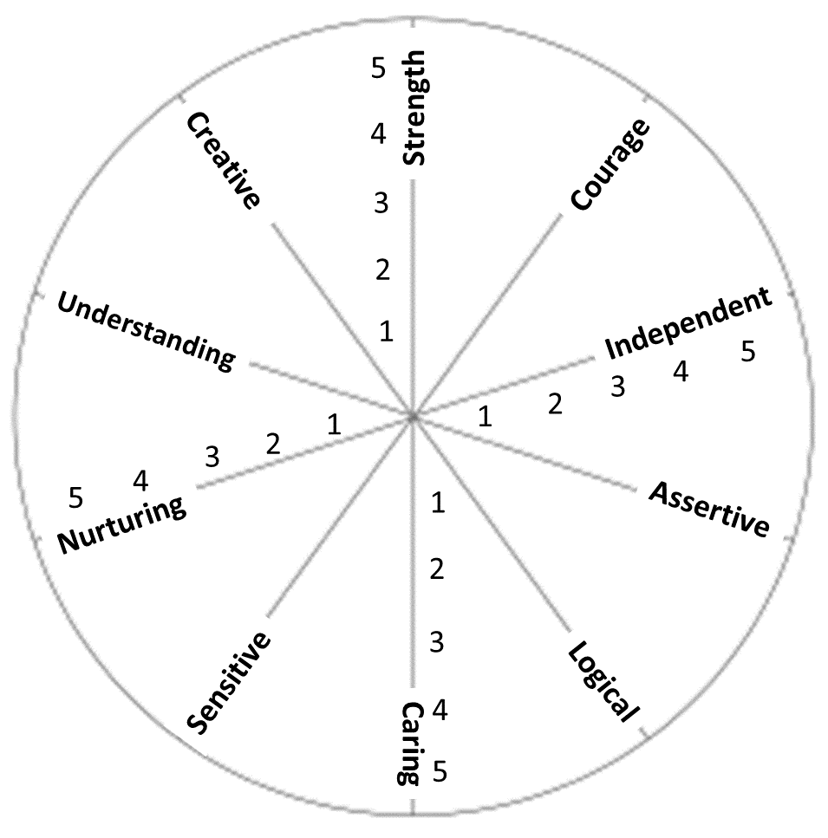
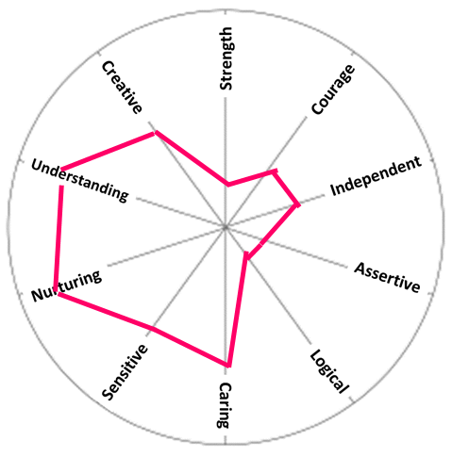
The Gender Spectrum
Gender is complex, therefore it is helpful to view it less as a straight line and more of a spider web like the ones shown below. As the examination of toys shows, we assign certain attributes to men and women, boys and girls, some of which are included on the ‘web’ below.
Going by the stereotype the ‘perfect’ boy would look like:
The ‘perfect’ girl would be more like this.

Slide 22
The Gender Spectrum
The reality is we have all these qualities and the amount of each that we reveal or use will vary depending on where we are, who we are with and what we are doing.
Stephanie Houghton
The qualities Stephanie would be expected to show during a match would be very different to those shown at home with her family.
Up until recently, girl’s football was frowned upon – the qualities needed were thought too masculine.
Gareth Thomas
RuPaul
A man in a dress is traditionally frowned upon as ‘weak’ as it’s seen as feminine but think how much strength and courage that must have taken. How independent and assertive would he have had to be to get his ideas approved? All traditionally ‘masculine’ qualities.
Whilst playing rugby, Gareth was displaying all the attributes expected of a ‘man’, this is in total contrast to the stereotypes of gay men.

Slide 23
At work
When alone
What about you?
Task
Think about the qualities you display in different situations.
The hardest situation to think about is probably the one when you’re alone. That is because there are no cultural rules for you to fit into. How do you know how to be?
With friends
With family

Slide 24
The impact of expectations
Sapolsky also discovered that the more uncertain their position in the group, the more cortisol the baboon produced.
As a species we have evolved to be part of a group, in cavemen times our very survival depended on it. Just like in the nature programmes, a lone animal is at greater risk than a pack one.
(Watts, 2009)
“In modern societies survival depends on social acceptance and social status; it is very stressful when these things are at stake.”
(Gerhardt, 2015)
Equally, the lower our position within our social group, the more cortisol we create.
If we don’t naturally fit into a group or are shunned because we don’t meet society’s expectations, then our group position is under threat, creating cortisol.
Excessive and uncontrolled cortisol can lead to anxiety disorders, in part explaining the increased percentage of mental health disorders seen amongst the LGBT+ community.
Attitudes and acceptance have an impact on mental health.
If our position amongst our group is at threat, then that creates stress. Stress creates cortisol.
In 1995, a scientist, Robert Sapolsky, did some work with baboons. He found the higher their status in the group, the lower their cortisol levels and vice versa.
(Gerhardt,2015)

Slide 25
Time to Transgress?
I’d far rather that, than sit alone in her room,
Posting selfies on Insta, for others to approve,
I’d far rather my son, be happy in his skin,
Than be changing himself, trying in vain to fit in.
A hundred years ago, women couldn’t vote,
They all wore long skirts, men controlled when they spoke.
In some countries now, you’re killed if you’re gay,
Girls denied rights to school and to play.
These things, they are wrong and we’re bound to be shocked,
Our culture has changed, what’s now right once was mocked.
In a hundred years’ time, will it still matter d’you think?
If a boy puts on make up or chooses to wear pink?
Should your gender define you whole sense of being?
Should it rule life, limit the future you’re dreaming?
Will the world end, if someone’s different to you?
Or should we transgress, the traditional views?
Transgress [verb]: to go beyond the limits of what is morally, socially, or legally acceptable.
Do you know yet, if it’s a boy or a girl?
What does it matter? Let’s see what unfurls.
But how will you know what colours to use?
Does it really matter, the colours we choose?
What going on? She can’t play with trains!
Why on earth not? She’s created a game.
Boys can’t have dolls, it’s simply not right!
It’s okay, I’ve checked, they’re not real, they won’t bite.
Why are you allowing your boy to wear pink?
Will the world stop, due to colour d’you think?
Too old for a tomboy, it’s time she moved on!
I’m glad she climbs trees and plays out having fun.

Slide 26
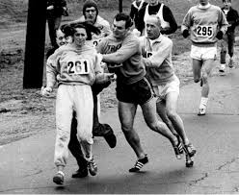
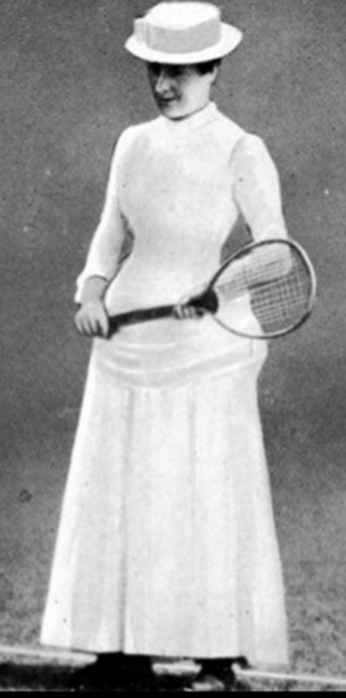
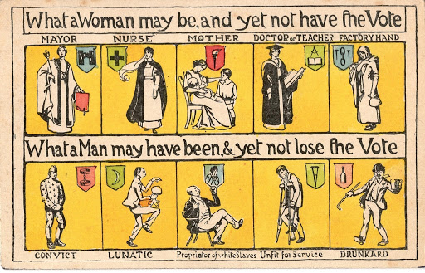
Time to Transgress?
The first half of the poem looks at the expectations of girls and boys. Is it more socially acceptable for a girl play with ‘boys’ toys than the other way round? Why is this?
Verse 5 looks at the peer pressure to fit in. What impact does this have on mental health?
The poem contains lots of rhetorical questions (questions designed to make you think). After reading the poem and thinking about the questions, has it challenged your views on gender?
Men trying to stop a woman running a marathon.
Women tennis players wore this at Wimbledon.

Slide 27
Be back in _______ minutes.

Slide 28
Part Two: Responding to the needs of LGBT+ patients
Most people would agree that today’s society has become more accepting or tolerant of LGBT+ issues, gay PRIDE is a spectacle that is often celebrated beyond the LGBT community. So, is there really an issue in healthcare regarding attitudes towards LGBT+ patients, and if there is, what can be done?
This session, is designed to help you understand:
The experiences some LGBT+ patients have had within healthcare.
How to improve services for LGBT+ patients.
The specific needs of older LGBT+ patients.
Rachel Symons

Slide 29
Attitudes towards LGBT+ in Health Care
In 2018, the LGBT+ charity, Stonewall, conducted a survey to reveal the experiences of patients in Britain.
Think about your own trust
What measures exist to make services welcoming to LGBT+ community?
Have you ever witnessed any trans or homophobia in comments said out of hearing of the patient?
Are there any policies to make LGBT+ staff welcome in the trust?
(Stonewall, 2018)

Slide 30
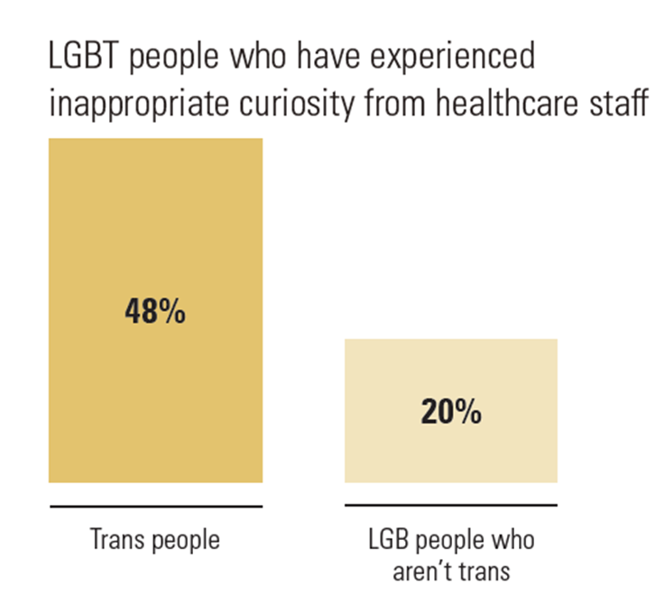
LGBT+ and Health Care
An NHS nurse asked about my recent gender reassignment surgery and then went on to compare me to being a paedophile as if being trans is the same thing. Igor, 32 (East of England)
5% of LGBT people have been pressured to access services to question or change their sexual orientation when accessing healthcare services.
9% of LGBT people aged 18-24, 9% Black, Asian and minority ethnic LGBT people and 8% of LGBT disabled people have been pressured to access services to question or change their sexual orientation when accessing healthcare services.
10% of LGBT people have been outed without consent by staff in front of other staff or patients.
13% LGBT people have experienced some form of unequal treatment from healthcare staff because they’re LGBT.
14% LGBT people have avoided treatment for fear of discrimination because they're LGBT.
(Stonewall, 2018)

Slide 31
19% LGBT people aren’t ‘out’ to any healthcare professional about their sexual orientation when seeking general medical care.
I got sectioned after a suicide attempt and the nurse said that my mental health problems were due to allowing Satan in my soul. If I just accepted my true gender then God could forgive me. Elijah, 19 (South East)
20% of trans people have been pressured to access services to suppress their gender identity when accessing healthcare.
23% LGBT people have witnessed discriminatory or negative remarks by healthcare staff.
27% of trans peoplehave been outed without their consent.
32% of trans people have experienced unequal treatment, including 16% who say this happened in the last year alone.
I have experienced repeated expression of prejudiced attitudes towards me by mental health service providers due to me being trans. …Repeatedly being needlessly outed as trans by NHS professionals to other NHS professionals, despite being transitioned for over 15 years. And repeatedly being asked intrusive and completely irrelevant questions by NHS professionals about my transition and other aspects of being trans. Euan, 39 (Scotland)
48% of trans people and 36% of non-binary people have experienced inappropriate curiosity; 29% of trans people experienced this in the last year alone.
(Stonewall, 2018)

Slide 32
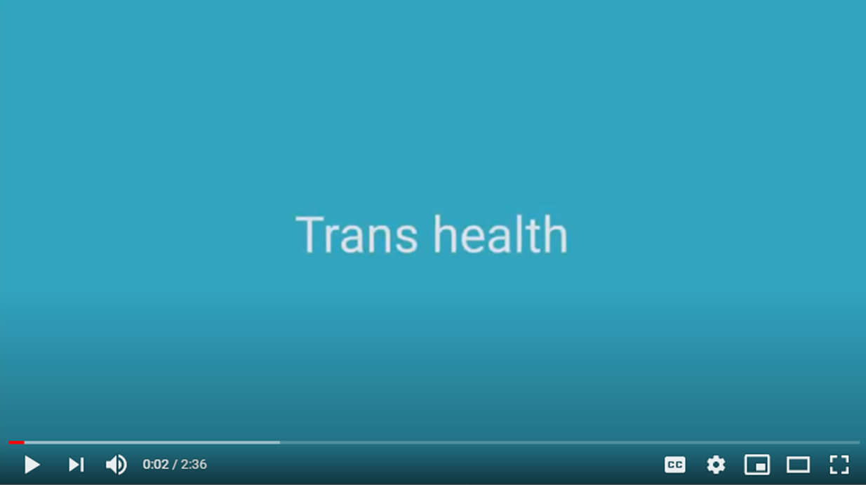
Improving the Health Care Experience for LGBT+ People
Don’t assume. A person’s gender, title or pronouns may not be what you expect. If you’re on the phone, the pitch of voice does not necessarily match their gender. Don’t make assumptions:
Refer to the patient’s medical record or referral form
Check who you are speaking to on the phone
If you are unsure about gender, title or pronouns, don’t guess, ask.
Language matters. Language reveals attitudes. 23% of LGBT+ have experienced or witnessed discriminatory remarks from healthcare professionals. Under the Equality Act 2010, healthcare services have a legal duty to treat LGBT+ people without discrimination.
(General Medical Council, 2018)
Confidentiality and record keeping. Under the Gender Recognition Act (2004), it is a criminal offence to tell people about a person’s previous gender without permission except when made to a health professional for medical purposes. Ask yourself whether their gender is relevant.
Not everything is about gender. It is important you listen to your trans patients and remember that the fact they are trans is not always relevant.
Look out for mental health difficulties. But don’t assume that all difficulties are due to gender or sexuality issues.
(Trans Actual, n.d.)

Slide 33
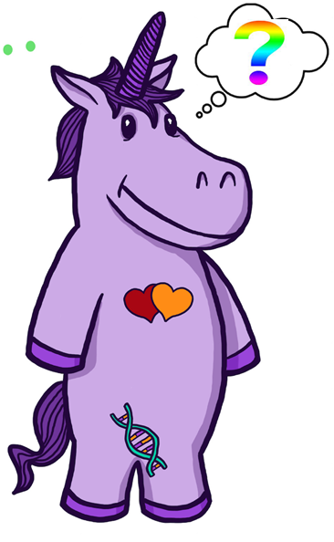
Explaining the pronoun ‘they’
Using the pronoun ‘they’ may seem confusing – it is being used to describe just one person – how can ‘he’ or ‘she’ become ‘they’? After all, they’ve not suddenly become 2 people.
But we do use ‘they’ to describe one person all the time – I did it in the last sentence and it did not sound odd. Generally if we don’t know the person, we substitute ‘him’ or ‘her’ for ‘they.
“They’ve left their phone, they’ll be back when they realise.”
“They’ve dropped their money, I’d better send them a text.”
Some non-binary people don’t feel comfortable with ‘he’ or ‘she’ and therefore substitute this with ‘they’, ‘them’, and ‘their’ in the same way as we have just seen.
Saying “Jacinta left their phone, they’ll be back when they realise” is the same as saying, “They’ve left their phone, they’ll be back when they realise.”
Or “Sam dropped their money, I’d better send them a text” is the same as “They’ve dropped their money, I’d better send them a text.”

Slide 34
Ward based care
The Equality Act (2010) states that a trans person does not need to have had, or be planning, any medical gender reassignment treatment to be protected.
NHS guidance outlines that:
Trans people should be accommodated according to their presentation: the way they dress, and the name and pronouns they currently use.
This may differ from the physical appearance of the chest or genitalia.
It does not depend on their having a gender recognition certificate (GRC) or legal name change.
It applies to toilet and bathing facilities (except, for instance, that preoperative trans people should not share open shower facilities).
The views the trans person’s takes priority over family members.
Non-binary patients should be asked where they would feel most comfortable.
(NHS England & NHS Improvement, 2019, p12-13)

Slide 35
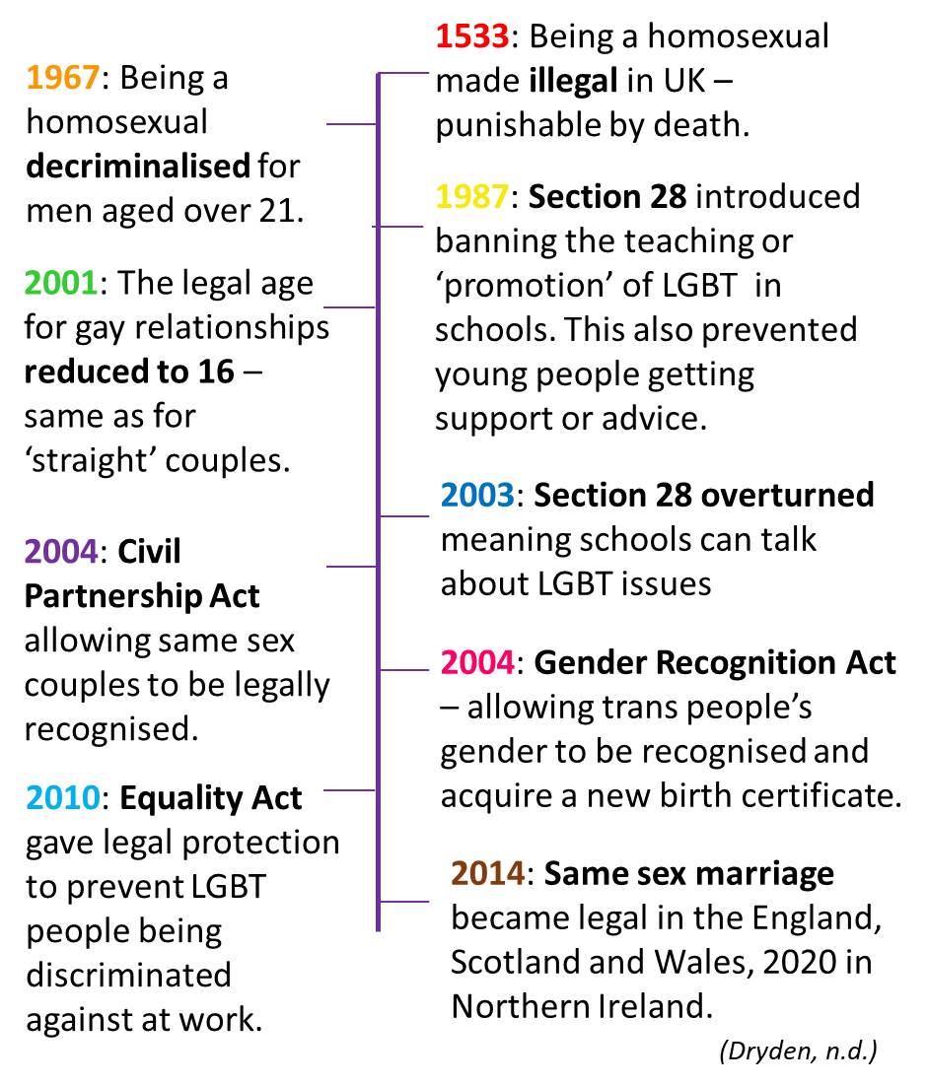
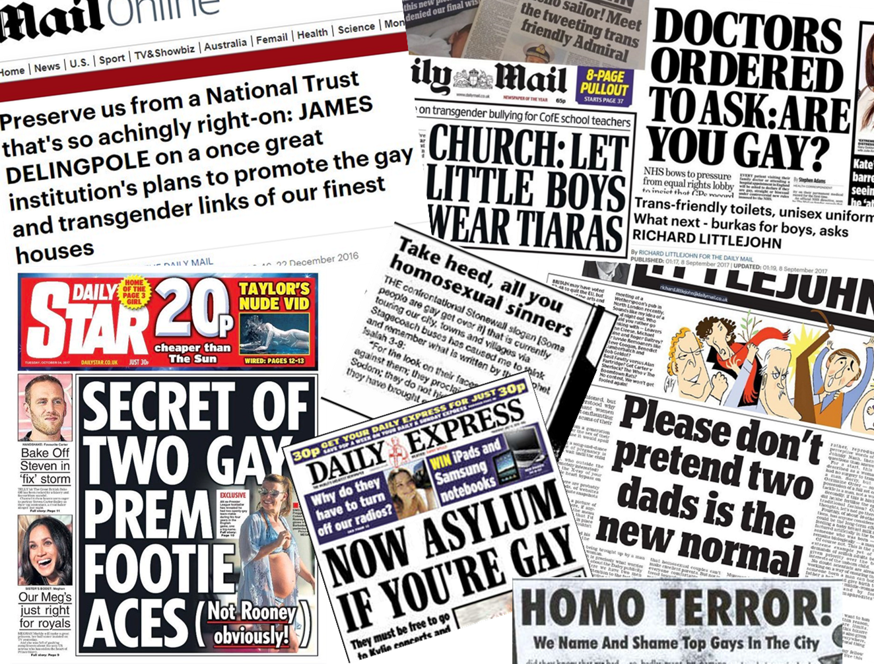
A brief history of LGBT prejudice
When talking about the LGBT+ community, we often think of young people. But what about the older generation – the ones for whom being LGBT meant being made a criminal, those who lost countless friends to AIDS during the 1980s and 90s?
We need to consider the specific health needs of older LGBT+ people for whom old prejudices may have had a lasting impact.
In pairs or groups, use the timeline to list the additional pressures that older LGBT+ people may face.

Slide 36
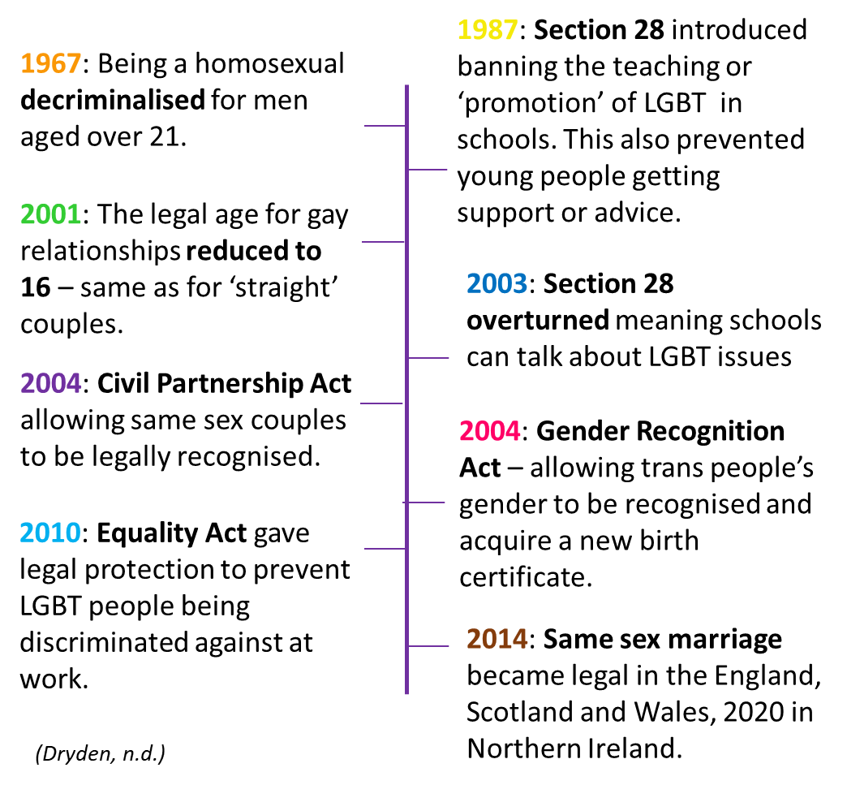
A brief history of prejudice
Exploring LGBT+ issues at school means younger people have better understanding. Older people haven’t had
this education.
The perception was that all homosexuals were deviants & criminals, some of this generation may still hold those prejudices. In a care home, there would be ‘no escape’ if other residents still believed this.
It is likely that a lot of older trans people have only been able to express their gender at home. What will be the impact of going into a care home?
Due to open prejudice, it was normal & legal for LGBT+ people to be sacked if their sexuality was discovered. This means that older LGBT+ people may have fewer savings due to not being able to progress as far in their career.
When a spouse dies, their partner is entitled to part of their pension. What impact will the length of marriage have on the amount of claimable pension?
LGBT+ couples are less likely to have children. This means there is less likely to be family to look after them as they age and a higher probability of going into a care home.

Slide 37
Care for LGBT+ Elders
It is important that we are aware of the specific issues that may effect older people who happen to be LGBT+ especially the potential loneliness and isolation they may face.
Watch the clip and consider the issues raised.
As a healthcare professional, you are not expected to be an expert in everything, however you are expected to know where to signpost people to in order to get the help and support needed.
Take time when back at the office to explore what organisations exist local to you that you could signpost and refer people to.

Slide 38
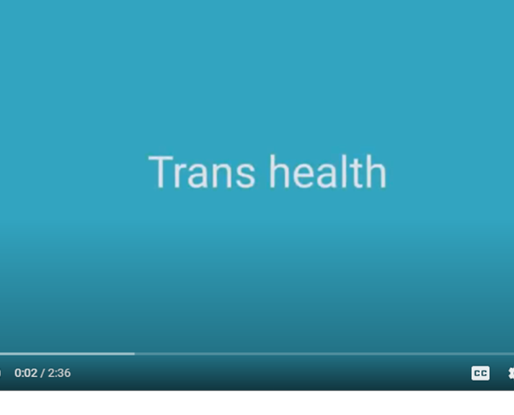
Recap

Slide 39
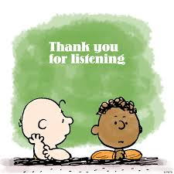

Slide 40
References
Baker, W. (n.d.) Gender neutral cartoon character. Retrieved from https://www.pinterest.co.uk/pin/210191507588941170/
Business Insider. (2014). 26 Sexist Ads Of The 'Mad Men' Era That Companies Wish We'd Forget. Retrieved from https://www.businessinsider.com/26-sexist-ads-of-the-mad-men-era-2014-5?r=US&IR=T
Dryden, S. (n.d.). A short history of LGBT rights in the UK. Retrieved from https://www.bl.uk/lgbtq-histories/articles/a-short-history-of-lgbt-rights-in-the-uk
Education Action Challenge Homophobia UK. (2016). What is gender? Retrieved from https://www.youtube.com/watch?v=qlYtj0sf6ec
Enfield, H. (2008). Women know your limits – BBC comedy. Retrieved from https://www.youtube.com/watch?v=LS37SNYjg8w
Gender Recognition Act 2004: http://www.legislation.gov.uk/ukpga/2004/7
General Medical Council. (2018). Trans Health. Retrieved from https://www.youtube.com/watch?v=jv3Ztrm73FQ&feature=emb_logo
Healthwatch. (2020). Trans healthcare: What can we learn from people’s experiences? Retrieved from https://www.healthwatch.co.uk/blog/2020-03-11/trans-healthcare-what-can-we-learn-people%E2%80%99s-experiences

Slide 41
NHS England & NHS Improvement. (2019). Delivering same-sex accommodation. Retrieved from Delivering_same_sex_accommodation_sep2019.pdf (improvement.nhs.uk)
Office for National Statistics. (2019). What is the difference between sex and gender? Retrieved from https://www.ons.gov.uk/economy/environmentalaccounts/articles/whatisthedifferencebetweensexandgender/2019-02-21
Pan, L., & Moore, A. (2015). The gender unicorn. Retrieved from https://transstudent.org/gender/
Simply Psychology. (2014). Biological theories of gender. Retrieved from https://www.simplypsychology.org/gender-biology.html
Stonewall. (2017). School report. The experiences of lesbian, gay, bi and trans young people in Britain’s schools in 2017. Retrieved from https://www.stonewall.org.uk/system/files/the_school_report_2017.pdf
Stonewall. (2018). LGBT in Britain. Health report. Retrieved from https://www.stonewall.org.uk/system/files/lgbt_in_britain_health.pdf
Trans Actual. (n.d.). Trans health. Trans inclusion. Retrieved from https://www.transactual.org.uk/inclusive-healthcare
Trans Student Educational Resources. (2015). Gender unicorn. Retrieved from https://transstudent.org/gender/

Slide 42
More than just a lanyard: Meeting the needs of LGBT+ patients
Rachel Symons
A two and half hour workshop exploring the experiences and needs of LGBT+ patients.
www.thrivingfutures.co.uk
Part One: Getting to grips with gender
This session explores the importance of addressing the needs of LGBT+ patients, what we mean by the term ‘gender’ and how this differs from ‘sex’. It also demystifies all the confusing terminology around transgender.
Part Two: Responding to the needs of LGBT+ patients
This session examines the experiences some LGBT+ patients have had within healthcare before looking at how services can be improved. The specific needs of older LGBT+ patients are also considered.

Slide 43
Part One: Getting to grips with gender
Most of the patients on your ward identify as cis-male (a person who was born as a male and identifies as a man) or cis-female (a person born as female and identifies as a woman). Some of your patients however will identify as:
Trans-Male
Trans-Female
Non-Binary
This session, is designed to help you understand:
Why it’s important to consider the specific needs of Lesbian, Gay, Bisexual, Transgender and other (LGBT+) patients.
What is meant by the terminology and ‘gender spectrum’.
Changing attitudes to gender.
Rachel Symons

Slide 44
LGBT+ and Mental Health
Before starting, it’s important to think about why we need to explore LGBT+ as a distinct group so that we can better meet their needs. The statistics make for sobering thought.
52% of LGBT people said they’d experienced depression in the last year.
60% of LGBT people who’ve experienced a hate crime based on their sexual orientation and/or gender identity have also experienced depression.
46% trans people have thought about taking their own life in the last year, 31% of LGB people who aren’t trans said the same.
64% LGBT people in lower income households and 48% LGBT people in higher income households experience depression.
(Stonewall, 2017; Stonewall,2018)

Slide 45
41% of non-binary people, 20% of LGBT women and 12% GBT men said they self harmed in the last year.
22% lesbian, gay and bi young people have attempted to take their own life.
61% lesbian, gay and bi young people have self-harmed.
45% trans young people have attempted to take their own life.
16% of LGBT people said they drank alcohol almost every day over the last year.
84% of young trans people have self-harmed.
(Stonewall, 2017; Stonewall,2018)

Slide 46
Terminology:
Trans: Short for trans-gender
Gender non-conforming: a man or woman who does not conform to society’s expectation of that gender, but do not identify as a different gender.
Transgender: a general term elating to a person whose sense of personal identity and gender does not correspond with their birth sex.
Genderqueer: A slang terms for a person who identifies as transgender.
Gender dysphoria: where your gender identity and sex assigned at birth don’t match up which causes distress, especially when looking at your body.
Trans-woman: A person assigned male at birth and who identifies as a girl or woman. Transwomen use the pronouns she/her.
MTF: Male to Female
(EACH UK, 2016)
Trans-male: A person assigned female at birth and who identifies as a boy or man. Transmen use the pronouns he/ him.
FTM: Female to Male
Non-binary: Where someone doesn’t identify as either male or female, where they don’t feel they meet the criteria for either. Non-binary people may use the pronoun ‘they’.
Gender fluid: Some people may feel that their gender isn’t fixed, that they move between male and female and want to express both these sides of themselves at different times.
Click the picture to find out more.

Slide 47
Gender Identity: Regardless of sex at birth – this is about whether you identify as male, female, both or neither.
2 people may identify on the same spectrum but at different levels. E.g. one may present as ultra feminine, whilst another less so.
Gender Expression/ Presentation: This is about how you show your gender identity through clothing, hairstyle, voice, body shape, etc.
(Pan & Moore, 2015).

Slide 48
The difference between sex and gender
The sex of a baby is the first thing someone usually asks when someone has had a baby. Sex is determined by 2 factors:
Chromosomes
The normal human body contains 23 pairs of chromosomes, the 23rd pair determine whether a child is female (XX chromosome, or male (XY chromosomes)
At 6 weeks, the Y chromosomes causes the embryo (developing baby) to develop testes if it is to become a boy.
Hormones
If the embryo is male, testosterone is released to help develop the male genitalia, this also has an impact on the way the brain develops.
During adolescence it is these hormones that are responsible for puberty and the changes in the body that this creates.
(Simply Psychology, 2014)

Slide 49
Gender expectations
Whilst a person’s sex is decided whilst still in the womb, the implications their gender has on a person’s life, is decided by parents and society.
The UK government defines gender as:
“a social construction relating to behaviours and attributes based on labels of masculinity and femininity”
(ONS, 2019)
Gender is based on how society/ culture view the roles of men and women.
Task
Toys are an excellent indicator of society’s expectations of men and women.
The next slide has been split in 2 with ‘boys’ on the top of one half, then ‘girls’ on the other.
You will be shown 2 slides with pictures of toys aimed at boys, then girls. Each slide will be on the screen for 3 minutes.
List the qualities that the toys reveal about what is expected of boys, then girls, e.g. adventurous, logical etc. You may work in pairs/ groups if you wish.

Slide 50
BOY
GIRL
Brave
Outdoors
Adventure…
Caring
Soft
Beauty…

Slide 53
Do we judge men and women differently?
Perhaps one of the most noticeable differences in our expectations of gender, is in our attitudes to violent crime. The news is quick to report on anyone who is thought to have murdered more than one person, but especially so with women, and even more so should their victims be children.
The realities of a killer and the contrast between society’s expectations is greater for a woman than a man, therefore we are more fascinated by them and judge them more harshly.
Joanna Dennehy, mother of 2, brutally murdered three men in Peterborough in just ten days in 2013.
Rose West, together with her husband Fred West, tortured and murdered at least nine young women between 1973 and 1987.
Myra Hindley, together with her partner Ian Brady, raped and murdered five small children between July 1963 and October 1965

Slide 54
Where do our expectations and attitudes come from?
Gender roles are very much about what our society and culture expect.
We’ve already seen how targeted toys still shape boys and girls expectations, but thankfully things do change.
These adverts show how shocking old attitudes are today – what used to be considered ‘normal’ has changed.
(Business Insider, 2014)
Women haven’t changed but attitudes and expectations have.

Slide 55
(Business Insider, 2014)

Slide 56
(Business Insider, 2014)
Harry Enfield summed up the attitude to women perfectly in this comedy clip
(Enfield, 2008)

Slide 57
The Gender Spectrum
In reality we know that not all men are hard & macho, and not all women are gentle & caring. We recognise that people are somewhere on a spectrum between ‘girly girl’ and ‘macho man’.
We tend to view this spectrum as a straight line.

Slide 58
The Gender Spectrum
However, the gender spectrum is problematic as people don’t tend to fit neatly onto it:
Stephanie Houghton is the captain of Manchester City and the England football team.
There is a stereotype that women in sport, especially football, must be lesbian. However, Stephanie is married and has a son.
RuPaul is credited with being the first drag queen to host an American talk show. This shows bravery, changing the way things are done takes courage, something which contravenes the stereotype of men wearing clothes being ‘weird’ and ‘weak’.
Gareth Thomas is the former captain of the Welsh rugby team. He has played 100 test matches for Rugby Union. He led a double life for a sometime, he was married but he knew he was gay. He came out in 2009 whilst he was still playing rugby. He has since revealed he is HIV positive.

Slide 59
The Gender Spectrum
Gender is complex, therefore it is helpful to view it less as a straight line and more of a spider web like the ones shown below. As the examination of toys shows, we assign certain attributes to men and women, boys and girls, some of which are included on the ‘web’ below.
Going by the stereotype the ‘perfect’ boy would look like:
The ‘perfect’ girl would be more like this.

Slide 60
The Gender Spectrum
The reality is we have all these qualities and the amount of each that we reveal or use will vary depending on where we are, who we are with and what we are doing.
Stephanie Houghton
The qualities Stephanie would be expected to show during a match would be very different to those shown at home with her family.
Up until recently, girl’s football was frowned upon – the qualities needed were thought too masculine.
Gareth Thomas
RuPaul
A man in a dress is traditionally frowned upon as ‘weak’ as it’s seen as feminine but think how much strength and courage that must have taken. How independent and assertive would he have had to be to get his ideas approved? All traditionally ‘masculine’ qualities.
Whilst playing rugby, Gareth was displaying all the attributes expected of a ‘man’, this is in total contrast to the stereotypes of gay men.

Slide 61
At work
When alone
What about you?
Task
Think about the qualities you display in different situations.
The hardest situation to think about is probably the one when you’re alone. That is because there are no cultural rules for you to fit into. How do you know how to be?
With friends
With family

Slide 62
The impact of expectations
Sapolsky also discovered that the more uncertain their position in the group, the more cortisol the baboon produced.
As a species we have evolved to be part of a group, in cavemen times our very survival depended on it. Just like in the nature programmes, a lone animal is at greater risk than a pack one.
(Watts, 2009)
“In modern societies survival depends on social acceptance and social status; it is very stressful when these things are at stake.”
(Gerhardt, 2015)
Equally, the lower our position within our social group, the more cortisol we create.
If we don’t naturally fit into a group or are shunned because we don’t meet society’s expectations, then our group position is under threat, creating cortisol.
Excessive and uncontrolled cortisol can lead to anxiety disorders, in part explaining the increased percentage of mental health disorders seen amongst the LGBT+ community.
Attitudes and acceptance have an impact on mental health.
If our position amongst our group is at threat, then that creates stress. Stress creates cortisol.
In 1995, a scientist, Robert Sapolsky, did some work with baboons. He found the higher their status in the group, the lower their cortisol levels and vice versa.
(Gerhardt,2015)

Slide 63
Time to Transgress?
I’d far rather that, than sit alone in her room,
Posting selfies on Insta, for others to approve,
I’d far rather my son, be happy in his skin,
Than be changing himself, trying in vain to fit in.
A hundred years ago, women couldn’t vote,
They all wore long skirts, men controlled when they spoke.
In some countries now, you’re killed if you’re gay,
Girls denied rights to school and to play.
These things, they are wrong and we’re bound to be shocked,
Our culture has changed, what’s now right once was mocked.
In a hundred years’ time, will it still matter d’you think?
If a boy puts on make up or chooses to wear pink?
Should your gender define you whole sense of being?
Should it rule life, limit the future you’re dreaming?
Will the world end, if someone’s different to you?
Or should we transgress, the traditional views?
Transgress [verb]: to go beyond the limits of what is morally, socially, or legally acceptable.
Do you know yet, if it’s a boy or a girl?
What does it matter? Let’s see what unfurls.
But how will you know what colours to use?
Does it really matter, the colours we choose?
What going on? She can’t play with trains!
Why on earth not? She’s created a game.
Boys can’t have dolls, it’s simply not right!
It’s okay, I’ve checked, they’re not real, they won’t bite.
Why are you allowing your boy to wear pink?
Will the world stop, due to colour d’you think?
Too old for a tomboy, it’s time she moved on!
I’m glad she climbs trees and plays out having fun.

Slide 64
Time to Transgress?
The first half of the poem looks at the expectations of girls and boys. Is it more socially acceptable for a girl play with ‘boys’ toys than the other way round? Why is this?
Verse 5 looks at the peer pressure to fit in. What impact does this have on mental health?
The poem contains lots of rhetorical questions (questions designed to make you think). After reading the poem and thinking about the questions, has it challenged your views on gender?
Men trying to stop a woman running a marathon.
Women tennis players wore this at Wimbledon.

Slide 65
Part Two: Responding to the needs of LGBT+ patients
Most people would agree that today’s society has become more accepting or tolerant of LGBT+ issues, gay PRIDE is a spectacle that is often celebrated beyond the LGBT community. So, is there really an issue in healthcare regarding attitudes towards LGBT+ patients, and if there is, what can be done?
This session, is designed to help you understand:
The experiences some LGBT+ patients have had within healthcare.
How to improve services for LGBT+ patients.
The specific needs of older LGBT+ patients.
Rachel Symons

Slide 66
Attitudes towards LGBT+ in Health Care
In 2018, the LGBT+ charity, Stonewall, conducted a survey to reveal the experiences of patients in Britain.
Think about your own trust
What measures exist to make services welcoming to LGBT+ community?
Have you ever witnessed any trans or homophobia in comments said out of hearing of the patient?
Are there any policies to make LGBT+ staff welcome in the trust?
(Stonewall, 2018)

Slide 67
LGBT+ and Health Care
An NHS nurse asked about my recent gender reassignment surgery and then went on to compare me to being a paedophile as if being trans is the same thing. Igor, 32 (East of England)
5% of LGBT people have been pressured to access services to question or change their sexual orientation when accessing healthcare services.
9% of LGBT people aged 18-24, 9% Black, Asian and minority ethnic LGBT people and 8% of LGBT disabled people have been pressured to access services to question or change their sexual orientation when accessing healthcare services.
10% of LGBT people have been outed without consent by staff in front of other staff or patients.
13% LGBT people have experienced some form of unequal treatment from healthcare staff because they’re LGBT.
14% LGBT people have avoided treatment for fear of discrimination because they're LGBT.
(Stonewall, 2018)

Slide 68
19% LGBT people aren’t ‘out’ to any healthcare professional about their sexual orientation when seeking general medical care.
I got sectioned after a suicide attempt and the nurse said that my mental health problems were due to allowing Satan in my soul. If I just accepted my true gender then God could forgive me. Elijah, 19 (South East)
20% of trans people have been pressured to access services to suppress their gender identity when accessing healthcare.
23% LGBT people have witnessed discriminatory or negative remarks by healthcare staff.
27% of trans peoplehave been outed without their consent.
32% of trans people have experienced unequal treatment, including 16% who say this happened in the last year alone.
I have experienced repeated expression of prejudiced attitudes towards me by mental health service providers due to me being trans. …Repeatedly being needlessly outed as trans by NHS professionals to other NHS professionals, despite being transitioned for over 15 years. And repeatedly being asked intrusive and completely irrelevant questions by NHS professionals about my transition and other aspects of being trans. Euan, 39 (Scotland)
48% of trans people and 36% of non-binary people have experienced inappropriate curiosity; 29% of trans people experienced this in the last year alone.
(Stonewall, 2018)

Slide 69
Improving the Health Care Experience for LGBT+ People
Don’t assume. A person’s gender, title or pronouns may not be what you expect. If you’re on the phone, the pitch of voice does not necessarily match their gender. Don’t make assumptions:
Refer to the patient’s medical record or referral form
Check who you are speaking to on the phone
If you are unsure about gender, title or pronouns, don’t guess, ask.
Language matters. Language reveals attitudes. 23% of LGBT+ have experienced or witnessed discriminatory remarks from healthcare professionals. Under the Equality Act 2010, healthcare services have a legal duty to treat LGBT+ people without discrimination.
(General Medical Council, 2018)
Confidentiality and record keeping. Under the Gender Recognition Act (2004), it is a criminal offence to tell people about a person’s previous gender without permission except when made to a health professional for medical purposes. Ask yourself whether their gender is relevant.
Not everything is about gender. It is important you listen to your trans patients and remember that the fact they are trans is not always relevant.
Look out for mental health difficulties. But don’t assume that all difficulties are due to gender or sexuality issues.
(Trans Actual, n.d.)

Slide 70
Explaining the pronoun ‘they’
Using the pronoun ‘they’ may seem confusing – it is being used to describe just one person – how can ‘he’ or ‘she’ become ‘they’? After all, they’ve not suddenly become 2 people.
But we do use ‘they’ to describe one person all the time – I did it in the last sentence and it did not sound odd. Generally if we don’t know the person, we substitute ‘him’ or ‘her’ for ‘they.
“They’ve left their phone, they’ll be back when they realise.”
“They’ve dropped their money, I’d better send them a text.”
Some non-binary people don’t feel comfortable with ‘he’ or ‘she’ and therefore substitute this with ‘they’, ‘them’, and ‘their’ in the same way as we have just seen.
Saying “Jacinta left their phone, they’ll be back when they realise” is the same as saying, “They’ve left their phone, they’ll be back when they realise.”
Or “Sam dropped their money, I’d better send them a text” is the same as “They’ve dropped their money, I’d better send them a text.”

Slide 71
Ward based care
The Equality Act (2010) states that a trans person does not need to have had, or be planning, any medical gender reassignment treatment to be protected.
NHS guidance outlines that:
Trans people should be accommodated according to their presentation: the way they dress, and the name and pronouns they currently use.
This may differ from the physical appearance of the chest or genitalia.
It does not depend on their having a gender recognition certificate (GRC) or legal name change.
It applies to toilet and bathing facilities (except, for instance, that preoperative trans people should not share open shower facilities).
The views the trans person’s takes priority over family members.
Non-binary patients should be asked where they would feel most comfortable.
(NHS England & NHS Improvement, 2019, p12-13)

Slide 72
A brief history of LGBT prejudice
When talking about the LGBT+ community, we often think of young people. But what about the older generation – the ones for whom being LGBT meant being made a criminal, those who lost countless friends to AIDS during the 1980s and 90s?
We need to consider the specific health needs of older LGBT+ people for whom old prejudices may have had a lasting impact.
In pairs or groups, use the timeline to list the additional pressures that older LGBT+ people may face.

Slide 73
Care for LGBT+ Elders
It is important that we are aware of the specific issues that may effect older people who happen to be LGBT+ especially the potential loneliness and isolation they may face.
Watch the clip and consider the issues raised.
As a healthcare professional, you are not expected to be an expert in everything, however you are expected to know where to signpost people to in order to get the help and support needed.
Take time when back at the office to explore what organisations exist local to you that you could signpost and refer people to.

Slide 74
Recap

Slide 76
References
Baker, W. (n.d.) Gender neutral cartoon character. Retrieved from https://www.pinterest.co.uk/pin/210191507588941170/
Business Insider. (2014). 26 Sexist Ads Of The 'Mad Men' Era That Companies Wish We'd Forget. Retrieved from https://www.businessinsider.com/26-sexist-ads-of-the-mad-men-era-2014-5?r=US&IR=T
Dryden, S. (n.d.). A short history of LGBT rights in the UK. Retrieved from https://www.bl.uk/lgbtq-histories/articles/a-short-history-of-lgbt-rights-in-the-uk
Education Action Challenge Homophobia UK. (2016). What is gender? Retrieved from https://www.youtube.com/watch?v=qlYtj0sf6ec
Enfield, H. (2008). Women know your limits – BBC comedy. Retrieved from https://www.youtube.com/watch?v=LS37SNYjg8w
Gender Recognition Act 2004: http://www.legislation.gov.uk/ukpga/2004/7
General Medical Council. (2018). Trans Health. Retrieved from https://www.youtube.com/watch?v=jv3Ztrm73FQ&feature=emb_logo
Healthwatch. (2020). Trans healthcare: What can we learn from people’s experiences? Retrieved from https://www.healthwatch.co.uk/blog/2020-03-11/trans-healthcare-what-can-we-learn-people%E2%80%99s-experiences

Slide 77
NHS England & NHS Improvement. (2019). Delivering same-sex accommodation. Retrieved from Delivering_same_sex_accommodation_sep2019.pdf (improvement.nhs.uk)
Office for National Statistics. (2019). What is the difference between sex and gender? Retrieved from https://www.ons.gov.uk/economy/environmentalaccounts/articles/whatisthedifferencebetweensexandgender/2019-02-21
Pan, L., & Moore, A. (2015). The gender unicorn. Retrieved from https://transstudent.org/gender/
Simply Psychology. (2014). Biological theories of gender. Retrieved from https://www.simplypsychology.org/gender-biology.html
Stonewall. (2017). School report. The experiences of lesbian, gay, bi and trans young people in Britain’s schools in 2017. Retrieved from https://www.stonewall.org.uk/system/files/the_school_report_2017.pdf
Stonewall. (2018). LGBT in Britain. Health report. Retrieved from https://www.stonewall.org.uk/system/files/lgbt_in_britain_health.pdf
Trans Actual. (n.d.). Trans health. Trans inclusion. Retrieved from https://www.transactual.org.uk/inclusive-healthcare
Trans Student Educational Resources. (2015). Gender unicorn. Retrieved from https://transstudent.org/gender/

