Slide 1
[Enter Name]
[Enter Job Title]
[Add Logos]

Slide 2
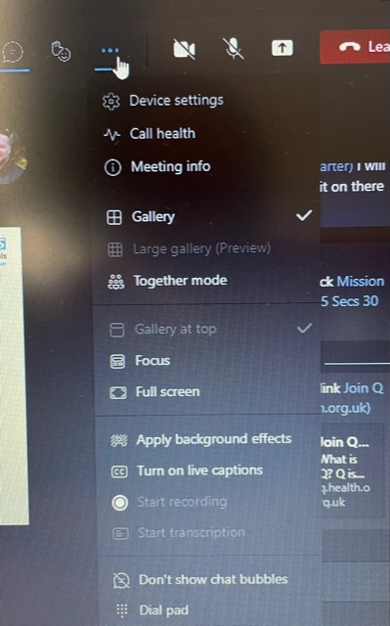
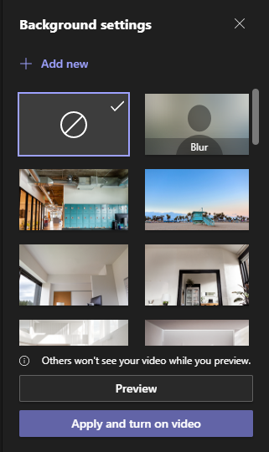
Instructions How to add to MS Teams
Enter your details on slide 1
Add your organisation logos
Save slide 1 only as a Jpeg file
Upload to MS Team
Share with colleagues…
‘Everyone on your call will now
who you are, what you do and
who you work with.’

