Slide 1
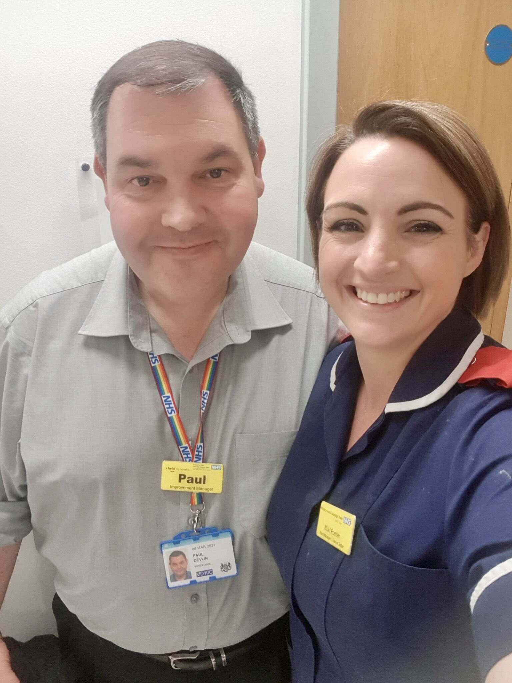
NHS Kindness & Positivity
Paul Devlin
Emergency Care improvement support team NHS ENGLAND
Nicki Pointer
Clinical Site Manager Maidstone and Tunbridge Wells NHS Trust

Slide 2
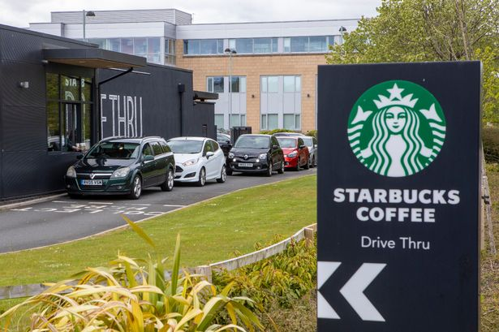
Kindness Is Contagious!
Kindness is, quite literally, contagious. Studies have found that this natural high makes people want to behave more altruistically towards other people.
One morning, a person in the drive-thru kindly paid for the next driver’s coffee along with their own order.
The next driver continued the gesture and so on. This act of kindness was repeated for over 2.5 hours (circa 150 cars).

Slide 3
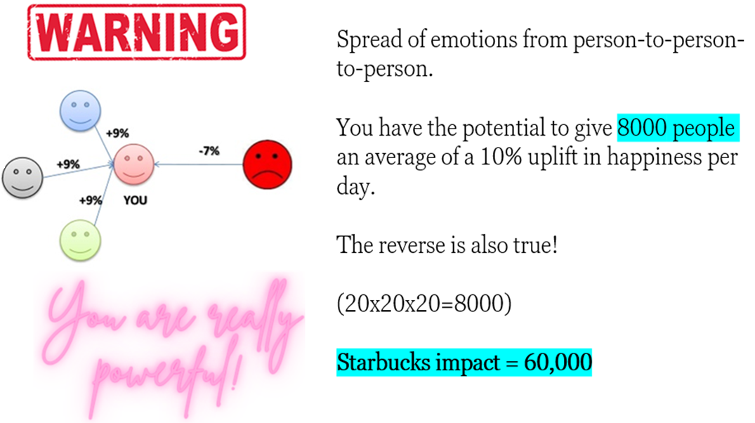
Hyper-Dyadic Spread

Slide 4
Experience Life From Inside-Out
Thought is not reality; yet it’s through thought that our realities are created.
All feelings become alive, whether negative or positive, from the power of thought. (Sydney Banks)
Knowing that your feelings come from the inside (your thinking), and not the outside (your circumstances), is what allows your state of mind to self-correct when you are troubled.

Slide 5
The Science & Power of Kindness
Makes you feel good (serotonin)
Builds positivity & self confidence
Creates high self esteem
Increases motivation & inspires action
Leads to goal achievement & success
For you & others!

Slide 6
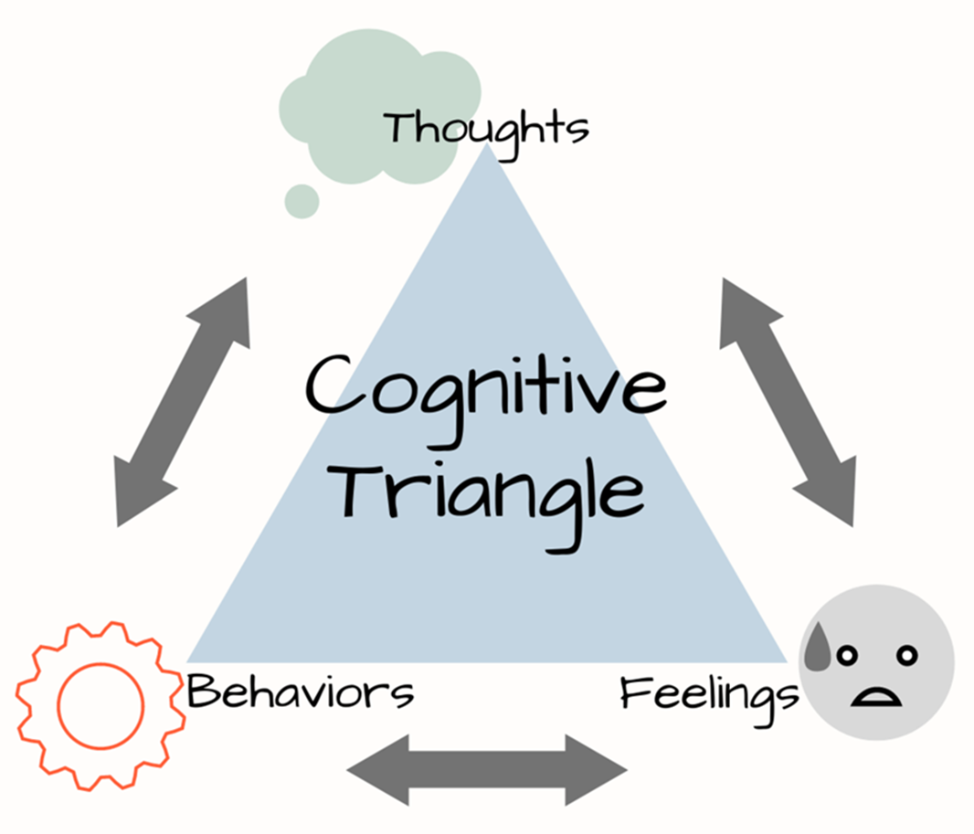
When we change the input to our minds, we change the output into our lives (Zig Ziglar)

Slide 7
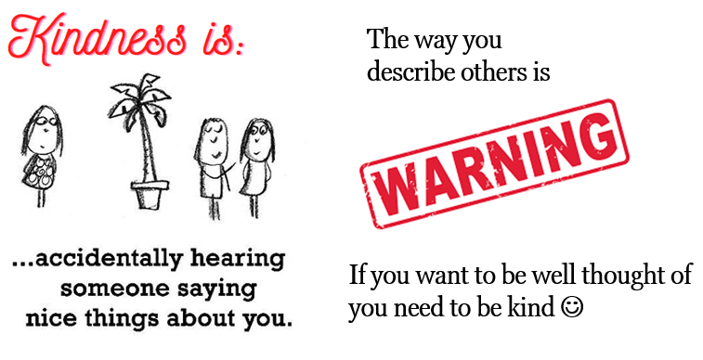
Spontaneous Trait Transference
The way you describe others is the way people see you.

Slide 8
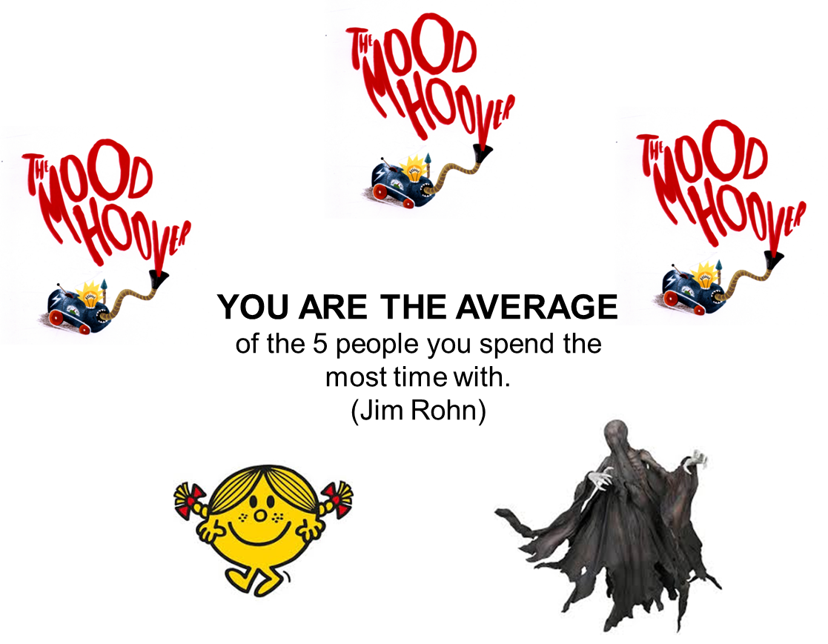

Slide 9
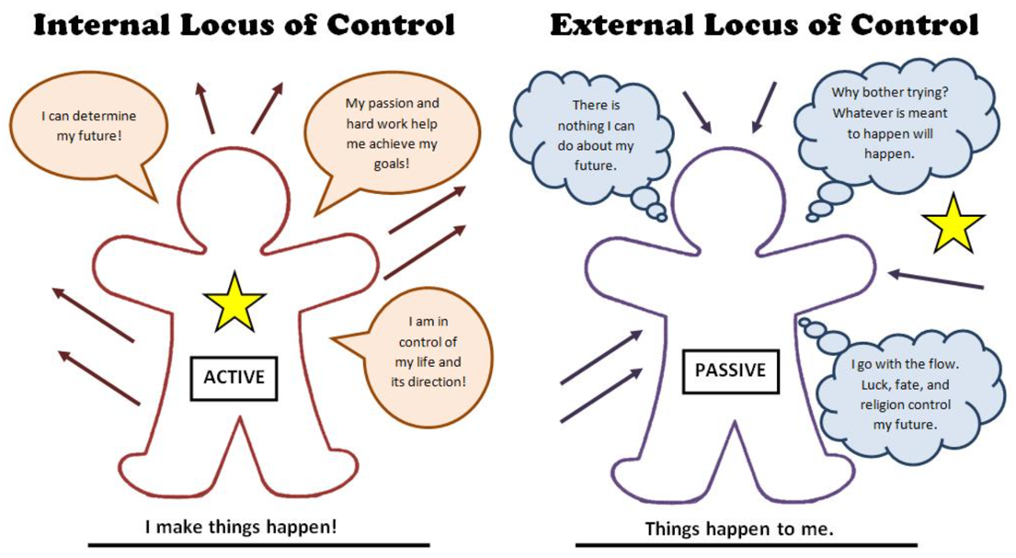
Kindness starts with you!
5 Top Tips
Kindness starts with you.
Take control of your own destiny.
Commit to being the best possible version of yourself and go for your potential.
Surround yourself with people who value you and will help you be successful.
Get a random act of kindness in as early as possible
Do at least one thing that moves you forward with a key personal goal
Do at least one thing that moves you forward with a key professional goal
Reflect and be grateful for one thing in your life
Do at least one act of kindness for yourself

Slide 10
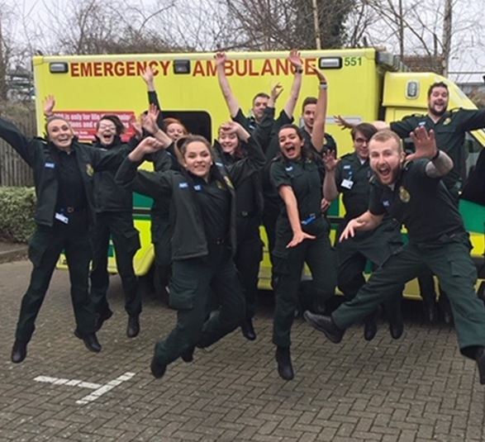
NHS Great Place to Work

Slide 11
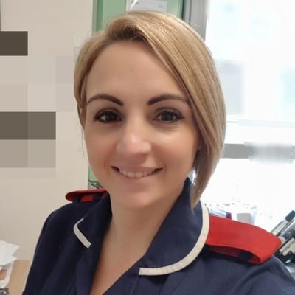
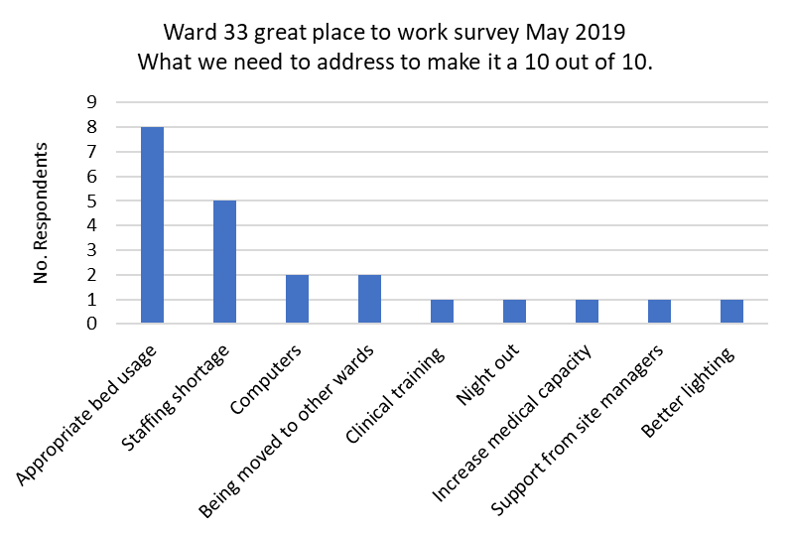
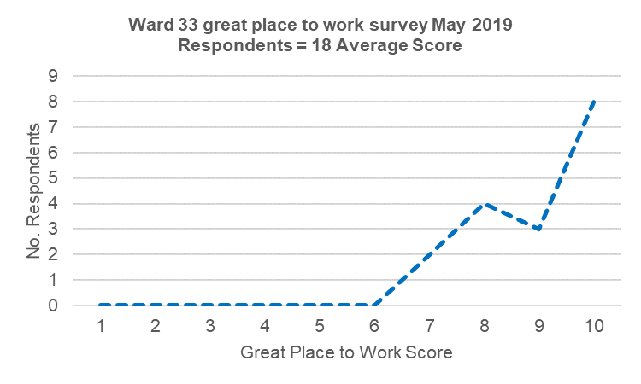
Ward 33 Great Place to Work Survey – May 2019
We believe that every patient deserves the quality
of care that we would expect for ourselves and our family.
We are committed to creating a positive and supportive environment where we genuinely look forward to coming to work, enjoy what we do, and can perform at our best.
Nicki Pointer Ward Manager
MTW lead for NHS great place to work national programme.
Action Plan – June & July 2019:
Work with site management to help protect our beds for patients that need them most
Review our skill mix and progress with filling vacancies
Work with IT to speed up our computers

Slide 12
Great Place to Work Survey

