Slide 1
Integral Response An Integral Approach to Prevention of Admission
Date: November 2019
Presented By: Richard C Anderson
WE WORK TOGETHER
HOME. COMMUNITY. HOSPITAL

Slide 2
Why integral?
integral
[in-ti-gruhl, in-teg-ruhl]
adjective
1. of, relating to, or belonging as a part of the whole; constituent or component:
integral parts.
2. necessary to the completeness of the whole:
This point is integral to his plan.
3. consisting or composed of parts that together constitute a whole.
WE WORK TOGETHER
HOME. COMMUNITY. HOSPITAL
Notes:
We’re developing a system that acts like an ecosystem.

Slide 3
Overview of ‘cluster’
Integrated Health and Social Care
Community Services Manager: Systems Leadership
Working together with GPs, acute hospital, voluntary and community services, LED etc
Enabling people to stay safe and well at home
Preventing admission to acute hospital
Expediting safe discharge back home
NETWORKED ECOSYSTEM OF CARE
WE WORK TOGETHER
HOME. COMMUNITY. HOSPITAL
Notes:
The overall goal for the health and social care community is to ensure that:
those people that can be treated or supported at home should be
those people who can be treated in their community (hospital) should be
inappropriate admissions to any part of the system should be avoided
discharges from any part of the system should be expedited
i.e. right care, right place, right time, and as close to home as possible.
The health and social care system within which these goals are delivered is in balance when it is:
effectively functioning as a single unit
no part of the system is functioning to optimise its own outcomes at the expense of others
no part of the system is interrupting the flow of people around the system

Slide 4
The 7 Ps
People - recruit well
Positivity - Develop the right culture
Prevention - Switch the tap off
Place-based
Pro-active
Process
Personnel
WE WORK TOGETHER
HOME. COMMUNITY. HOSPITAL

Slide 5
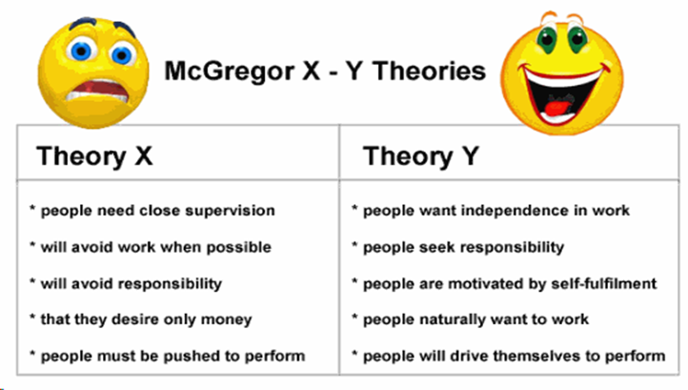
People
Recruit well – positivity, EQ, team working
Theory Y, not theory X
Once recruited, develop competencies (e.g. Band 6 educator/clinical supervisor to Urgent Care Response workers + Care Homes)
Recruit people with a natural tendency towards positivity, team working, building generative relationships and networking
WE WORK TOGETHER
HOME. COMMUNITY. HOSPITAL
Notes:
On the wider point of “team culture”, Omar Chaudhuri, head of football intelligence at the consultancy 21st Club, has a theory. “Smarter clubs in general are beginning to think a lot more around culture and identity - taking a lead from the corporate world,” Chaudhuri said. “This means thinking more about what the club 'stands for', and working back from that, rather than simply building a team through individual pieces.

Slide 6
Positivity
3 Principles:
Be the person Be the service Be happy
Resulting in:
Autonomy and Empowerment: Freedom within a Framework
Pursuing Perfection:
Right Place, Right Time, Right Treatment
Centralised intent, decentralised implementation
Freedom, speed of action and initiative
Less asking for permission
Support and coaching, not management
BOTH SOPs and policies AND principles and expansive rules
Monitor outcome, not production
Strong team spirit
Maximise efficiency, reduce costs
WE WORK TOGETHER
HOME. COMMUNITY. HOSPITAL

Slide 7
Prevention: Switch off the tap
Band 7 matrons in every town
Wellbeing Sidmouth/Seaton/Axminster
Long-term approach: Ways to Wellbeing – Health coaches linked with H&SC Teams and GP Practices (Social Prescribing)
Close GP communications: SystmOne
Band 6 Rehab Nurses & strength and balance group
Dementia Matron and Admiral Nurse
PREVENTION OF UNNECCESSARY
HOPSITAL ADMISSIONS
WE WORK TOGETHER
HOME. COMMUNITY. HOSPITAL

Slide 8
Place-Based
Place-based (town) holarchic:
Holons are self-reliant units that possess a degree of independence and can handle contingencies without asking higher authorities for instructions. i.e. they have a degree of autonomy
Each town has the same integrated health and social care structure, and is a self-contained unit
Peripatetic capacity across cluster
Weekly Wellbeing (Sidmouth/Seaton/Axminster)
Daily MDT
Voluntary Sector Rep from Place-based Voluntary/Community Services Groups
Close links to other organisations e.g. LED
Place-based Urgent Care Response Rota
WE WORK TOGETHER
HOME. COMMUNITY. HOSPITAL
Notes:
A Holon is something that is simultaneously a whole and a part. Do seeds contain trees or do trees contain seeds? We could say both are true, because 'trees and seeds' is an example of a holon.
The best networks are organic, natural ones

Slide 9
Pro-Active
Associate Community Matrons (ACMs) attend GP Practices 10:00 am to prevent pm crises/case-finding
ACMs case-find in the acute – attend in person
Supported by vertically and horizontally integrated systems:
Patient Transfer System (community full read-write access to acute system)
GP SystmOne
ComPAS
WE WORK TOGETHER
HOME. COMMUNITY. HOSPITAL
Notes:
Assertive
Pro-active
Networking between:
Community and Primary Care
Community and Acute Provision

Slide 10
Process: 5 Simple Rules
Each component of the system follows 5 simple ‘holarchic’ rules, e.g:
Left/Right or Up/Down: If optimal flow cannot be achieved, use an alternative route or escalate. Escalation routes are always pre-determined. Don’t sit on a delay, or palm it off onto somebody else via the PTS; as soon as a delay is recognised, go left, right (to alternative colleagues or teams) or up (i.e. escalate).
3Bs: Always have a back-up/buddy/plan B (Redundant systems)
Parallel Thinking and Operations (not series/determinant)
One to One: No system-based or e-mail hand-offs. When patients are being transferred from one team to another, both teams will have a lead worker who agree the plan. i.e. one-to-one, not many-to-many communication. People are capable of processing more than one thing at once, so parallel, not series steps.
Subsidiarity: responsibility and power lies as close to the patient as possible unless it has to be escalated. This promulgates empowerment, flexibility and adaptability. Increasing iterations lead to an endless cycle of organisational learning. The generative relationships within the system act like new synapses within a neuron network.
Feedback loops are built into systems of communication. E.g. place-based staff member checks in with acute and primary care to confirm optimal transfer/reduce readmission.
WE WORK TOGETHER
HOME. COMMUNITY. HOSPITAL
Notes:
Networking shapes and patterns
Social Care:
Don’t break the law
Don’t break the bank
Start with assets
Balance happiness and safety
All patients on PTS will have acute-based and place-based named professionals, regardless of status (including ‘reds’)
UCR/SCR to work as virtual team until merged
Tipping points, not baseline
Same day or next day is the default
Ask the questions:
a) ‘would the system self-replicate and remain stable in the absence of a system manager?’
b) whilst optimising the system, reflect if the entire system is ‘phase-locked’? i.e. are all parts of the system matched in capacity , responsiveness and culture? If not, modify the simple component rules, or educate and inform.
Designing Rules:
Determine the objective
Find the bottleneck: what’s really keeping you from the objective
Craft the rules: expert advice, own experience

Slide 11
Personnel
Band 7 oversight of entire Urgent Care Response system
Band 6 ACMs in each town
Band 6 Therapists in each town
Band 6 Clinical Educator for cluster
Band 4 Assistant Practitioner in each town
Co-ordinator in each town
Place-based UCR manager + rota management
Place-based UCR Support Workers
Social Care Assessor embedded with UCR team
CAPACITY CAPABILITY FLEXIBILITY
WE WORK TOGETHER
HOME. COMMUNITY. HOSPITAL
Notes:
Fostering Generative Relationships

Slide 12
Outcomes
Eastern Devon has one of the lowest Standardised Admission Ratios in the country at 76.
Seaton, Axminster and Sidmouth Cluster (SAS) has the lowest Standardised Admission Ratio in Devon (Axe Valley PCN = 64)
SAS has the fewest patients waiting for discharge from the RD&E for the shortest length of time. Median wait for discharge 1.8 days
Works much better than Home First. Safer, faster, fewer readmissions
BETTER DIFFERENT COURAGE
WE WORK TOGETHER
HOME. COMMUNITY. HOSPITAL

