Slide 1
Implementation of Electronic Prescribing in Outpatient Clinics and the Adult Emergency Department
Joseph Grayson (Lead EPMA Pharmacy Technician) and Chandni Khanderia (Lead EPMA Pharmacist)
Whittington Health

Slide 2
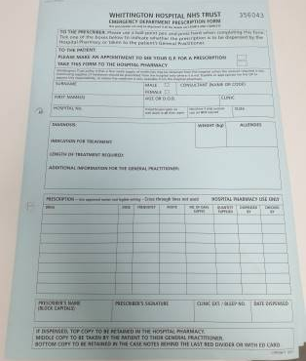
Problem
Outpatient clinics and the emergency departments use paper prescriptions

Slide 3
Aim
To switch all outpatient clinics and the Emergency Departments to electronic prescribing by October 2020

Slide 4
Plan
Decision made to stop using paper outpatient prescriptions due to infection control.
Planned which clinics required training and contacted consultant leads.
Advertised the cessation of paper outpatient prescription supply.
Organised training sessions.
Provided face to face training and remote training for those working from home.
We used a quality improvement methodology to conduct this.

Slide 5
I love the electronic system
Benefits
This is safer during the pandemic, as patients can arrange collection from home and will not need to spend time queuing and waiting for prescriptions, or use paper touched by multiple people.
Increase adherence to the medicines formulary
Reduce the likelihood of prescribing errors
Provide clear legible prescriptions in patient records
Make it easier to audit and report the use of medicines
Electronic prescribing is more secure as prescriptions cannot be forged
Reduced costs as no longer need to order controlled stationary
It has allowed me to prescribe virtually
I can’t believe we didn’t implement the system earlier
I don’t need to come into the hospital to collect my medications

Slide 6
Measures

Slide 7
Measures

Slide 8
Measures
Over 200 staff members trained.
Reduction in prescriptions needing clinical interventions from 5.6% to 3.4%.
77% of trust outpatient prescriptions are now completed on JAC, compared to 30% previously.

Slide 9
Resources & team
Two staff members and a training room which allowed for social distancing. The biggest factor was the attitude for adoption which was extremely positive during Covid-19.
The Chief Pharmacist was involved in making the change, together with the electronic prescribing and medicines administration team. A questionnaire was conducted with patient’s who received the remote outpatient service and their response was very positive as it meant patient’s did not need to attend the hospital to obtain their medications.
The team had previous experience of rolling out electronic prescribing to a variety of areas including the Emergency Department in other organisations, this assisted with the scoping and roll-out to Outpatient clinics and the Emergency Department at Whittington Health.

Slide 10
Learning
An e-learning training module would speed up roll out (particularly for off-site areas).
Learnt how to manage fast paced roll-out in multiple areas at the same time.
If this was repeated, we would ensure that all the information documented on a paper prescription could be documented electronically such as the prescribers contact number as pharmacy have experienced some difficulties in contacting prescribers for queries.
We would use the same platforms for advertising everywhere, maintain strong stakeholder engagement, distribute quick guides to everyone continue virtual training sessions.
All Trusts who are currently using paper outpatient prescriptions can benefit from this work.
Advice for other Trusts would be to use the current climate to make change happen.

Slide 11
Questions
Joseph Grayson and Chandni Khanderia
whh-tr.epma@nhs.net
URLs for the images:
https://flickr.com/photos/lumaxart/2137737248
https://favpng.com/png_view/electronic-prescribing-medical-prescription-electronic-health-record-patient-pharmacist-png/CE0juz7g
https://recordsmanagement.tab.com/document-imaging/how-to-plan-your-imaging-project-part-2-backfile-conversion-workflow-and-indexing/

