Slide 1
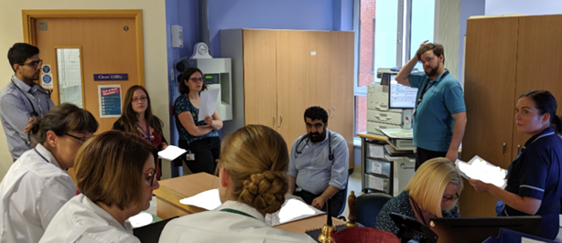
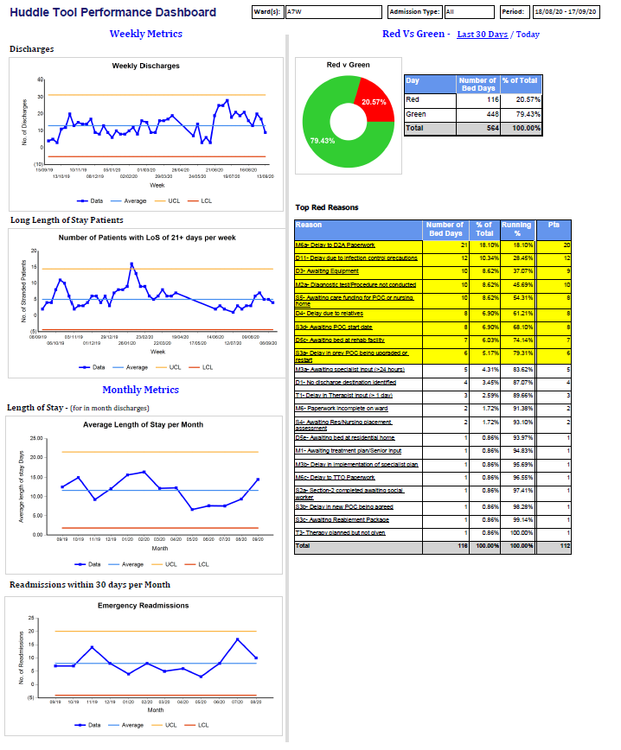
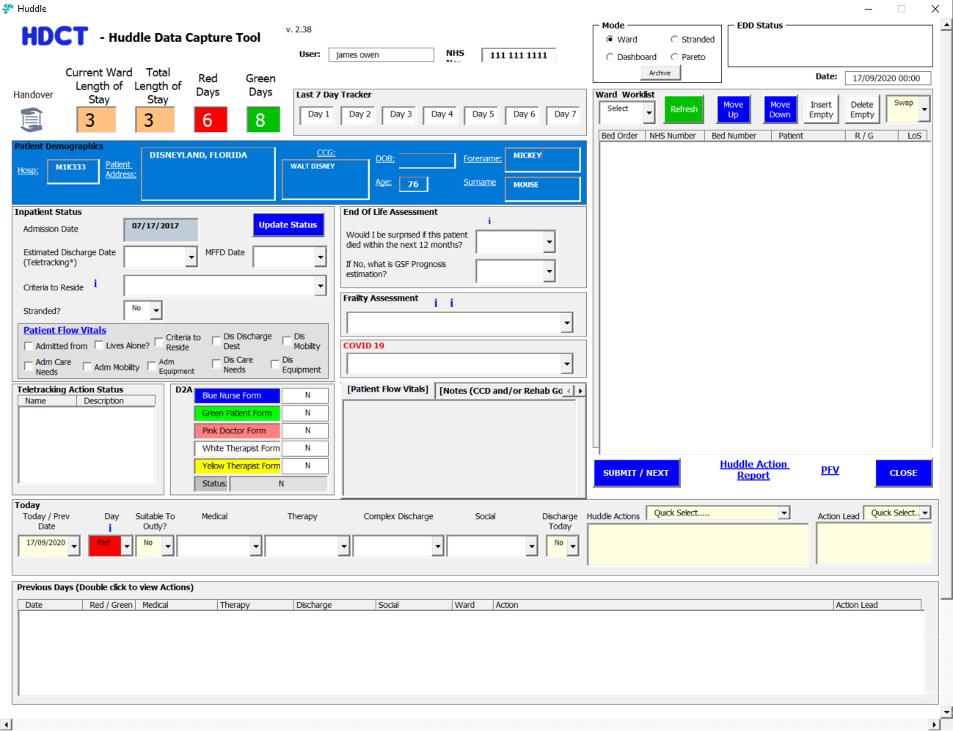
Huddle Data Collection Tool (HDCT)
James Owen, Vijay Klaire, Prof Baldev M Singh and Dr Lee Dowson
Abstract: The Trust has designed and implemented a Huddle Data Collection tool to collect #Red2Green data to review patient flow constraints in the Trust. The tool is in use across the rehabilitation, medical and orthopaedic wards. The tool also collects information regarding frailty and end of life assessments. The tool is being used to inform the Trust of constraints to patient flow and is helping decide improvement projects.
Plan
The trust had tried multiple systems to collect Red2Green data* but found methods involving the input on excel sheets quite difficult to use.
The Trust undertook a trial of using a simple database to record constraints on our rehabilitation wards, and used this information to drive improvement in Length of Stay.
After this successful pilot, the Trust decided to design a system which pulled demographic and other flow metrics into one place. This enables users to review information ‘live’ during ‘huddles’** and make better decisions on actions to progress patient care.
Do
The tool was designed in collaboration with clinical teams, patient flow staff and developers in the Trust. Over a number of months the tool was developed into a system that could be used ‘live’ during the huddles to record constraints.
The data items that are collected each day include
Red / Green status
Actions from the huddle
Delay reasons
Between October 2019 and January 2020 the tool was implemented across all of our rehab, medical and Orthopaedic wards. The team created a video*** to educate staff members on the tool and help in implementation.
Figure 1 shows a screenshot of the tool.
Figure 1 HDCT Screenshot (data entry screen
The team also worked with the Frailty and Palliative Care Teams to incorporate the Frailty ‘Rockwood Score’ for patients, the ‘Surprise Question’ and GSF score so these data are discussed and recorded at huddle.
Fig. 2 HDCT in use
Study
When information is entered into the tool users can access an actions report for use after the huddle. This report is used to communicate actions the team have decided during the huddle, immediately after the huddle. Data can also be reviewed to look at the main constraints in the system so improvement work can be focused on the areas that are the biggest issue at a ward/directorate/division/Trust level. Figure 3 is an example of the HDCT Dashboard
The Palliative Care and Frailty Teams also use the clinical data in the tool to identify inpatients for interventions.
Figure 3 HDCT Dashboard
Act
The Trust it now using the tool to report constraints at an executive level. This will inform quality improvement projects going forwards relating to patient flow. We have also recently incorporated the new ‘criteria to reside’ return fields into the tool to satisfy this national requirement. For more information on the tool, please contact James.Owen@nhs.net
*https://improvement.nhs.uk/improvement-offers/red2green-campaign/ ** https://www.youtube.com/watch?v=SNxIxAugiFU&feature=youtu.be
*** https://www.youtube.com/watch?v=HgYKd3veLK0&feature=youtu.be

