Slide 1
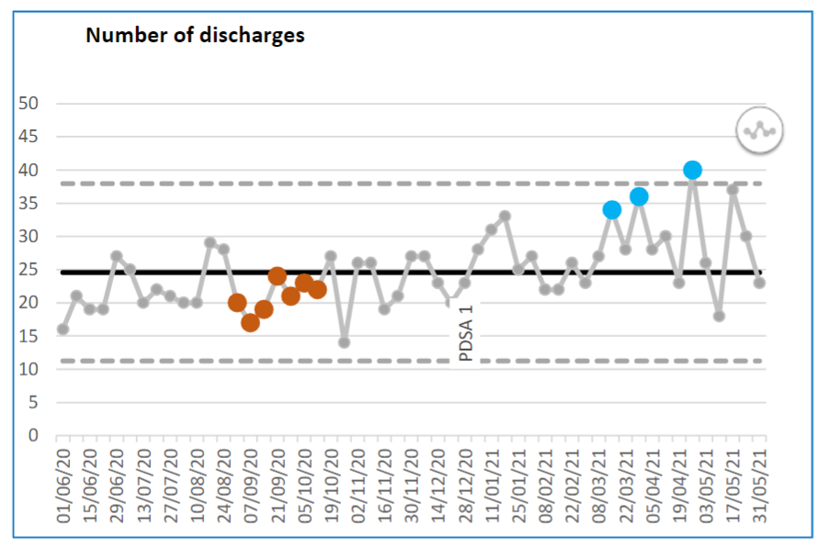
Improving patient care and effective discharge planning by introduction of an additional Senior Trainee on the ward team structure (Retrospective QIP)
Dr Harsh Khatri, Dr Shivangi Dwivedi, Dr Harit Buch, Dr Rajeev Raghavan
Abstract:
A majority of NHS Trusts are under pressure due to a shortage of available beds with implications on patient flow, elective operations and acute services. This situation usually reaches a crisis point during the winter months. During the past year, the COVID-19 pandemic further highlighted the impact of delayed discharges on bed shortage and had significant adverse implications on patient care, patient flow and delivering clinical services. During this period, the Trust learnt essential lessons and brought about several reforms e.g. radical enhancement of OOH medical services.
In our directorate of Endocrinology and Diabetes, we have reviewed our discharge process to identify barriers to timely discharge. We found that the following factors were significant contributors (a) delay in communication within the discharge MDT and with care homes and families, (b) execution of completed discharge plans and (c) delay in non-urgent decisions in medically active patients by a senior clinician.
The directorate had implemented a new system in which a senior trainee is added to the ward team for the entire day, with the primary objective being to address the above-mentioned factors. This QIP aimed to assess the impact of this new system on patient care and discharge rates.
Plan
Introduction of an additional ward cover led by a senior trainee to improve patient care, patient safety, junior doctor support and effective discharge planning.
The trainee would be supported by a consultant and would in turn support the junior team and nursing colleagues.
SMART Aim
The aim then would be to measure at the end of three months
Study period 1/3/2021 to 1/6/2021
1.Improvement in the discharge rates during a fixed time frame
2.Improvement in patient care and patient safety
3.Impact of additional huddles and earlier non-urgent clinical decisions
4.Improved training and support
Do
1. Introduction of an additional ward cover led by a senior trainee
2. Introduction of additional huddles to help effective discharge planning
Study
Discharge rates
The weekly discharge rate from C16 ward increased from 27.43 to 34.28 after the intervention which can be seen in the illustration below.
2. Readmission rates
(Balancing measure – readmission within 30 days of discharge date))
Total 13 readmissions with a readmission rate of 3.61% which is remarkably low.
3. Multiple Choice Questionnaire (Survey Monkey) for consultants, senior nurses and junior doctors
The survey concluded that the ward team felt additional huddles helped to make discharge process more effective. In addition to that, presence of a senior trainee on the ward helped to improve patient care and safety with earlier resolution of clinical issues. It also helped improve training and education of Junior Doctors and nursing colleagues.
Act
Implement formal huddle education among senior trainees and assess its impact on discharge rates and safe discharge rates (readmission rate) for PDSA cycle 2
References
Survey Monkey link : https://www.surveymonkey.co.uk/r/3MCHFKC

