Slide 1
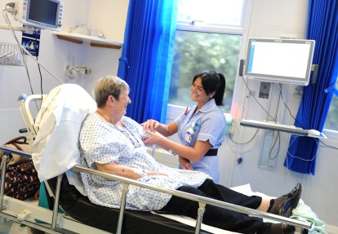
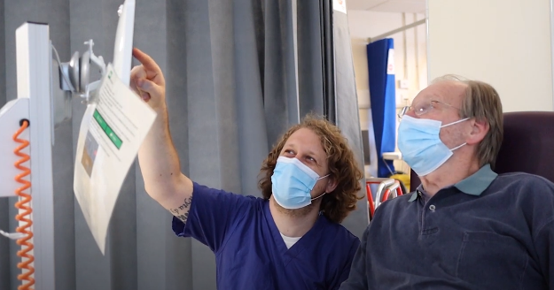
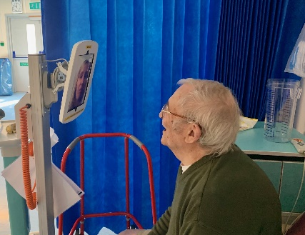
Digitising patient services initiative
Keeping in Touch
The Keeping in Touch service
Supporting evidence for HSJ

Slide 2
Outcome (supporting evidence)
Please find below the link to the Keeping in Touch website where relatives can request a video call with a loved one. There are also ‘How to’ PDF guides available online and a short video explaining how the service works
https://www.wsh.nhs.uk/Coronavirus/Keeping-in-touch.aspx

Slide 3
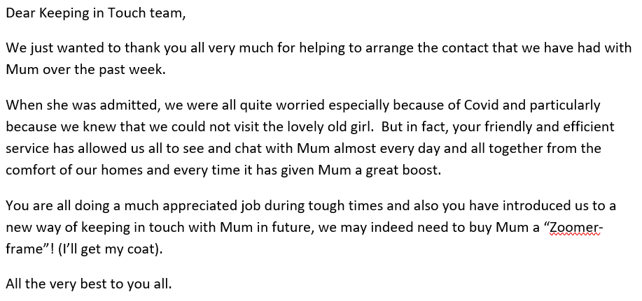
Value (supporting evidence)

Slide 4
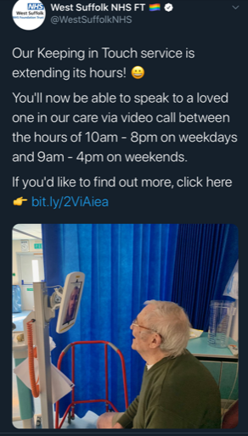
Involvement (supporting evidence)

