Slide 1
How We Made Data Count!
The development of a one-stop web portal to integrated information and intelligence across performance, quality, workforce, and finance.

Slide 2
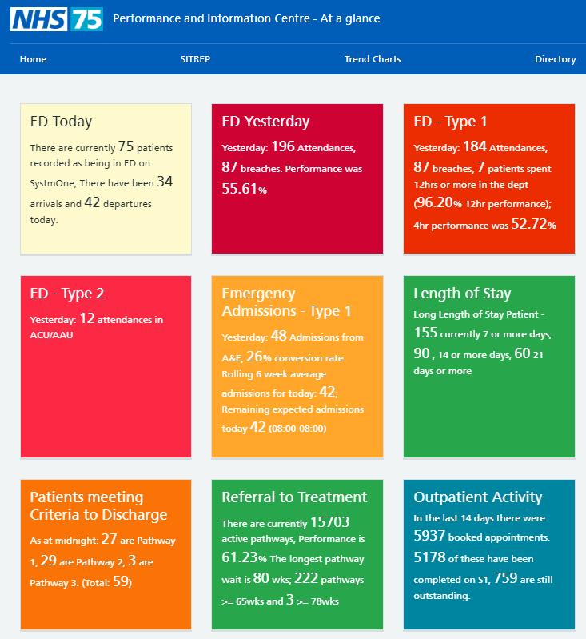
At a glance Our front door and 5 minute briefing to get an overview of key operational, performance and quality measures

Slide 3
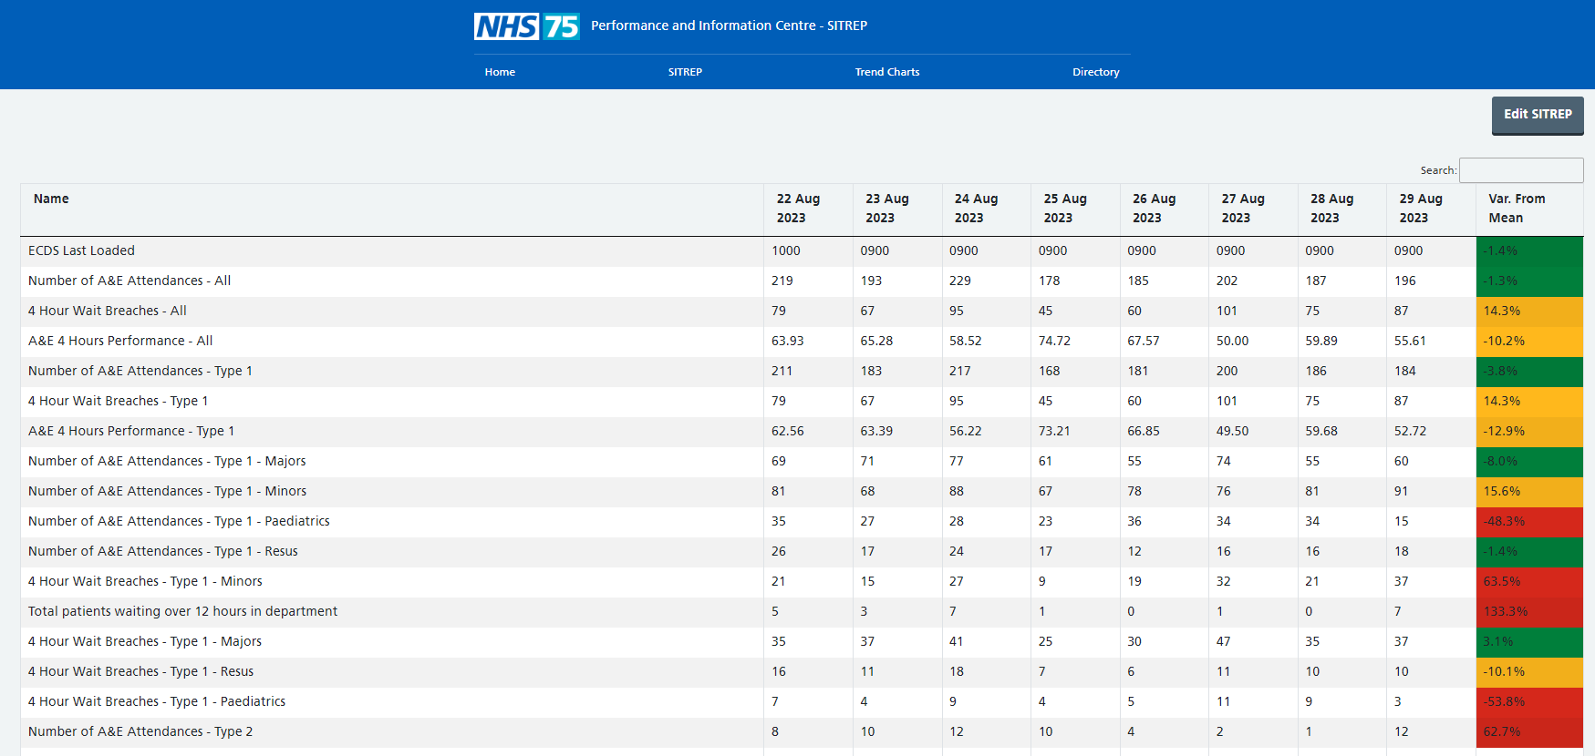
SITREP Manager Data to support and report as part of the daily Urgent + Emergency Care SITREP

Slide 4
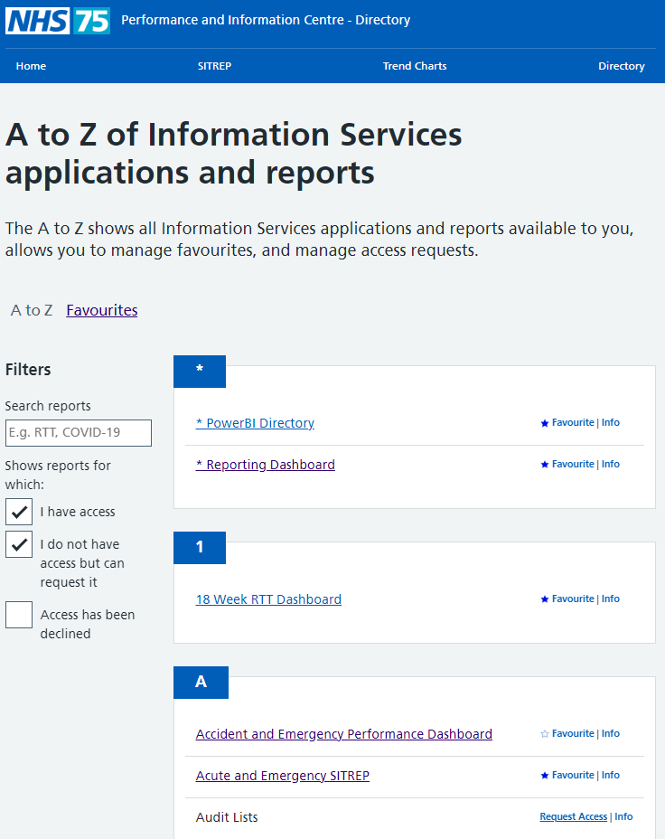
Directory All reporting links and shortcuts in a single place

Slide 5
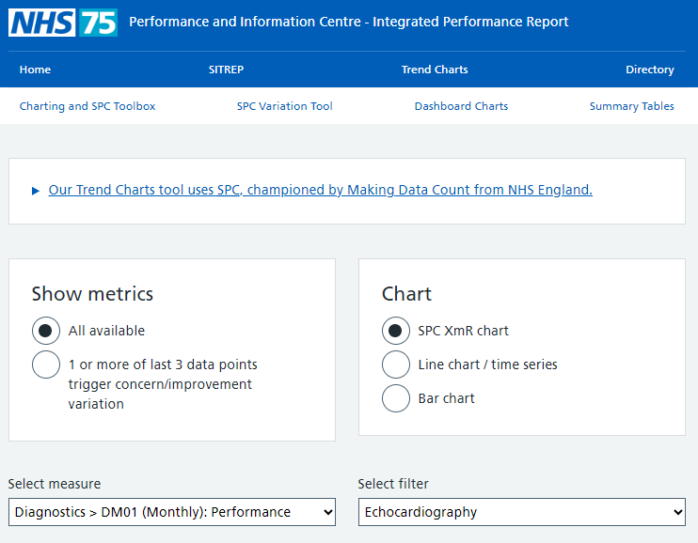
Trend Charts Our Making Data Count repository and heart of the Performance and Information Centre

Slide 6
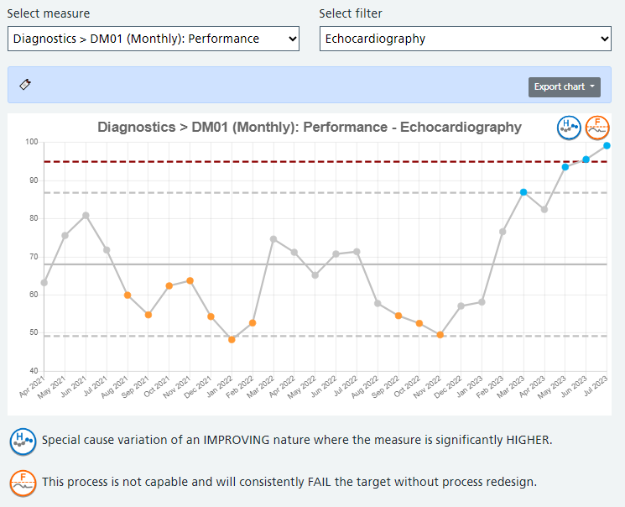
Trend Charts Any measure can be viewed using Making Data Count principles simply and quickly.
This includes variation and assurance icons to help interpret and understand what the data is saying.

Slide 7
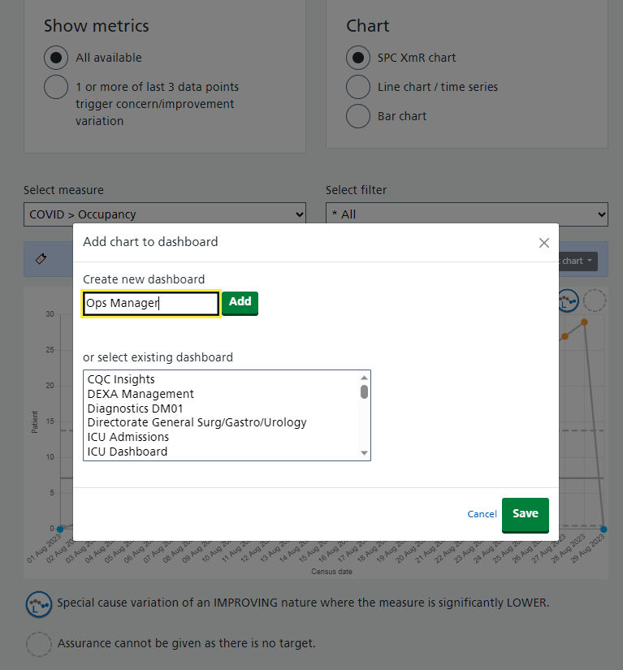
Dashboards Any measure can be added to a personalised dashboard to allow colleagues to group together areas of importance.

Slide 8
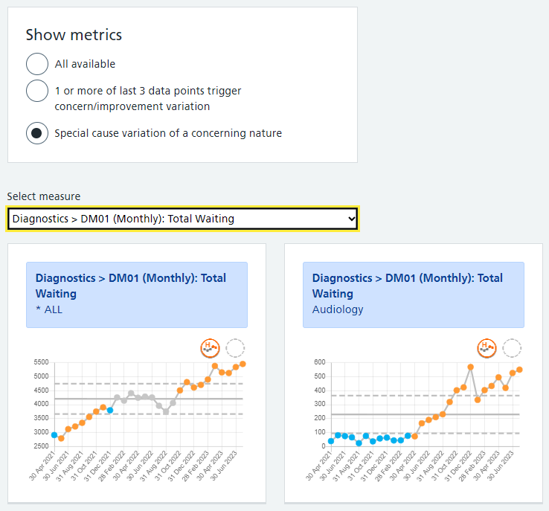
Variation Identifier A shortcut approach to reviewing data where only combinations of measures and filters are shown when special cause variation is identified.

Slide 9
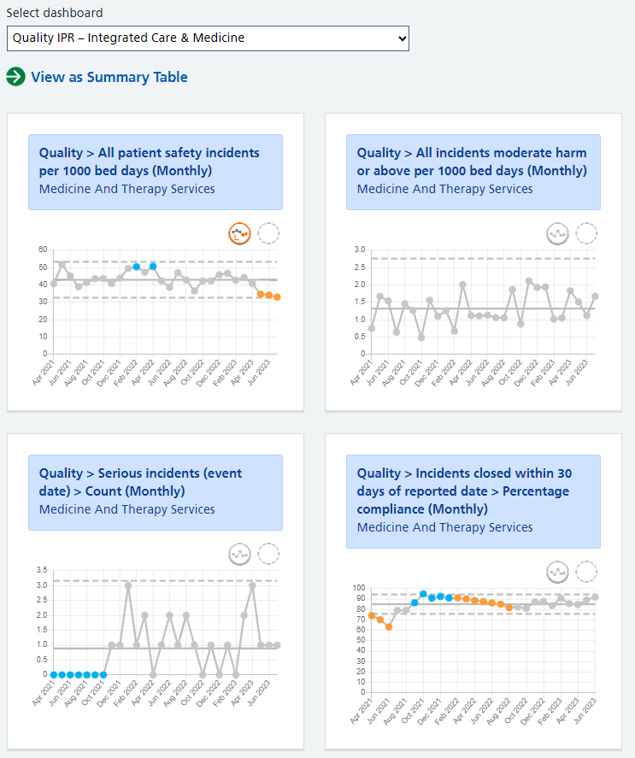
Dashboards Once pinned, custom dashboard will present measures together to allow for greater triangulation.

Slide 10
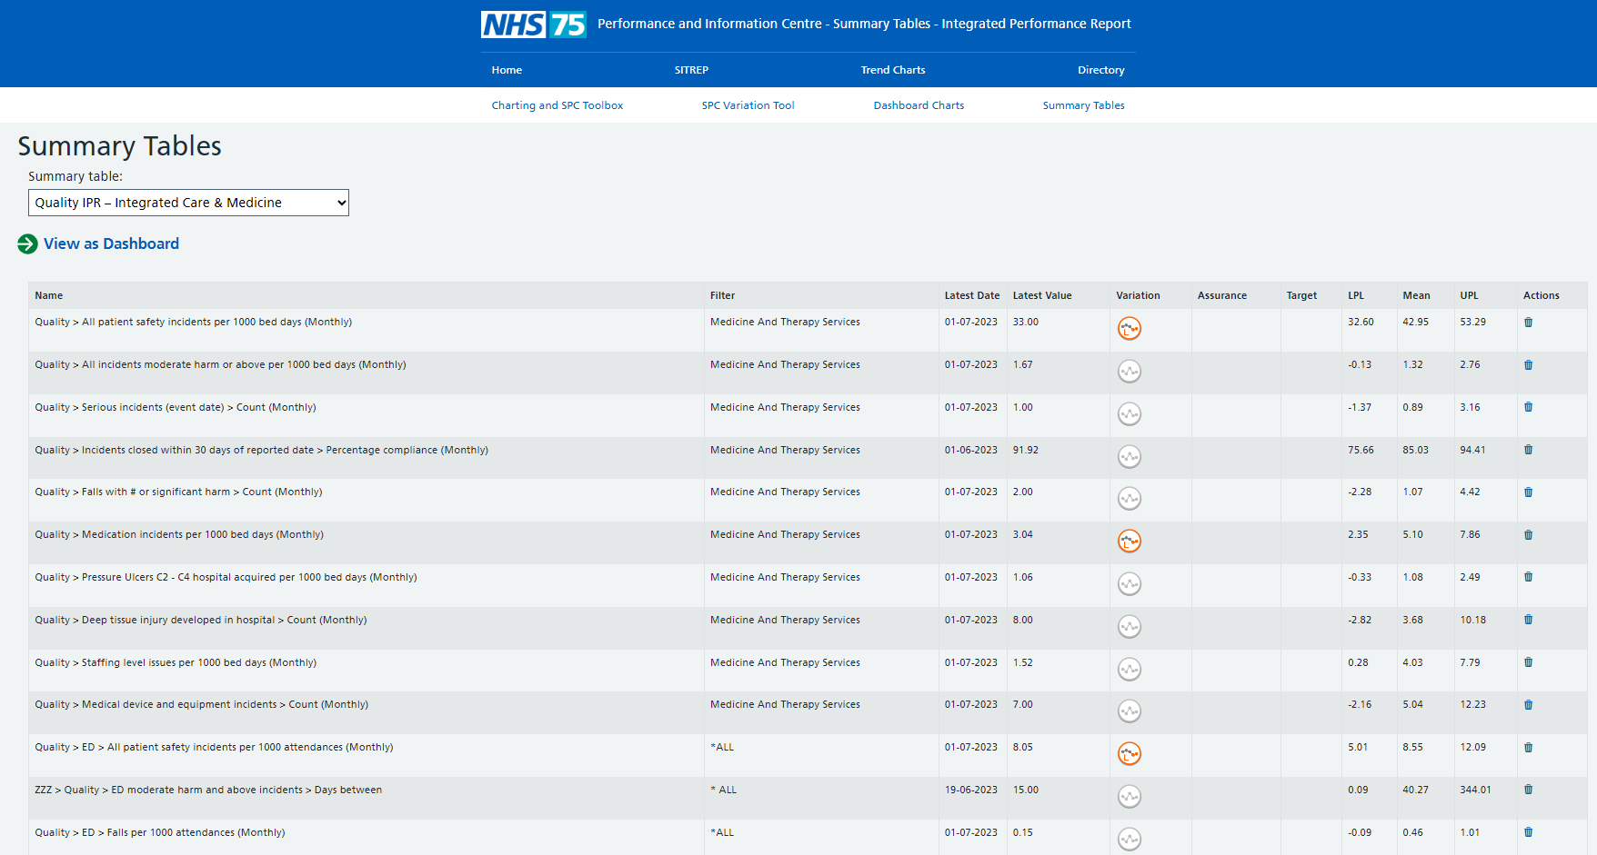
Summary Tables A headlines view of any set of dashboards.

