Slide 1
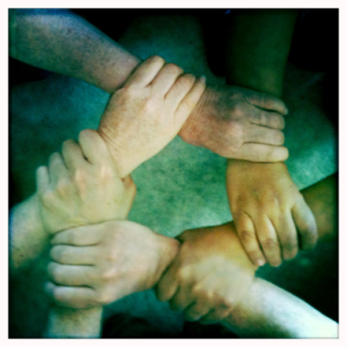
Compassionate Connection Model
Transforming how a healthcare Trust can meet the emotional needs of staff during a pandemic
Dr Lorraine McGurk and Dr Sinead Hannan, Consultant Clinical Psychologists
Dr Ivor Crothers, Clinical Director, Psychology Services
Vivienne Toal (Director) & Maxine Williamson (Assistant Director ), Human Resources & Organisational Development
Southern Health and Social Care Trust, Northern Ireland

Slide 2
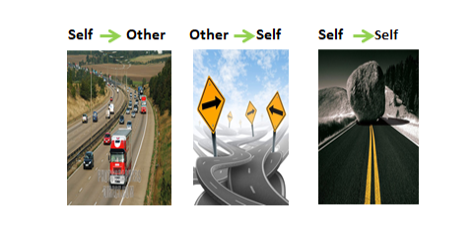
Compassionate Connection Model
The Covid pandemic has altered every aspect of our world - our personal and our professional lives.
The current pandemic brought additional work pressures and emotional distress to an already overstretched NHS.
This is the biggest challenge to our collective well-being we, as a workforce have ever faced.
Healthcare professionals are dedicated in their care for others, however, they generally find it challenging to prioritise their own care.

Slide 3
Aim
To deliver a staff wellbeing support service which is proactive, responsive to need and easily accessible to staff.
To reduce the shame and stigma of needing support.
To offer innovative, effective and evidence based targeted interventions to alleviate distress and promote resilience.
The objective of the service during the pandemic included: -
Promotion of psychological health and wellbeing through offering a continuum of support based on individual and team needs.
Assessment and implementation of environmental strategies to promote emotional resilience in the workplace environment and the organisation.
Provision of direct support and advice to leaders/managers to support teams.
Provision of advocacy for staff to enhance and protect psychological wellbeing.
Provision of intervention to staff members/teams who experience psychological difficulties or acute distress related to the pandemic.

Slide 4
Compassionate Connection Model
Authentic and Caring Relationships
Empathic Thinking and Understanding
Responsive Action for Wellbeing
Visible Presence
The corner stone of the model emphasises developing genuine & caring relationships with staff.
Bringing the service daily to teams (clinical and non-clinical) and leaders in their own work environment reduced the stigma and shame and traditional barriers for NHS staff in seeking help.
Embodying compassion
The ‘Compassionate Connection’ ethos is adopted by the team in their thinking, intentions, interactions and actions at all time in their work with staff of all levels, even lunchtime drop-ins.
The team encourage staff, particularly managers, to adopt this approach in order to normalise reactions, increase wellbeing and reduce emotional distress.
Timing
Support and intervention was offered when needed to alleviate acute distress.

Slide 5
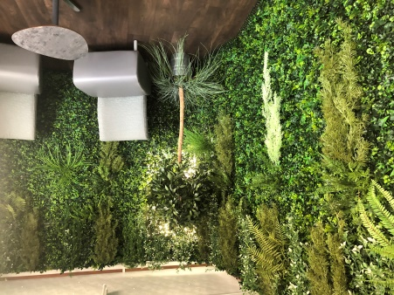
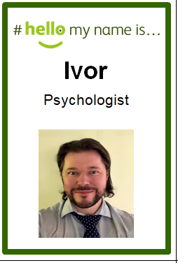
Plan
Acute Hospital Direct Inreach Support:
Team of Consultant Psychologists and the Clinical Director of Psychology Services offered staff support in designated rooms inside Craigavon Area Hospital (CAH) for staff working with patients with C19. Staff were identifiable while wearing PPE with selfie ‘My Name is stickers’.
Targeted daily contact in CAH with ICU & wards, with managers and staff. Daily support slots allocated to ICU and regular slots for hospital wards for individual and group work.
Village cabin in the CAH Wellbeing Village (pictured) for staff who were on a break or off shift who wanted to access support.
Psychological First Aid and Compassion Focused models informed individual and team based interventions.
Innovative and evidence based acute distress intervention - Eye Movement Desensitisation Therapy (EMD)

Slide 6
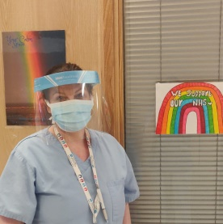
Plan
Detailed assessment of the work environment resulted in:
Creation of Calm Rooms for staff to promote wellbeing - ‘Rest-Restore-Recharge’ ethos. Stocked with essential oil soothing products, resources and technology to aid relaxation.
Targeted well-being techniques for anxiety resulting from wearing PPE
Grounding posters in PPE doffing areas; Q Radio tailored music recording for main PPE Donning area.
Bespoke breathing practices for promoting relaxation when using FFP3 masks.
Advocacy role in communication of staff needs and concerns to team leaders and senior trust management.
Impact of working while wearing PPF3 masks
Purchase of Ipads to enable communication with patients’ families in ICU.
Appreciation & Visibility of management on the wards
Organisational issues.

Slide 7
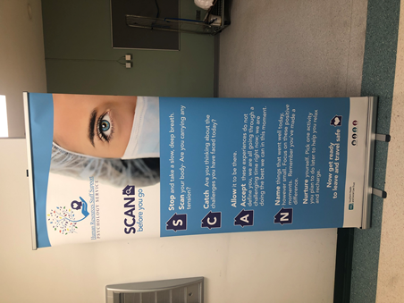
Plan
Communication & Information:
Bespoke psychological resources and techniques were developed in response to the identified needs.
Easily assessable resources and web links for staff, leaders, parents and children.
Posters and visual aids created and distributed to teams. This included Staff Well-being check-ins to support compassionate care during team handovers; Tips for before, during and after shifts; Going home checklist; Compassionate Leadership; Compassion Care Flow. Promotion of material on our Twitter site.
Promotion of material and well-being messages on the Southern Trust intranet site, Podcasts & our Twitter and YouTube social media sites.
Partnership working with Trust teams (i.e. Promoting Wellbeing Team & Recovery College) developing relevant psychological material for Trust-wide and public communication platforms.

Slide 8
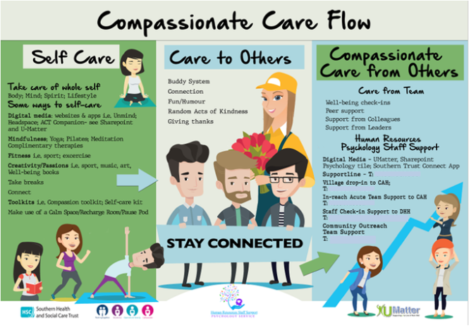
Benefits
Staff experienced a resolution of acute distress from targeted interventions .
Staff wearing PPE reported that the breathing techniques and environmental changes helped reduce anxiety.
Staff had an increased knowledge of the role of the Psychologist in providing workplace support.
Staff are now more aware of the general impact of their work on their wellbeing. They were receptive to the continuation of staff wellbeing opportunities including dedicated wellbeing spaces.
Managers and teams who engaged meaningfully with our service developed their emotional awareness and aided their understanding the flow of compassion and compassionate leadership in action. Manager in turn demonstrated compassionate leadership to their team.

Slide 9
Measures
“It was really good to know that someone cared about us, and they really cared. You could see that straight away and the fact that they were there from the start made a difference. They came to us; we didn’t have to look for them. They were always there for us.”
Nurse Manager
Qualitative feedback
I saw one of the (outreach) team. They were inside the hospital and that made it easier that they were there waiting for us. I talked to her and it was good to have someone to talk to. I don’t have family nearby. It's great to have someone you can turn to, to get help when you need it. I had EMD sessions to help me with the panic attacks. I didn’t go on sick leave. I was able to stay in work which is what I wanted”
Ward Administrator
“We are not very good at asking for help, we help others not the other way round. In a strange way it helped knowing that the team were there waiting if we needed them. You know, even if you never used it, knowing that someone was there for us made a difference in itself. That someone was thinking about you and ready to support you.” Medical Consultant

Slide 10
Measures
Quantitative Rating
Subjective Units of Distress (SUDS)
0 – 10 scale (10 is maximum disturbance; 0 is no disturbance)
72% received a reduction to 1 or 0 in one session.
Average SUDS difference pre-post session = 6.3

Slide 11
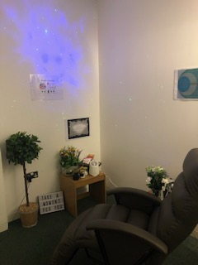
Resources & team
Support & commitment of Director of Psychology, HR and Senior Management Team
Support from IT, Porters & Estates to quickly redesign
environment and provide technology supports.
Access to pool of experienced staff for the team
Specific room and protected time on ongoing basis.
Equipment to create therapeutic space
Financial commitment to develop materials
Staff training in evidence-informed approaches.
Financial resource for external supervision
Generous financial and time donations from public and staff in setting and equipping calm spaces.
Model devised and delivered based on the experience and expertise within the Psychology service.

Slide 12
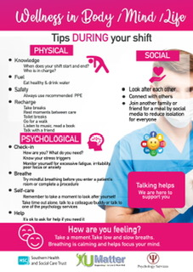
Learning
Developing relationships with managers and teams is essential for successful engagement.
You need to go to healthcare professions, rarely do they drop in. A trusting relationship is key. Passive approaches are not as effective.
Regular daily or weekly contact with the same Psychologist fostered trust and reduced stigma.
Easily accessible appointments and regular sessions makes availing of the service more likely.
Staff who did not directly access the service highlighted that knowing that it was available still made them feel cared for and valued by the Trust.
Adopting this model, requires great courage as NHS staff do not find it easy to ask for or receive support. Services need to continue to show up even if it is difficult or not wanted initially.
The staff wellbeing team needs to have weekly reflective team sessions with external facilitator to look after their own wellbeing.

Slide 13
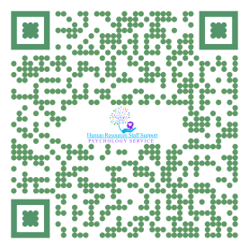
Learning
Managers and Team leaders who used the service modelled that it was safe for staff to ask for help and support and gave permission to use the service too.
Managers who followed the advice in supporting staff benefited most from this approach. e.g. visible and regular presence, timely action to reduce stress.
Resource overload
Staff do not have time to read in a pandemic. Be creative in how you get them to access the material e.g. Youtube channel, Audio resources.
Psychological changes in the environment and advocacy for staff at senior level is an important element to success.
EMD sessions processed acute distress quickly and will potentially reduce later need for psychological interventions.

Slide 14
Learning
You need the ongoing commitment of senior management and Director of Psychology to provide this model of service delivery with additional dedicated staff resources.
It will be difficult to sustain this level in another wave without additional dedicated resources as virtual working will mean that the Psychologists redeployed into this will not available to step up given expectation to provide core patient services on an ongoing basis.
Through the developing relationships our team are in awe of the care that healthcare staff are provide and the role every person has played through the varying phases of the pandemic. It is a credit to the Southern Trust to have such dedicated, compassionate and skilled staff.
We want to thank all our psychology staff and partners for their hard and committed work since the start of the Pandemic in supporting staff within the Southern Trust.

Slide 15
Questions
Dr Lorraine McGurk
Lorraine.mcgurk@southerntrust.hscni.net
@southern_for

