Slide 1
Specialist fatigue services: change and development in response to COVID-19
Claire Fox
Specialist Occupational Therapist
The Bath Centre for Fatigue Service, Royal United Hospitals Bath NHS Foundation Trust

Slide 2
The Challenges…
Outpatient groups and specialist face to face clinics cancelled
Staff were not set up for remote home working
Existing demand to meet current patient needs
Processing of new referrals
RUH and GP colleagues requesting support on
managing post COVID-19 fatigue

Slide 3
Our Aims
To maintain specialist Lifestyle and Fatigue management services for patients with complex long term health condition/s
To utilise specialist skills and provide advice to colleagues on how best to support patients with physical, cognitive and/or emotional fatigue post COVID-19.
To provide advice to staff in these difficult times to support health and wellbeing.
To support Bath Centre for Fatigue service staff to work effectively at home.

Slide 4
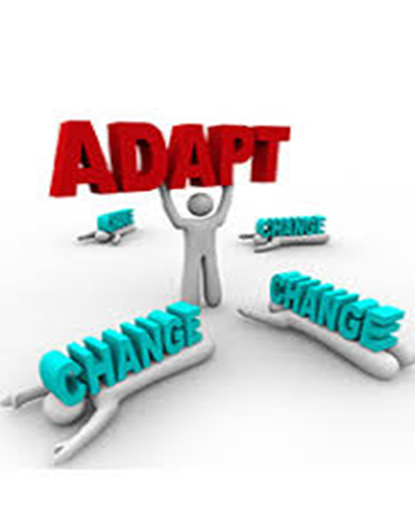
Plan- adapting current services
Modified our six week group programme to three personalised individual follow ups.
Deliver assessments and interventions via
telephone/video conferencing platforms.
Utilise workbook resources and youtube
videos to support treatments.
Working with IT colleagues and information
governance to support remote working

Slide 5
New opportunities
Fatigue advice line to support RUH staff
Developing new referral pathways for significant
fatigue post COVID-19; primary care and critical care
Virtual group Lifestyle and Fatigue management programmes
Adapting AHP student placements

Slide 6
Patient feedback- July 2020- Sept 2020
Feedback provided by 16 out of 22 patients who received modified Lifestyle and Fatigue interventions
More than 99% of patients would recommend the programme to someone else with fatigue. Reasons for this included the programme being helpful in knowing ‘my condition better and taking it seriously’, feeling ‘more supported, listened to, and understood’, and gaining ‘useful and professional advice’.
The common topics for most helpful aspects of the programme were being accepted and understood, sharing experiences and knowledge, tailoring the programme to their needs, and being able to attend sessions from home.

Slide 7
Patient feedback continued…
Patients were asked to report on the helpfulness of the group programme content. The majority of responses were positive (‘very helpful’ or ‘helpful’):
Understanding fatigue – 94%
Activity & energy management – 88%
Managing thoughts & feelings – 81%
Mindfulness – 69%
Values & goals – 94%
Communication – 88%
Activity Rest and Sleep Logs – 94%
Stress & relaxation – 81%

Slide 8
Supporting RUH staff and post COVID-19 fatigue
16 RUH staff members contacted Fatigue Advice Line and were provided with specialist advice regarding their own fatigue
5 referrals from primary care from July to October 2020 for specialist assessment and interventions for post COVID-19 fatigue
GP referrals are set to increase based on NHS
England advice on prevalence of long-covid

Slide 9
Learning
Positive response from patients to new ways of working…..to consider in future service planning
Modified Lifestyle and Fatigue management has supported a self management approach
Virtual group programme has commenced and will be evaluated
Virtual AHP student placements in the process of being set up and will be evaluated

Slide 10
Questions
Claire Fox
Claire.fox5@nhs.net

