Slide 1
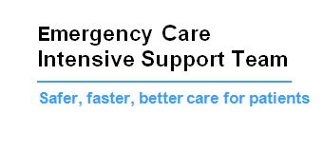
FOCUS
Operational site management principles
June 2019

Slide 2
Five guiding principals - FOCUS
F - Front door position and triggers - current position and actions.
O – Operational oversight and management of whole hospital constraints.
C – Challenge patient plans and pathways.
U – Understand actions required and agree accountability.
S – Site plans, escalation and report.

Slide 3
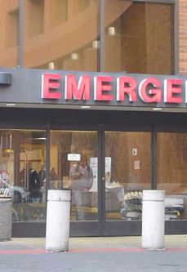
Front door position
Use of the trigger tool specific to site.
Todays performance - current and against predicted performance.
Oversight of waits in each stream e.g. minors, resus, paediatrics, triage.
Speciality delays and response to the emergency department (how are we doing against agreed inter professional standards?)
Next breach time and plan for patient.
Ensure all patients have a plan at two hours.
Senior nurse and medical coordination i.e. board rounds at agreed times.
Ambulance arrivals and offload position.

Slide 4
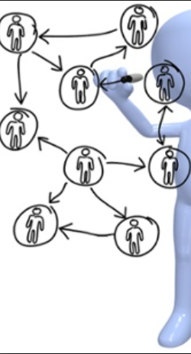
Operational oversight of whole hospital constraints
Outlier areas - ensure all patients have been reviewed. Prioritise which areas should be closed first.
Staffing issues.
ITU / HDU capacity and escalation plan.
Tertiary referral and repatriation position.
Infection control i.e. side room capacity and decontamination.
Understand demand and capacity of all diagnostics.
Unresolved delays – communicate Red day problems (including complex discharge issues) that can’t be sorted at ward level and ensure action is taken.
Todays ACTUAL and POTENTIAL discharges (risks identified e.g. transport, pharmacy, clinical decision making.
Confirm that board / ward rounds happened on all wards
Use a predictive demand model based upon previous activity.

Slide 5

Challenge
Is the bed request appropriate? Has a senior review taken place?
Can the patient be appropriately managed as short stay or do they require a speciality specific bed?
Is the patient on the right pathway or could they be managed using an alternative pathway e.g. hot clinics, day case, ambulatory emergency care.
Plans for all emergency department patients at two hours with the doctor and nurse in charge.
Speciality teams who fail to respond to emergency department referrals in line with agreed internal professional standards.

Slide 6

Understand actions & agree accountability
Site meeting should generate specific actions for individuals. Actions need to be allocated to an individual with an agreed response time to ensure accountability and delivery.
Understand the actual demand against predictive demand throughout the day.
Actions should be logged and circulated to relevant teams.
Actions should be monitored for progress and reported back to the site team.
Agree OPEL (operational pressures escalation levels) level.
Any service continuity challenges and impact on flow.

Slide 7
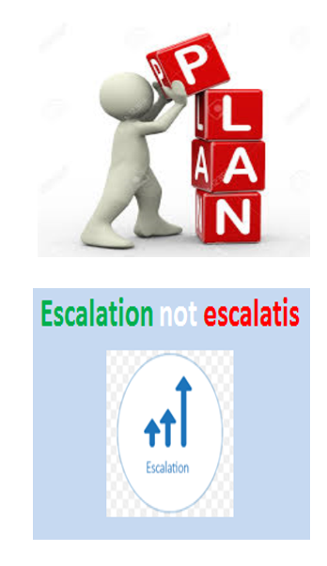
Site plan, report & escalation
Be proactive not reactive. Always have a plan for the next two hours, eight hours and the following day.
Clear documented actions and identify responsible colleagues responsible for delivery.
Each OPEL (escalation) level should trigger specific actions to prevent further deterioration.
System wide escalation, support and response monitoring.
Avoid ‘escalitis’ – use SBAR (situation, background, assessment, recommendation) to communicate.

Slide 8
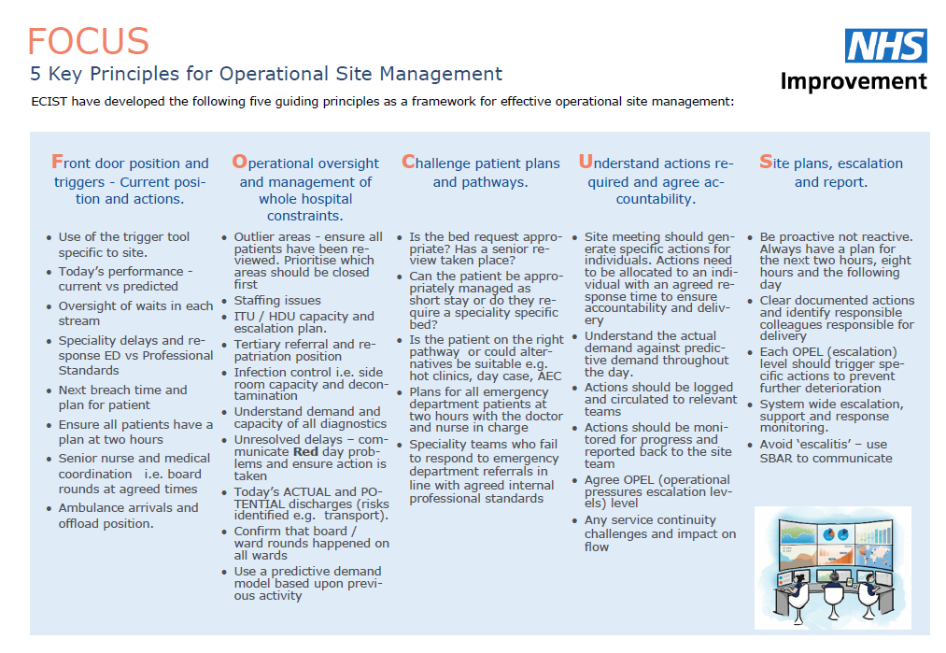
Summary

