Slide 1
NeuroDiversity
By Aaron Hobin

Slide 2
Aim
To give a small insight into what an Neurodiversity is
To understand how an Neurodiversity works
To adjust your practice for people with additional needs
To show you its not a bad thing !

Slide 3
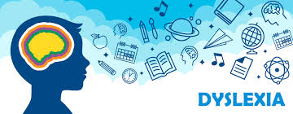
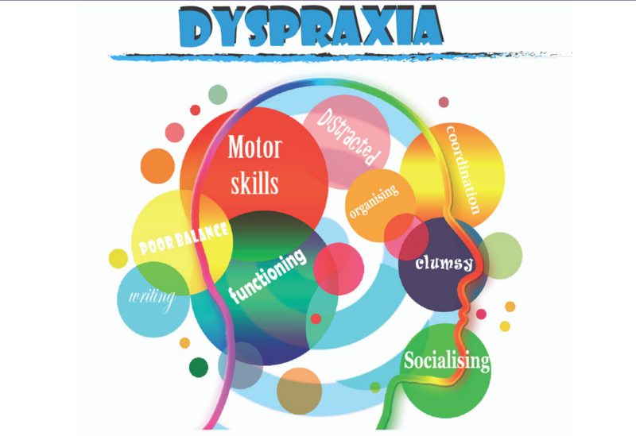
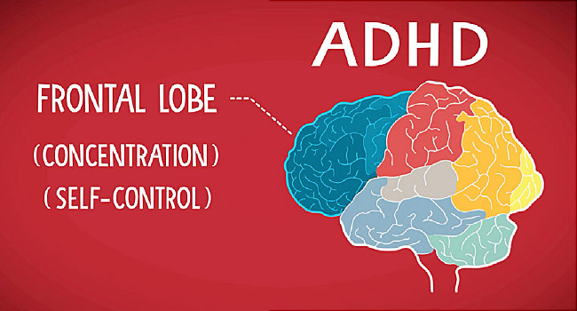
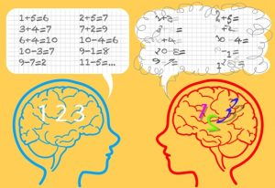
What is an Neurodiversity??
Neurodiversity otherwise known as Specific Learning Difficulties (SpLDs), affect the way information is learned and processed. They are neurological (rather than psychological), usually run in families and occur independently of intelligence. They can have significant impact on education and learning and on the acquisition of literacy skills. It doesn’t measure your intelligence.
This is an umbrella term for the following:
Notes:
This is the section that is also known as Neuro-Diversity. It might be worth putting it down as Neuro-Diverse rather than SPLD. THIS NEEDS LOOKING AT AGAIN BECAUSE TECHNICALLY ITS NEURODIVERSITY NOW

Slide 4
Prevalence
UK population - approximately 10% with around 4% of people suffering serious affect, making it the largest disability group in the UK
This estimation is around 375,000 students in the UK have some kind of SpLD
Between 3% and 10% of nurses admit they have a SpLD across the trust.
WHY though?
Notes:
https://www.cache.org.uk/news-media/dyslexia-the-facts
http://www.dyslexia.uk.com/
According to the British Dyslexia Association, the number of dyslexics in the UK is around 10%, where 4% of this severely suffer from Dyslexia. The Equality Act 2010 identified dyslexia as a disability, because both adults and children suffering from this are unable to fulfill their potential. Unfortunately, a large percentage of the population doesn’t know what dyslexia is.
On a global scale, between 5-10% of the population are suffering from dyslexia, but it could go as high as 17%, and of people who are having reading difficulties, around 70-80% of them are more likely to have dyslexia.

Slide 5
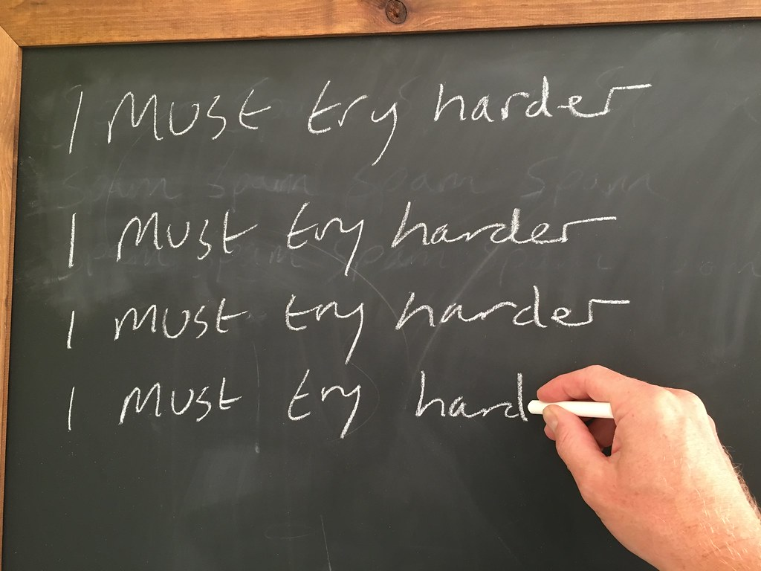
Bad PREss
Notes:
This is the part where we see it in a bad light. We get called lazy, try harder, weird, odd one out, no understanding what they are why they effect us.

Slide 6
Feelings
Notes:
My personal feelings that other people will also feel, isolated, alone, shy, not confident, self doubt, odd one out, low self esteem, thinking there is something wrong with you

Slide 7
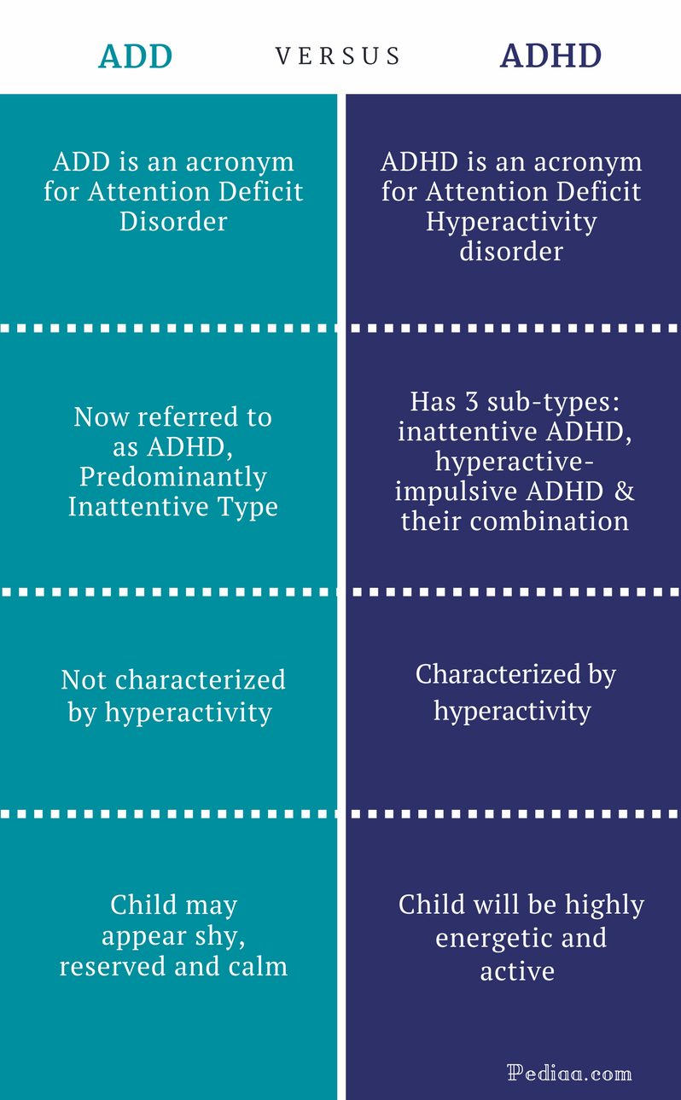
ADHD- Attention Deficit Hyperactivity Disorder
A person with ADHD has differences in brain development and brain activity that affect attention, the ability to sit still, and self-control. ADHD can affect a child at school, at home, and in friendships.
People with this condition are very easily distracted, lose track of what they are doing and have poor listening skills. By failing to pay attention to details, they may miss key points. Often co-occurs with dyslexia.
There are different aspects. Inattentive and Attentive, extrovert and also ADD.
Notes:
https://www.adhdfoundation.org.uk/
Common symptoms
Is easily distracted
Doesn't follow directions or finish tasks
Doesn't appear to be listening
Doesn't pay attention and makes careless mistakes
Forgets about daily activities
Has problems organizing daily tasks
Doesn’t like to do things that require sitting still
Often loses things
Tends to daydream
Symptoms in Adults
Symptoms of ADHD may change as a person gets older. They include:
Chronic lateness and forgetfulness
Anxiety
Low self-esteem
Problems at work
Trouble controlling anger
Impulsiveness
Substance abuse or addiction
Unorganized
Procrastination
Easily frustrated
Chronic boredom
Trouble concentrating when reading
Mood swings
Depression
Relationship problems
https://www.webmd.com/add-adhd/childhood-adhd/attention-deficit-hyperactivity-disorder-adhd#2
Causes
Heredity. ADHD tends to run in families.
Chemical imbalance. Brain chemicals in people with ADHD may be out of balance.
Brain changes. Areas of the brain that control attention are less active in children with ADHD.
Poor nutrition, infections, smoking, drinking, and substance abuse during pregnancy. These things can affect a baby’s brain development.
Toxins, such as lead. They may affect a child's brain development.
A brain injury or a brain disorder. Damage to the front of the brain, called the frontal lobe, can cause problems with controlling impulses and emotions.
Sugar doesn’t cause ADHD. ADHD also isn’t caused by watching too much TV, a poor home life, poor schools, or food allergies.
ADHD can't be prevented or cured. But spotting it early, plus having a good treatment and education plan, can help a child or adult with ADHD manage their symptoms.
ADD- a developmental disorder that is marked especially by persistent symptoms of inattention (such as distractibility, forgetfulness, or disorganization) or by symptoms of hyperactivity and impulsivity (such as fidgeting, speaking out of turn, or restlessness) or by symptoms of all three and that is not caused by any serious underlying physical or mental disorder
Inattentiveness
The main signs of inattentiveness are:
having a short attention span and being easily distracted
making careless mistakes – for example, in schoolwork
appearing forgetful or losing things
being unable to stick to tasks that are tedious or time-consuming
appearing to be unable to listen to or carry out instructions
constantly changing activity or task
having difficulty organising tasks
Hyperactivity and impulsiveness
The main signs of hyperactivity and impulsiveness are:
being unable to sit still, especially in calm or quiet surroundings
constantly fidgeting
being unable to concentrate on tasks
excessive physical movement
excessive talking
being unable to wait their turn
acting without thinking
interrupting conversations
little or no sense of danger

Slide 8
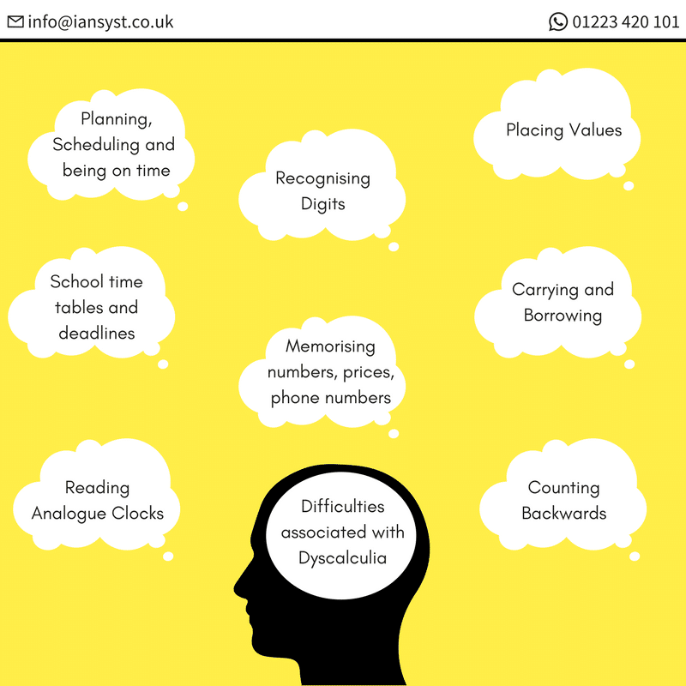
Dyscalculia
Is a difficulty understanding maths concepts and symbols. It is characterised by an inability to understand simple number concepts and to master basic numeracy skills. There are likely to be difficulties dealing with numbers at very elementary levels; this includes learning number facts and procedures, telling the time, time keeping, understanding quantity, prices and money.
Notes:
https://www.dyslexic.com/blog/what-is-dyscalculia/
Common conecpts we take for granted like reading a clock, ifficulties associate with dyscalculia include: counting backwards, difficulty reading analogue clocks, memorising numbers, prices and phone numbers, carrying and borrowing, placing values, planning, scheduling and being on time, school time tables and deadlines.

Slide 9
Dyspraxia
This is a common disorder affecting fine and/or gross motor coordination in children and adults.
An individual’s coordination difficulties may affect participation and functioning of everyday life skills in education, work and employment. Children may present with difficulties with self-care, writing, typing, riding a bike, play as well as other educational and recreational activities. In adulthood many of these difficulties will continue, as well as learning new skills at home, in education and work, such as driving a car and DIY.
Notes:
https://dyspraxiafoundation.org.uk/about-dyspraxia/
https://www.medicalnewstoday.com/articles/151951.php#dyspraxia_symptoms
Dyspraxia is a neurological disorder that impacts an individual's ability to plan and process motor tasks.
Symptoms tend to vary depending on the age of the individual. Later, we will look at each age group in more detail. Some of the general symptoms of dyspraxia include:
poor balance
poor posture
fatigue
clumsiness
differences in speech
perception problems
poor hand-eye coordination

Slide 10
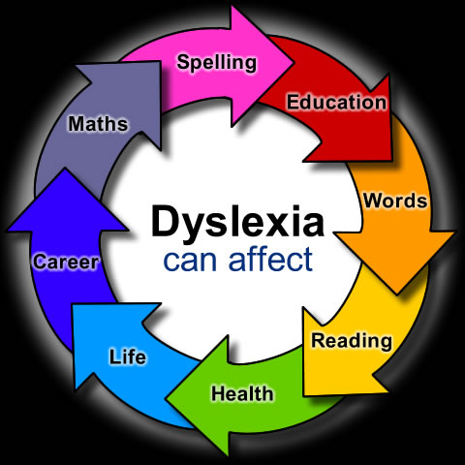
Dyslexia
A student with dyslexia may mix up letters within words and words within sentences while reading. They may also have difficulty with spelling words correctly while writing; letter reversals are common.
However Dyslexia is not only about literacy, although weaknesses in literacy are often the most visible sign. Dyslexia affects the way information is processed, stored and retrieved, with problems of memory, speed of processing, time perception, organisation and sequencing. Some may also have difficulty navigating a route, left and right and compass directions.
https://www.youtube.com/watch?v=F9SxijF8VRc
Notes:
https://www.cache.org.uk/news-media/dyslexia-the-facts
https://www.dyslexia.uk.net/what-is-dyslexia/
What are the signs and symptoms?
According to Bishop and Snowling (2004), the common broader characteristics of dyslexia include:
Memory difficulties
Organisational difficulties
Writing difficulties
Reading difficulties
Time management difficulties
In addition to these characteristics, Burden (2005) acknowledges the visual and auditory processing difficulties that some individuals with dyslexia can experience; whereas Reading Rockets (2018) highlights challenges around phonological awareness, verbal memory and / or verbal processing speed that can be affected by dyslexia.

Slide 11
Famous People with a Spld
Dyslexia
Dyslexia
ADHD
Dyspraxia
Dyslexia
Dyslexia

Slide 12
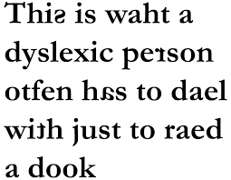
An insight into a dyslexic person (I will make the video thing here)
https://www.youtube.com/watch?v=RDFkwkSgjtg

Slide 13
Another example
1. Stand up
2. Turn around to the left
3. put right hand on the person next to you shoulder
4. stand on one leg
5. count backwards from 10-1
Notes:
This is the example to tell people about the ability to process information and organisation. Some people may be able to process and hold all 5 instructions but for someone who is neuro diverse then it is difficult to process this information.

Slide 14
Now try this
You have 30 seconds to memorise the 10 instructions and carry out the task:
1. stand up
6. Swap hands while standing on left leg
2. sit down
7. count down from 20
3. turn to the left
8. Pick up a pen
4. put right hand on head
9. Write your favourite object in your house on a piece of paper
5. Put left hand on back
10. Wave and say I’m done
Notes:
This is just another one but to test a little further as 5 actions is not that hard and they may misunderstand what it is trying to show.

Slide 15
How many did you get?

Slide 16
Reasonable adjustments
2 Minute Challenge
Overlay ruler disclosure
Allowing a little extra time to complete tasks
Writing down instructions in simple form
Using overlays to help read notes or consent forms
Reading out loud for the patient or nurse to understand
Asking the question on admission or employment do you need any help
Not judging a person
Asking the person if they need help and look overwhelmed
Getting assisted equipment in all wards and trusts.

Slide 17
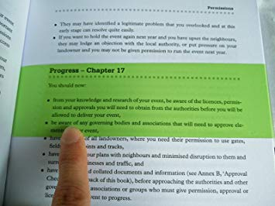
Equipment

Slide 18
Short Term Goals ideas
Boxes on each floor of the hospital at Preston and in various locations in chorley.
Each box to include:
- Overlays x 2
- Overlay Rulers
Coloured Paper
Powerpoints to student nurses to make them more aware and in turn the next generation will be more aware.

Slide 19
Long Term goals
To get an e-learning package to make all staff more aware of how to help anybody with a specific learning difficulty
To train staff to become Neurodiversity Champions and allow in house training
To get an application like the Read and Write software on all trust computers and ipads so each member of staff can simply click a button and have and overlay on the screen
To help other trusts to do the same

Slide 20
Costs
Overlays: Crossbow education pack of 10 £22.59, Dyslexia shop £27.11 for 11, ryman £25.99 for pack of 10. All A4 in size and worth getting 2 packs due to some people needing 2 overlays one on top of the other to help read a document.
Overlay Rulers: Ryman £9.99 for 10, Amazon £12.99 for 10
Read and Write software £180 per user or £2,500 for higher education pack, there is also enterprise license but unaware of cost at present as the company would prefer to speak on this behalf.
Training would just take 45mins.

Slide 21
Additional information
British Dyslexia Association
https://www.bdadyslexia.org.uk/educator/what-are-specific-learning-difficulties
Helen Arkell
https://www.helenarkell.org.uk/about-dyslexia/what-is-an-spld.php
The dyslexia association
https://www.dyslexia.uk.net/specific-learning-difficulties/
SASC – SpLD Assessment Standards Committee http://www.sasc.org.uk/
ADSHE – Association of Dyslexia Specialists in Higher Education http://adshe.org.uk/
Notes:
https://www.nursingtimes.net/students/are-students-with-dyslexia-supported-in-their-nurse-training-20-05-2014/ 3-10% stats
RCN- coverage on dyslexia https://www.uhs.nhs.uk/Media/suhtideal/NursesAndMidwives/PreQualifyingNursing/RCNreportdyslexiaandpractice.pdf
RCN advisory file:///C:/Users/ahobi/Downloads/IHAD-Nursing-with-Dyslexia-workplace-aids-and-equipment.pdf
https://www.healthcare.ac.uk/wp-content/uploads/2019/10/Supporting-nursing-students-in-practice-with-a-dyslexia-and-or-a-dyspraxia-a-guide-for-supervisors-and-assessors-2019.pdf
RCN advisory booklet for managers- file:///C:/Users/ahobi/Downloads/PUB-003833.pdf
Student nurse information- https://www.worcester.ac.uk/documents/advice-for-students-with-dyslexia.pdf

