Slide 1
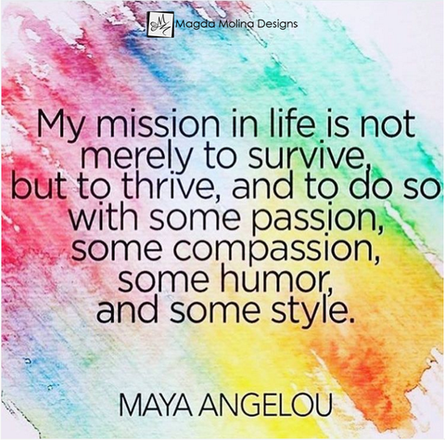
Drugs and how they affect the teenage brain
Rachel Symons
www.thrivingfutures.co.uk
Lesson One: The Teenage Brain and addiction
This lesson examines how the teenage brain is wired to seek pleasure and excitement which makes them more susceptible to addiction
Lesson Two: Cannabis Confusion
This lesson will examine the difference between medical and recreational cannabis, exploring the possible psychotic effects of the drug.
Lesson Three: Good Golly it’s Molly
This lesson will examine the physical and mental health dangers of MDMA (Molly or Ecstasy) before asking pupils to bring together their understanding from the unit to complete a task of their choosing.

Slide 2
Lesson 1: The teenage brain and addiction.
Resources
Slides 16 & 17 (1 each)
Slide 18 (1 between 2)
Prize for winning team
This lesson examines how the teenage brain is wired to seek pleasure and excitement which makes it more susceptible to addiction
Learning Objectives:
To understand what the term ‘addiction’ means.
To understand how the development of the brain makes teenagers more susceptible to addiction.
To recognise why people behave differently in a group and the impact this could have on the choices they make.
Slide | Time | Activity
4 | 7 min | Settling/ register activity. In pairs, discuss and write down the answers to the questions.
5-14 | 8 mins | As class, go over the answers and discuss pupil’s opinions.
15-18 | 15 min | Print out slides 16 & 17 preferably one each or one between two. Print slide 18 one between two As class read through and discuss slides 16 to 17. If you have not done the core unit, you may need to extend this task by examining the core unit slides 50-53. In pairs or groups of 3/4, use the hand outs of slides 16 & 17 to write question and answer cards. Encourage pupils not to be too obvious.
18 | 5 min | Split class into groups A & B. Pass questions to the front. Teacher asks Group A questions to Group B and vice versa. Possible prize for winning team – up to you.

Slide 3
Lesson 1: The teenage brain and addiction.
Slide | Time | Activity
19 | 10 min | Mirror Clapping – full instructions are on the slide. Class to stand up in a circle. Aim of the game is for 1 person to face the other and clap their own hands at the exact same time as the person next to them – that person turns round and repeats with the next person – the clap goes round the circle. The first person (teacher) faces the person on the left of him/ her. They each clap their own hands (not the other person’s) but they try to synchronise the clap so it happens at the same time and sounds like 1 clap. No talking is allowed, so this requires body language. This person then turns and looks at the person to their left and they try to get a synchronised clap. (Teacher – if they are way out – don’t let them off – have them try again.) The clap then continues going round the circle 2 or 3 times. (Teacher – once pupils have got the hang of it, try to get the group to speed up) Once everyone is clear about the task. Teacher introduces two claps, which again have to be done synchronised with the partner (this means watching body language to see if the other person is going to clap again). When somebody gives two claps, the clap changes direction and goes the other way around the circle. No talking allowed to get the clap synchronised – must be done based on body language.
20 | 10 min | Read through the information, then click on picture to watch the link. Discuss pupil’s reaction.
21 | 5 min | Plenary, write a short paragraph (4 or 5 sentences) explaining why teenagers are at high risk of addiction.

Slide 4
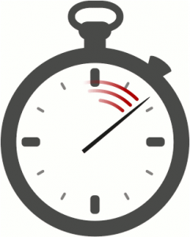
Lesson One: The teenage brain and addiction.
Learning Objectives:
To understand what the term ‘addiction’ means.
To understand how the development of the brain makes teenagers more susceptible to addiction.
To recognise why people behave differently in a group and the impact this could have on the choices they make.
Starter: In pairs discuss and write down the answers to the questions below:
What is addiction?
How does addictive behaviour differ from ‘normal’ behaviour?
List 5 examples of things people can become addicted to?
What sort of things help lead to addiction?
If someone was worried about being addicted to something, who could they talk to?
7 minutes
Rachel Symons

Slide 5
What is addiction?

Slide 6
What is addiction?
Addiction is a psychological or physical need for a substance (e.g. drugs) or process (need to do something e.g. exercise) where the person will risk negative consequences in an attempt to meet the need.
(Quizlet, 2019)

Slide 7
How does addictive behaviour differ from ‘normal’ behaviour?

Slide 8
How does addictive behaviour differ from ‘normal’ behaviour?
The addict will ‘have’ to get the substance or carry out the process in order to feel ‘normal’, rather than it being something they do because they want to (e.g. an alcoholic will have to have a drink otherwise s/he will get bad side effects, they’re not drinking for enjoyment).
(Quizlet, 2019)

Slide 9
List 5 things people can become addicted to.

Slide 10
Things people can become addicted to:
Substances: tobacco, alcohol, illegal drugs, prescription drugs, sugary food, fatty food, caffeine.
Processes: work (yes I know!), gambling, shopping, eating disorders, exercise, gaming, computers, porn, sex, self harm.
(Quizlet, 2019)

Slide 11
What sort of things help lead to addiction?

Slide 12
What sort of things help lead to addiction:
Biological: If members of your family struggles with addiction, you may be more susceptible.
Psychological: People who suffer with low self esteem and other mental health issues are at higher risk as some will use substances or processes to help reduce symptoms (self medicating).
Social: As you will see, you social group has a big influence on what you do or do not experiment with.
Research shows that children of parents who have and addiction might have a genetic predisposition (greater risk) of developing an addiction themselves. The risk is made even greater because:
Children of addicts are more likely to have behavioural problems which can lead to exclusion.
They have greater opportunity to try substances.
People drinking/ doing drugs seems more ‘normal’ and less of a big deal.
This doesn’t mean that if your parents are addicts you will become one, most children don’t and some become totally anti-drink/ drugs as a result. It just means that statistically there’s a greater chance, so it’s important that if you feel you’re at risk, that you get help sooner rather than later so that you don’t develop an addiction.
(National Institute on Drug Abuse For Teens, 2014)
(Quizlet, 2019)

Slide 13
If someone was worried about being addicted to something, who could they talk to?

Slide 14
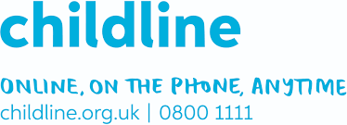
Teacher: A teacher you trust or your mental health lead would be a good place to start, but be aware that if something is putting you in danger, they have a duty to pass it on.
GP: Your GP or practice nurse can help with addiction – many run stop smoking clinics.
Brook Clinic: this is mainly for sexual health advice, but they can also support with addiction.
Helpline: Childline is free and confidential. If you don’t want to ring, you can leave a message.
The site contains
Info and advice
Just use the search box to find info and advice on whatever it is that you’re bothered about, from bulling to body issues, and school to sex.
Support
If you need to talk to someone online, you could get in touch with a 1-2-1 counsellor, check out the message board, or write a letter to Sam, as well as look at previous letters that have been written and responded to, about similar issues.
Toolbox
Watch videos, do some artwork, play distraction games, or even download an app. Lots here to help you to switch off and relax.
(Quizlet, 2019)

Slide 15
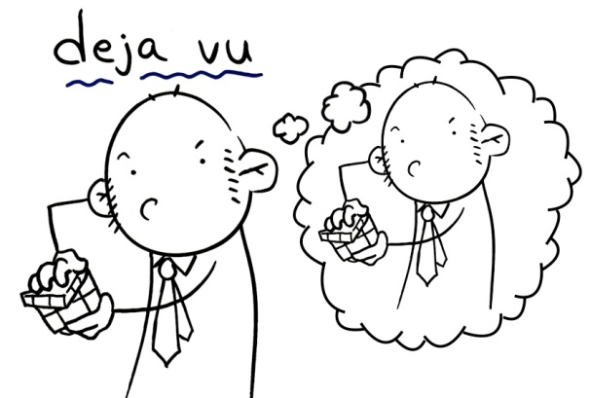
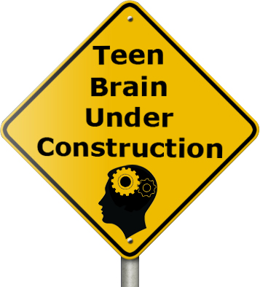
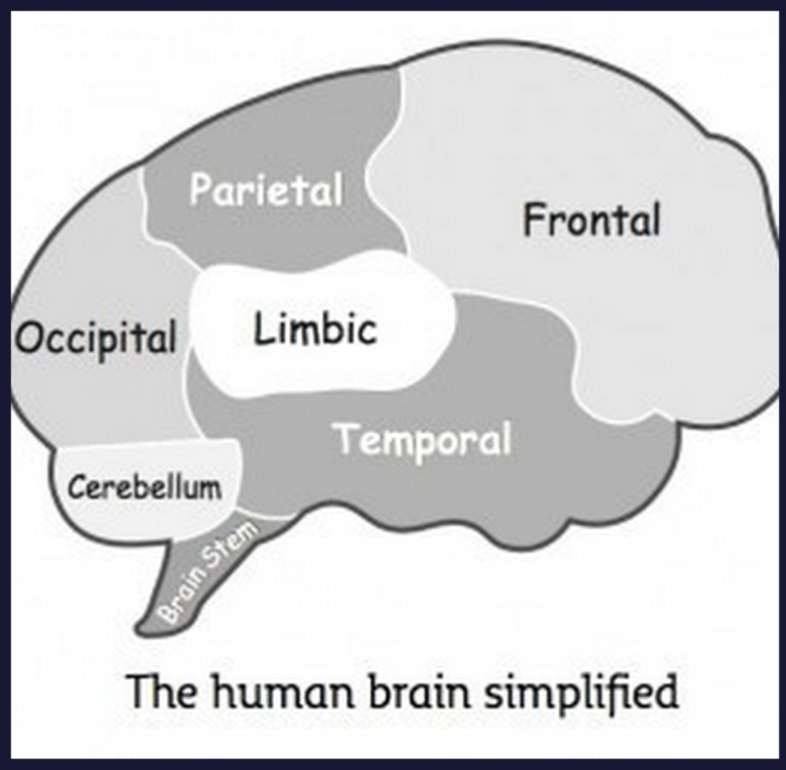
The Teenage Brain
From the Core Unit (slides 50-53), we know that the brain is split into different zones that are responsible for different functions:
The Limbic System is your emotional caveman brain: this area of the brain helps keep you alive by recognising danger and responding with the fight, flight or freeze reaction.
The Frontal/ Prefrontal cortex is your thinking brain: this is where your logic and reasoning takes place, it is also helps with your organisation.
As a teenager, your Limbic system is already fully developed, but your pre-frontal cortex doesn’t finish developing until your mid twenties. The pathways that connect the two are also not yet fully developed.
(Halton Region, n.d.)
This means that whilst your limbic system is fully alert and tells you when something is wrong, your pre-frontal cortex is slow at figuring out what, and, more importantly, what to do about it. In addition, it is really bad at working out the long term consequences which is why teenagers:
Take more risks
Appear to have no common sense at times
React emotionally to lots of things
Take things more personally rather than looking for more logical explanations
It’s not your fault, blame your brain!
(There’s a book called Blame my Brain by Nicola Morgan if you want to find out more)
(Peters, 2012)
(Jensen & Nutt 2014)

Slide 16
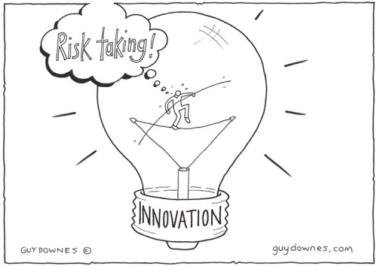
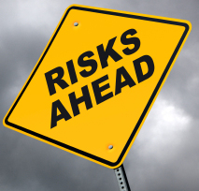
Risk Taking
We are all risk takers – it’s a natural part of life and programmed into us. If we were not prepared to take risks, we would not survive. If you don’t risk failure when studying for an exam or going for a job, you will definitely not achieve it. If you don’t risk trying something new, or meeting new people, then you will never move on with your life. As a species we would still all be cavemen/ women. Risk is inherent in everything we do.
When we take a risk and it pays off - maybe you passed the exam, got the job, scored in the match, came off the rollercoaster alive - whatever, our brain rewards us with the release of dopamine which feels a bit like excitement. Dopamine gives is a buzz, it creates the ‘wow’ factor, the ‘I did that’ factor. It is extremely pleasurable which is what makes us continue taking risks. The more you experience that dopamine rush, the more you want to experience if, hence the more you go looking for it.
The problem for teenagers is that whilst they are programmed to take risk, their pre-frontal cortex which helps you think things through and weigh up the pros and cons of the risk, is not fully developed, neither are the pathways that link this part of the brain to the limbic (emotional) part. This means that adolescent risk taking is more risky than adult risk taking especially as it can be based on something as simple as ‘I felt like it’, or ‘it seemed a good idea at the time’.
(Peters, 2012)
Food, alcohol, drugs and sex are easy ways for the brain to produce dopamine. We know that once dopamine has been produced, we’re motivated to want more of it, this can lead to dangerous levels of risk taking and addiction.
(Morgan, 2013)

Slide 17
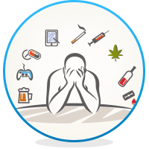
Addiction
We know that the teenage brain responds differently to dopamine than the adult brain, and we know that it is still developing. Teenagers often have an exaggerated response to dopamine which means they are even more motivated to want to repeat it – the bigger the reward, the more you want it. It’s easy to understand then how this can lead to addiction.
Drugs, alcohol, gaming, gambling etc cause a surge in the level of dopamine in the brain. Substances such as drugs and alcohol also interfere with the normal progress of the brain, making it slower and more sluggish.
If the brain receives too much dopamine, it can respond by becoming more tolerant to it, meaning, more is needed to get the same response.
This means that in ‘normal’ everyday circumstances, the dopamine system is not producing enough which makes things seem dull and unexciting, creating depression like symptoms.
(Philips, 2018)
The brain craves more dopamine to create a feeling of normality.
(Morgan, 2013)

Slide 18
Make your own Quiz
Question:
Answer:
What is addiction?
Addiction is psychologic or physical need for a substance (e.g. drugs) or process (need to do something e.g. exercise) where the person will risk negative consequences in an attempt to meet the need.
Think about the quiz cards used in the starter activity.
In pairs or groups of 4, write down questions and answers on the cards ready for a class quiz.
Don’t be too obvious – you don’t want to make it too easy for your opponents.
Question:
Answer:
Question:
Answer:

Slide 19
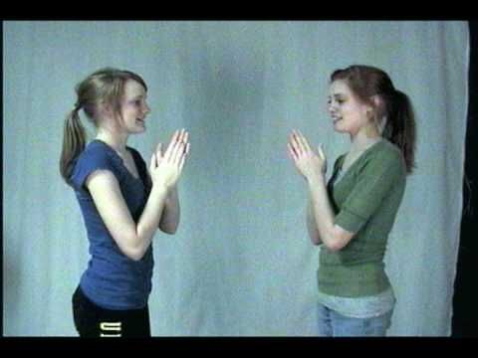
Mirror clapping
As a class (teacher included), stand in a circle – you may have to move the tables a bit in order to do this. Don’t worry you’re not going to be moving around much once you are in the circle.
The first person (teacher) faces the person on the left of him/ her. They each clap their own hands (not the other person’s) but they try to synchronise the clap so it happens at the same time and sounds like 1 clap. No talking is allowed, so this requires watching each other’s body language.
This person then turns and looks at the person to their left and they try to get a synchronised clap. (Teacher – if they are way out – don’t let them off – have them try again.) The clap then continues going round the circle 2 or 3 times. (Teacher – once pupils have got the hang of it, try to get the group to speed up)
Notice how they’re carefully watching each other to see what the other person is doing.
Once everyone is clear about the task. Teacher introduces two claps, which again have to be done synchronised with the partner (this means watching body language to see if the other person is going to clap again). When somebody gives two claps, the clap changes direction and goes the other way around the circle.
If this is too easy – try using a movement instead – again no talking – the purpose is to watch and mirror body language.

Slide 20
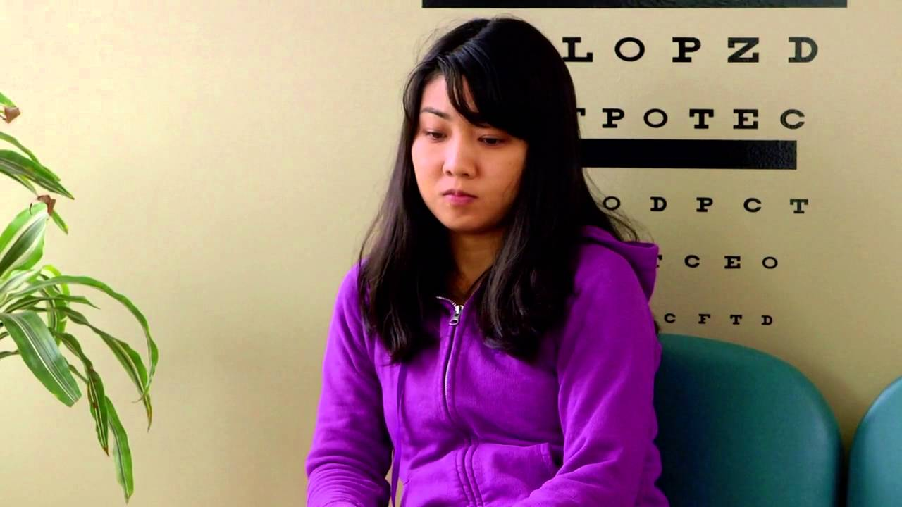
Mirror Neurons
Human beings work best and have the highest chance of survival when they work together in groups. It is easier to pick of a lone person than a group of people working together, therefore, an important part of our genetic make up is the need to get along with other people. In order to help us do this, our brains contain mirror neurons, cells that help us mirror or copy the people around us so that we fit into society.
As babies, we learn how to be, by copying our parent/ care givers (stick out your tongue at a baby, and they’ll do the same back). When we become teenagers, the most important group to copy and fit into are our peers, therefore, we adapt our behaviour in order to fit in; we are genetically programmed to do it.
(Perry & Szalavitz, 2010)
Click on the picture to find out more about the need to conform.
Whilst this is quite a funny example, the implications of this can be quite serious.
If you’re with a group who are all smoking, drinking, doing drugs or whatever, it becomes normal to do the same.
If you include the fact the teenagers naturally take more risks, that their thinking brain isn’t fully developed yet, and the fact drugs/ alcohol etc provide our brain with dopamine, it is easy to understand how it is possible to start doing something that is out of character, and how easy it could be to become addicted.
The answer: Chose your friends/ group wisely
https://www.youtube.com/watch?v=b9O9SokTTA8
(Brain Games, 2017)

Slide 21
To finish …
Use the information we have looked at in today’s lesson to write 4 or 5 sentences explaining why teenagers are at high risk of addiction.

Slide 22
Lesson 2: Cannabis Confusion
Resources
EGGS!!! Meringues, custard & mayonnaise products for taste tests. (The more effort put in here, the more impact the lesson will have.)
If possible, a clear bowl and whisk (ask food tech)
Print slides 28 & 29 (one each)
Previously prepared post it notes for slide 30. (For each group of four/ five pupils, have ready post it notes with, instructions of how the pupil should be treated by the rest of the group – see instructions of what to write)
This lesson will examine the difference between recreational and medicinal cannabis, and the dangerous impact it can have on the developing brain.
Learning Objectives:
To understand the difference between medicinal and recreational cannabis.
To understand how the impact cannabis can have on the developing brain.
To recognise common misconceptions about cannabis.
Slide | Time | Activity
24 | 10 min | Settling/ register activity. Brainstorm prior knowledge of cannabis, then spend 5 minuets discussing what pupils think they know about the drug.
25-26 | 10 min | Please note this lesson will have far greater impact if you use real eggs and bring in examples of meringues, mayonnaise, custard etc, so pupils have a visual, tactile and taste memory of the lesson. If you have one, a fake bouncy egg would be great to ask a pupil to catch! Examine the different components of an egg – if possible break an egg and separate the white from the yolk, or ask a pupil to have a go. Try whisking an egg white to demonstrate what happens and hold the bowl upside down over a students head, but show how an egg yolk responds differently. Discuss and taste the meringues and custard/ mayonnaise products. The more you discuss and demonstrate the difference between egg whites and yolks, the greater their understanding of slides 27 & 28.
27 | 5 min | Read and discuss slide – relate the different parts of cannabis to the different parts of egg. Question pupils about stories they have heard in the news, or of things they know people have done when ‘stoned’.

Slide 23
Lesson 2: Cannabis Confusion
Slide | Time | Activity
28 & 29 | 10 min | Read through the slides and watch the clip on slide 29
30 | 7 min ***** Import-ant – prepare this before lesson ***** | Divide class into groups of four or five pupils. Give pupils just over 5 minutes to discuss brain teasers. Important – before lesson, prepare post it notes with instructions of how the pupil should be treated by the rest of the group. For each group have: Act like I know everything Agree with what I say to shut me up Ignore me because I’m always wrong Get annoyed with me when I try to talk Act like I’m always talking too loud Whilst discussing, go round and put post it notes on head, tell pupils not to spoil it by looking. Tell pupils to treat their class mates in the ways described. (Know your pupils, don’t give the ‘get annoyed’ one to someone who you know is volatile) Monitor the class and stop the discussions if you think it’s starting to cause trouble. Don’t allow more than 5 mins for discussions.
30 & 31 | 5 min | Tell pupils to look at their post-it note, then discuss how pupils found the experience. Explain that having paranoia, or a delusional belief can feel a bit like that because you have another agenda. Whilst the task was to discuss the brain teasers – their real agenda was to try and work out what was written on their head. Highlight how distracting and uncomfortable it can be. Don’t forget to reveal the answers to the brain teasers (slide 31)
32 | 5 min | In books pupils to write down questions, leaving half a page after each one. Answer with True or False
33-36 | 10 min | Read through and look at the answers – pupils to make some notes in their books.
37 | 3 min | Plenary: Q&A about the images on the slide

Slide 24
Lesson Two: Cannabis Confusion
Learning Objectives:
To understand the difference between medicinal and recreational cannabis.
To understand how the impact cannabis can have on the developing brain.
To recognise common misconceptions about cannabis.
Starter: Brainstorm everything you know about cannabis, including other names for it.
Weed
Cannabis
5 minutes
Stoned
Used for epilepsy
Rachel Symons

Slide 25
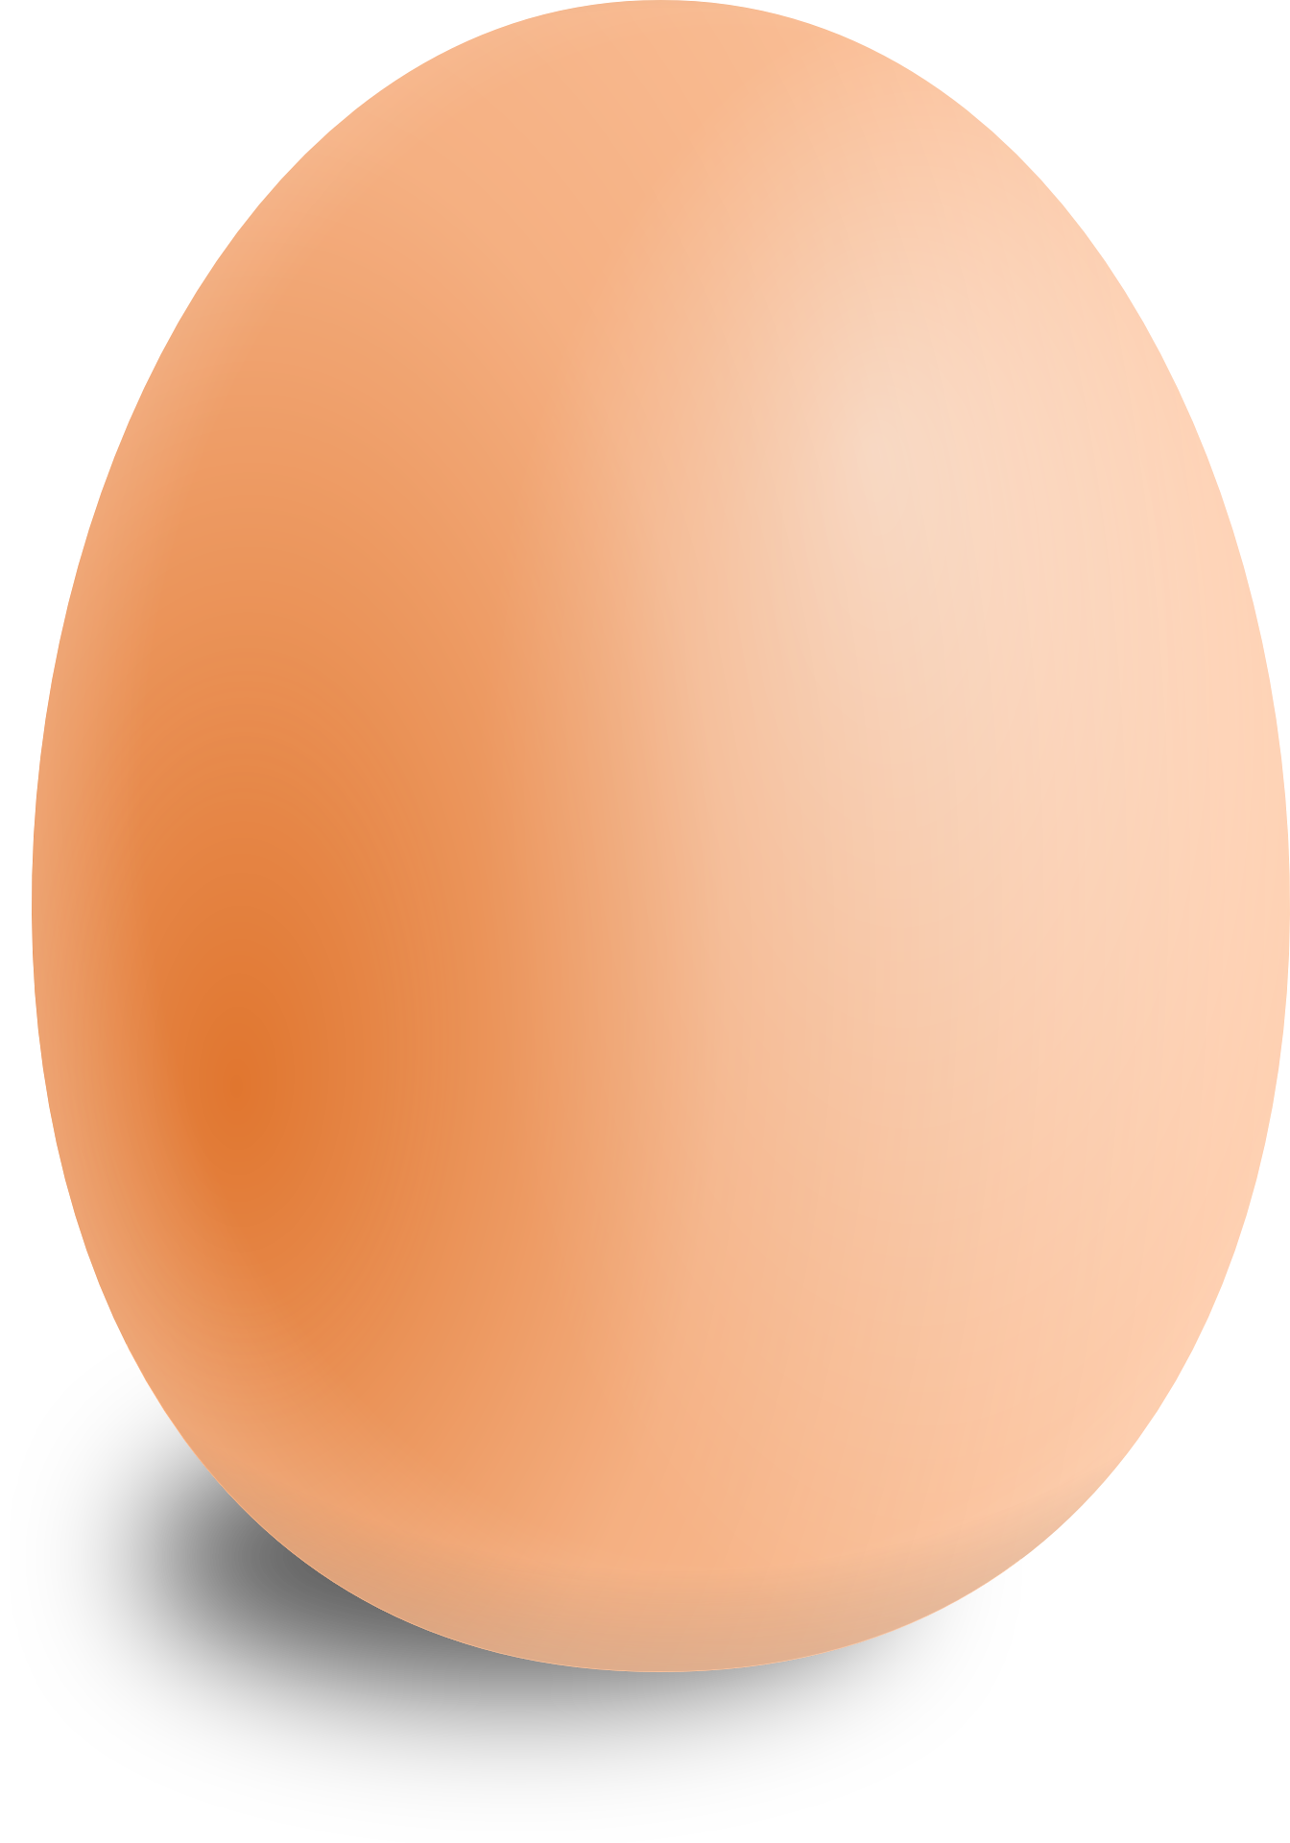
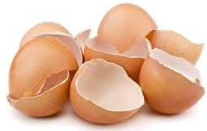
An egg’s just an egg, isn’t it?
Look at an egg – it’s quite simply an egg isn’t it? And, one egg is pretty similar to another, right? You might not like them, and they might smell a bit, but you can eat them without too much worry can’t you?
Whilst an egg is quite simple, you can split it into 3 separate parts:
The Egg Shell
This is a vital part of the egg, it protects it, and, well, can you imagine how messy it would be if eggs didn’t have a shell? But you wouldn’t want to eat that part, right? I mean it probably wouldn’t do you too much harm but ever ended up with a small bit in some scrambled egg? Not nice.

Slide 26
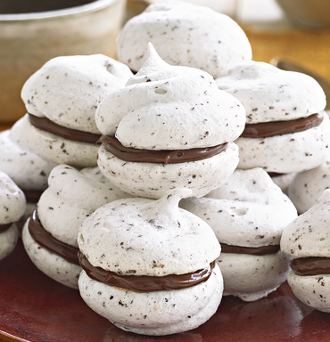
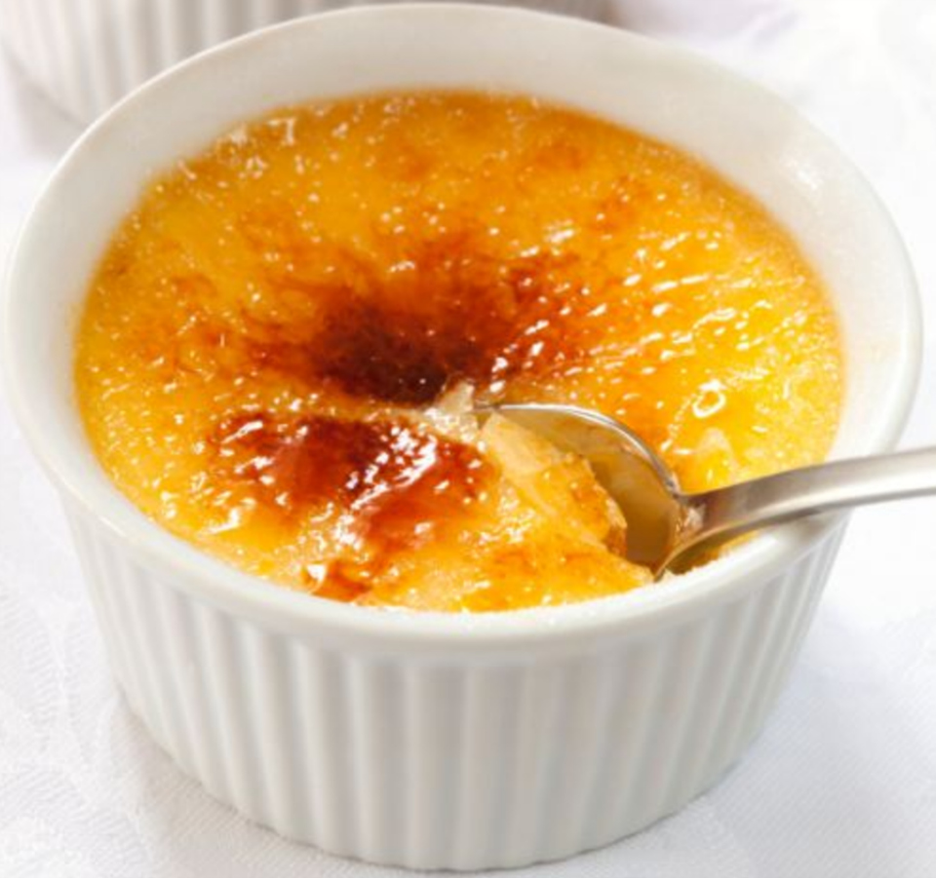
An egg’s just an egg, isn’t it?
The Egg White
It’s quite hard to separate an egg, but if you’re a cook, sometimes you have to. The egg white is the ‘snotty’ looking part when it isn’t cooked which turns white when you heat it up. The egg white contains quite a bit of protein.
Egg whites can be whisked up, with sugar, to make meringue, but even if you get a small bit of yolk in it, the meringue will not form properly and will be ruined.
The Egg Yolk
The egg yolk is the rich tasty part of the egg – the happier the chicken, the larger, more yellow and tasty the egg yolk. The yolk contains more vitamins and nutrients than the white.
Egg yolks are used to make custard and mayonnaise (although, not together – yuck!).

Slide 27
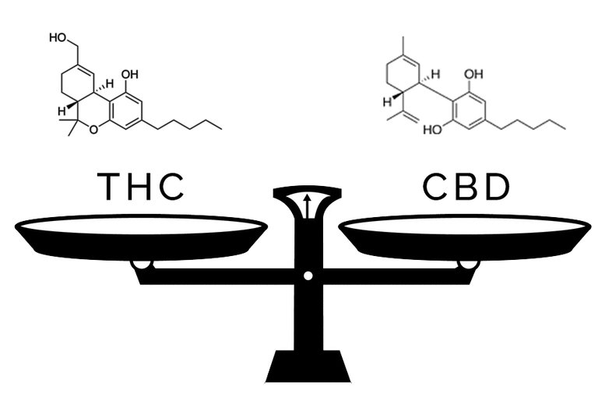
But so what?
We can all agree that there are different parts to eggs, all of which have different purposes. The same is true with cannabis.
In the news, there has been a lot of talk of medicinal cannabis being used for things such as epilepsy, arthritis an even cancer.
Whilst there is a growing argument for medicinal cannabis and you can now buy weak versions of it from chemists/ health food shops, this part of cannabis is very different to the cannabis bought and used for recreational purposes.
Just like an egg has different components, so does cannabis, the main being THC and CBD.
THC = Recreational (high) part of cannabis.
CBD = Medicinal component of cannabis.
In other words – they are not the same thing!!
Recreational cannabis is controlled as a class B drug under the Misuse of Drugs Act. The maximum sentence for possession is 5 years and a fine or both. For possession with intent to supply the maximum sentence is 14 years or a fine or both
(Drugwise, n.d.).
Recreational
Medicinal
tetrahydrocannabinol
cannabidiol

Slide 28
THC vs CBD
Recreational
Medicinal
CBD
CBD is the ‘good’ part of cannabis, it is the bit that eases muscles and appears to be effective on epilepsy and other illnesses.
Crucially, CBD is also an anti-psychotic (it prevents pscyhosis). Traditionally THC and CBD have been pretty equal balancing out the risk of psychosis. However, as the amount of THC has increased, so the amount of CBD has decreased, creating greater risk of psychosis.
THC
The THC part of cannabis is the bit that gets you high, it is the reason people smoke it. The thing is drug dealers know this, and therefore they’ve engineered cannabis to be higher in THC so that it is more potent. However, one of the negative parts of THC is that it can cause psychosis (we’ll examine this more later).
Traditionally, in the 1960s cannabis contained equal amounts of THC and CDB – about 3% potency for both.
(Murray & Di Forti, 2016)
All this means that anyone who uses cannabis today is at far greater risk of having a psychotic experience than someone in the 60s. Marijuana actually doubles the risk of a psychotic episode and users are six times more likely to develop schizophrenia. (Jensen & Nutt 2014)
What is worse is that because the teenage brain is still developing, adolescents are at greater risk of experiencing permanent changes in their brain which can affect adult brain functions and behaviour.
(Rubino &Parolaro, 2008)
This meant that any potential psychosis was offset by the CBD.
Today in England the strength of THC is about 16% but the strength of CBD is much reduced. Some of the newer strains of weed have as much as 40% THC but no CBD.
(Murray & Di Forti, 2016)

Slide 29
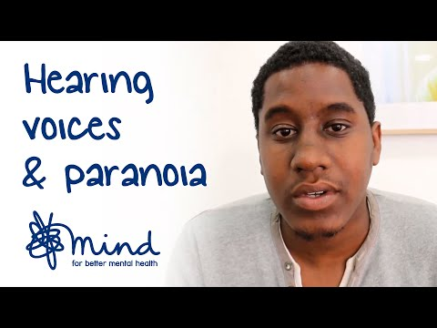
What is psychosis?
People can have a one off psychotic episode, for example as a result of smoking weed, which goes away, once they sober up.
However, if you have one psychotic episode, you are at greater risk of more if you continue to use cannabis. For some people, using cannabis may trigger a lifetime of having such episodes. People who have frequent episodes are diagnosed with schizophrenia.
Psychosis is when you experience the world differently from other people, or ‘lose touch with reality’.
You may have hallucinations, these can be:
Visual – you see things that other people can not see
Auditory – you hear things that other people can’t
Olfactory / taste – you smell or taste things that are not there.
Tactile – you feel strange sensations, for example, insects crawling on your skin.
Some people have delusions
These are unshakeable thoughts or beliefs that are different from those of people around them, and which can’t be proven to be true. For example
Someone is trying to kill you
You are the King/ Queen of England and own all the country.
You have a strange illness that is killing you for which there is no evidence.
Click on the image to find out more.
Disorganised thought and speech
This is why your mind is racing so you have lots of different thoughts very quickly changing the conversation topic very quickly as your mind jumps from one thing to another.
(Mind, n.d.)
https://www.youtube.com/watch?v=KYW86kX3Ea8
(Mind, 2016)

Slide 30
Discussion Task
You are going to discuss any of the brainteasers shown on this slide.
Whilst you are discussing, your teacher is going to stick a post-it note on your head (DO NOT LOOK AT IT), it will tell the others how to treat you during the discussion.
Whilst you are discussing the brain teasers, treat the other members of the group by the instruction on their post-it and try and work out what your post-it says by how the others are treating you.
e.g. if the post-it note said ignore me, then you would ignore the person’s suggestions.
A man condemned to death has the option of picking one of the mentioned three rooms. The first room is a furnace filled with flames. The second has armed men with loaded guns, while the third has lions starving for years. Which one should the man choose?
What has a mouth, but cannot eat; moves, but has no legs; and has a bank, but cannot put money in it?
Your parents have six sons including you and each son has one sister. How many people are in the family?
A boy is walking down the road with a doctor. While the boy is the doctor’s son, the doctor is not the boy’s father. Then who is the doctor?
A man pushes his car to a hotel and tells its owner that he is bankrupt. Why?
(Icebreaker Ideas, 2016)

Slide 31
How did you find the task?
Act like I know everything
Agree with what I say to shut me up
Ignore me because I’m always wrong
Get annoyed with me when I try to talk
Act like I’m always talking too loud
What has a mouth, but cannot eat; moves, but has no legs; and has a bank, but cannot put money in it?
A River
A man condemned to death has the option of picking one of the mentioned three rooms. The first room is a furnace filled with flames. The second has armed men with loaded guns, while the third has lions starving for years. Which one should the man choose?
The third one – the lions would be dead if they had been starving for years.
Your parents have six sons including you and each son has one sister. How many people are in the family?
Nine. Two parents, six sons, and one daughter. All of them have one sister (not six sisters).
A boy is walking down the road with a doctor. While the boy is the doctor’s son, the doctor is not the boy’s father. Then who is the doctor?
The boy’s mother
A man pushes his car to a hotel and tells its owner that he is bankrupt. Why?
He is playing Monopoly
(Icebreaker Ideas, 2016)

Slide 32
True or False?
Task:
In your books write down the questions below. Leave half a page after each question so that you can make notes later. Think about the answer to each question.
5 minutes
Smoking cannabis makes you stupid
Cannabis makes you better at thinking deeply about yourself
Cannabis isn’t addictive
Cannabis has more cancer causing chemicals than tobacco
Cannabis helps you relax
Cannabis has a greater effect on adults than adolescents
You can trust your dealer – they wouldn’t sell bad stuff.
As we go through the answers use the space you have left to make some notes, so you remember for next lesson.

Slide 33
True or False?
Smoking cannabis makes you stupid
Adolescents who smoke pot have been shown to have smaller brain volume with increased damage to the pre-frontal cortex (the thinking part of the brain) when compared to non-users. Cannabis interferes with the pathways to the prefrontal cortex which is where most ‘thinking’ takes place and it can cause problems with memory. Because this part of the teenage brain is still developing, cannabis has a greater impact with memory problems lasting for longer than in adults. For teenagers who regularly use, this can become a long term problem. Several studies have shown that adolescents who smoke cannabis have a lower IQ than those who don’t, worse that even when they stop using the drug the IQ doesn’t recover (Meier, Caspi, Ambler, Harrington, Houts, Keefe... & Moffitt, 2012).
True
Cannabis makes you better at thinking deeply about yourself.
Cannabis interferes with the part of your brain that helps you reflect and notice errors or mistakes that you make. This is something also found in people who suffer from schizophrenia. In addition, people who smoke regularly have less ‘white matter’ (thinking part of the brain) than those who don’t, this too is seen in people who suffer with psychosis.
False
(Jensen & Nutt 2014)

Slide 34
Cannabis isn’t addictive.
In the limbic brain, there is a small part called the amygdala – it is this part that helps govern our emotions and keeps a look out for potential threats to spark the fight, flight or freeze reaction; as part of this, it recognises things that are new or different as something new might be a threat. When this part of the brain becomes flooded with THC, it becomes over active, so things that are normal, become heightened, which is why some smokers experience colours or tastes more vividly than usual. Once this part of the brain has been overactivated, it takes more than normal amounts of stimulation to become activated and interested in things again, which can lead to the brain ‘needing’ more pot to stimulate it.
Early teen users are twice as likely to become addicted compared to those who try it after the age of 16. About 17% of teenagers will become addicted, this rises to as high as 50% for those who use daily (Cannabis Skunk Sense, 2015). In addition, changes that cannabis makes to the developing brain can increase addict-ability, meaning increased likelihood of becoming addicted to other substances as well.
False
Cannabis has more cancer causing chemicals than tobacco.
Tar and carbon monoxide are three to five times higher in cannabis than in tobacco and has 50% to 70% more cancer causing chemicals. Because people who smoke pot hold it in their lungs for longer than people who smoke tobacco, it causes greater damage and increases the damage caused by the tobacco. Smoking pot in a bong does not stop you inhaling these dangerous chemicals as they do no dissolve in water.
(Jensen & Nutt 2014)
True
(Jensen & Nutt 2014)

Slide 35
Cannabis helps you relax.
For some people, experiencing senses in a heightened way can help them for get their troubles and relax. For other people though, especially those susceptible to psychosis, it can increase anxiety, making them more paranoid and give them delusional beliefs which are unshakeable. In addition, research has shown that people who used cannabis from a young age had a 50% increase in the likelihood of suffering from clinical (long lasting) depression when they were older.
True and False
Cannabis has a greater effect on adults than adolescents.
Because teenager brains are still developing, especially the thinking part, the frontal and prefrontal cortex, it has a greater and longer lasting effects, in some cases, causing permanent changes. Whilst your parents or someone older may have smoked when they were younger and turned out fine, the cannabis being smoked today is far more potent and therefore dangerous than the cannabis smoked, even 10 years ago.
False
(Jensen & Nutt 2014)

Slide 36
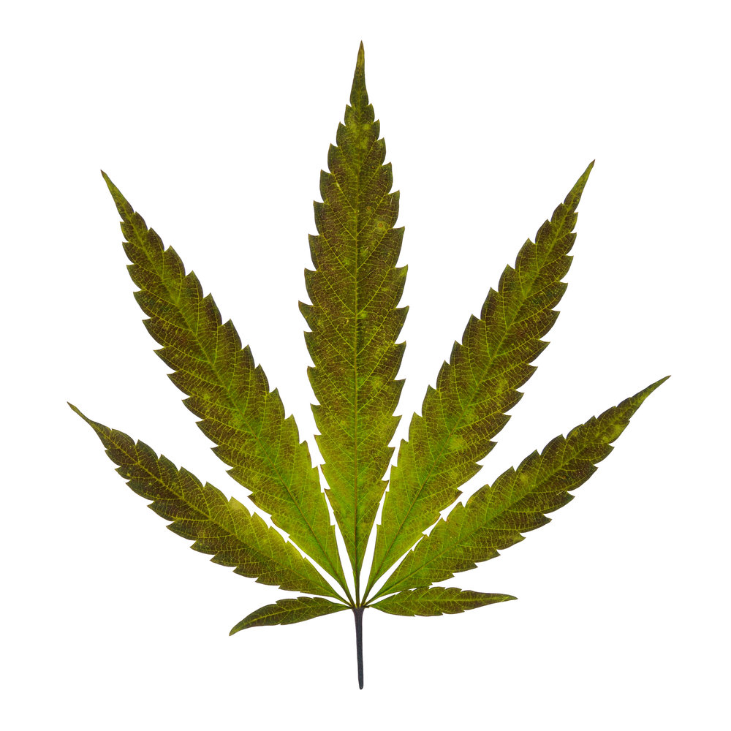
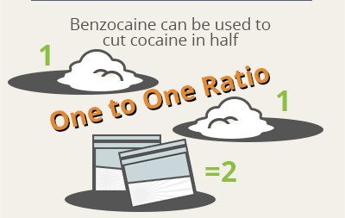
You can trust your dealer – they wouldn’t sell bad stuff.
Many people believe that they can trust their dealer – they may know them as a friend, may have sat with them and shared a spliff and s/he may be a very nice person. However think about the journey illegal drugs go on before reaching the local dealer.
Cannabis
Cannabis is the most commonly used drug in the UK and the industry is work about £1billion a year. The National Crime Agency estimates that 270 tonnes of cannabis is needed to satisfy annual UK user demand. Most cannabis in the UK is imported from countries like Afghanistan, Morocco and South Africa.
(National Crime Agency, n.d.)
UK distribution
Once the drugs get into the UK, they are sent to major cities like London, Liverpool and Birmingham; they are then sent onto smaller cities and towns before being sold in bulk to a dealer who then sell to local dealers. That means a LOT of people handle the drugs before they are sold to individuals through local dealers. As the drugs go through each stage, there is the potential for them to be ‘cut’ with other substances to increase the profit made by each person in the chain.
(National Crime Agency, n.d.)
Cutting Agents
Powdered drugs are often cut with substances like paracetamol or chalk; weed, with herbs, for example oregano. In 2011/2010, street drugs actually only contained 8 to 20% of the drug it was being sold as. This is extremely dangerous as the cutting agents may be damaging to health (e.g. rat poison), or if a purer version of the drug is sold, the individual can easily overdose.
(National Crime Agency, n.d.)
Regardless of how well you know the dealer, they can never be 100% of the product they’re selling, it’s impossible.
(Sunrise House, n.d.)

Slide 37
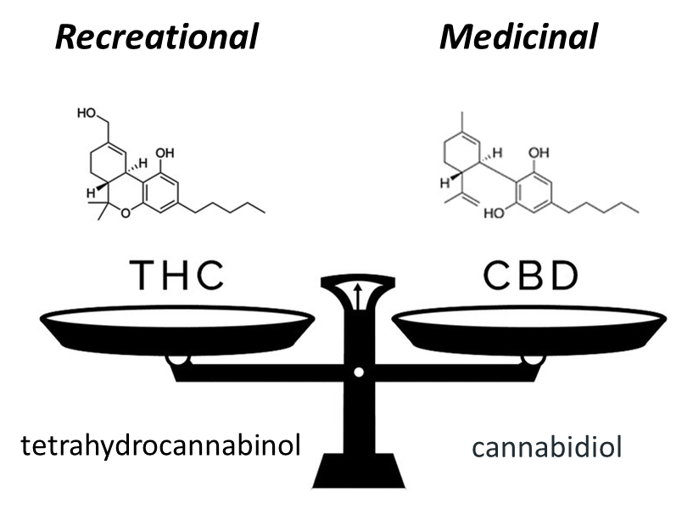
To finish …
What have you learnt?

Slide 38
Lesson 3: Good Golly it’s Molly
Resources
Print slides 40 – 42 (1 between 2 should be enough
Slide 44 (1 each to take home)
This lesson will examine the physical and mental health dangers of MDMA (Molly or Ecstasy) before asking pupils to bring together their understanding from the unit to complete a task of their choosing.
Learning Objectives:
To recap knowledge of the dangers of cannabis
To understand the impact MDMA (Molly) has on the teenage brain.
To demonstrate knowledge of the unit by completing a task of own choosing.
Slide | Time | Activity
39 | 10 min | Settling/ register activity. Individually write a short paragraph about the differences between THC an CBD (remind pupils of notes written previous lesson). Spend 5 mins Q&A points from last lesson.
40-42 | 15 min | Print slides 40 – 42 (1 between 2 should be enough – they will need access to the information in order to complete the later task but won’t all need to look at the same sheet at the same time) Read through slides, watch the 2 clips and discuss pupil reactions. When looking at news item (slide 42) remind pupils of ‘conformity waiting room’ clip from 1st lesson, and how easy it would be to take a drug in a setting where everybody else is taking it.
43 | 25 min | Remind pupils of notes on cannabis written the previous lesson. Use those notes and the information from today’s lesson to complete one of the tasks.
44 | 10 min | Print slide 44 (1 each to take home) Read through and discuss slide ensuring pupils have understood.

Slide 39
Lesson Three: Good Golly, it’s Molly
Learning Objectives:
To recap knowledge of the dangers of cannabis
To understand the impact MDMA (Molly) has on the teenage brain.
To demonstrate knowledge of the unit by completing a task of own choosing.
Starter:
Think back to last lesson. Write a short paragraph (4 to 6 sentences) about the difference between THC and CBD in cannabis.
If you were off last lesson, write a short paragraph about what you know of the dangers of cannabis.
5 minutes
Rachel Symons

Slide 40
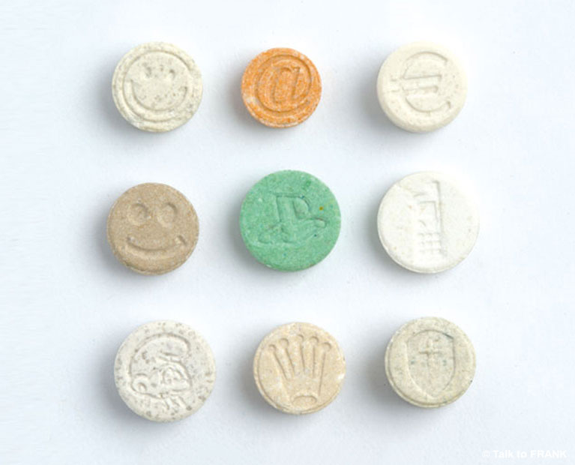
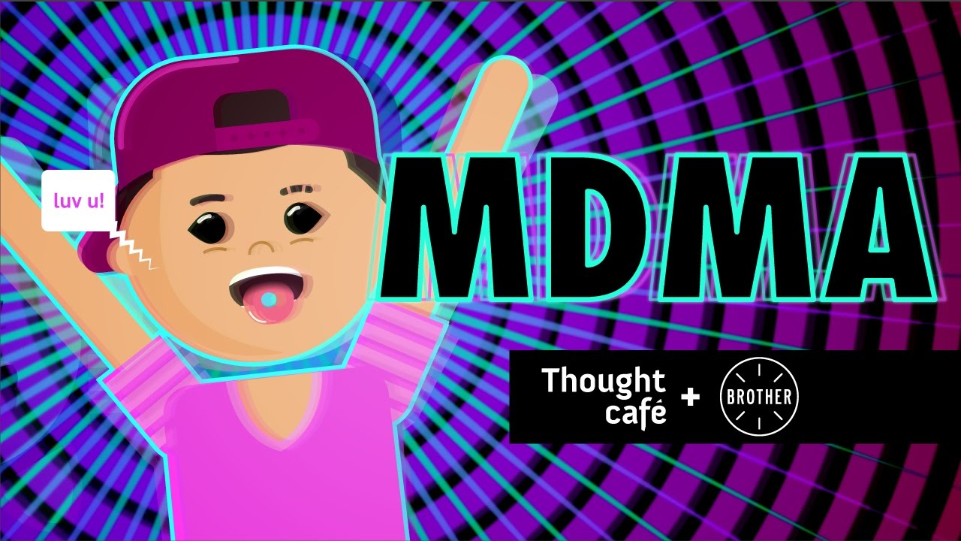
What about Molly?
Molly is also known as ecstasy (sold in pills) or MDMA (sold as a powder), Mandy or MD. It is a stimulant and mild hallucinogen.
Stimulant - increases heart rate and blood pressure which increases energy levels.
Hallucinogen – distorts your senses (you see and hear things differently to normal) and distorts your perception of time
How it works:
MDMA makes you feel really good about yourself and people/ things around you. It does this by working on two chemicals in your brain:
Dopamine: MDMA activates the dopamine reward system which makes you feel good but which also makes it highly addictive.
Serotonin: Molly releases large amounts of stored serotonin.
Ecstasy or MDMA is a Class A drug, which means:
There is no medicinal use for ecstasy or MDMA.
It's illegal to have for yourself, give away or sell.
Possession can get you up to 7 years in prison, an unlimited fine or both.
Supplying someone else, even your friends, can get you life in prison, an unlimited fine or both.
Serotonin improves your mood, creates feelings of emotional closeness and increased empathy. (This is why it’s often taken as a drug to enhance sex). The problem is, because it uses your stores of serotonin, you feel very low afterwards because your body needs to reproduce more. Click on the picture to find out more.
(Frank, n.d.)
https://www.youtube.com/watch?v=d8Uw4Hkh1OA
(Frank, n.d.)
(Thought Café, 2016)

Slide 41
Long term effects on the brain
In the short term, when serotonin levels drop, users feel a ‘come down’ where they feel irritable and anxious. Serotonin is essential to regulate our mood and is linked to ‘working’ or ‘short term’ memory (remembering what you’re doing, why you went in that room etc), people who don’t produce enough serotonin often suffer with depression (most anti-depressant drugs work on the serotonin levels in the brain). It also impacts on their memory, which is not good if you’re a school and studying for exams.
Same old problem
For teenagers the situation is even worse; because the brain is still developing, it can cause long term issues with depression and memory. The drug also has a greater effect on the teenage brain’s dopamine reward system with research showing the teenage brain:
is activated by lower amounts of the drug
is more motivated to get it
(Jensen & Nutt 2014)
this means they become addicted faster and harder than adults.
(Jensen & Nutt 2014)
(Halton Region, n.d.)
Because MDMA is a powder (or powder pressed into a tablet), it means there is very high probability that it has been cut with something on its journey to the local dealer. This is dangerous because:
You don’t know what it has been cut with and you may have a bad reaction.
The drug might be purer than you’re used to causing you to take too much.
(Sunrise House, n.d.)

Slide 42
Physical health risks
Because it speeds up the heart and blood pressure and it impacts on the brain it is especially dangerous to anyone who has a heart condition, blood pressure problems, epilepsy or asthma.
Ecstasy can also release a hormone which stops you being able to make urine. This means it’s also easy to drink too much as your body can’t get rid of it, this can be as dangerous as not drinking enough.
Someone who has had ecstasy should sip no more than 1 pint of water (or other non-alcoholic drink) an hour.
The strength of ecstasy/ MDMA is unpredictable because it is often cut with other substances, which means you can easily take too much by mistake.
It has been linked to liver, kidney and heart problems.
Ecstasy raises the body's temperature. If you add that to the fact it’s often used as dance drug in clubs to help people keep going for longer, there is a real chance of overheating and dehydration.
It is important people using it take regular breaks from the dance floor to cool down and have a drink. If you are with someone who has used it, it’s important to encourage this because, they might not realise how overheated/ dehydrated they are becoming.
(Frank, n.d.)
Click on picture to hear news story
https://www.youtube.com/watch?v=ypLt9jKiV4c
(Five News, 2016)

Slide 43
Task
Use the images from the past 3 lessons, your notes and the information sheets available to complete 1 of the following tasks:
Design a leaflet warning teenagers of the dangers of doing drugs.
Write an article for a teenage magazine, informing of the dangers of MDMA or cannabis.
Draw a picture that represents the difference between THC and CBD in cannabis.
Write the diary of the parents or friend of the girl featured in the news extract, describing what happened and how you feel.
Write thought of a person who is high on MDMA, then that person’s thoughts when they are coming down from it.
Write an apology to you parents explaining why you took drugs when you were at a party (think about pressure to conform)

Slide 44
Staying Safe
All of you are going to come into contact with drugs at some point, some of you probably already have.
The purpose of these lessons was to give you the information you need to make an informed decision. If you want to know more about specific drugs check out Talk to Frank.
If you do decide to experiment with drugs, then do so as safely as possible and know what to do in an emergency.
What to do
The first things you should do are:
stay calm
calm them and be reassuring - don’t scare them or chase after them
try to find out what they’ve taken
stay with them
If they are anxious, tense or panicky :
sit them in a quiet and calm room
keep them away from crowds, bright lights and loud noises
tell them to take slow deep breaths
stay with them
What to look out for
Someone who is having a bad time on drugs may be:
anxious
tense
panicky
overheated and dehydrated
drowsy
having difficulty with breathing
If they are really drowsy:
sit them in a quiet place and keep them awake
if they don’t respond or become unconscious call an ambulance immediately
don’t scare them, shout at them or shock them
don’t give them coffee to wake them up
don’t put them in a cold bath to “wake them up”
(Frank, n.d.)
In an emergency
If you're with someone who needs medical help, call an ambulance, stay with them and tell the crew everything you know about the drugs taken, it could save their life. If you have any drugs left, hand them over to the crew as it may help. They won't tell the police.

Slide 45
References:
Brain Games. (2017). Conformity (Waiting room). Retrieved from https://www.youtube.com/watch?v=b9O9SokTTA8
Cannabis Skunk Sense. (2015). Marijuana: Facts for Teens. Retrieved from https://www.cannabisskunksense.co.uk/articles/press-article/marijuana-facts-for-teens
Downes, G. (n.d.). Risk taking. Retrieved from http://www.officeguycartoons.com/product-tag/risk-taking/
Five News. (2016). Warning from police after teenage girl dies after taking ecstasy. Retrieved from https://www.youtube.com/watch?v=ypLt9jKiV4c
Frank. (n.d.) Ecstasy. Retrieved from https://www.talktofrank.com/drug/ecstasy?a=MDMA#the-law
Frank. (n.d.) What to do in an emergency. Retrieved from https://www.talktofrank.com/get-help/what-to-do-in-an-emergency
Halton Region. (n.d.). Teen brain: Understanding the teen brain. Retrieved from http://www.halton.ca/cms/One.aspx?pageId=112134
Icebreaker Ideas. (2016). 100 Brain Teasers With Answers for Kids and Adults. Retrieved from https://icebreakerideas.com/brain-teasers/#Brain_Teasers_with_Answers
Jensen, N., & Nutt, A. (2014). The teenage brain: A neuroscientist’s survival guide to raising adolescents and young adults. New York, America: Harper Paperbacks.
Meier, M. H., Caspi, A., Ambler, A., Harrington, H., Houts, R., Keefe, R. S., ... & Moffitt, T. E. (2012). Persistent cannabis users show neuropsychological decline from childhood to midlife. Proceedings of the National Academy of Sciences, 109(40), E2657-E2664.
Mind. (2016). Hearing voices, paranoia and schizophrenia/ Miles. Retrieved from https://www.youtube.com/watch?time_continue=245&v=KYW86kX3Ea8

Slide 46
References:
Mind. (n.d.). Psychosis. Retrieved from https://www.mind.org.uk/information-support/types-of-mental-health-problems/psychosis/types-of-psychosis/#hallucinations
Morgan, N. (2013). Blame my brain: The amazing teenage brain revealed. London, United Kingdom: Walker Books.
Murray, R., & Di Forti, M. (2016). Cannabis and Psychosis: What Degree of Proof Do We Require? Biological Psychiatry, April, 79:514–515 www.sobp.org/journal.
National Crime Agency. (n.d.). Drugs. Retrieved from http://www.nationalcrimeagency.gov.uk/crime-threats/drugs
National Institute on Drug Abuse for Teens. (2014). Real teens ask: Is addiction hereditary? Retrieved from https://teens.drugabuse.gov/blog/post/real-teens-ask-addiction-hereditary-updated
Philips, Z. (2018). Overcoming Addiction. Retrieved from https://www.zachary-phillips.com/realitycheck/41-overcoming-addiction
Perry, B., & Szalavitz, M. (2010). Born for love. Why empathy is essential and endangered. New York, America: William Morrow Paperbacks.
Quizlet. (2019). Addiction (questions and answers). Retrieved from https://quizlet.com/5395115/addiction-questions-answers-flash-cards/
Rubino, T., & Parolaro, D. (2008). Long lasting consequences of cannabis exposure in adolescence. Molecular and Cellular Endocrinology 286S (2008) S108–S113
Sunrise House. (n.d.). What Types of Cutting Agents Are Used in Drug Manufacturing? Retrieved from https://sunrisehouse.com/cause-effect/cutting-agents-drug-manufacturing/
Thought Café. (2016). Your brain reacts: Molly (MDMA). Retrieved from https://www.youtube.com/watch?v=d8Uw4Hkh1OA

