Slide 1


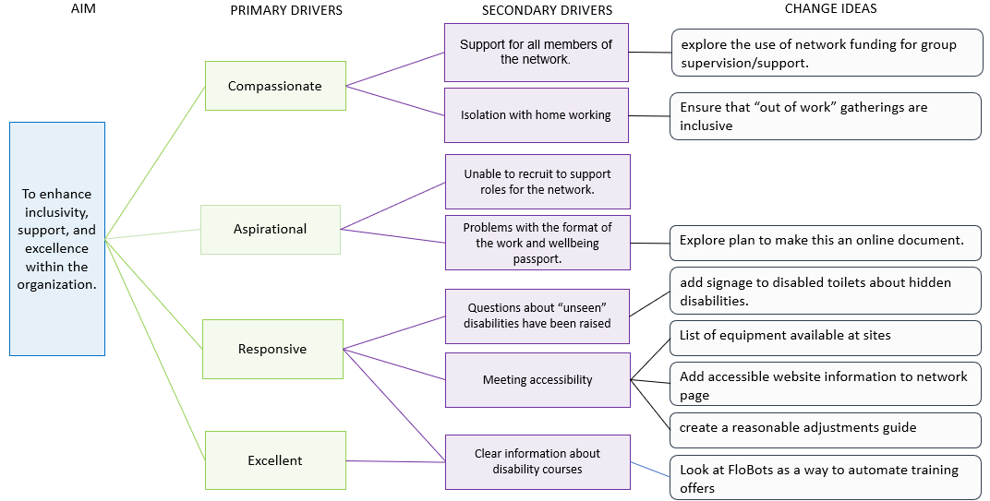
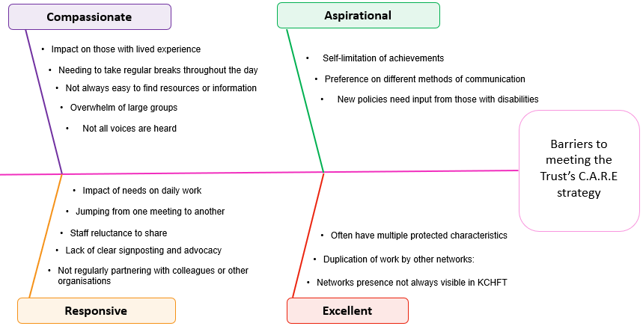
KCHFT ambition: A great place to work
Improvement: Aligning the Disability and Carers Network with trust values
Project team: Helen Merrick, Chair of the Disability and Carers Network
Problem statement:
Our staff members have diverse needs. Those with disabilities and/or caring responsibilities require health and wellbeing support while at work.
SMART aim:
To review the Disability and Carers Network and create a culture that meets the need of this staff group by increasing membership from 29 to 58.
Understanding the problems:
Developing a strategy:
“Really supportive and so much useful information.”
Membership data:
What’s next:
Membership
has grown by almost 400%
continues to achieve and exceed the aim
additional spotlight sessions have a membership of 44 people regularly attending.
We have introduced a series of measures designed to give a robust structure to the network ensuring sustainability and support.
What our members said:
Members want more spotlight sessions, smaller peer support groups, social meet-ups, face-to-face opportunities, and ways to link staff with similar disabilities. They also value the newsletter, buddy scheme, and addressing hearing impairment issues.
Disability and Carers Network
Breakfast Club
Community Showcase
Mental Health Support Taster Sessions
Sites Equipment Log
Develop Champion Roles
Guide to organising events
Training Courses
BSL Interpreters at large meetings
“Amazing, supportive, informative, with Teams chat I feel I can obtain support at any time.”
“I really like the fact that I don’t have to hide myself or pretend that I am ‘normal’.”

