Slide 1
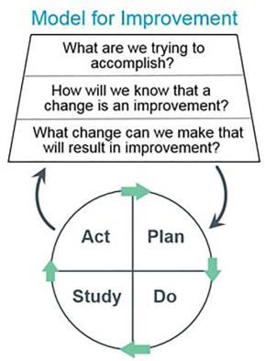
‘What can we do for you?’
A focus on promoting Staff Well-Being
Prepared by: Dionne Shumba
Submitted: 29 March 2022
Introduction
Data Collection: Staff Survey
Research has shown that there is a direct link between staff well-being, staff morale and the quality of patient care our patient's receive. Half of the doctors and a third of the nurses are known to seek another job within a year according to studies.¹
This QI Project embarked on finding out what was most important to our members of staff and how we could make their working experience better, thereby ensuring they are able to give their best when it comes to patient care.
The impact
Improvement Methodology
Current
Openness and honesty among members of the team
Freedom to speak up
Increased collaboration and teamwork
Increased physical and psychological safety
Participative management – ward team leaders are taking more responsibility and accountability in terms of management role and service improvement
Projected
Improved staff well-being
Satisfied staff resulting in better staff retention
Improved patient care and patient experience
Increased productivity
Increased staff morale
The Improvement methodology used was the IHI’s model for improvement. The model incorporates iterative tests of change using PDSA cycles. In addition, it incorporates What matters to you? conversations to gather data.
The study will be incorporation co-production and co-design with a patient volunteer.
The approach
Leadership learning
What we were trying to accomplish
Current
Increased confidence in regards to identifying areas for improvement, driving a QI project and leading a team.
Ability to use different energies and physical presence in order to obtain specific results.
Actively making use of communication and listening skills in order to reach out to staff at all levels and encourage their engagement .
Developing patience and endurance as any project takes time and effort, and it is a mammoth task to get people on board and moving with the vision.
To find out what is most important to our staff, act on what we found out and in turn improve staff engagement and patient care.
What we measured to understand if our change was an improvement
Created an online Staff Survey that was completely anonymous
Our patient co-production/co-design volunteer, Andrew Watkins volunteer interviewed members of staff about well being and what was most important to them
To measure staff engagement and it’s effects on patient care, inpatient surveys will be conducted to identify and to compare if there was an improvement in their care after implementing the changes
Next steps
To continue to openly discuss with staff in regards to their well-being at work
Encourage freedom to speak up
Identify freedom to speak up champions for staff well being and general staff concerns
The surveys are still ongoing and we intend on discussing with the team how we can measure their improved well-being after the implementation of the change ideas
To meet with team to discuss plans for tests of change and umbrella joy in work projects
What changes we made / are making
Seeking funding to support the requests shared by staff e.g For free staff snacks and drinks in the staff room
Offering increased recognition to staff for accomplishments and achievements
Reference: ¹Jessica Perlo, et al, 2017. IHI Framework for Joy in Work
‘Continuous Improvement is better than delayed perfection.’ - Mark Twain

