Slide 1
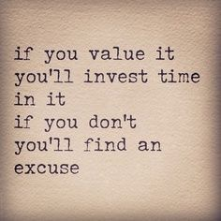
Spreading Good Stories: Cracking Recruitment and Retention in Emergency Medicine
Dr Dan Boden
Emergency Medicine Consultant
ECIST Clinical Associate
HEE SAS Doctor Lead for EM
Thursday 9th May 2019

Slide 2
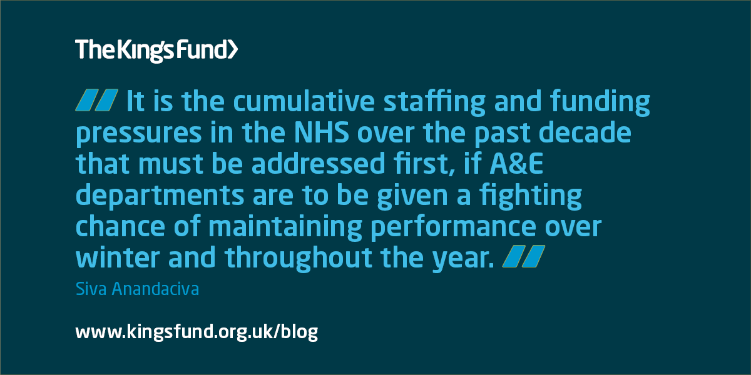

Slide 3
Along with Exit Block/crowding, poorly matching staffing to demand is the biggest risk faced by our patients.
We must get this right….......

Slide 5
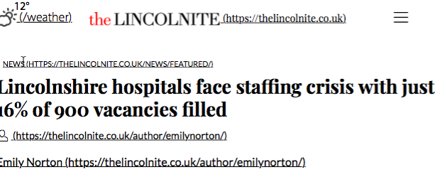

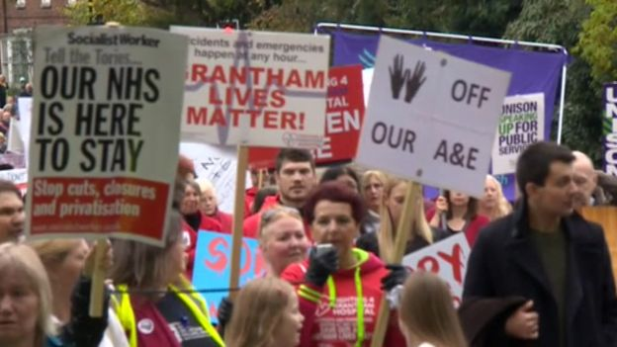


Slide 6
Some books about Lincoln…....

Slide 7
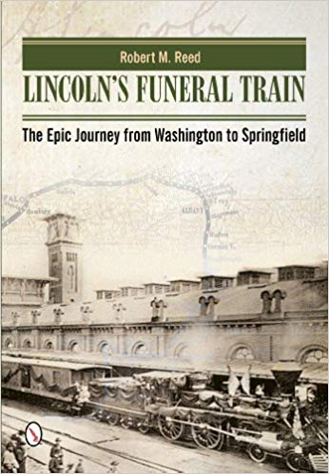

Slide 8


Slide 9
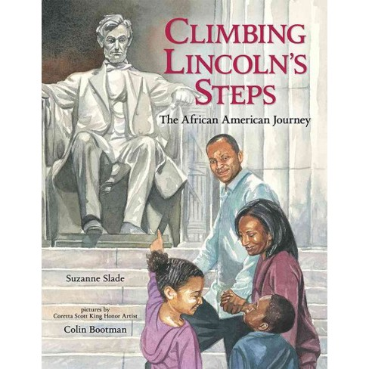

Slide 10


Slide 11


Slide 13


Slide 15
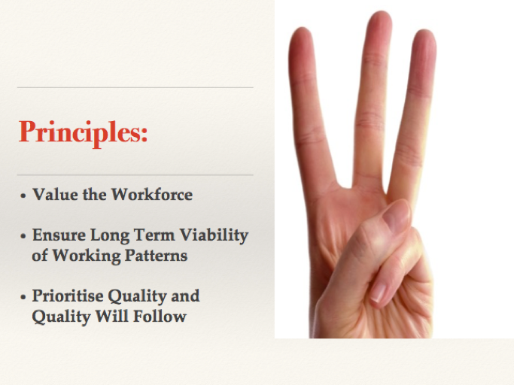

Slide 16


Slide 17


Slide 18
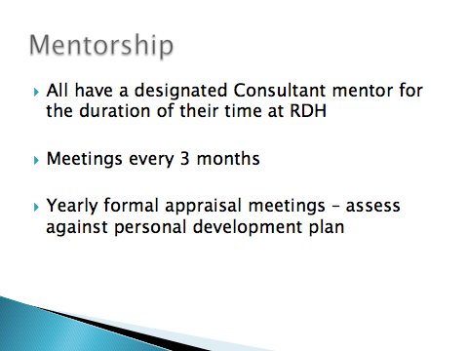

Slide 19
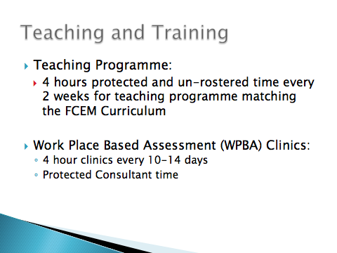

Slide 20


Slide 21
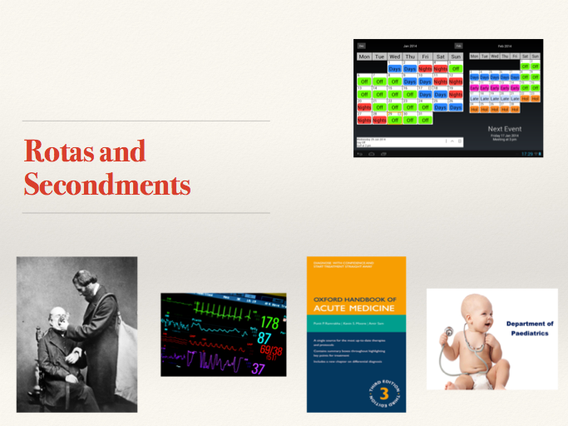

Slide 22
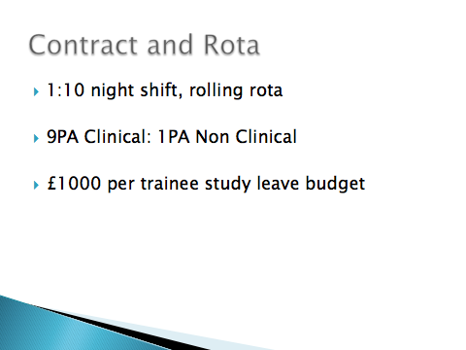

Slide 23
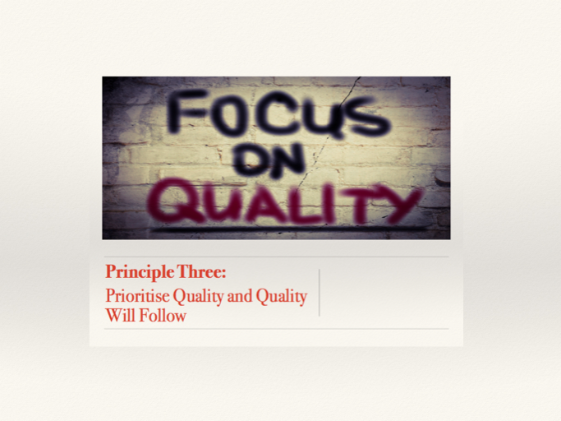

Slide 24
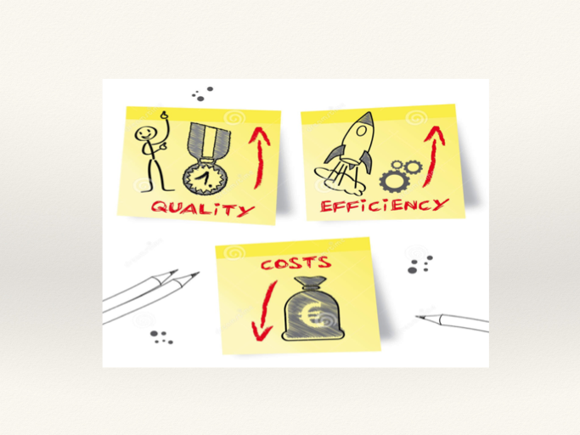

Slide 25
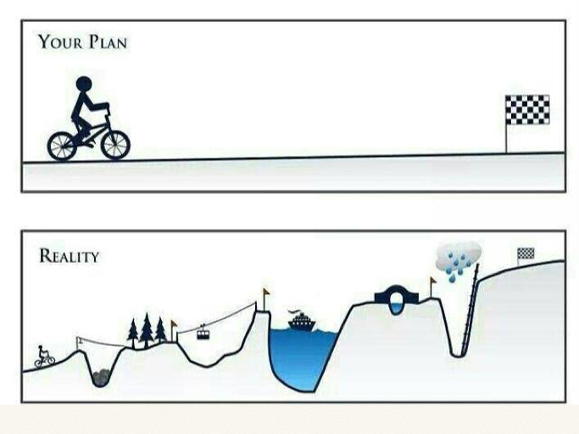

Slide 26
How Have We Got There………
Respected the individual and their career aspirations
Offered training/support/education tailored to the need of the individual doctor
Considered long term sustainability – rota’s, supervision etc

Slide 27
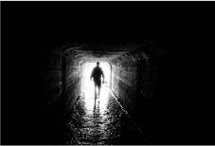
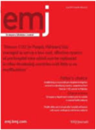

Slide 28


Slide 29


