Slide 1
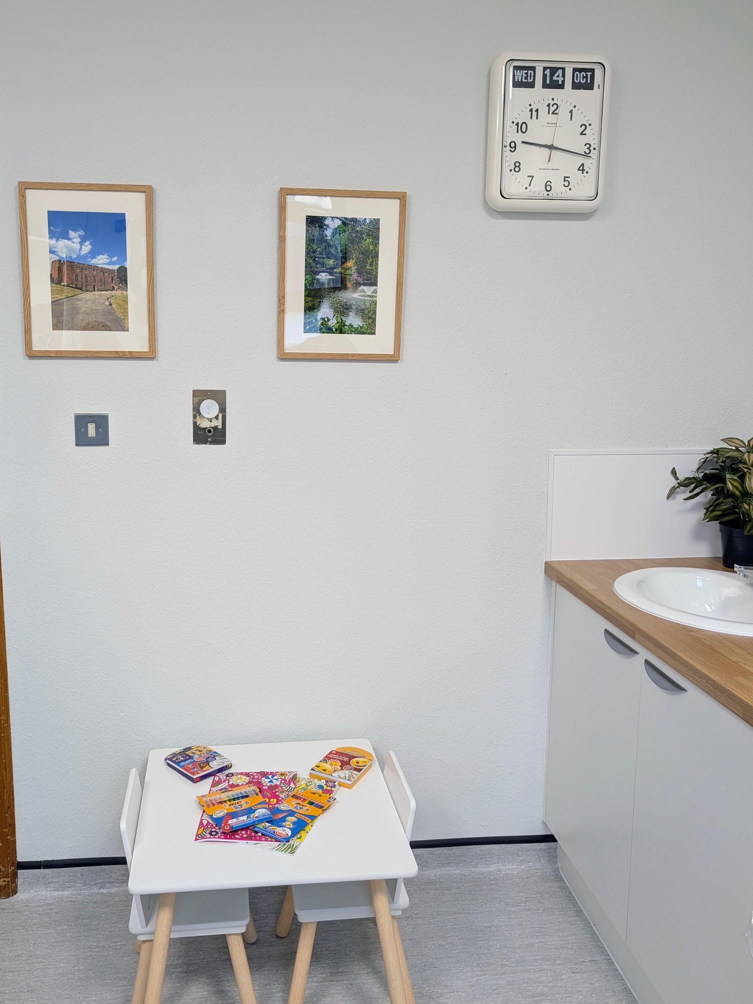
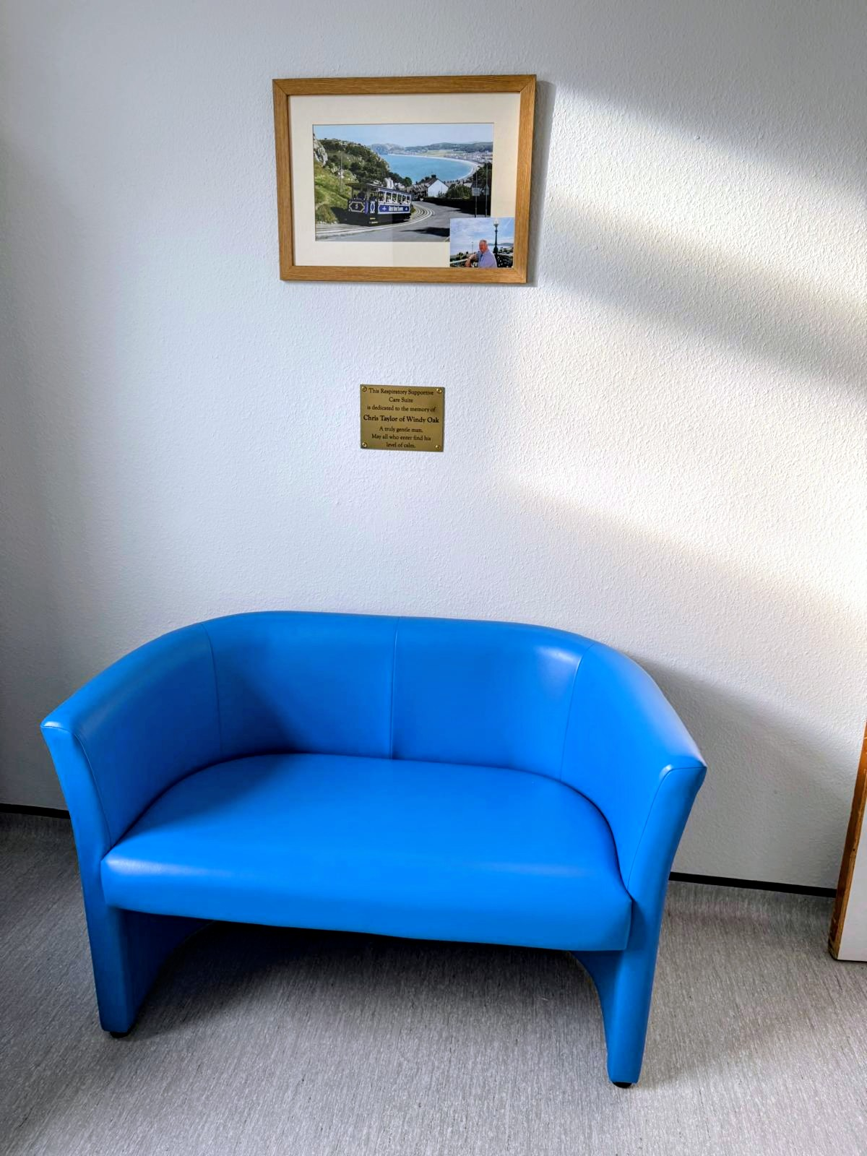
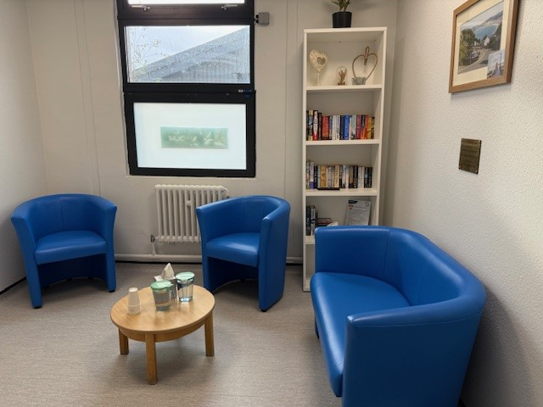
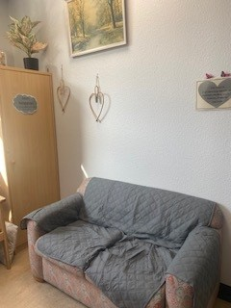
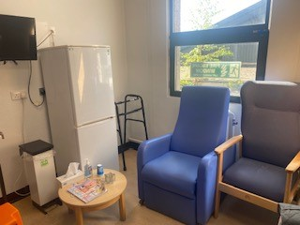
Improvement – Respiratory Supportive Care Suite WD 24
Theme | Getting to Excellent: Fundamentals in Care
Produced by | Jules Lewis and Penny Watson
Case Study Date | 7/10/2025
Doctors, Nurses/MDT Staff need time and space to have important conversations with relatives. The current space (family room) on Ward 24 is outdated which means that conversations are held in an inappropriate space which is unconducive to sensitive conversations. The Respiratory Supportive Care Suite for Relatives will give the Ward a calm and comfortable space.
To improve the current relatives, room and create a Respiratory Supportive Care Suite on Ward 24 RSH to allow staff to have open and honest conversations with relatives about supportive and end of life care. This will be achieved by October 2025. Official opening of the room is planned for December 2025.
PLAN
Working together, the Ward Manager Leanne; Belinda and Tina, Ward Clerks and Team and Swan End of Life Care (EoLC) Lead Nurse Jules met to discuss improvement plans. We reviewed the current Relatives Room on Ward 24.
Pre photos were taken. The room would become a Respiratory Supportive Care Suite for Ward 24 Doctors, Nurses and MDT Staff to provide a calm space on the Ward, to have important, open and honest conversations with relatives about their loved ones about supportive and end of life care. This space would also allow relatives to have rest breaks in a calm space. The current space, we felt, was functional but could be improved.
BEFORE PHOTOS
DO
After discussions with Leanne, Belinda, Tina & Team, it was agreed to discuss with Sean Capital Projects Manager. The room would have a new floor and other improvements and be painted in calm colours. A review of the way the current space was utilised and new furniture and pictures purchased. The improvements were funded by the Swan Fund from donations from the Taylor family, in memory of Chris Taylor who died on the unit in 2024.
The team:
Ordered a new door sign and placed on the door and a plaque for inside the room.
We had donated an artificial plant, boxes of tissues and frames for pictures, The Taylor family donated a lovely framed picture, we purchased an activity table for children and a bookcase. These all made the room feel calm and comfortable.
Thank you to the Taylor family, Leanne Ward Manager, Belinda and Tina and the team who went above and beyond to make this happen. Thanks go to Emma Gibbons HCA on Ward 28 who donated some pictures for the room; Sean and Estates Team and Nick the Painter for donating his time; Jules Lewis’s Mum for donating boxes of tissues and Penny EOLC Admin Assistant for support with ordering / coordinating. Thank you everyone this improvement will make a real difference at the hardest of times.
STUDY
Congratulations to Leanne, Belinda, Tina and the Team and Sean Roberts and Team for making this happen.
Team work at it’s best. It was important to the team that this improvement was done incorporating the wishes of the Taylor family, in memory of Chris Taylor who died on the Ward in 2024.
The improvement has given us the results we were expecting, as we have completed a few of these rooms now. However, feedback from Leanne and the Team has been above our expectations, the difference this room has made already has been incredible. Thank you to Sean Roberts and his team for always supporting us with this important work.
ACT
The room will be officially opened during National Grief Awareness Week Dec 2025. We will celebrate this achievement with key people invited to the opening.
The Ward Team will monitor relative feedback and appropriate use of the room. Leanne, Belinda, Tina and Jules will remain in communication and highlight any further improvements needed, following relative / staff feedback.
AFTER PHOTOS
Thank you to everyone named above, teamwork and the one chance message at it’s best. The biggest thank you goes to Leanne, Belinda, Tina & the ward team & Sean Roberts and Team for making this improvement happen, the room will make the biggest difference at the hardest of times.

