Slide 1
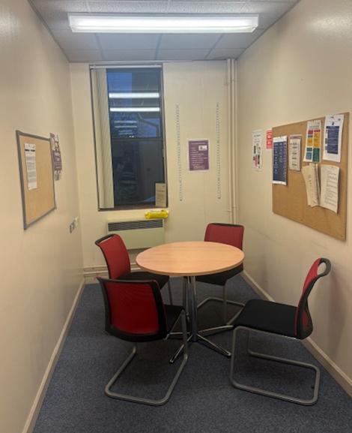
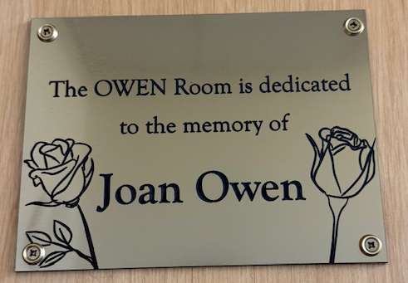
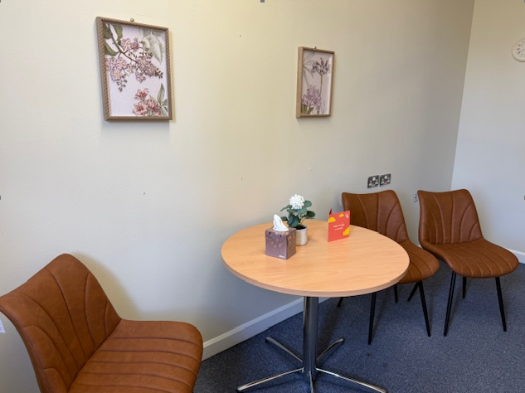
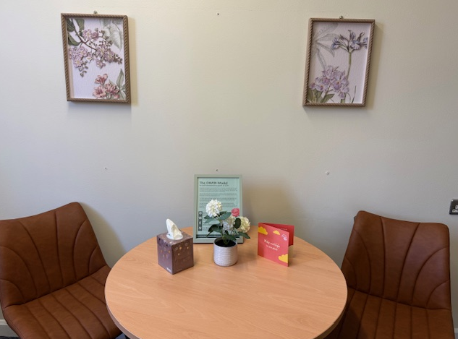
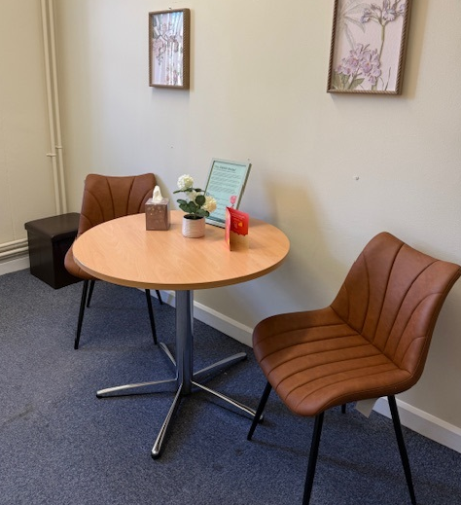
Staff Bereavement Support - OWEN Room PRH
Theme | Moving to Excellence: Fundamentals in Care
Produced by Jules Lewis, Lead Nurse for Staff Bereavement Support
Case Study Date | 06/05/2026 Dying Matters Week
Staff often need time and space to have support following a personal bereavement or if affected by a colleague / patient death. There is no current designated room / space at PRH in which to give this support, meaning that conversations are sometimes held in inappropriate spaces which is not conducive to giving needed support.
To develop an OWEN Room for staff bereavement support sessions; a calm, inviting, comfortable and safe space that allows staff to share how they are feeling, be heard and supported / signposted. The Room will also need to act as an Interview Room.
PLAN
Working together the Staff and Volunteers from the Staff Bereavement Support Service Jules Lewis (Staff Bereavement Support Lead Nurse), Penny Watson (Former Swan EOLC Admin Support & now a Swan Volunteer) Jules Lock and Heather Pitchford (Staff Bereavement Support Volunteers), SaTH Charity, Gillian and Sam and Team PRH Education Centre, Paddy the Carpenter, Nick the Painter, developed, designed and completed the OWEN Room. This will provide a calm, inviting and safe space, to allow staff to share how they are feeling, be heard and supported / signposted.
DO
After discussions and meetings an appropriate space was found. Approval was given to develop the interview room in the education centre. A SaTH Charity funding bid was placed and approved which allowed Penny to source and order furniture for the room.
We wanted this room to be in memory of Joan Owen who died during the pandemic in 2020. A plaque has been created in her memory. Joan’s Son in-law Shane, a friend of Jules, has been a real supporter of this work and is part of the Academy of Fabulous Stuff Team who celebrate their 10th Birthday in 2025.
OWEN Stands for –
Openness
Wellbeing
Empathy
New Beginnings
Picture 1 – Pre makeover photo
Picture 2 - The OWEN Room Plaque
Picture 3 – The OWEN Room
Picture 4 - The OWEN Room
Picture 5 – The OWEN Room
STUDY
The official opening is to be planned in the Summer 2026 – The room, will be opened by a Bereaved Staff Member & Staff at the Education Centre and in memory of Joan Owen. They will cut the ribbon in front of Staff, Volunteers and Senior Leaders.
ACT
To our knowledge this is the 2nd Staff Bereavement Support room; we know it’s the 2nd ever OWEN Room. The room at RSH is making such a difference to our staff at SaTH, having a dedicated, calm space we can book to have one- to-one bereavement support sessions. We have an approved SOP for the Staff Bereavement Support Service.
The Compassionate Staff Bereavement Support Programme for Healthcare Staff - A Pilot Study was completed in Nov 2025 by Jules Lewis Principal Investigator/PhD Student. Thank you to SaTH Research Team Jo & Team. Supervisors at University of Staffordshire Wilf, Fiona & Jessica. Cat O’Callaghan Psychology Lead.
AFTER
BEFORE
Thank you to -
SaTH Charity for support & funding for the comfy chairs, storage box and lamp #smallthingsmakeabigdifference; Jules Lewis donation of the pictures and artificial plant, Shane Tickell and family for their donation in 2020 and support with the OWEN Model; Gillian and Sam and Team in the Education Centre for their support and kindness; Hannah Furness for stopping and helping me carry furniture, Jules Lock and Heather Pitchford Staff Bereavement Support Volunteers for their dedication; Penny Watson former Staff Bereavement Support Service Admin Support, (now Swan Volunteer for everything, her dedication to this work; Paddy the carpenter for his support on this project, going above and beyond at short notice, Nick and Team the painters; SaTH Comms, Rebekah in Improvement for support with this case study. This room was completed in May 2026 during Dying Matters Week - thank you to Linda founder of The Good Grief Trust for always being supportive of the work we do at SaTH and the biggest thank you goes to the bereaved staff for sharing their feelings and stories with Jules Lewis, Heather and Jules Lock in confidence to enable new beginnings. The room like the one at SECC opened last year will make the biggest difference at the hardest of times. Thank you all, Jules Lewis Lead Nurse for the Staff Bereavement Support Service at SaTH. Ref OWEN Model Creators – Jules Lewis and Jules Lock copyright SaTH - for more information please contact Jules Lewis jules.lewis@nhs.net or on Tel 01743 261000 ext. 3464.

