Slide 1
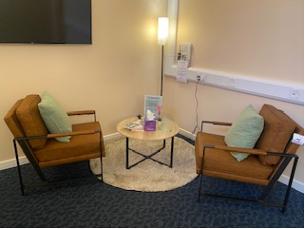
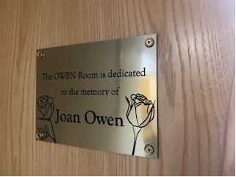
Staff Bereavement Support - OWEN Room SECC
Theme | Getting to Good: Fundamentals in Care
Produced by Jules Lewis, Lead Nurse for Staff Bereavement Support / Penny Watson Admin Support for Staff Bereavement Support
Case Study Date | 29/1/2025
Staff often need time and space to have support following a personal bereavement or if affected by a colleague / patient death. There is no current designated room / space in which to give this support, meaning that conversations are sometimes held in inappropriate spaces which is not conducive to giving needed support.
To develop an OWEN Room for staff bereavement support sessions; a calm, inviting, comfortable and safe space that allows staff to share how they are feeling, be heard and supported / signposted.
PLAN
Working together the Staff and Volunteers from the Staff Bereavement Support Service Jules Lewis (Staff Bereavement Support Lead Nurse), Penny Watson (Staff Bereavement Support Service Admin Support), Jules Lock and Heather Pitchford (Staff Bereavement Support Volunteers), SaTH Charity, Paul Lewis SECC Facilities Manager and Team, planned, developed, designed and completed the OWEN Room. The area would provide a calm, inviting and safe space, to allow staff to share how they are feeling, be heard and supported / signposted.
DO
After discussions and meetings an appropriate space was found. Paul Lewis SECC Facilities Manager gave approval to use a room in SECC. A SaTH Charity funding bid was placed and approved which allowed Penny to source and order furniture for the room.
We wanted this room to be in memory of a lady named Joan Owen who died during the pandemic in 2020. A plaque has been created in her memory. Joan’s Son in-law Shane, a friend of Jules, has been a real supporter of this work and is part of the Academy of Fabulous Stuff Team who celebrate their 10th Birthday on February 14th 2025.
OWEN Stands for –
Openness
Wellbeing
Empathy
New Beginnings
Picture 1 - The OWEN Room
Picture 2 - The plaque in memory of Joan Owen
STUDY
The official opening is planned for May 2025 – The room, we hope will be opened by Shane Tickell and his family in memory of Joan Owen. Shane and family hope to cut the ribbon in front of SECC Staff, SaTH Staff/Volunteers and Senior Leaders.
ACT
To our knowledge this is the first Staff Bereavement Support room; we know it’s the first ever OWEN Room. The room is making such a difference to our staff at SaTH, having a dedicated, calm space we can book to have one- to-one bereavement support sessions. We have an approved SOP for the Staff Bereavement Support Service.
The Compassionate Staff Bereavement Support Programme for Healthcare Staff - A Pilot Study starts in February 2025 by Jules Lewis Principal Investigator/PhD Student. Thank you to SaTH Research Team Jo and Rachel and Supervisors at University of Staffordshire Wilf and Fiona.
Thank you to -
SaTH Charity for support & funding for the comfy chairs, table & lamp #smallthingsmakeabigdifference; Jules Lewis donation of the rug; University of Staffordshire for the artificial plant; Shane Tickell and family for their donation and support with the OWEN Model; Paul Lewis SECC Facilities Manager and Team for their support, kindness and humour; Emma Wilkins and Cat O’Callaghan for their support with this work; Jules Lock and Heather Pitchford Staff Bereavement Support Volunteers for their dedication; Penny Watson Staff Bereavement Support Service Admin Support, for everything, her dedication to this work; Sean Roberts Capital Projects Manager for his support on this project, going above and beyond as always; Nick and Team the painters; SaTH Comms; Palliative & End of Life Care Team for great team work. This room was completed in Dec 2024 during National Grief Awareness Week - thank you to Linda founder of The Good Grief Trust for always being supportive of the work we do at SaTH and the biggest thank you goes to the bereaved staff for sharing their feelings and stories with me in confidence to enable new beginnings. The room is making the biggest difference at the hardest of times. Thank you all, Jules Lewis Lead Nurse for the Staff Bereavement Support Service at SaTH.
Ref OWEN Model Creators – Jules Lewis and Jules Lock copyright SaTH - for more information please contact Jules Lewis jules.lewis@nhs.net or on Tel 01743 261000 ext 3464.

