Slide 1

Inclusion, Accessibility and Equality in Observations….
Observe and Act
You don’t know what you don’t know….
‘Observe and Act’ was devised and developed by
Shropshire Community Healthcare Trust
Notes:
Observe and Act is a great tool that encourages you to use your eyes to see the good things that are going on and also the things that are overlooked. But…. what about the things that you don’t know about – for example, how someone completely different to you might experience the service?

Slide 2

Walk in my shoes.
Imagine that you have to walk in someone else’s shoes for the day……
Notes:
Imagine that you have been given someone else’s shoes and you have to walk through a day in their life?
If that person had sight loss, would you fall over badly-placed obstacles in the office such as low stools?
If that person were deaf, would you hear the receptionist calling your name?
If they were a wheelchair user, would you be able to operate the foot-pedal on the waste bin?
To understand Diversity, Inclusion and Accessibility in Observe and Act, you need to be every patient for a day and envisage how the service might or might not meet their needs.

Slide 3
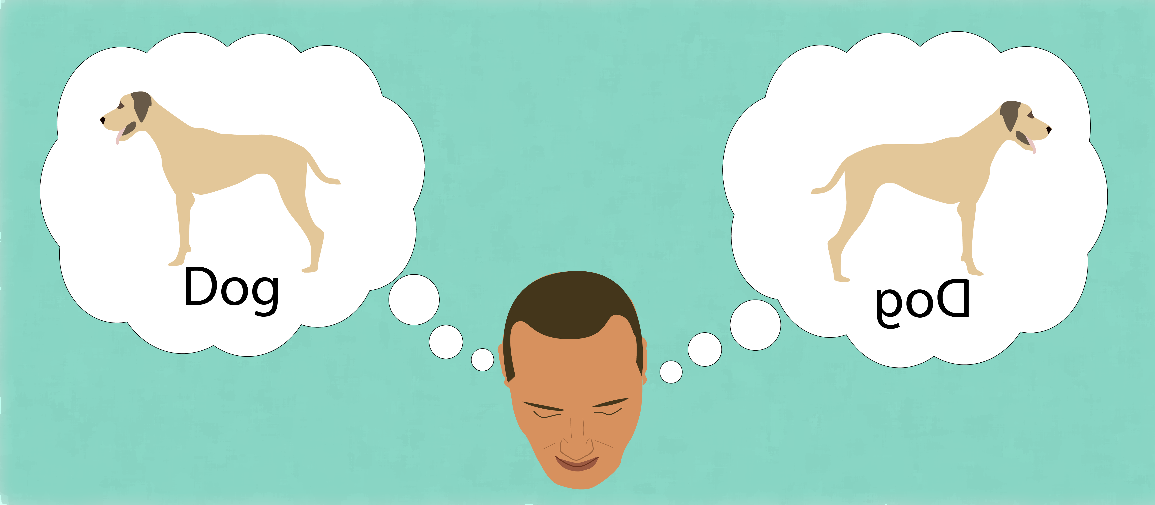
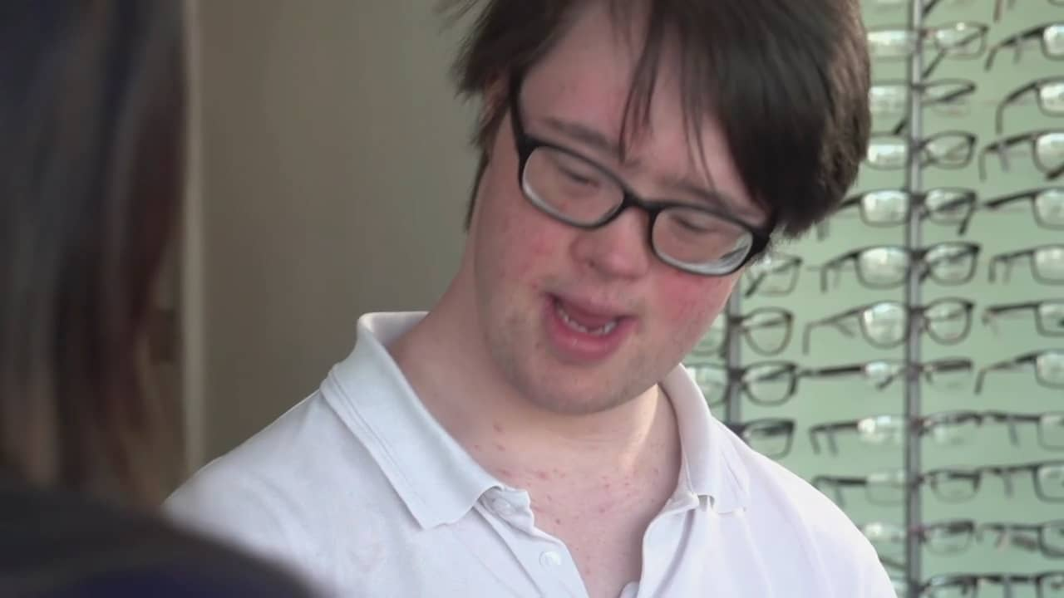
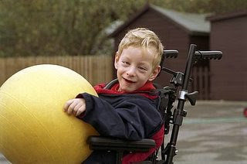

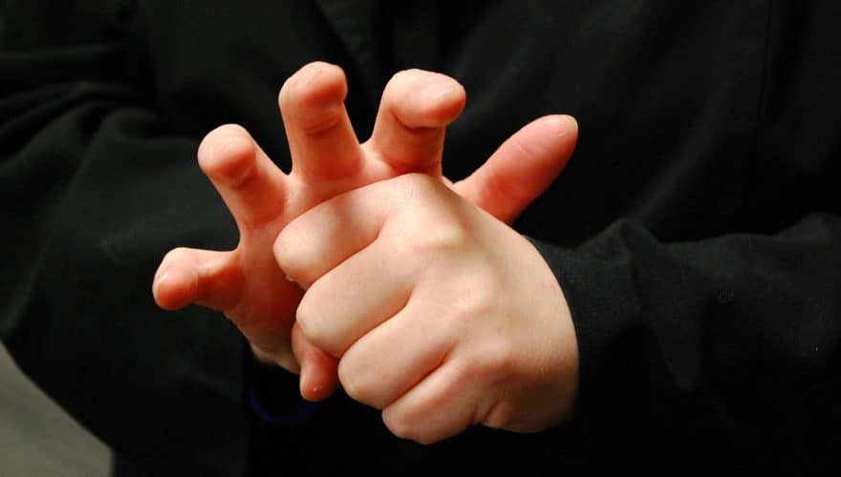

It’s not easy……
But sometimes, with a little thought, you can imagine how someone else might experience a service..
Notes:
It’s not easy, when you don’t share a protected characteristic, to imagine how someone who does, might experience a service. In this brief guide we’ll offer you some things to look out for to make your observation the most inclusive that it can be.

Slide 4

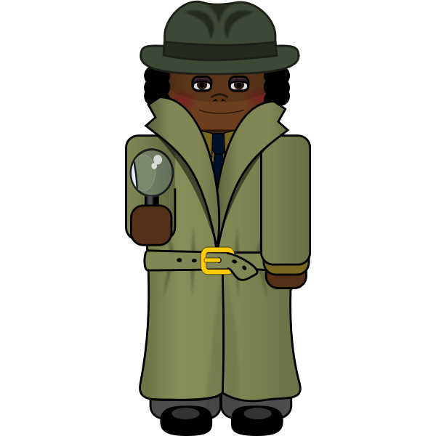
You are on auto-pilot
Obstruction
Disability
Discrimination
Barrier
Threat
Hazard
Notes:
We are used to our own bodies and we take our capacity for granted to overcome obstacles. We go through life and we don’t realise that we are using our senses to see, hear, understand, interpret, feel and relate to everything around s. We are constantly analysing and checking everything around us to make sure that we are safe and comfortable, to ensure that we are included and that there are no threats from people who are not like us. We are on autopilot using our senses
For those people who are unaffected by disability, who fit in with the majority and feel at one with the environment around us life just goes on as normal But take away one of your senses or your comfort zones and life starts to feel very different.

Slide 5
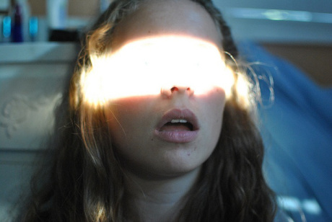
Light Levels
Notes:
Lighting is often overlooked when doing an observation:
Glaring lights are difficult for people with eyesight issues such as nystagmus and can trigger epilepsy and vertigo.
Conversely, light levels that are too low are also difficult for people with sight loss.
People who lip read d and use BSL interpreters need the interpreter’s face to be out of shadow and front lit – staff need to bear this in mind.

Slide 6

Sound and Hearing
Deaf and Deafened people often find services inaccessible. Always think how Deaf people would fare in your observed location.
It doesn’t take a lot to make communication easier.
A hearing induction loop is always worth looking out for in a service. This is simply a microphone and amplifier that uses a pick up/ transmitter wire to boost signals to hearing aids. If it is in place all the staff need to do is switch it on. The ‘LOOP’ sign will alert Deaf visitors to switch their hearing aids to ‘T’ setting to enable
loop pickup.

Slide 7
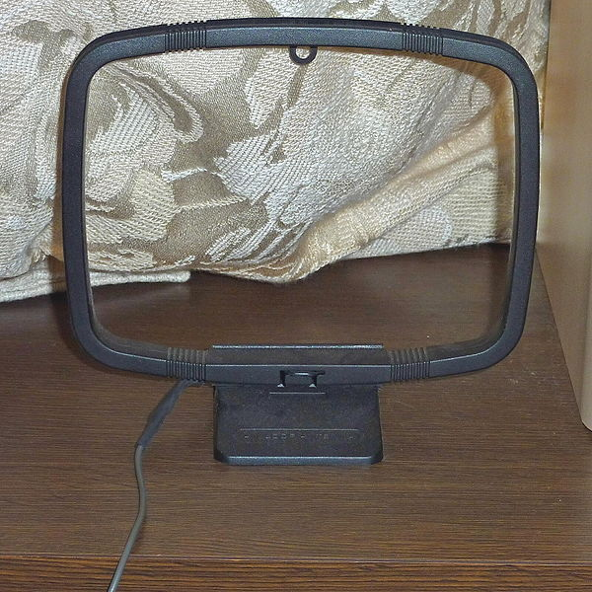
Deafness 1
An accessible office will always have a simple strategy for communicating with Deaf or Deafened people.
Strategies don’t need to be complicated. If no BSL interpreter is available, often a pen and paper or a keyboard and screen will suffice.
BSL finger spelling can be learned easily in 20 minutes using on-line resources.
https://www.youtube.com/watch?v=DgIvXXdwjvw

Slide 8
Deafness 2
Calling out patients’ names for appointments does not work for Deaf/Deafened people in large reception areas.
Tickets plus a number display or writing down names on a sheet of paper might be better.
Background noise will always make communication more difficult for Deaf/Deafened people.
People who have used British Sign Language since birth use very different sentence structures to hearing people. When using text, avoid complicated sentence structures and keep sentences short.

Slide 9

Signage
Signage needs to be simple and clear
Images rather than words reach more people
Is Braille signage in place at key points, e.g. toilets?
Door signs need to be high contrast (yellow/black) so that people with sight loss can locate them).

Slide 10
Blindness
Signage needs to be simple, large, high contrast and clear.
Simple, clearly presented WORD versions of key documents will enable people with sight loss to read them using on-screen text readers.
Contrasting floor colours at key junctions or changes in floor texture will help people to navigate.
Uncluttered floor surfaces will make walking easier and safer for people with a high degree of sight loss or impaired vision.

Slide 11
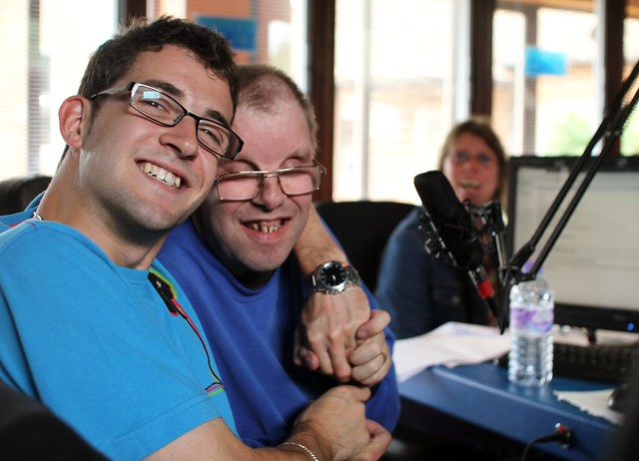

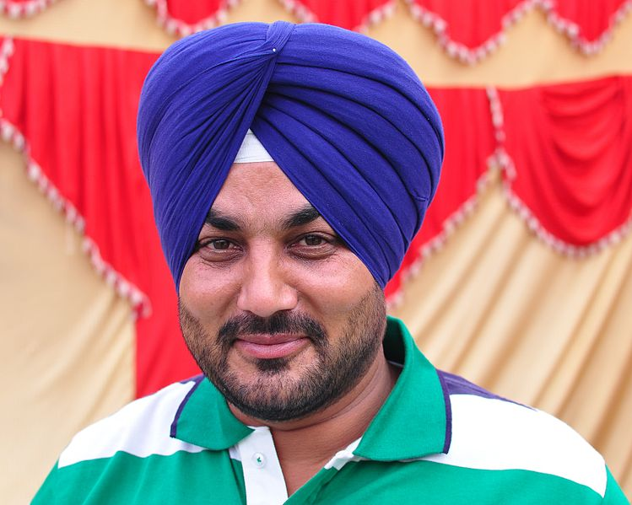
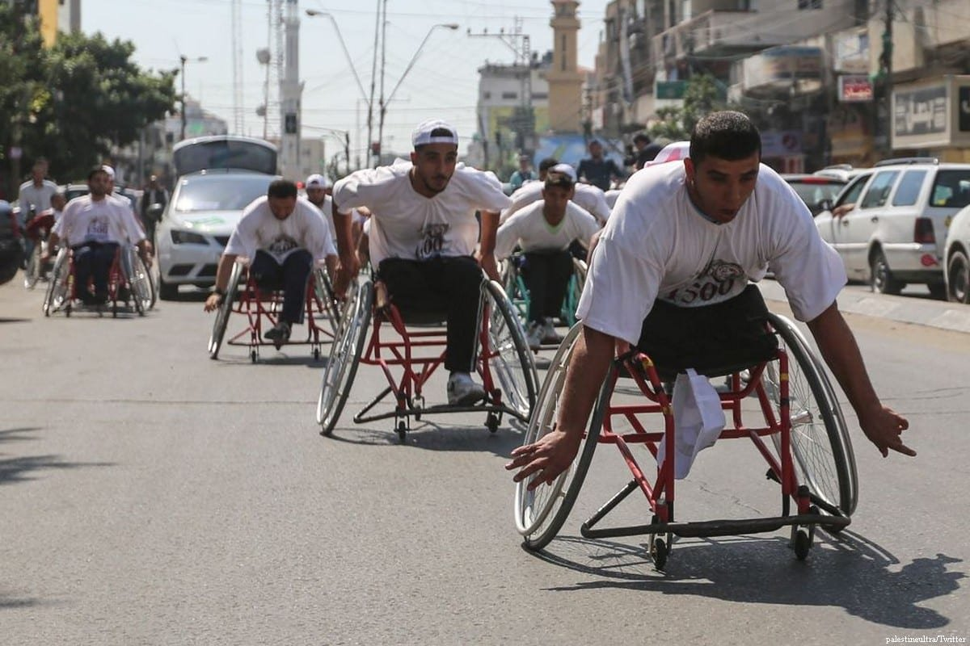
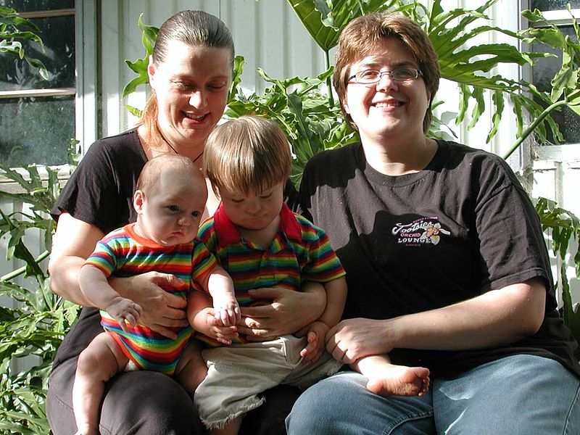
Imagery and Representation
Notes:
One of our characteristics as human beings is that we are most comfortable when we are with people who are ‘just like us’. We need to feel part of, and accepted by the community around us. For people who are in a minority - this is particularly important. Imagery in a service needs to represent a wide range of service users. Without this, many people who use the service will feel that the service is not for them. They will feel alienated.

Slide 12
Restricted Mobility
Is there enough space for wheelchairs to enter and manoeuvre around the service?
Are there counters and desks and sinks at a lowered height for wheelchair users?
Can wheelchair users reach and operate bins without having to use foot pedals?
Are there any step-changes in floor levels or steep ramps that might cause difficulty?
Is the floor area clear and uncluttered with furniture?

Slide 13
Language
Notes:
Language can be one of the biggest blocks to communication
Accessible offices will know how to support people whose first language is not English
A ‘Which Language’ card on reception will enable staff to identify which interpreter to request

Slide 14
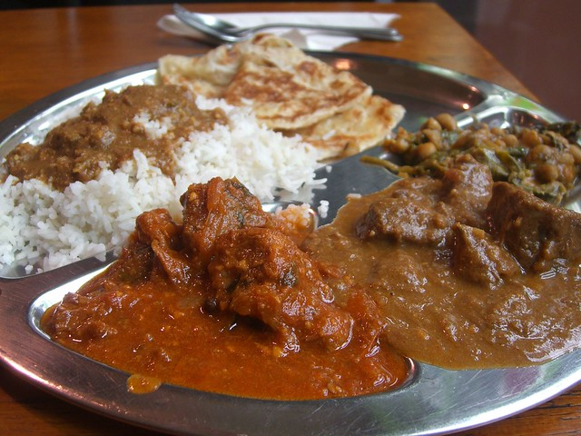

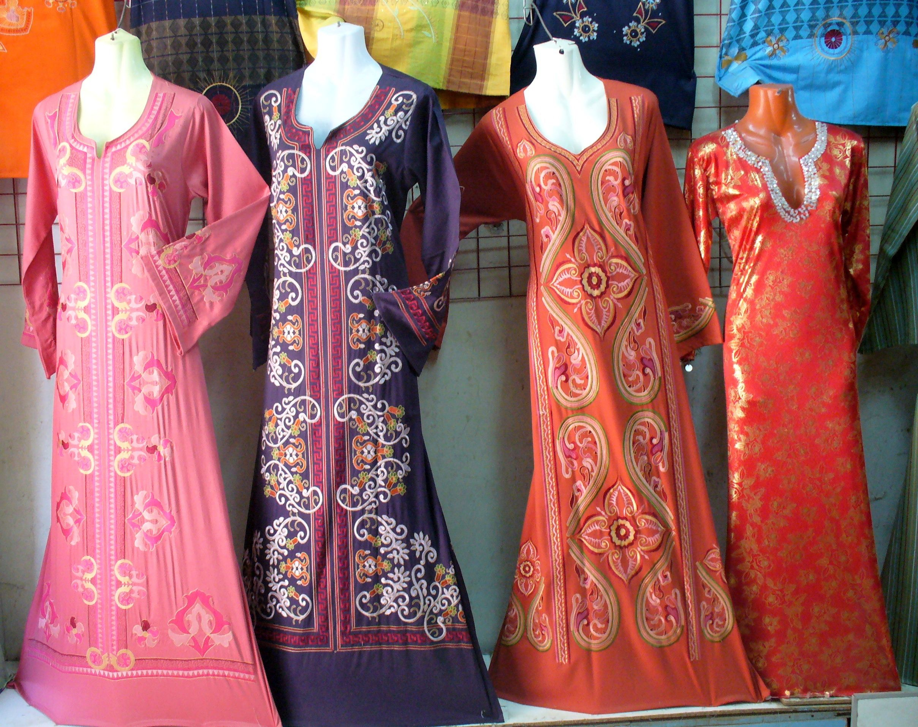


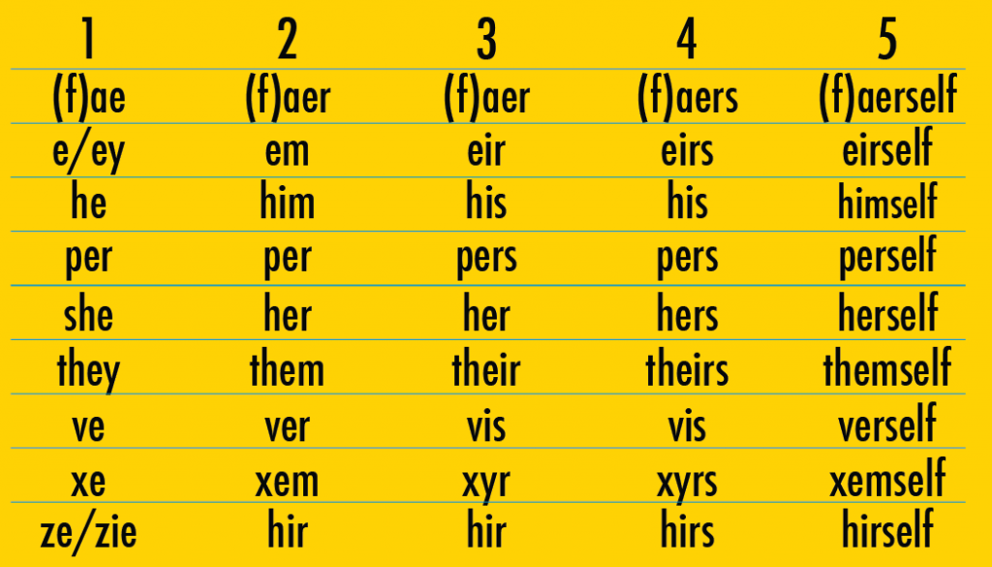
Culture, Care & Identity
Notes:
Inclusive services will meet the specific needs of the people who use them
Some care units will adopt a ‘one-size-fits-all’ pattern of care delivery. They are not inclusive.
Look out for signs that people are being catered for as individuals, with reference to their own culture and traditions. These can include:
Clothing, food, religion and prayer, skin and haircare and referring to people by their preferred name and pronoun

Slide 15
Presentation of text
People with dyslexia and people with sight loss will find cluttered notice boards difficult to read.
Printed texts should ideally be in a clear typeface with as few background graphics as possible to distract.
English should be simple. Long sentences and complicated phrasings are inaccessible to many people.
Where possible, images reach people of all ability levels, with or without disabilities, and who speak different languages.

Slide 16
Summary
In Observe and Act, it would be very easy simply to observe what appears before you and to consider life from your own experience and viewpoint.
A first-class observation will be one where the observer has expanded their imagination to visualise how someone with completely different characteristics would experience it.
In considering the diversity of our service users, we are increasing access to services, inclusivity, and greater equality for everyone.
End of presentation

Slide 17
Observe and Act
‘Observe and Act’ was devised and developed by the Patient and Volunteer Carer Group of the
Shropshire Community Healthcare Trust

