Slide 1
Service Improvement Project
By Archana Majmudar
Notes:
Good afternoon everyone. My name is Archana Majmudar, I work as a Validator in the RTT team and I cover Gynae and Paeds. Earlier this year I participated in an ICS Inclusive Career Development programme where I had to complete an improvement project within my service area and present the project to the penal.

Slide 2
My Project
Issue
Gynae Emergency Unit
1200 incorrect RTT referrals created every month
Two and a half hours per day to correct
Notes:
I choose the Gynaecology Emergency Unit as my project. This was the biggest problem in the RTT team at that moment. The issue was that there were 1200 incorrect RTT referrals were created every month and it used to take me two and half hours daily to correct it. That’s why I choose this as my project.

Slide 3
Objectives
To improve RTT compliance
To increase data capture accuracy
To improve patient care
Notes:
The objectives of my project were,
To improve and to increase accuracy , that would lead to improved better patient care as patients will treated in correct priority

Slide 4
What is RTT
RTT - Referral to Treatment
RTT clock starts with GP referral into a consultant led service
Validation team – check RTT pathways on the patient tracking list (PTL) for accuracy
Patients can then be treated in correct priority order
Notes:
I am sure you all know what RTT is. As my role as a validator, I check for the accuracy in the patient pathway so that patient gets treated in the correct order and in timely manner.

Slide 5
Not all referrals come under RTT…
There are 2 types of referrals:
The patient needs to be treated within the 18 weeks rule. Example, normal outpatient referral-come under RTT
Those where the patient attends emergency and gets treated on the same day- this referral is non-RTT .
Notes:
Not all the referrals come under RTT rules. Basically there are 2 types of referrals. One which is normal GP outpatients referrals to consultant led service, where patient needs to be treated under 18 weeks rule and the other one where patient attends A&E or emergency services and they get treated on the same day, They are Non RTT referrals.
It is important to have RTT so that we can monitor patients treatment

Slide 6
Cause of the problem
The Gynaecology Emergency Unit
40 to 60 emergency referrals being created everyday
These referrals were incorrectly generating an RTT code which added patients to the elective waiting list
Two and a half hours of work per day correcting errors
Notes:
Gynae has their own emergency unit and most of the referrals created in this unit are non RTT. However, these referrals were created incorrectly, and were generating an RTT code. There were 40 to 60 referrals were created everyday incorrectly and I had to correct these mistakes on a day to day basis. This resulted in me being less productive in my other jobs.

Slide 7
What I did
 | Step | How / What
1 | Investigated the cause of the problem | Spent time with the staff who created these referrals
2 | Found the source of the error | While creating the ‘emergency’ referral staff selected Referral Type ‘OUTPATIENT’ instead of ‘Emergency’ which automatically generated an RTT start code
3 | Identified a solution | Met with key stakeholders Agreed a new pathway Change the Referral Type to ‘EMERGENCY’
4 | Implemented solution | Trained staff on new pathway
5 | Measured impact of change | No more in accurate referrals and Patients will have timely appointments
Notes:
I sat with the staff who created these referrals because I wanted to understand how these mistakes were being made. I discovered that While creating referrals, instead of choosing ‘referral type- Emergency’, ward clerks were selecting ‘outpatient’. This action was generating an RTT code.
So I tested putting Emergency instead of outpatient and that referral became non RTT. So, then I planned to implement this solution, by training the staff and monitoring their progress. But first I had to get agreement from the estakeholders to make this change.

Slide 8
Challenges
Embedded practice
Confusion over terminology, in particular Referral Type and Referral Source
Potential negative impact to income
Potential increase in administration work
Notes:
As with any project I did come across a few challenges. Creating the referral this way was a historical embedded practice and people were really hesitant to change that. There was a confusion over the terminology of Referral type and Referral source and there was a concern about potential negative impact of the income in the unit. And there was a worry that there will be a huge increase in workload of administration staff.

Slide 9
The stakeholders / teams involved
The Data Quality
The information team
The manager of the ward clerks
The Income / Contract team
Service
Access / RTT
Notes:
I proposed this change to the stakeholders, We had a few meetings with the General manager, the service manger and the service co Ordinator of the gynae department, the income team, the Data quality team, the Information team and the Manager of those Ward Clerks to check what the impact of this change would be on each team in the long run.

Slide 10
Authorisation and plan for the new way of working
Got agreement from all the teams on 10th of March
Created guidelines for the Ward Clerks to follow
Started training on the 24th of March
Training completed 21st of April
Notes:
After a deliberation with everybody, everybody had agreed with the change. I got agreement from all the teams on the 10th of March. I created a guideline for the ward Clerks to follow. I started the training on 24th of March. I finished training all the staff on 21st of April.

Slide 11
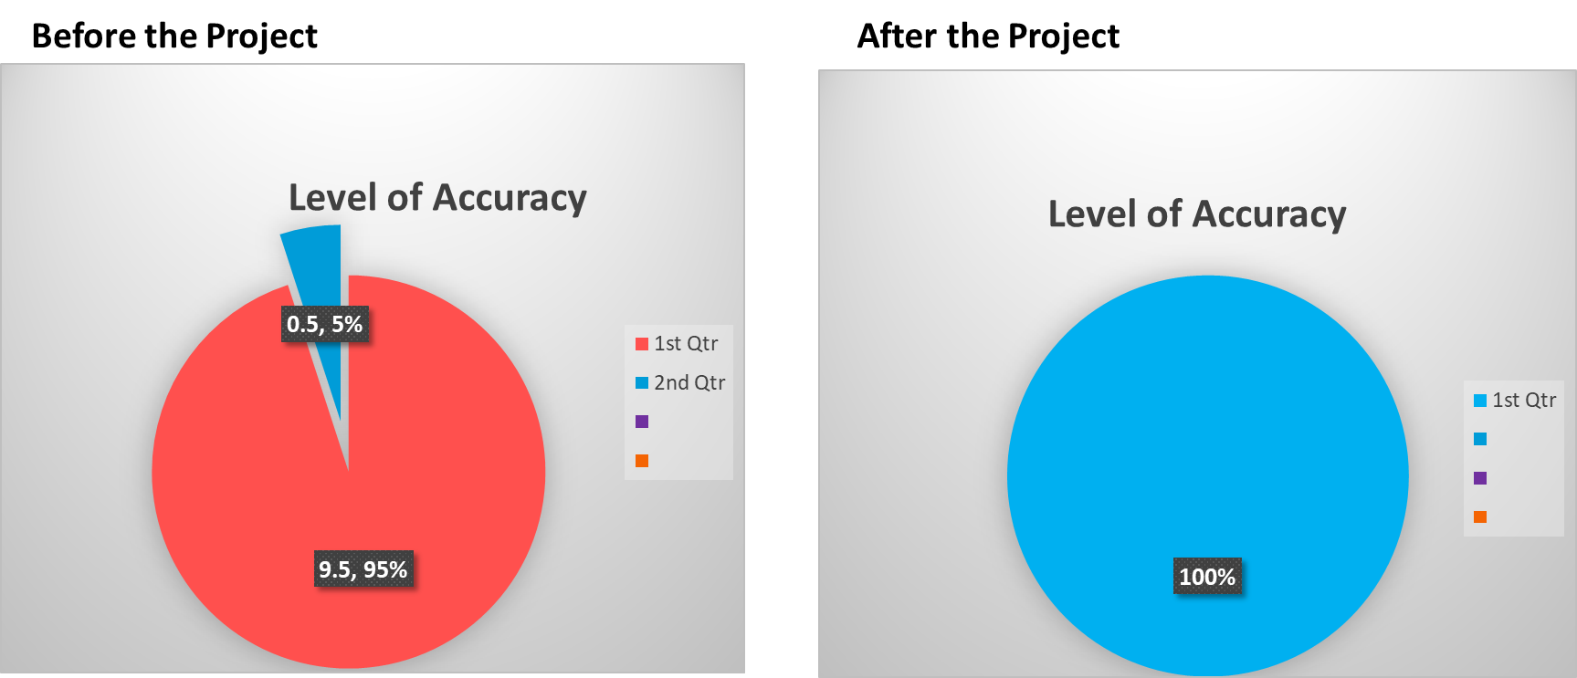
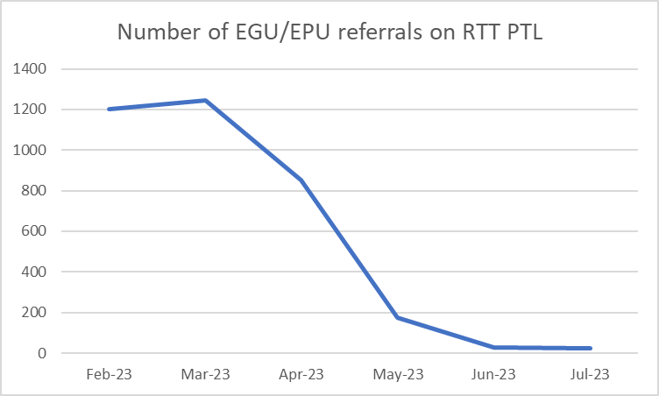
Results
As a result of the improvement in accuracy of outcoming the appointments, the number of patients on the RTT PTL reduced significantly.
Ongoing monitoring to ensure old practices don’t creep back in
Notes:
When I started this project, the level of accuracy was 1%. Approximately, 1200 incorrect referrals were made every month. RTT PTL was showing very poor level for accuracy. After training the staff and even now, the accuracy has reached 100%. RTT PTL error rate have gone down significantly in this area

Slide 12
The skills used that I learnt from the course
Time management
Collaborative relationship
Decision making
Leadership skills
Having open communication skills
Coaching/mentoring
Project planning
Interpersonal skills
Organisational skills
Presentation Skills
Negotiating skills
Notes:
These are the few skills I learnt from the course and I used during my project. And I will be using these skills to make changes in my area of work in the future.

Slide 13
Notes:
A special thanks to Juliet for encouragement me, to Jade for believe in me for making these changes in her department, AJ for sharing his knowledge of the system, so that I could make this change very quickly and to Adam for giving me his time to come up with the project and helping me with the few aspect of the project. Thank you to all of you for listening to my presentation. I’m happy to answer any questions you may have.

