Slide 1
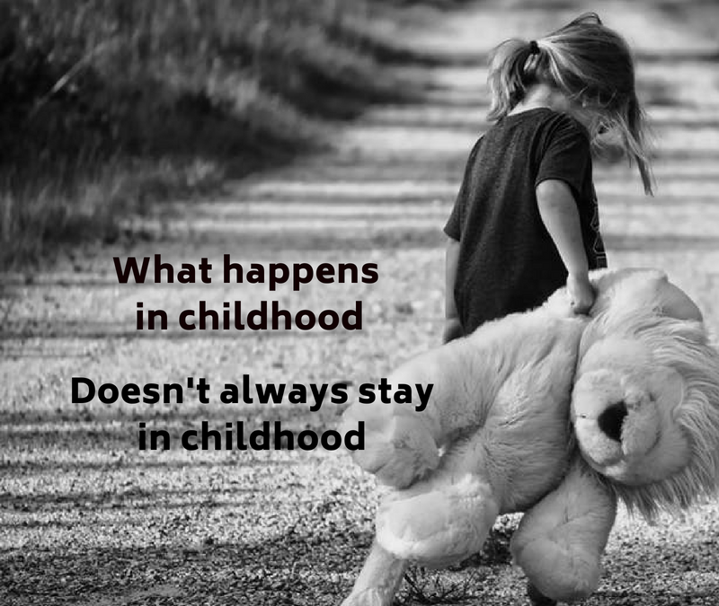
Adverse Childhood Experiences (ACEs)
This PowerPoint is a presentation designed to inform staff of:
What an ACE is.
The short and long term impact of ACEs on pupils.
The importance of trauma informed responses with young people.
It is recommended that an hour and half inset is devoted to the presentation, with extra time given within departments/ year teams, to discuss appropriate policies/ procedures in light of the information.
(Liverpool CAMHS, n.d.)
Please Note
The information contained in this PowerPoint is a result of my own experience of adverse childhood experiences, poor mental health, extensive reading and 20 years teaching experience; it is not based on medical qualifications or experience.
(Davies Maxon, 2018)

Slide 2
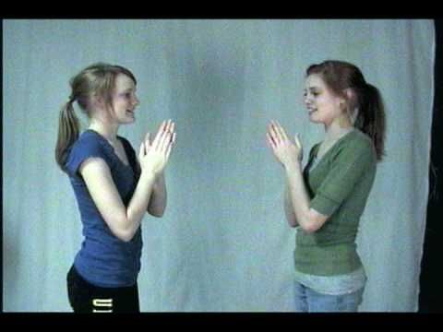
Starter: Mirror clapping
As a staff (SLT included), stand in a circle, don’t worry you’re not going to be moving around much once you are in the circle.
The first person (presenter) faces the person on the left of him/ her. They each clap their own hands (not the other person’s) but they try to synchronise the clap so it happens at the same time and sounds like 1 clap. No talking is allowed, this requires watching each other’s body language.
This person then turns and looks at the person to their left and they try to get a synchronised clap. (Presenter – if they are way out – don’t let them off – have them try again.) The clap then continues going round the circle 2 or 3 times. (Presenter – once people have got the hang of it, try to get the group to speed up)
Notice how they’re carefully watching each other to see what the other person is doing.
Once everyone is clear about the task, presenter introduces two claps, which again have to be done synchronised with the partner (this means watching body language to see if the other person is going to clap again). When somebody gives two claps, the clap changes direction and goes the other way around the circle.
The purpose of this activity will become clear later on in the presentation.

Slide 3
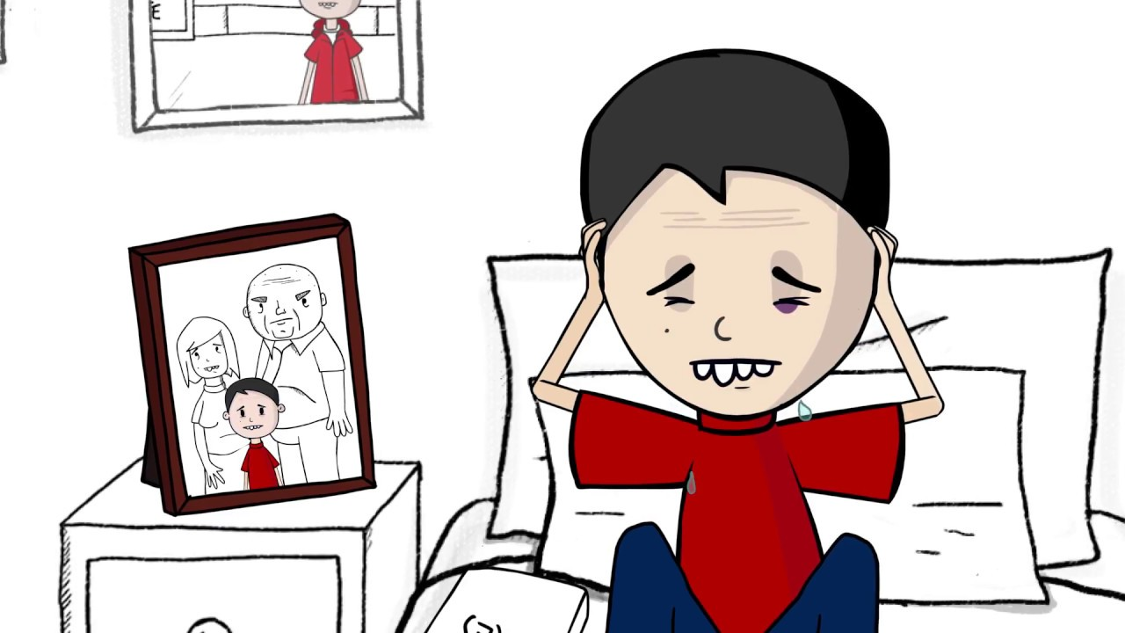
What do we mean by Adverse Childhood Experience?
ACEs are traumatic experiences that children experience that can then go on to effect their mental health and their future prospects in life. It is vital that, as teachers, we understand not just what they are, but how they affect the child and the impact they can have on their behaviour and attainment. Watch the clip below to find out more:
(Liverpool CAMHS, n.d.)
The most widely recognised ACES are:
Abuse:
physical
sexual
verbal
Growing up in a household where:
there are adults with alcohol and drug use problems
there are adults with mental health problems
there is domestic violence
there are adults who have spent time in prison
parents have separated
Other types of childhood adversity that can have long term implications include bereavement, bullying, poverty and community adversities such as living in a deprived area, neighbourhood violence.
Neglect:
emotional
physical
https://www.youtube.com/watch?v=YiMjTzCnbNQ
(Public Health Wales & Blackburn with Darwin Borough Council, 2017)
The more ACEs a child experiences, the greater the risk of long term impact.
(Liverpool CAMHS, n.d.)

Slide 4
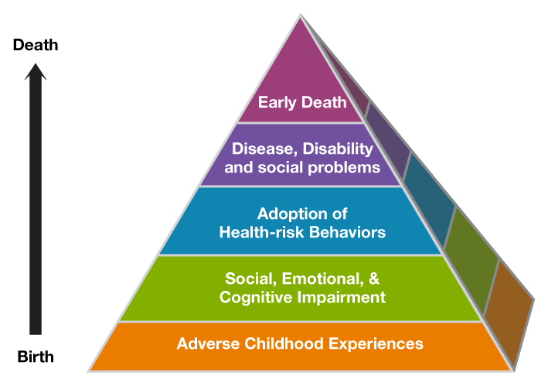
The impact of Adverse Childhood Experiences
67% of the population has at least one ACE;
12.5% of the population has more than 4. (70/30 Campaign, 2017)
Adverse Childhood Experiences aren’t just something that effect the child whilst they’re happening, they can have an impact on their whole life.
The higher the number of ACEs you experience in childhood the higher your chances of
Impaired neurological development
Lower academic performance
Exclusion from school
Increased risk of anti-social behaviour
Increased risk of poor health
Increased socioeconomic problems
Increased risk of health problems
Increased risk of early death.
Perry & Szalavitz, 2010; Van der Kolk, 2014)
(70/30 Campaign, 2017)

Slide 5
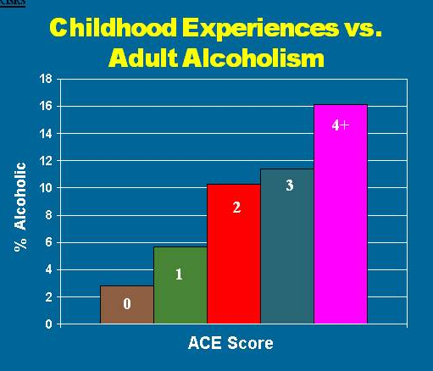
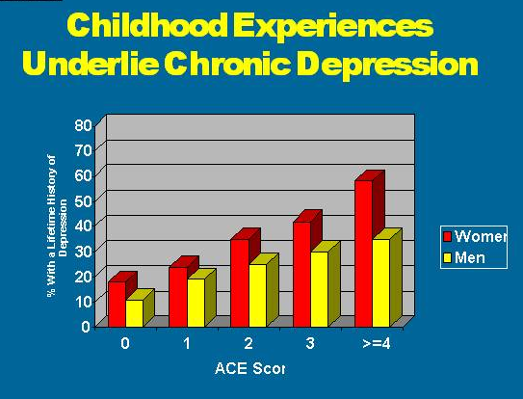
The impact of Adverse Childhood Experiences
(ACES Too High, n.d.)

Slide 6
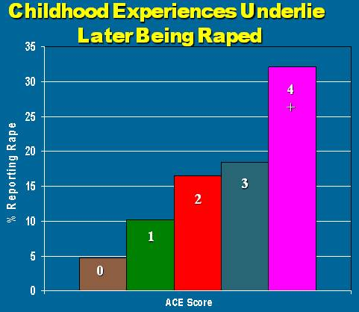
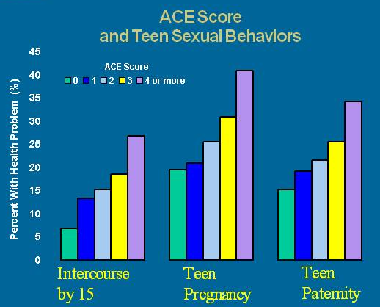
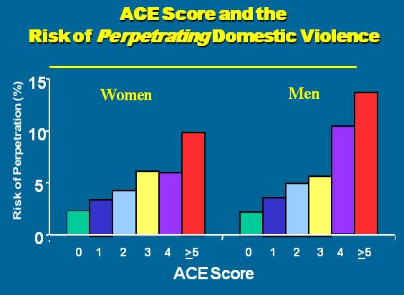
The impact of Adverse Childhood Experiences
(ACES Too High, n.d.)

Slide 7
(Patton, 2016)

Slide 8
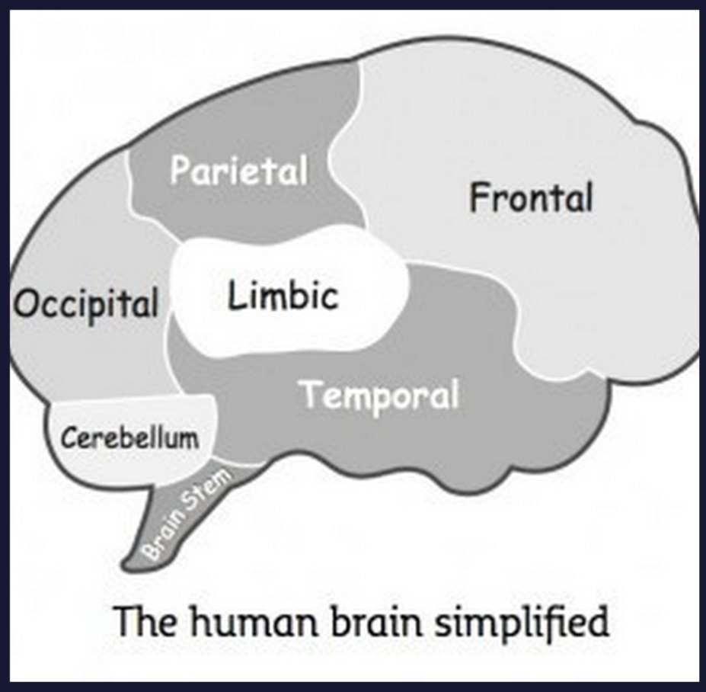
Why do ACEs have such a huge impact?
(Peters, 2012)
To understand why childhood trauma has such a negative impact on children’s development, we need to understand more about the development of the brain.
The Brainstem
When we are born, the brainstem is pretty much fully developed – it contains cranial nerves that link the brain with the rest of the body, which is what enables us to move, see, talk etc. The brainstem is important but we’ll come back to this later
The Limbic system
The limbic lobe is our caveman brain. The limbic lobe’s main function is survival. When presented with stress or dangerous situations, the limbic system automatically takes over to keep us alive. The brain fills up with cortisol and adrenaline which speeds up our breathing and reactions. This is to give us the energy and power to fight or flight.
As we grow up we learn to modulate our stress response, so that not everything is seen as a threat, so for most of us, when someone looks at us in a ‘funny’ way, it doesn’t spark our limbic lobe, we just ignore it and carry on with our day.
How babies are cared for in the first year of their lives plays a big part in this; when a baby is hungry, thirsty, wet or cold, it cries. When a parent/ carer comes and picks it up resolving the issue, it learns that everything is okay, its needs will be met, thus slowly, the brain learns, through repetition, that it’s okay be uncomfortable, things will be dealt with.

Slide 9
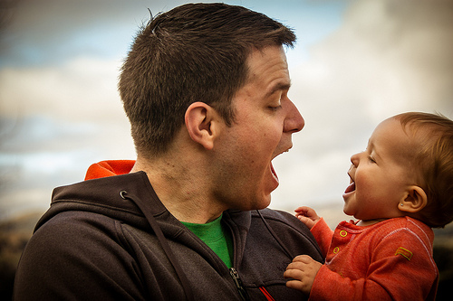
Attunement – think back to the starter activity
Normally, parents have a natural attunement with their baby. As babies, we learn how to be, by copying our parent/ care givers (stick out your tongue at a baby, and they’ll do the same back). In order to help us do this, our brains contain mirror neurons, cells that help us mirror or copy the people around us so that we fit into society.
This is why you were able to synchronise your clapping fairly easily.
It is vital that babies receive this stimulation if they are to develop empathy, understanding and the ability to adapt their behaviour in order to fit in with their peers and society.
(Gerhardt, 2015; Perry & Szalavitz, 2010; Van der Kolk, 2014)
When things go wrong.
For babies who don’t receive this interaction, for those who are left to cry and whose needs are not met, their brain continues producing cortisol and adrenaline. A baby is totally dependent on adults, if their cries are not responded to, it is literally a life or death situation, a baby who is not fed will die. They don’t learn how to modulate their stress, which can have life long consequences.
As they get older, their brains either produce far too much cortisol meaning they become pupils who go from ‘naught to nuclear’ in their response to stress; or their cortisol ‘tap’ switches off and becomes unresponsive – these become the pupils who seem unaffected by anything and seem emotionally ‘cold’.
(Gerhardt, 2015)

Slide 10
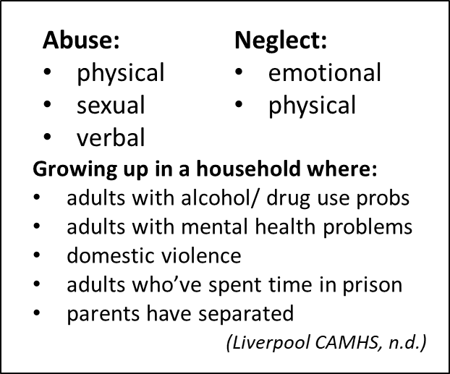
Long term impact of ACEs
There are many reasons why a child may experience an adverse experience; sometimes it is deliberate
(Liverpool CAMHS, n.d.)
abuse, but often it can be unintentional, the result, for example of parental depression/ ill health or lack of knowledge of how to care for a baby.
For babies that experienced a good first year, with adverse experiences starting after this, their long term outcomes are far better than
for babies that experienced adverse experiences in their first year which stopped after this (due to being taken into care for example)
(Perry & Szalavitz, 2010).
The damage caused in the first year, by the development of our stress response, is subconscious and long lasting. Knowing this will help you better understand the behaviour of some pupils.

Slide 11
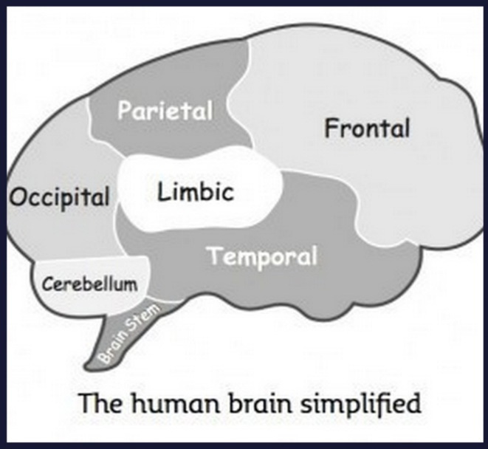
Long term impact of ACEs
Think back to the diagram of our brain. We are now going to look at three parts – the brainstem, the amygdala (which is part of the limbic system) and the medial pre-frontal cortex (which is part of the frontal cortex).
(Liverpool CAMHS, n.d.)
Medial Prefrontal Cortex or The watch tower.
The purpose of this part of our brain is watch out for potential threats – it does this by noticing when things are slightly different to normal – a different person is around, the temperature is hotter than usual, a door that is usually shut is open, etc.
Amygdala
This is like the smoke alarm within our brains, it works subconsciously and before our thinking brain has time to catch up. This is what makes you stop suddenly when crossing a road, before seeing a car approaching.
For people who have experienced past trauma, their smoke alarm can be broken, so they are constantly being alerted to danger, it’s like the smoke alarm is constantly bleeping, even when the battery has been removed.
The problem for people who have a broken smoke alarm is that they’re constantly been told to look out for a threat. Because that part of the brain is so over active, it means they see everything as a threat, therefore are less likely to spot real threats, hence why victims of domestic violence may end up with another perpetrator of violence and so the cycle continues.
(Van der Kolk, 2014).
(Van der Kolk, 2014).
https://www.youtube.com/watch?v=x-tgoXncKh4
The poem on the next slide describes my experiences of living with that constant anxiety, which led to self harm when younger (thankfully, I now have greater understanding and better coping strategies). How many of your pupils may be experiencing something similar? NB: Trigger Warning.

Slide 12
Self-Harm
*TRIGGER WARNING*
Disjointed thoughts,
Invade the mind,
March rough shod
Over all original thought,
Stirring up memories, doubt,
Useless, useless, USELESS.
As the vice gets tighter,
Scratch, screech, drip, useless.
A boa constrictor suffocates the chest,
Scratch, screech, drip, useless.
Gets tighter,
Scratch, screech, drip, useless.
Can’t breathe,
Scratch, screech, drip, useless.
Feel sick. Pathetic.
The silver point of a hard, cold blade,
Scratchscreechdripuselesspathetic.
Pierces deep into soft relenting flesh.
Scratchscreechdripuselesspathetic.
Blood trickles across clammy skin.
A welcome sting, that brings relief.
A mark to demonstrate the pain.
Silence.
It’s okay to
breathe.
For now.
Imagine.
A deep and searing pain,
No mark to act as proof,
No swelling or temperature
Or sickness or heat.
No sign of any kind.
Fraud.
Inside, the pain is constant,
It’s one that cannot be described.
Nails scratching across an everlasting blackboard,
The incessant screeching of a wheel,
A tap dripping into an empty tin pot,
The echo rebounding as in meets the next,
Drip, drip, drip. Unrelenting.
All played out together,
As the vice like grip
on the exhausted brain
Gets tighter, scratch,
And tighter, screech,
And tighter, drip.
Unceasing.
Scratch.
Unremitting.
Screech.
Unending.
Drip.
(Symons, 2019)

Slide 13
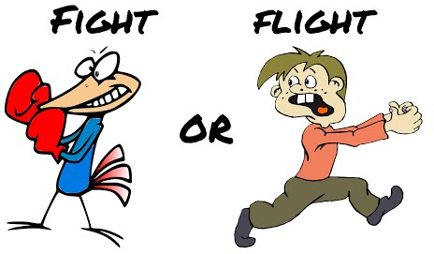
Polyvagal Theory
The final part of the puzzle is the brainstem, this is the part of the brain than links the brain with the rest of the body and turns our thoughts into actions.
Stephen Porges, American professor in psychiatry developed the Polyvagal Theory to explain how our brainstem sends messages to our body when the brain believes there is a threat:
1. Ventral Vagal Complex
This is the nerve that links the brain to your main bodily functions – your heart, lungs and stomach. So long as there is no threat, your breathing, heart rate, blood pressure and digestive system remain working normally.
2. Autonomic Nervous System (ANS)
(Peters, 2012)
When your brain detects danger, your sympathetic ANS takes over, your heart rate speeds up, your blood pressure increases, your digestive system is deactivated, all of which helps us ‘fight of flight’. Once the danger has passed, we return to our VVC.
(Porges, 1994).
(Learning Junction, 2014)
3. Dorsal Vagal Complex (DVC)
If the threat is ongoing or if our amygdala (smoke alarm) is broken, our brain keeps on being informed that there is a threat, causing us to enter our DVC. This means we are either:
Hypervigilant. Everything is a threat so our brain is constantly in a distressed state, as was described at the start of the ‘Self Harm’ poem. If this is the case, the individual can relieve this distress by becoming violent/ aggressive to others (this accounts for many people in prison) or to themselves (self harm). They may appear hyperactive or fidgety as you would if facing danger. OR
Freeze/ Dissociate. There is only so long the brain can cope with being in such a heightened state, so at times the brain will dissociate, this means that it will switch off and mentally take the person to a totally different place. The person will appear distant or ‘away with the fairies’.
(Porges, 1994).
(Grusovin, n.d.).
(Porges, 1994).

Slide 14
Dissociation
Nothing
A glass wall surrounds me.
Trapped in a vacuum of nothingness.
The daily actions continue as before
But they are nothing, they mean nothing.
The actions are robotic,
The feelings elusive.
I have become a mannequin,
An empty vessel who no one sees or regards.
A blank face in a nameless crowd
Of no more significance than
Yesterday’s torn up newspaper
Floating on the wind.
Redundant.
If I sit still enough,
Maybe I will
Become a statue.
Maybe I
will
fade
away.
Become
Noth
Dissociation is often a response learnt from trauma in which it was impossible to fight back or run away – the brain’s only option to cope with the trauma was to remove itself.
Many people describe dissociation as leaving their body, floating up and watching the trauma from a distance. For some people, they describe going to a ‘safe place’ totally away from the scene (Perry & Szalavitz, 2010). This is why people who have experienced trauma may be totally unable to remember it, and if they do, they only remember snippets rather than the full story.
My experience of dissociation is feeling my body becoming heavy and sinking out of it into the sofa or bed, hidden and safe but numb. At that point it’s possible to do or say anything to the body that remains, because Elvis has left the building!
The main problem is, that once this response has been learnt, the brain will often use it to cope even when it’s inappropriate, leaving the person feeling confused, frightened and numb.
(Perry & Szalavitz, 2010; Van der Kolk, 2014)
(Symons, 2019)
(Grusovin, n.d.).

Slide 15
Why this matters
Without doubt, there will be young people that you teach that have experienced at least 1 ACE, many will have experienced more than that, they’re usually the pupils that have you tearing your hair out.
I remember teaching one young man in year 9, he was intelligent and perfectly capable of doing the work, he didn’t talk or mess about when I was teaching or present any real behaviour problems. The problem was, that he would never do the work, and no matter how many times I explained it, in how many different ways, he still claimed he didn’t understand and couldn’t do it. It was infuriating.
At the time, I put his lack of willingness to even attempt the work down to pure laziness. Now when I look back, I suspect the reason he couldn’t do it was because he was in his Dorsal Vagal Complex and ‘frozen’. He wasn’t lying, he wasn’t being lazy, he just couldn’t access his thinking brain. Me nagging, moaning, giving detentions, phoning home etc etc, won’t have helped change the root cause. If I’d known then what I know now, I would have handled the situation very differently.
We need to change the focus. Instead of asking of “What’s Wrong With You?” We need to ask “What Happened to You?”

Slide 16
That child who seems to deliberately wind everyone up, is it because he didn’t learn empathy as a baby?
Changing Focus
That child who just stormed off for nothing, is it because her stress response isn’t modulated?
REALIZE the impact of trauma
RECOGNIZE the signs of trauma
RESPOND by integrating knowledge about trauma into practices, policies, procedures
RESIST re-traumatizing people (by shouting, belittling or insensitive comments)
That child who punches the walls or kicks the doors, is it because her ‘smoke alarm’ is broken?
That child who never seems to be listening and is too lazy to even attempt the work, has she dissociated?
That child who won’t sit still, is it because he’s hypervigilant?
(Patton, 2016)

Slide 17
So what can I do about it?
Consistency is key!
For young people who are hypervigilant, their brains are programmed to look for threats, this can and will distract from the lesson.
Make sure your classroom is organised and not chaotic. Have a place for everything and everything in its place.
Ensure you have consistent routines so that pupils coming into the classroom know what to do and what to expect.
Clearly set out the tasks that you will be looking at in the lesson stating what your expectations are. If you know a pupil struggles because they are too fidgety or always forget, print out the slide and have it next to him/her to tick the tasks off.
The clearer the environment and expectations, the less anxious the pupil.
Remain calm
Remember those mirror neurons? If you are stressed and uptight, it will rub off on the pupils.
Show patience and understanding
It is true that pupils with ACEs are more than likely the ones you want to throttle and seem to know exactly what buttons to press! Shouting at these young people will achieve nothing especially if their home life is full of shouting. Release your inner swan!!
Ask and really listen to the young person’s perspective, identify with their experience and emotions. Later when they are calm use SET UP to talk:
Support – “I’m here to help you with this.”
Empathy – “It’s a really difficult topic, lots of people struggle”
Truth – “You won’t pass if you’re not prepared to try.”
Understanding – Show you understand their perspective
Perseverance – things aren’t going to change instantly, but maintain consistency and things can and will change.
Be like a swan – calm and serene on top, but kicking like mad underneath! If you can project an appearance of calmness, it will rub off on your pupils.
It’s important to use these three together.
(Kreisman & Straus, 2010)

Slide 18
Final Thoughts
The impact of Adverse Childhood Experiences can be immense. You are a teacher or teaching assistant, not a doctor, nurse, social worker, therapist or … and nobody expects you to be. Your main focus is, and unfortunately, has to be, exam results, nothing else seems to satisfy Mr Ofsted or Mrs League-Table. However, if we can be aware of ACEs and respond more appropriately, the child will be better able to focus in lessons and results will improve.
As a teacher, or TA, you are in the extremely privileged position of being able to build relationships with young people. One of the most important components of recovery is positive relationships, never underestimate the power of the relationships that you enable as a natural part of your job.
“Just as a traumatic experience can alter a life in an instant, so too can a therapeutic encounter.
….The good news is that anyone can help with this part of ‘therapy’ – it merely requires being present in social settings and being, well, basically, kind. An attentive, attuned, and responsive person will help create opportunities for a traumatized child to control the dose and pattern of rewiring their trauma-related associations. … The more we can provide each other these moment of simple, human connection – even a brief nod or a moment of eye contact – the more we’ll be able to heal those who have suffered traumatic experience.”
[Perry & Szalavitz, 2017; Shevrin-Venet, 2018]

Slide 19
References
70/30 Campaign. (2017). Adverse Childhood Experiences (ACEs). Retrieved from https://www.70-30.org.uk/18737-2/
ACES Too High. (n.d.). Got you ACE score? Retrieved from https://acestoohigh.com/got-your-ace-score/
Davies Maxon, A. (2018). The lingering effects of childhood trauma. Retrieved from http://allisondavismaxon.com/the-lingering-effects-of-childhood-trauma/
Gerhardt, S. (2015). Why love matters: how affection shapes a baby’s brain. London: Routledge, Taylor & Francis Group.
Grusovin, E. (n.d.). Dissociation. Retrieved from https://www.flickr.com/photos/emiliano-iko/
Kreisman, J. J., & Straus, H. (2010). I hate you--don't leave me: Understanding the borderline personality. Completely Revised and updated. New York, America: Pedigree, Penguin Group.
Liverpool CAMHS. (n.d.). Adverse childhood experiences (ACE). Retrieved from https://www.liverpoolcamhs.com/resources/adverse-childhood-conditions-ace/
Patton, L. (2016). Shifting the Paradigm: Asking “What Happened to You?” Instead of “What’s Wrong With You?” National CAP Conference 2016. Retrieved from http://files.constantcontact.com/d1b76d8c201/f0082df0-6e4b-4fc6-ae9a-bbc203fc25df.pdf?ver=1475262617000

Slide 20
Perry, B., & Szalavitz, M. (2010). Born for love. Why empathy is essential and endangered. New York, America: William Morrow Paperbacks.
Perry, B. D., Szalavitz, M. (2017). The Boy Who Was Raised as a Dog, 3rd Edition: And Other Stories from a Child Psychiatrist's Notebook--What Traumatized Children Can Teach Us About Loss, Love, and Healing. p 308-9 New York, USA: Basic Books.
Peters, S. (2012). The chimp paradox: The mind management programme for confidence, success and happiness. London, United Kingdom: Vermilion.
Porges, S. W. (1994). The polyvagal theory. Neurophysiological foundations of emotions, attachment, communication and self-regulation. London, United Kingdom: W.W. Norton & Company.
Public Health Wales & Blackburn with Darwin Borough Council. (2017). Adverse childhood experiences (ACEs) (Wales). Retrieved from https://www.youtube.com/watch?v=YiMjTzCnbNQ
Shevrin-Venet, A. (2018). What can one teacher really do about trauma? Retrieved from https://unconditionallearning.org/2018/01/15/what-can-one-teacher-really-do-about-trauma/
Symons, R. (2019). Nothing. Retrieved from www.thrivingfutures.co.uk
Symons, R. (2019). Self harm. Retrieved from www.thrivingfutures.co.uk
Van der Kolk, B.A. (2014). The Body Keeps the Score: Brain, Mind, and Body in the Healing of Trauma. New York, America: Viking.

