Slide 1
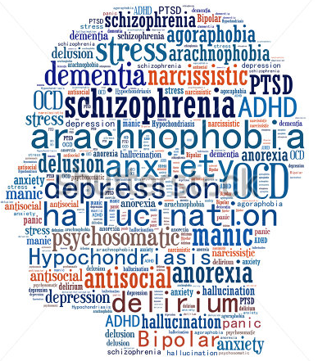

A Journey into Mental Illness
Learning Objectives:
To think about what it is like to experience mental illness
To use this understanding to inform our practice when treating a mentally ill patient for a physical illness
Presenter instructions: Please print out slides 5 and 6 and practice reading out-loud before delivering this presentation.
www.thrivingfutures.co.uk

Slide 2

How do you feel about treating a patient that has a serious mental illness?
Nooooooooo
I don’t understand, why are they behaving that way?
https://www.youtube.com/watch?v=hdPZ7rw0wMc

Slide 3
Understanding Mental Illness
The purpose of this session is to think about what it feels like to have a mental illness.
We know that there is a strong link between physical and mental health. As a physical health nurse, you will have to treat people who are also presenting with a mental illness and vice versa as a mental health nurse.
If we have some insight as to what it feels like to by psychotic, depressed or anxious, then we are better placed to respond to it.

Slide 4

A Journey into Mental Illness
I am going to take you on a journey but before we begin I need you to:
Stand up and take one step backwards from your chair.
Spread your legs so that they are shoulder width apart– this will help you keep your balance.
Now close your eyes. Do not open them again until you are told, unless you feel unhappy in which case, simply open them.
I need you to really listen to what is about to be read and try and visualise it. Start by taking a deep breath in through your nose – feel your tummy rise like a balloon, and out through your mouth, imagine the balloon deflating. And again, in through your nose, feel the balloon growing, and out, let the balloon deflate.
Keep your eyes closed, we are ready to begin.

Slide 5
The person reading this should read calmly and steadily, giving the listener time to imagine what you are reading. Try reading out loud a few times before delivering the session so that the flow isn’t interrupted .
The engine hum dies as your car pulls softly to stand still. You take a deep breath, the air is cold as it fills your nose and lungs; your chest rises then falls as you exhale. As you look out of the window fat drops of rain begin to splosh sporadically onto the windscreen. The sky is magnificent in its greys, blues, blacks and white, it looks almost like a water colour painting; a stormy sky set against the edge of dramatic cliffs.
Your hand pulls the door leaver and your feet swing round to crunch on the gravel car park, the rain is cool on your skin. You push the door to a squeaky close and stand for a while, face up turned to the cleansing water as it falls softly on your forehead. It runs down your face, drips off your eyebrows onto your lips, leaving the taste of salt from the sea. Taking a deep breath once again, you set off; your feet leave the hard crunch of gravel and move onto the soft squelch of what had once been green grass. As you look to the edge of the cliffs, you feel the wet creeping into you trainers, working its way through your socks, coming to rest against your skin. Your feet sink into the squelching mud, feeling thick and heavy as you speed up to get to drier land.
You continue towards the cliff’s edge, getting closer to the vastness of the sea beyond. You can see the tips of the waves, they look like white horses racing, bending gracefully then lifting their white heads once more, this time closer, as they pace their way towards the shore. The race becomes faster and more aggressive the closer they get. The competition ends dramatically as the tips of the waves crash violently up against the jagged edges of rocks, spewing foam angrily back into the blue expanse.
You near the edge and your stride alters, as your foot knocks a stone off the verge. You watch it bound off the rock as it enters oblivion. You carefully ensure your feet remain the right side of safety.
(Continues onto the next slide)

Slide 6
As you stand looking to the horizon where the sky merges seamlessly with the sea, the rain stops. The sun slides out from behind the silver lined clouds, rays hit the smooth grey rocky cliffs like a spotlight, turning the cold grey into a magical glistening purple. You feel the new warmth soaking into the wetness of your bare arms.
Staring down, you notice a jagged shelf of rock jutting out, home to a nest of chicks, their scrawny mouths squawk for the return of their parents, their balding bodies huddled together for warmth. Looking down further, the vertical rock continues for an eternity before levelling out into rough boulders that are swallowed up whole by the hungry sea, swush, swush, swush.
You feel small and insignificant standing high above the world, the sea, miles below is just a step away. The swish of the sea starts to blur, and become fuzzy as the thumping of blood schwirling through your brain becomes the dominant sound . You feel yourself melt into the background, swallowed up in the tumultuous sky, the tempestuous sea. The world becomes surreal and blurred as it starts spinning. You feel caught up in a merry-go-round of danger; sea, white horses, vertical cliffs, boulders, white horses, sky, cliffs, rocks jutting, vertical cliffs, sea …
Purposefully, you take a step forward.
Keeping your eyes closed, I want everybody to take a step forward.
[Wait 5 seconds]
Keep your eyes closed, you’re in the classroom, it is safe, take a step forward.
[Wait 5 seconds]
Open your eyes and take a seat.
This part should be read clearly as instructions, not as part of the story.

Slide 7
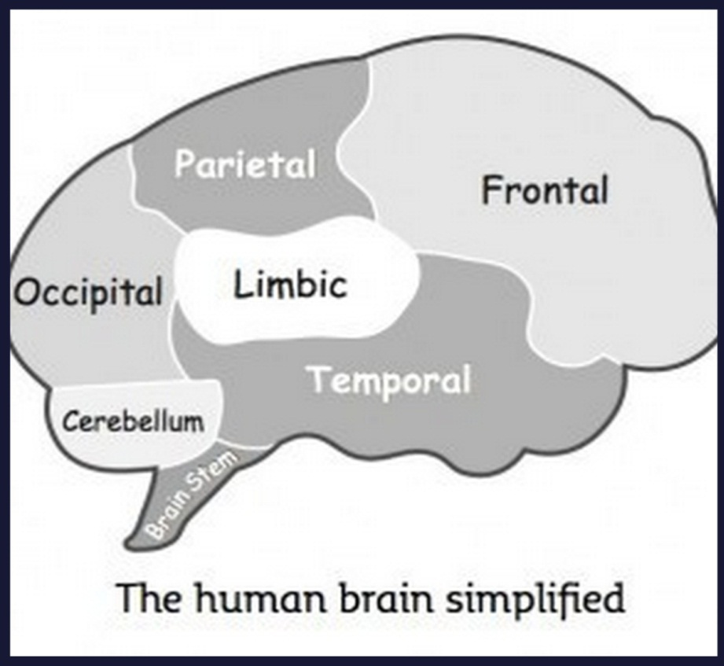
A Journey into Mental Illness
Hands up:
Who was unable to take a step forward when asked?
Who was still reluctant to take a step forward when reminded where they were?
Who was unable to move until they opened their eyes?
Explanation:
Your brain has been immersed into a world where taking a step forward would be incredibly dangerous, leading to almost certain death. The primary function of our brain is to keep us alive.
The brain is an incredible, complicated organ with around 100 billion neurons sending and receiving information back and forth.
For the purpose of this exercise we are going to think about just 2 parts:
The Limbic
The Frontal
(Peters, 2012)

Slide 8



Our inner caveman
The Limbic
The limbic lobe is our caveman brain. The limbic’s main function is survival; it also governs our emotions.
When presented with stress or dangerous situations, the limbic automatically takes over to keep us alive. It has 3 responses:
Fight
Flight
Freeze
The Frontal
The frontal lobe carries out many different functions, but for the purpose of this exercise, it is our thinking brain.
When our limbic lobe has been engaged, we are not able to reach our thinking brain.
This is why, even though you knew you were safe, your caveman didn’t and wanted to keep you safe so took over and stopped you from moving. This is the same reason why, after you watch a scary film, you continue to be scared, even though you know it’s just a film.
When we get this response the brain fills up with cortisol
(Peters, 2012)
and adrenaline which speeds up our breathing and reactions. This is to give us the energy and power to fight or run. This response is automatic and something we have little conscious control over.

Slide 9

So what’s the point of all this?
Definition – Psychosis
Psychosis occurs when the person loses touch with reality, this can include hallucinations, delusions, confused or disturbed thoughts or a lack of self awareness.
(NHS Choices)
At the end of the description, your brain was in a different reality to your body, your reaction of being unable to move was totally predictable when we understand that our brain is programmed to keep us safe.
You were able to reconnect your brain and body by opening your eyes. For someone who is psychotic – their brains are, and remain in a different place to the reality that we are experiencing. This is caused by too much of the chemical, dopamine in the brain.
A nurse treating someone who is psychotic needs to be able to identify with their patient’s reality and understand the emotions it may cause. If we can empathise with what they are thinking and believe, we are better able to understand how they may be feeling and ultimately how their they may behave.
Think:
    What does the person believe?
    How is this likely to make them feel/act?
    How can I protect my own safety?
    What can I do to reassure them of their safety?
If someone had made you step through the door and your brain believed that that step meant you falling off a cliff – you would probably react violently.

Slide 10

Treating a person with a mental illness
The bad news: Mental illness can be caused by many things including taking drugs, stress, or childhood trauma. Because there are so many variables causing the illness, and because treating it is dependent on how the individual responds to both talking & pharmacological therapies, treatment it can be a lengthy, complex process.
The good news: As a physical health nurse, you’re not there to treat the mental illness, however:
You do need to manage the mental health condition it in order to address the physical ailment.
To do this, you mush be able to show some understanding and empathy of what the patient is experiencing.
The person may not have a diagnosis, you need to be able to recognise the symptoms in order to refer onto mental health services.
For the purpose of the next task, you are an A&E nurse, think about the following questions in order to say how you would manage the mental illness in order to treat their condition.
What does the person believe?
How is this likely to make them feel/act?
How can I protect my own safety?
What can I do to reassure them of their safety?

Slide 11

Case One
The patient has a broken leg, and has cuts and grazes that need dressing. She received the injuries after jumping from an upstairs window. The patient claims her house was on fire and is worried about the amount of damage. An ambulance was called, and you know that the fire is a psychotic belief.
Case Two
The patient has a broken leg and has cuts and grazes which need dressing. She received the injuries after jumping from an upstairs window. The patient claims that her next door neighbours are members of ISIS and that they are after her because he has informed the police. She says she had to jump to escape because ISIS were now wanting to kill her and had sent 2 members round to her house to ‘do her in’. She believes that there are members everywhere looking for her, and that they could also be in the hospital.
Think:
What does the person believe?
How is this likely to make them feel/act?
How can I protect my own safety?
What can I do to reassure them of their safety?

Slide 12
Think:
What does the person believe?
How is this likely to make them feel/act?
How can I protect my own safety?
What can I do to reassure them of their safety?
This belief is very distressing for the patient but poses no danger to you as a practitioner.
Psychotic beliefs often have roots in reality – it could be that the patient has experienced a fire in the past. Even if this isn’t the case, the patient is likely to be very distressed and will need lots of reassurance, you can provide this without colluding with the delusion by:
Don’t try and dismiss the delusion, if it was strong enough to make them jump from an upstairs window, you’re unlikely to change their mind. Remember you need to treat their physical injuries, not their mental health ones, arguing will make them distrust you making treating them more difficult.
Identify with the emotion that is likely to be felt based on the belief.
Emphasise that the patient is currently safe and that support can be provided to make sure they stay that way (they may interpret this as practical support in the aftermath of a fire, whereas you mean mental health services, but that doesn’t matter – remain vague if necessary).
Draw attention back to dealing with physical injuries so that other issues can then be sorted later.
Make sure you don’t block yourself in, sit nearest to the exit so you can escape if you need to.
Case One
The patient has a broken leg, and has cuts and grazes that need dressing. She received the injuries after jumping from an upstairs window. The patient claims her house was on fire and is worried about the amount of damage. An ambulance was called, and you know that the fire is a psychotic belief.
The patient’s worry could cause them to try and abscond, but with a broken leg, it is unlikely; as a precaution you could inform security.

Slide 13
Make sure you don’t block yourself in, sit nearest to the exit so you can escape if you need to.
This belief could pose a real danger to you especially is she believes that you or other staff members are members of ISIS. If she believes you are there to do her harm, there is a high chance she will be come violent to protect her self.
Don’t try and dismiss the delusion – this will only make her more suspicious, remember it was strong enough to make her jump from an upstairs window. You need to treat her physical, not mental, health.
Reassure of her safety explaining exactly who you are, what you are doing, and why.
  Show her your badge/ picture
  Introduce and explain everyone who enters the room, showing badges if necessary.
  A&E cubicles are very accessible, see if you can move her to a separate room if possible so that she feels safer – but remember to ask/ explain what you are doing.
REMEMBER – IT DOESN’T MATTER THAT IT IS A DELUSION, TO THAT PERSON IT IS REAL – TREAT IT AS SUCH. You can do this without colluding or agreeing, by identifying with the fear/ emotion.
Delusions are often linked to what is happening in the news.
Case Two
The patient has a broken leg and has cuts and grazes which need dressing. She received the injuries after jumping from an upstairs window. The patient claims that her next door neighbours are members of ISIS and that they are after her because he has informed the police. She says she had to jump to escape because ISIS were now wanting to kill her and had sent 2 members round to her house to ‘do her in’. She believes that there are members everywhere looking for her, and that they could also be in the hospital.
If the police have been informed, the chances are mental health issues have already been identified; look at Care Notes to get background information, or contact care- coordinator for further advice.

Slide 14


How does our body respond to fear?
Fear has a physical and an emotional response – it happens because the limbic part of our brain tells our body that we are in danger, therefore it needs to get ready to fight or flight.
Feel angry
Feel nervous
Feel down or depressed
Feel guilt or shame
Can’t think straight
Tight muscles
Emotional
Sweating
Fast heartbeat
Feeling tired all the time
Feel scared
Feel short tempered
Physical
Headache
Stomach aches
Feel sad
Feel confused
Fast breathing
Difficulty sleeping
Our body’s physical reaction confirms our caveman’s response that we really are in danger, so it becomes even harder to think straight, creating a whole host of emotional reactions.
Restlessness
(American Institute of Stress, 2017)

Slide 15
How does our body respond to anger?
Anger has a physical and an emotional response – it happens because …
Feel angry
Feel nervous
Feel down or depressed
Can’t think straight
Tight muscles
Feel guilt or shame
Sweating
Emotional
Fast heartbeat
Feeling tired all the time
Physical
Feel scared
Feel short tempered
Headache
Stomach aches
Fast breathing
Feel sad
Feel confused
Difficulty sleeping
Our body’s response to fear and anger are very similar – remember how angry your parents got when you did something that scared them?
If we don’t recognise and address the fear the patient may be feeling, there is a high chance it will be expressed as anger.
Restlessness
(American Institute of Stress, 2017)

Slide 16
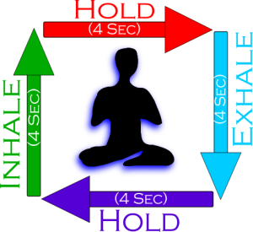
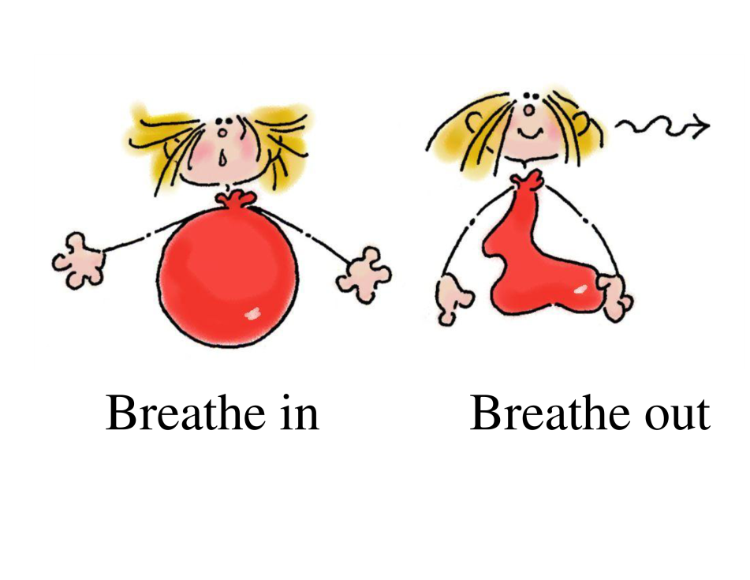
Controlled Breathing (short term)
If the patient is particularly anxious, you can help reduce this by focusing on breathing – this will help stimulate parasympathetic nervous system, helping reduce the fight, flight or freeze reaction which in turn makes their behaviour calmer and more predictable.
Square Breathing
When we breathe too fast, we take in too much oxygen, but don’t give ourselves a chance to release carbon dioxide which can make us feel sick and dizzy. Square breathing is a way of getting the right levels of oxygen back and bringing our breathing back under control.
Focus on something square – a piece of paper, a paving slab, a window, a table – anything. Move your eyes to trace the edge of square.
Breathe in
Hold
Breathe out
Hold
This is especially useful as it
gives the patient something
physical to focus on as well as getting oxygen levels and heart beat back to normal. (Life Charger, 2016)
Balloon Breathing
Balloon breathing is also good for bringing the heart rate and breathing down.
Place your hands on your stomach, over your belly button. When you breathe in, you should feel your hands move out (imagine a balloon filling with air) and then back in when you breathe out – like the balloon is emptying.
Try counting as you do it – “In, two, three, four. Out, two, three, four.” (Dorter,2016)

Slide 17
Self Harming
A common reason for patients with mental health concerns presenting at accident and emergency, is that of self harming.
It can be difficult to understand why someone may deliberately want to hurt themselves, resulting in some people concluding that it is attention seeking. Whilst there are many reasons for self harming, the is one common link is a maladjusted coping strategy, one that requires empathy and understanding.
The poem on the next slide describes how I have felt when self harming in the past (thankfully, with greater understanding and better coping strategies, I have found better ways to deal with the emotions expressed). This will not be the same for everybody, but hopefully it will give some insight as to why a person feels the need to do physical damage to themselves.
NB: Trigger warning – this has been written to aid professionals in understanding self harm, not for people who do self harm as it may be a trigger.
Reasons for self harm
express something that is hard to put into words
turn invisible thoughts or feelings into something visible
change emotional pain into physical pain
reduce overwhelming emotional feelings or thoughts
have a sense of being in control
escape traumatic memories
have something in life that they can rely on
punish yourself for your feelings and experiences
stop feeling numb, disconnected or dissociated.
create a reason to physically care for themselves
express suicidal feelings and thoughts without taking their own life.
[Mind, n.d.]

Slide 18
Self-Harm
*TRIGGER WARNING*
Disjointed thoughts,
Invade the mind,
March rough shod
Over all original thought,
Stirring up memories, doubt,
Useless, useless, USELESS.
As the vice gets tighter,
Scratch, screech, drip, useless.
A boa constrictor suffocates the chest,
Scratch, screech, drip, useless.
Gets tighter,
Scratch, screech, drip, useless.
Can’t breathe,
Scratch, screech, drip, useless.
Feel sick. Pathetic.
The silver point of a hard, cold blade,
Scratchscreechdripuselesspathetic.
Presses deep into the soft relenting flesh.
Scratchscreechdripuselesspathetic.
Blood trickles across clammy skin.
A welcome sting, that brings relief.
A mark to demonstrate the pain.
Silence.
  It’s okay to
breathe.
For now.
Imagine.
A deep and searing pain,
No mark to act as proof,
No swelling or temperature
Or sickness or heat.
No sign of any kind.
Fraud.
Inside, the pain is constant,
It’s one that cannot be described.
Nails scratching across an everlasting blackboard,
The incessant screeching of a wheel,
A tap dripping into an empty tin pot,
The echo rebounding as in meets the next,
Drip, drip, drip. Unrelenting.
All played out together,
As the vice like grip
on the exhausted brain
Gets tighter, scratch,
And tighter, screech,
And tighter, drip.
Unceasing.
Scratch.
Unremitting.
Screech.
Unending.
Drip.
(Symons, 2019)

Slide 19
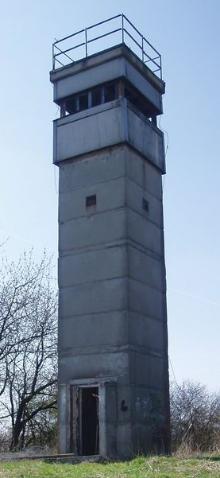

Self Harming – Why does it happen?
The start of the poem describes the brain experiencing distressing noises. We all have background noise or thoughts, but usually we don’t notice them. If you think about a time when you have been anxious, a job interview or dentist appointment for example, that noise will have be come louder and more distressing with unwanted thoughts and feelings. But why does this happen?
Think back to the diagram of our brain. We are now going to look at three parts – the brainstem, the amygdala (which is part of the limbic system) and the medial pre-frontal cortex (which is part of the frontal cortex).
Amygdala
This is like the smoke alarm within our brains, it works unconsciously and before our thinking brain has time to catch up. This is what makes you stop suddenly when crossing a road,
Medial Prefrontal Cortex or The watch tower.
The purpose of this part of our brain is watch out for potential threats – it does this by noticing when things are slightly different to normal – a different person is around, the temperature is hotter than usual, a door that is usually shut is open, etc.
(Peters, 2012)
then you see a car approaching. For people who have experienced past trauma, their smoke alarm can be broken, so they are constantly being alerted to danger, it’s like the smoke alarm is constantly bleeping, even when the battery has been removed.
The problem for people who have a broken smoke alarm is that they’re constantly been told to look out for a threat. Because that part of the brain is so over active, it means they see everything as a threat, therefore are less likely to spot real threats, hence why victims of domestic violence may end up with another perpetrator of violence and so the cycle continues.
(Van der Kolk, 2014).
https://www.youtube.com/watch?v=x-tgoXncKh4
(Van der Kolk, 2014).

Slide 20
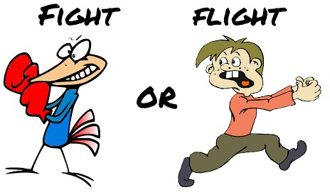
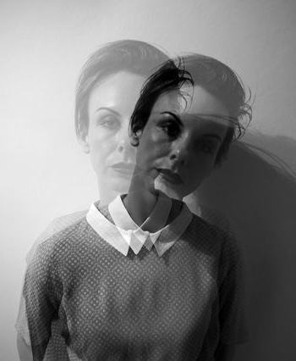
Polyvagal Theory
The final part of the puzzle is the brainstem, this is the part of the brain than links the brain with the rest of the body and turns our thoughts into actions.
Stephen Porges, American professor in psychiatry developed the Polyvagal Theory to explain how our brainstem sends messages to our body when the brain believes there is a threat:
1. Ventral Vagal Complex
This is the nerve that links the brain to your main bodily functions – your heart, lungs and stomach. So long as there is no threat, your breathing, heart rate, blood pressure and digestive system remain working normally.
2. Autonomic Nervous System (ANS)
(Peters, 2012)
When your brain detects danger, your ANS takes over, your heart rate speeds up, your blood pressure increases, your digestive system is deactivated, all of which helps us ‘fight of flight’. Once the danger has passed, we return to our VVC.
(Van der Kolk, 2014).
(Learning Junction, 2014)
(Van der Kolk, 2014).
3. Dorsal Vagal Complex (DVC)
If the threat is ongoing or if our amygdala or smoke alarm is broken and it keeps informing our brain that there is a threat, we enter our DVC. This means we are:
Hypervigilant. Everything is a threat so our brain is constantly in a distressed state, as was described at the start of the ‘Self Harm’ poem. If this is the case, the individual can relieve this distress by becoming violent/ aggressive to others (this will account for many people in prisons) or to themselves (self harm).
Freeze or dissociate. There is only so long the brain can cope with being in such a heightened state, so at times the brain will dissociate, this means that it will switch off and mentally take the person to a totally different place.
(Grusovin, n.d.).
(Van der Kolk, 2014).

Slide 21
Nothing
A glass wall surrounds me.
Trapped in a vacuum of nothingness.
The daily actions continue as before
But they are nothing, they mean nothing.
The actions are robotic,
The feelings elusive.
I have become a mannequin,
An empty vessel who no one sees or regards.
A blank face in a nameless crowd
Of no more significance than
Yesterday’s torn up newspaper
Floating on the wind.
Redundant.
If I sit still enough,
Maybe I will
Become a statue.
Maybe I
I will
fade
away.
Become
Noth
Dissociation
Dissociation is often a response learnt from a trauma in which it was impossible to fight back or run away – the brain’s only option to cope with the trauma is to remove itself.
Many people describe dissociation as leaving their body, floating up and watching the trauma from a distance. For some people, they describe going to a ‘safe place’ totally away from the scene (Perry & Szalavitz, 2010). This is why people who have experienced trauma may be totally unable to remember it, and if they do, they only remember snippets rather than the full story.
My experience of dissociation is feeling my body becoming heavy and sinking out of it into the sofa or bed, hidden and safe but numb. At that point it’s possible to do or say anything to the body that remains, because – Elvis has left the building!
The main problem is, that once this response has been learnt, the brain will often use it to cope even when it’s inappropriate, leaving the person feeling numb.
(Van der Kolk, 2014).
(Symons, 2019)
(Grusovin, n.d.).

Slide 22

Why this matters
Regardless of what area of the health care system you work in, you will experience people who have had traumatic experiences and felt things similar to that which I have described. Many times I have heard said that people who self harm only do it for attention, or that people with personality disorders are just attention seekers. This in some sense, may be true, but not in a deliberate, thought through, conscious way.
For an individual whose brain is in constant hypervigilance, it is virtually impossible for them to reach their thinking brain – their need for attention or to know they are safe comes from a deep rooted emotional need. The decision to self harm isn’t a logically thought through decision, it’s a desperate way to stop the pain the brain is experiencing.
My experience of poor professional attitudes to mental health
I once had an accident which resulted in 2 broken arms, fractured ribs, a punctured lung and concussion. At that time, I was in a deep depression. The thing that still stays with me is the utter sense of confusion as to the amount of fuss people were making. I was in hospital for a few days, had many visits, cards, presents etc but I couldn’t understand it. The physical pain of the accident was a tiny, minute fraction of the pain I was experiencing in my head, pain which was constantly dismissed as nothing.
When I went back to the doctors to plead for her to do something, telling her I had thrown all morphine (pain relief from the accident) away because I didn’t trust myself not to take the lot. I was dismissed as being too negative.
As a nurse you have the power to make a huge difference, simply by listening and understanding. The first stage to healing, is being heard. You aren’t expected to have all the answers, but if you can show patience and empathy, that, in itself, is powerful.

Slide 23
Other mental illnesses: Depression
Depression
Depression is not just feeling a bit fed up, nor is it a case of someone being lazy. J.K Rowling (Harry Potter) probably describes it best in her creation of the dementors. When the dementors come they contaminate the whole atmosphere with coldness, darkness and a feeling of hopelessness. A dementor’s kiss is described as ‘worse than death’ as it sucks all life and happiness out of you, taking your soul.
https://www.youtube.com/watch?v=YznIACku9CQ
Note how the ‘antidote’ is a ‘happy memory’ – this helps explain why people who have difficult pasts can find it hard to recover.
But what does it feel like?
We’ve all felt a bit down, stressed or unhappy from time to time, but with depression, this feeling is persistent. The feelings of hopelessness and low self worth don’t leave or change according to where you are or who you are with – they remain, constantly.
https://www.youtube.com/watch?v=SE5Ip60_HJk
Signs of Depression
down, upset or tearful
restless, agitated or irritable
guilty, worthless and down on yourself
empty and numb
a sense of unreality
hopeless and despairing
finding no pleasure in life or things you usually enjoy
no self-confidence or self-esteem
isolated and unable to relate to other people
Suicidal
[Mind, n.d.]

Slide 24
He throws out his seeds, they quickly take root,
Turning good into bad, and bright into soot.
He slows down your thoughts, makes everything dull,
Bad memories resurface, good becomes null.
Things that had been, that you’d rather forget,
He shows you the picture, then watches you sweat.
Humiliation, regret, guilt and shame;
Mr D grows fat on your feelings of blame.
What is the point? I’m stupid, I’m fat,
I’m ugly, pathetic, useless, a brat!
Things can’t get better, these facts, they are certain,
Nobody likes me, I’m a horrible person.
But these thoughts are not facts, they’re not even yours,
They belong to another; whose voice is a roar.
Mr D, he grows stronger, feeds on all that is bad,
Seeping through thoughts, twisting happy to sad.
The Cautionary Tale of Mr D
This is the cautionary tale of, old Mr D,
Depression, as he’s known to you and to me.
He lives beside ‘memories’, inside of your brain,
Silently waiting to cause sorrow and pain.
Mr D is a bullying tormentor,
Who feeds on bad memories right from the centre
Of our brains, things long since forgotten,
He stacks them and stores them, he files and records them.
He lurks until times get a little bit tough,
Then like a snake, he sneaks out from the rough.
A toxic fog, he creeps through your brain,
Worming and squirming till you feel insane.

Slide 25
Is that the end of this sad tale, you wonder?
To tell of such sorrow, surely a blunder!
Mr D, I agree, he’s a spiteful, mean creature,
Why tell of a sorrow that makes life so much bleaker?
It’s true that the tale I tell is most sad,
But not telling about him, makes Mr D glad.
If you don’t know he exists, his power is legitimate,
And it leaves the sufferer in an awful predicament.
You see there’s an antidote to Mr D’s power,
But first you must see that it’s HIS thoughts that flower.
He’s wrong when he says that you’re stupid and fat,
You’re not, you’re not ugly, not useless or a brat.
These thoughts make us want to hide, not to walk,
Tall with your friends, afraid people will gawk,
Afraid that they’ll guess, you’re a failure, you’re a fraud,
But the antidote to Mr D’s power is to, TALK.
Keep Mr D’s thoughts to yourself and they grow,
Leave you playing the villain, your true thoughts all froze.
But talk to your friends, they’ll tell you the truth,
Not perfect, they know, but his lies they’ll uproot.
If a friend’s not available, then talk to a teacher,
A parent, a doctor, a help line, a preacher.
The more that you talk, the more you will see,
The lies Mr D told are really quite beastly.
And as you talk, a curious thing happens,
Mr D starts to shrink, his grasp on thoughts slackens.
The fog that once had made thinking all fuzzy,
Drifts quietly away, the day break is sunny.
(Symons, 2019)

Slide 26
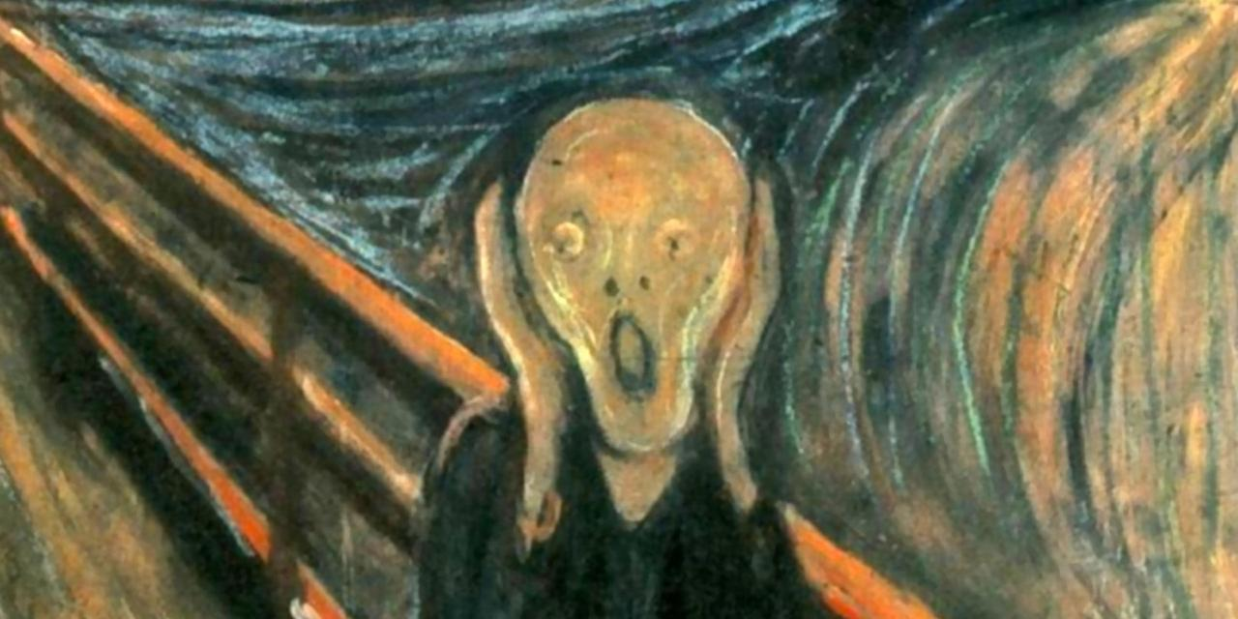
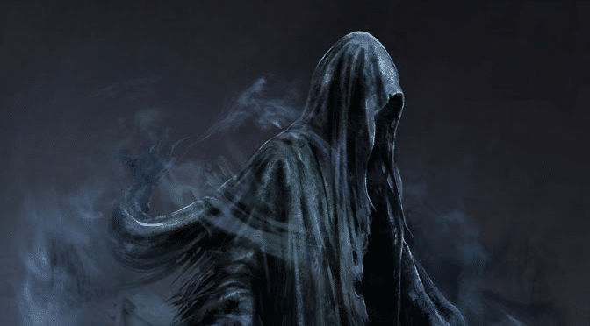
Other mental illnesses: Anxiety
We all feel anxious from time to time, that’s normal, it’s when it takes over and starts to interfere in our normal activities of daily living that it becomes a mental illness.
https://www.youtube.com/watch?v=ymTm7dJP5L4
[Munch, n.d.]
Signs of Anxiety
a churning feeling in stomach
feeling light-headed or dizzy
pins and needles
feeling restless or unable to sit still
headaches or other aches and pains
faster breathing
a fast, thumping or irregular heartbeat
Sweating or hot flushes
sweating or hot flushes
problems sleeping
grinding teeth, especially at night
nausea
needing the toilet more or less often
changes in sex drive
having panic attacks.
[Mind, n.d.]
[Counselling Matters, n.d.]

Slide 27
Final Thoughts
Mental Health is very complex, the reasons for disorders developing are as varied as they are complicated, and so are the treatments. As a physical health nurse, your task is to be aware of disorders and manage them in order to treat their physical health condition, this will allow mental health services to then address the mental health disorder.
Remember – the person’s reality may be very different from our reality and the brain will respond to that in order to keep them safe, therefore:
Think:
What does the person believe?
How is this likely to make them feel/act?
How can I protect my own safety?
What can I do to reassure them of their safety?
Slow down to go faster:
Trying to rush someone with psychosis, anxiety or depression will only serve to confuse them more - their head is already swimming with other thoughts:
Explain things simply and clearly
Allow time for them to think before answering
Seek to reassure them of their safety
Be positive without dismissing their fears.
There is little point in arguing about a patient’s delusion, it will only serve to make them not trust you, making your job harder. Respond to the feelings the delusion will be creating and identify with that – regardless of whether the thoughts or beliefs are real, the feelings definitely are.

Slide 28
References
American Institute of Stress. (2017). Stress effects. Retrieved from https://www.stress.org/stress-effects/
Counselling Matters. (n.d.). Anxiety. Retrieved from http://counselling-matters.org.uk/content/anxiety
Dorter, G. (2016) Abdominal breathing to calm and relax. Retrieved from https://www.guelphtherapist.ca/blog/abdonimal-breathing-to-calm-and-relax/
Grusovin, E. (n.d.). Dissociation. Retrieved from https://www.flickr.com/photos/emiliano-iko/
Learning Junction. (2014). The stress response – fight or flight. Retrieved from https://www.youtube.com/watch?v=mtRrxNTnyh8
Life Charger…a new beginning. (2016) what is four square breathing. Retrieved from http://lifecharger.org/what-is-4-square-breathing/
Mind. (n.d.). Anxiety and panic attacks. Retrieved from https://www.mind.org.uk/information-support/types-of-mental-health-problems/anxiety-and-panic-attacks/anxiety-symptoms/#.WxRkWvZFzIU
Mind. (n.d.). Depression. Retrieved from https://www.mind.org.uk/information-support/types-of-mental-health-problems/depression/symptoms/#.WxRk8vZFzIU
Mind. (n.d.). Self Harm. Retrieved from https://www.mind.org.uk/information-support/types-of-mental-health-problems/self-harm/?gclid=CjwKCAiAgrfhBRA3EiwAnfF4tjLCitFutvQcFcfwxRPU6ryr8laxhWD4xnaMVmTEAmyDAmNerRSAoBoCK9cQAvD_BwE&gclsrc=aw.ds#.XC3uNfZ2vIU

Slide 29
References
Munch, E. (n.d.). The scream. Retrieved from http://www.bbc.com/culture/story/20160303-what-is-the-meaning-of-the-scream
NHS Choices. (n.d.). Psychosis. Retrieved from https://www.nhs.uk/conditions/psychosis/
Perry, B., & Szalavitz, M. (2010). Born for love. Why empathy is essential and endangered. New York, America: William Morrow Paperbacks.
Symons, R. (2019). Nothing. Retrieved from www.thrivingfutures.co.uk
Symons, R. (2019). Self Harm. Retrieved from www.thrivingfutures.co.uk
Symons, R. (2019). The cautionary tale of Mr D. Retrieved from www.thrivingfutures.co.uk
Van der Kolk, B.A. (2014). The Body Keeps the Score: Brain, Mind, and Body in the Healing of Trauma. New York, America: Viking.

