Slide 1
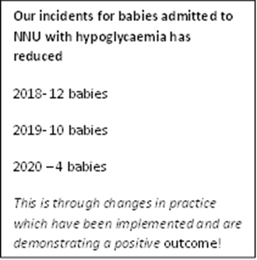
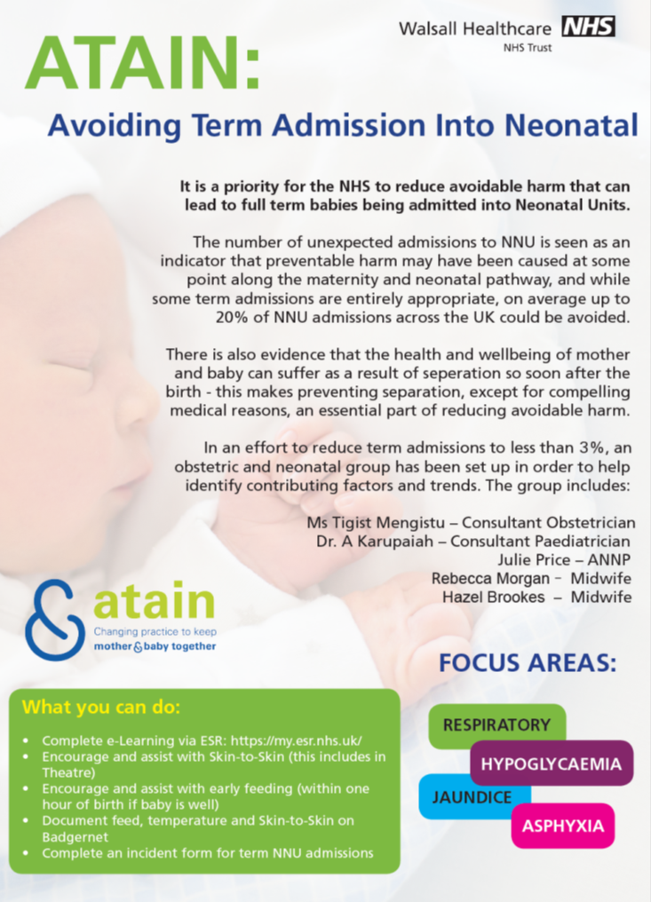
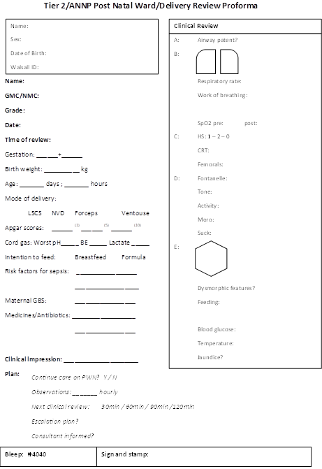
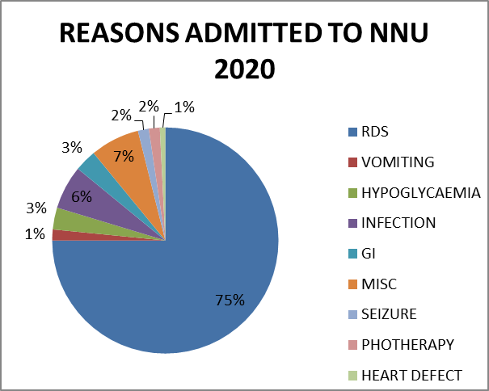
ATAIN
Avoiding Term Admissions Into Neonatal units
Dr Ashok Karupaiah¹, Dr Rohini Thapliyal¹, ANNP Margaret Price¹, Dr T Mengistu², Dr S Gupta², Midwife Karen Scott²
¹Department of Paediatrics and ²Department of Obstetrics
ATAIN team
ATAIN
Mothers and babies have a physiological and emotional need to be together in the hours and days following birth.
There is overwhelming evidence that separation of mother and baby soon after birth interrupts the normal bonding process and has profound and lasting effect on maternal mental health, breastfeeding, long-term morbidity for mother and child.
ATAIN is a national programme under patient safety with objective to ensure correct management of antenatal, intrapartum and postnatal care to minimise the number of avoidable term admissions to NNU and therefore minimise separation of mothers and babies.
ATAIN team of Neonatal consultant, ANNP ,Obstetric consultant and midwifery staff working closely together from 2019 to reduce term admissions to neonatal unit.
The national aim is to reduce avoidable admissions to below 6 %, we set an ambitious target to achieve 3% consistently.
Audit conducted to benchmark problems.
Training midwifery team on recognising main conditions- respiratory, hypoglycaemia in babies.
Complete e-learning via ESR.
Proforma introduced for assessment of term babies
Data analyst recruited onto team.
ATAIN data now on maternity dashboard for all to see.
Regular monthly meeting of ATAIN team members.
Monthly ATAIN newsletter to all team members to share learning.
Summary of learnings:
Ensure all staff aware of new hypoglycaemia pathway
For baby’s at risk of haemolytic disease of newborn send DAT test as urgent.
Early senior review of abnormal CTG’s.
Ensure steroids given for elective caesarean sections less than 38+6 weeks.
Paediatrics and Obstetrics

