Slide 1
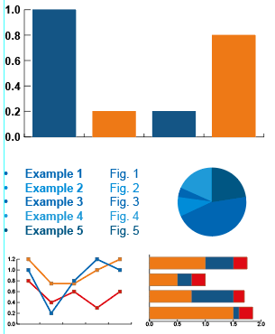
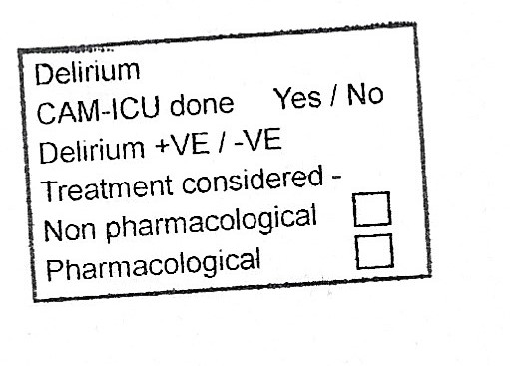
A21-58
Confusion Assessment Method for ICU (CAM-ICU)
Dr Le Theng Gan/ FY1, Dr Ayomikun Soyombo/ ACCS EM ST2,
Dr Atul Garg / Consultant ICU/, Ly Fletcher / SSR
Introduction:
Delirium is characterized by impaired cognition and manifestations can be grossly non-specific. Prolonged duration of delirium following critical illnesses necessitating ICU admissions has been proven to significantly increase risk of mortality. To help with prompt diagnosis and management of patients with Delirium in the ICU the CAM-ICU assessment tool was developed.
Graphs / Charts to go here
Objective of the project:
To assess the level of compliance with use of the CAM-ICU delirium screening tool.
Project Methodology:
Two cycles of data were gathered (from August 2019-September 2020) capturing all patients in ICU weekly admissions. Overall, 272 data were gathered.
Findings:
Of the 272 patients,77% were eligible for CAM-ICU assessment. Of these, only 28% had their assessments done of which 6% were positive. A high percentage of patients had incompletely documented assessments (blanks).
Recommendations:
Daily use of CAM-ICU assessment stamps.
Increase awareness in the department
Enlistment of staff as Delirium champions.
Photo to go here
Summary
A significant number of patients admitted to Walsall ICU missed out on proper Delirium assessment during the study period and this can adversely impact on patient care. It is hoped that the recommendations will help improve practice and care delivery.
Intensive Care Unit
TACC

