Slide 1
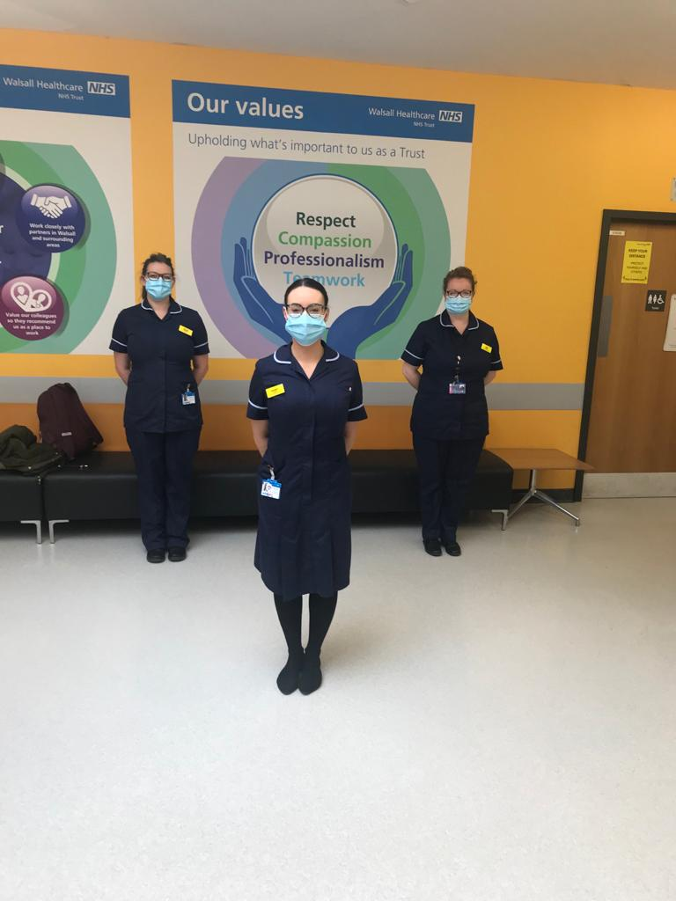
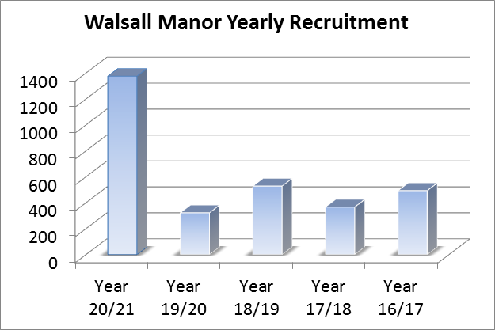
CLINICAL ACADEMIC LINK TUTOR ROLE
WITHIN RESEARCH
Amber Jones, Sarah Calloway, Kay Wilson- Clinical Academic Link Tutors.
Aim of Role:
Increase in participants recruited to Research studies in 20/21 despite COVID and redeployment of staff
To be a link between the clinical area and research,
making research more accessible to clinicians
and students.
Why is this important?
Home Grown Research:
“Tissue viability team identified atypical skin changes that are not clinically perceived to be traditional pressure ulcers. The team initially held off contacting the research team as we were nervous that this might not be something they would be interested in or the idea would seem silly, however we couldn’t have been more mistaken. The research team have been so supportive in developing our idea and putting us on the right track to undertake home-grown research.” Tissue Viability Nurse, May 2021.
CQC report highlighted safety improvements needed.
Clinicians being research active contributes to our evidence based practice, which directly benefits patient safety and is in line with our Trust Vision of providing Safe and High Quality care.
What Now?
What Next?
Having a midwifery Clinical Academic Link Tutor within the team has enabled more midwifery research studies to be opened. (UKOSS and PAN COVID)
Opportunities for Clinical Academic Link Tutor to take on role of Principle Investigator for COVID Nurse Study.
Sarah (Physiotherapist) ‘I’m really enjoying this role and am especially looking forward to finding opportunities for physiotherapists and other AHP’s to be involved in shaping the clinical care we provide by being involved in research.’
Amber (Midwife) ‘Research in the clinical area tends to take a backseat in terms of priority- by encouraging clinicians to become ‘Research Active’ this will bring research to the forefront of their minds, improving our outcomes for the women in our care’.
Kay (Nurse) ‘This role for me helps to promote and inspire integrated collaboration, sharing of ideas and critical inquiry to encourage deeper learning and enhance our patient experiences’.
“No research without action, no action without research”
Kurt Lewin

