Slide 1
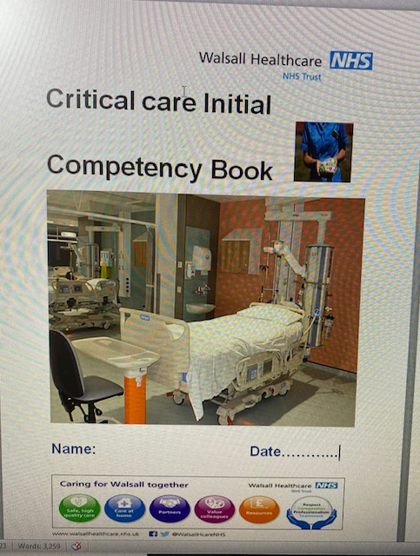
ICU New Starter Initial Document for RN’s
ICU Professional Development Nurses Rachel Jenkins & Mel Jones
We have developed our Initial Competency Booklet to ensure the beginning of our Nurses journey is robust for the New Starter and for the ICU Unit. Developed Staff grafted into the work environment builds a resilient team that can rely upon one another in times of challenge. We have found this document has helped New Starters and Senior staff to identify if ICU is an area they wish to specialise alternatively it provides the Nurse to explore alternatives. The Nurses engage with the program and we have been consistent this is now an established Pathway, we have found those who complete this document STAY.
You can see to the right a document titled ICU mentor group there is a strict colour code to enable all staff to see their stage of development. We use a ink colour system and this is updated monthly with a clear date on the document.
This assists Juniors and seniors to easily identify development needs.
New Nurses on ICU have the Initial Competency book for up to 3 months and then move to the National Framework Competency Booklet for Critical Care, they have 12 months to complete this. Due to some very simple steps we have ensured the majority of staff achieve this time target. All the staff are displayed in a colour code visible to all denoting their level of skills and expertise. This is helpful to keep them on target with their development. It provides equity to all as there is a clear process for staff to progress and develop. As a result we have seen many staff move through each stage and complete their ICU Specialist Course
2017
11 staff
Developed
2018
6 Staff Developed
2019
5 Staff developed
2020
16 staff developed
2021
9 Staff To develop
We are still to collect formal data regarding retention of Newly recruited staff during the Pandemic 2020 4 staff moved from ICU. 2 members of staff to other areas within the Trust and 2 new staff member left the Trust
NB: this data does not capture established staff who have left the Trust
Development for New Starters:
New Starters development:
Initial Competency Booklet for up to 3 months
Allocated to a Mentor Group
First 6 weeks Supernumerary
Support of the ICU PDN’s
New Starter Study days – 2 with differing subjects
Established with in the Trust systems
Equipment training
Mandatory Training completion
Attendance of Staff Team meetings
IPDR when beginning ICU , repeated at 3 months and then in 12 months
All ICU Staff:
Complete the National Framework booklets which you can access below
Further info
National Framework
Step 1
National Framework
Step 2
National Framework
Step 3
National Framework
Step 4
Our local Network provide us with the Critical Care National Competency Booklets. Recognised Nationally
Step 1 = All Staff
Step 2 and 3 = Staff on the ICU specialist Course University of Wolverhampton use these competency books
Step 4 = All Senior Staff for Management of the ICU
Our Initial Document has been improved following evaluation from New Starter Nurses from ICU.
All our Staff are familiar with the document and the expected Standard.
We have found the staff are well developed and progress within 15 months we have a very competent ICU nurse.
ICU TACC

