Slide 1
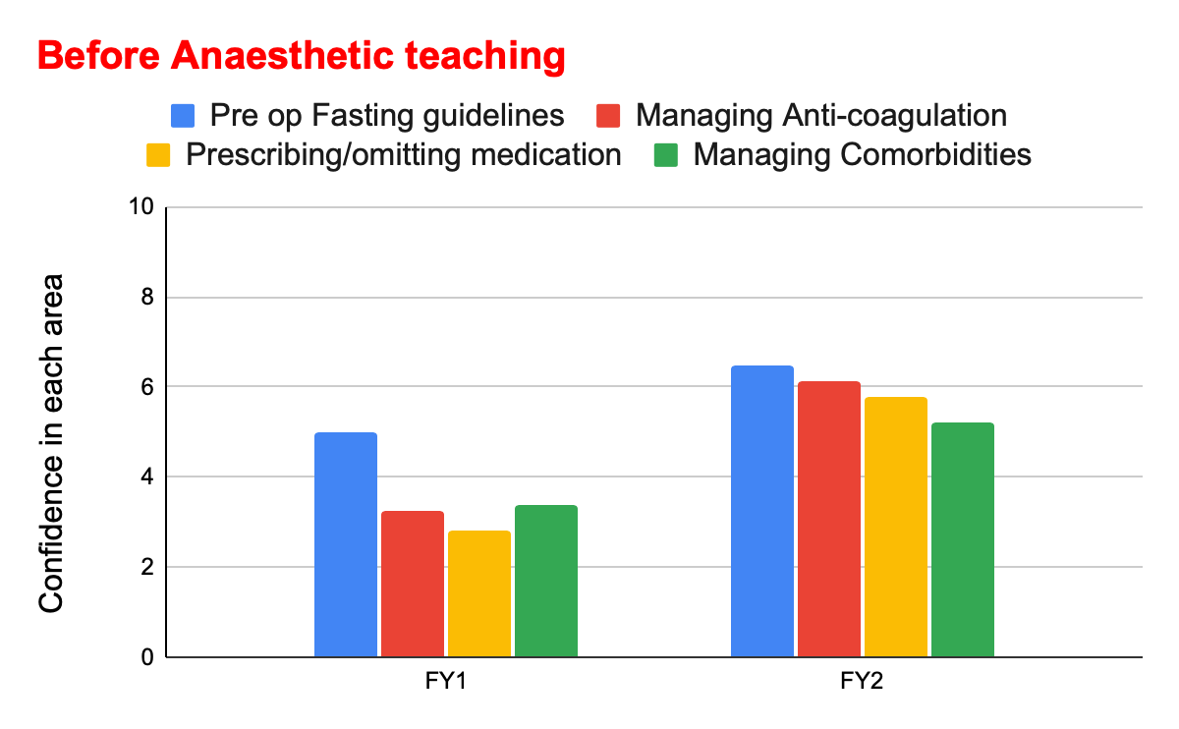
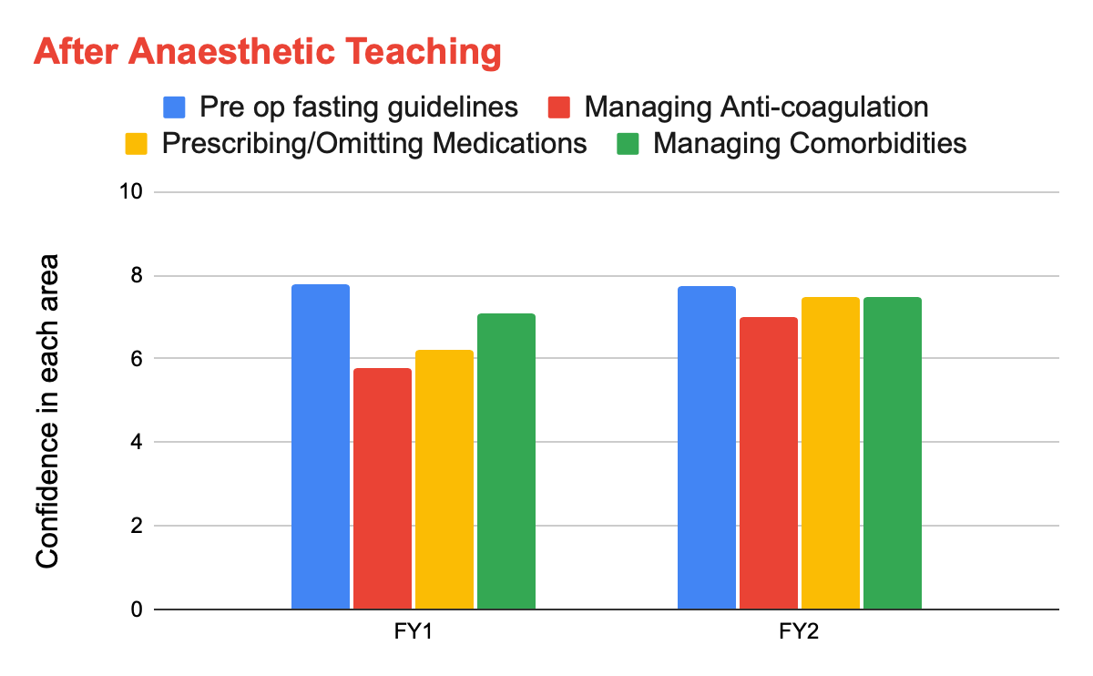
Peri-operative care in Wards: A QI Project to help FY Doctors
Dr Shivam Dhar (Registrar) Dr Samir Nazir (Consultant)
Dr Atul Garg (Consultant)
Background
Peri-operative management of patients for emergency surgery is largely dependent on the personnel who take care of them in the wards. High quality training of junior doctors who are working on those wards can significantly improve their confidence thus uplifting the quality of care.
Aim
To improve quality of Peri-operative care in wards by teaching Foundation year doctors.
Chart 1
Methods
We conducted an initial survey to assess the confidence (scale of 1-10) of FY doctors in various elements of Peri-op care (chart 1).
Following the survey, we organised teaching sessions for them targeting the key areas of Peri-op care including:
A) Fasting Guidelines
B) Anti-coagulation
C) Managing Co-morbidities & prescribing medications
D) Peri-operative management of Diabetes
We did another survey after 15 days following the teaching to assess the improvement in the confidence of FY doctors and to get their feedback on the teaching.
Chart 1
Chart 2
Acknowledgements
Sincere thanks to Drs Katie, Sanya, Sarah and Sarah for helping with the project and teaching
Results
The teaching sessions received excellent feedback & the post-teaching survey showed significant improvement in their confidence in Peri-operative care (Chart 2).
All FY doctors unanimously felt that the teaching should be a part of their curriculum.
As a result, the Anaesthetic Department is in contact with the FY teaching coordinator to ensure it becomes a regular session & developing a sim-based teaching programme.
In addition, a similar programme is being developed for the pre-op assessment nurses for elective patients.
Conclusion
Confidence of FY doctors in peri-operative management of emergency surgical patients can be improved by a teaching programme.We believe this can improve quality of patient care & Peri-operative outcome.
Anaesthetics

