Slide 1
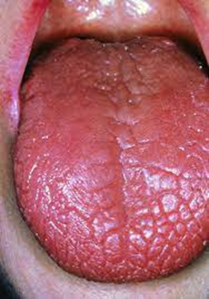
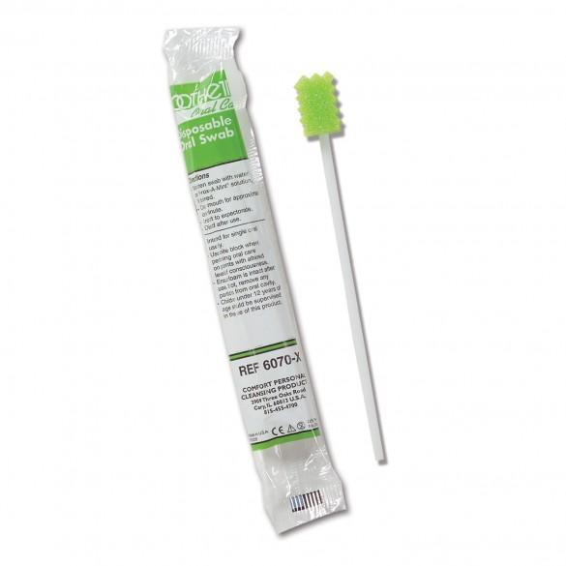
Oral Comfort at the End of Life
Lizzie Walters-Mabbott / Palliative Care Specialist Nurse Practitioner, Pippa Pinches / Speech and Language Therapist / Sarjit Basra / Speech and Language Therapist
Problem
Following an MHRA alert pink swabs were removed from the trust but we recognised the comfort of our dying patients was suffering. As part of the oral care improvement strategy in the hospital we looked at ways of improving oral comfort for our end of life patients.
Approximately 2000 dying people a year access Walsall Healthcare services. Oral health for dying and palliative care patients is crucial but is often overlooked. Good mouth care should be maintained to keep the mouth clean and moist ensuring the individual is comfortable. This reduces the risk of associated infection, especially if not eating or drinking or if approaching end of life.
Solution
Its great to finally have a safe and effective product
To support comfort and flavours for our end of life patients.
Jenny Hadley- Palliative Care CNS
We researched safe and effective products that could be used and found the Toothette swab. They can be used with any fluids and give our patients moisture, fresh tastes and essential medication when they are not able to eat of drink. We introduced these branded as comfort sponges within the trust Blossom Boxes.
Poor oral care can have negative impact our patients and their families. It is good that we have a safe product that will provide comfort to our patient’s during the last days of their lives
Sarjit Basra- SLT
We use the Comfort sponges on a daily basis and they are beneficial to patient care.
In patient unit, Goscote Hospice
Walsall Healthcare Trust has approximately 2000 deaths per year. Comfort sponges were implemented to administer moisture, taste and essential medications to our dying patient.
Palliative care

