Slide 1
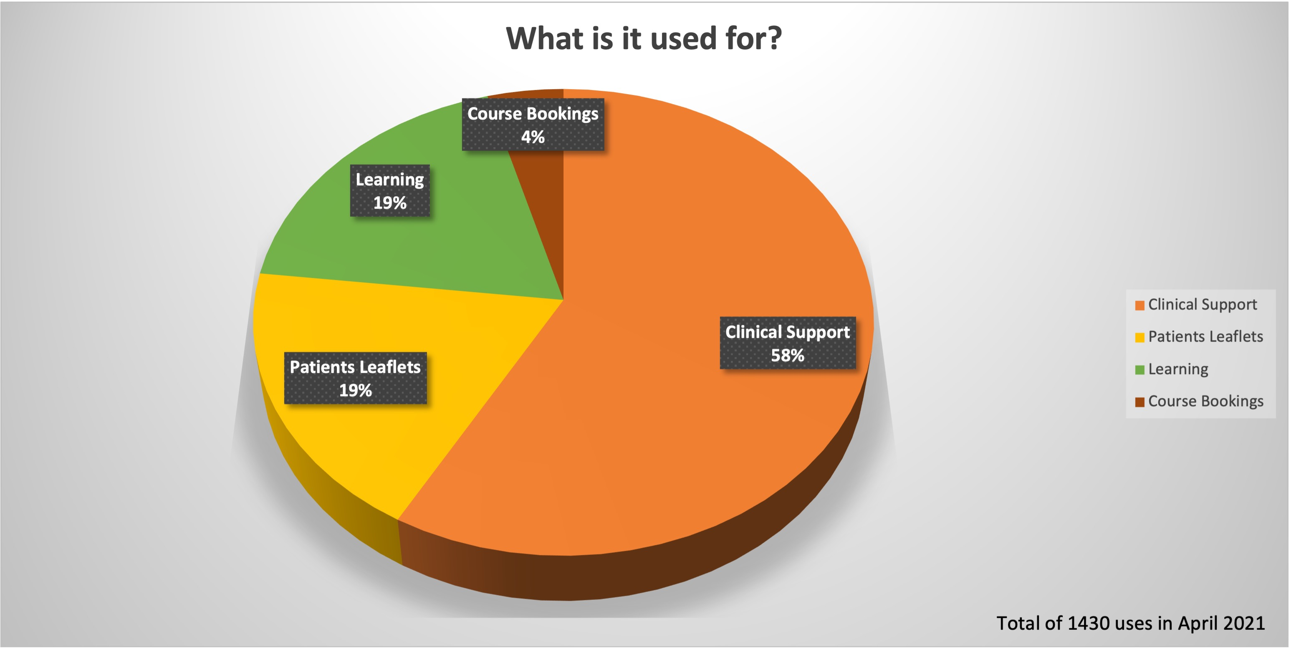
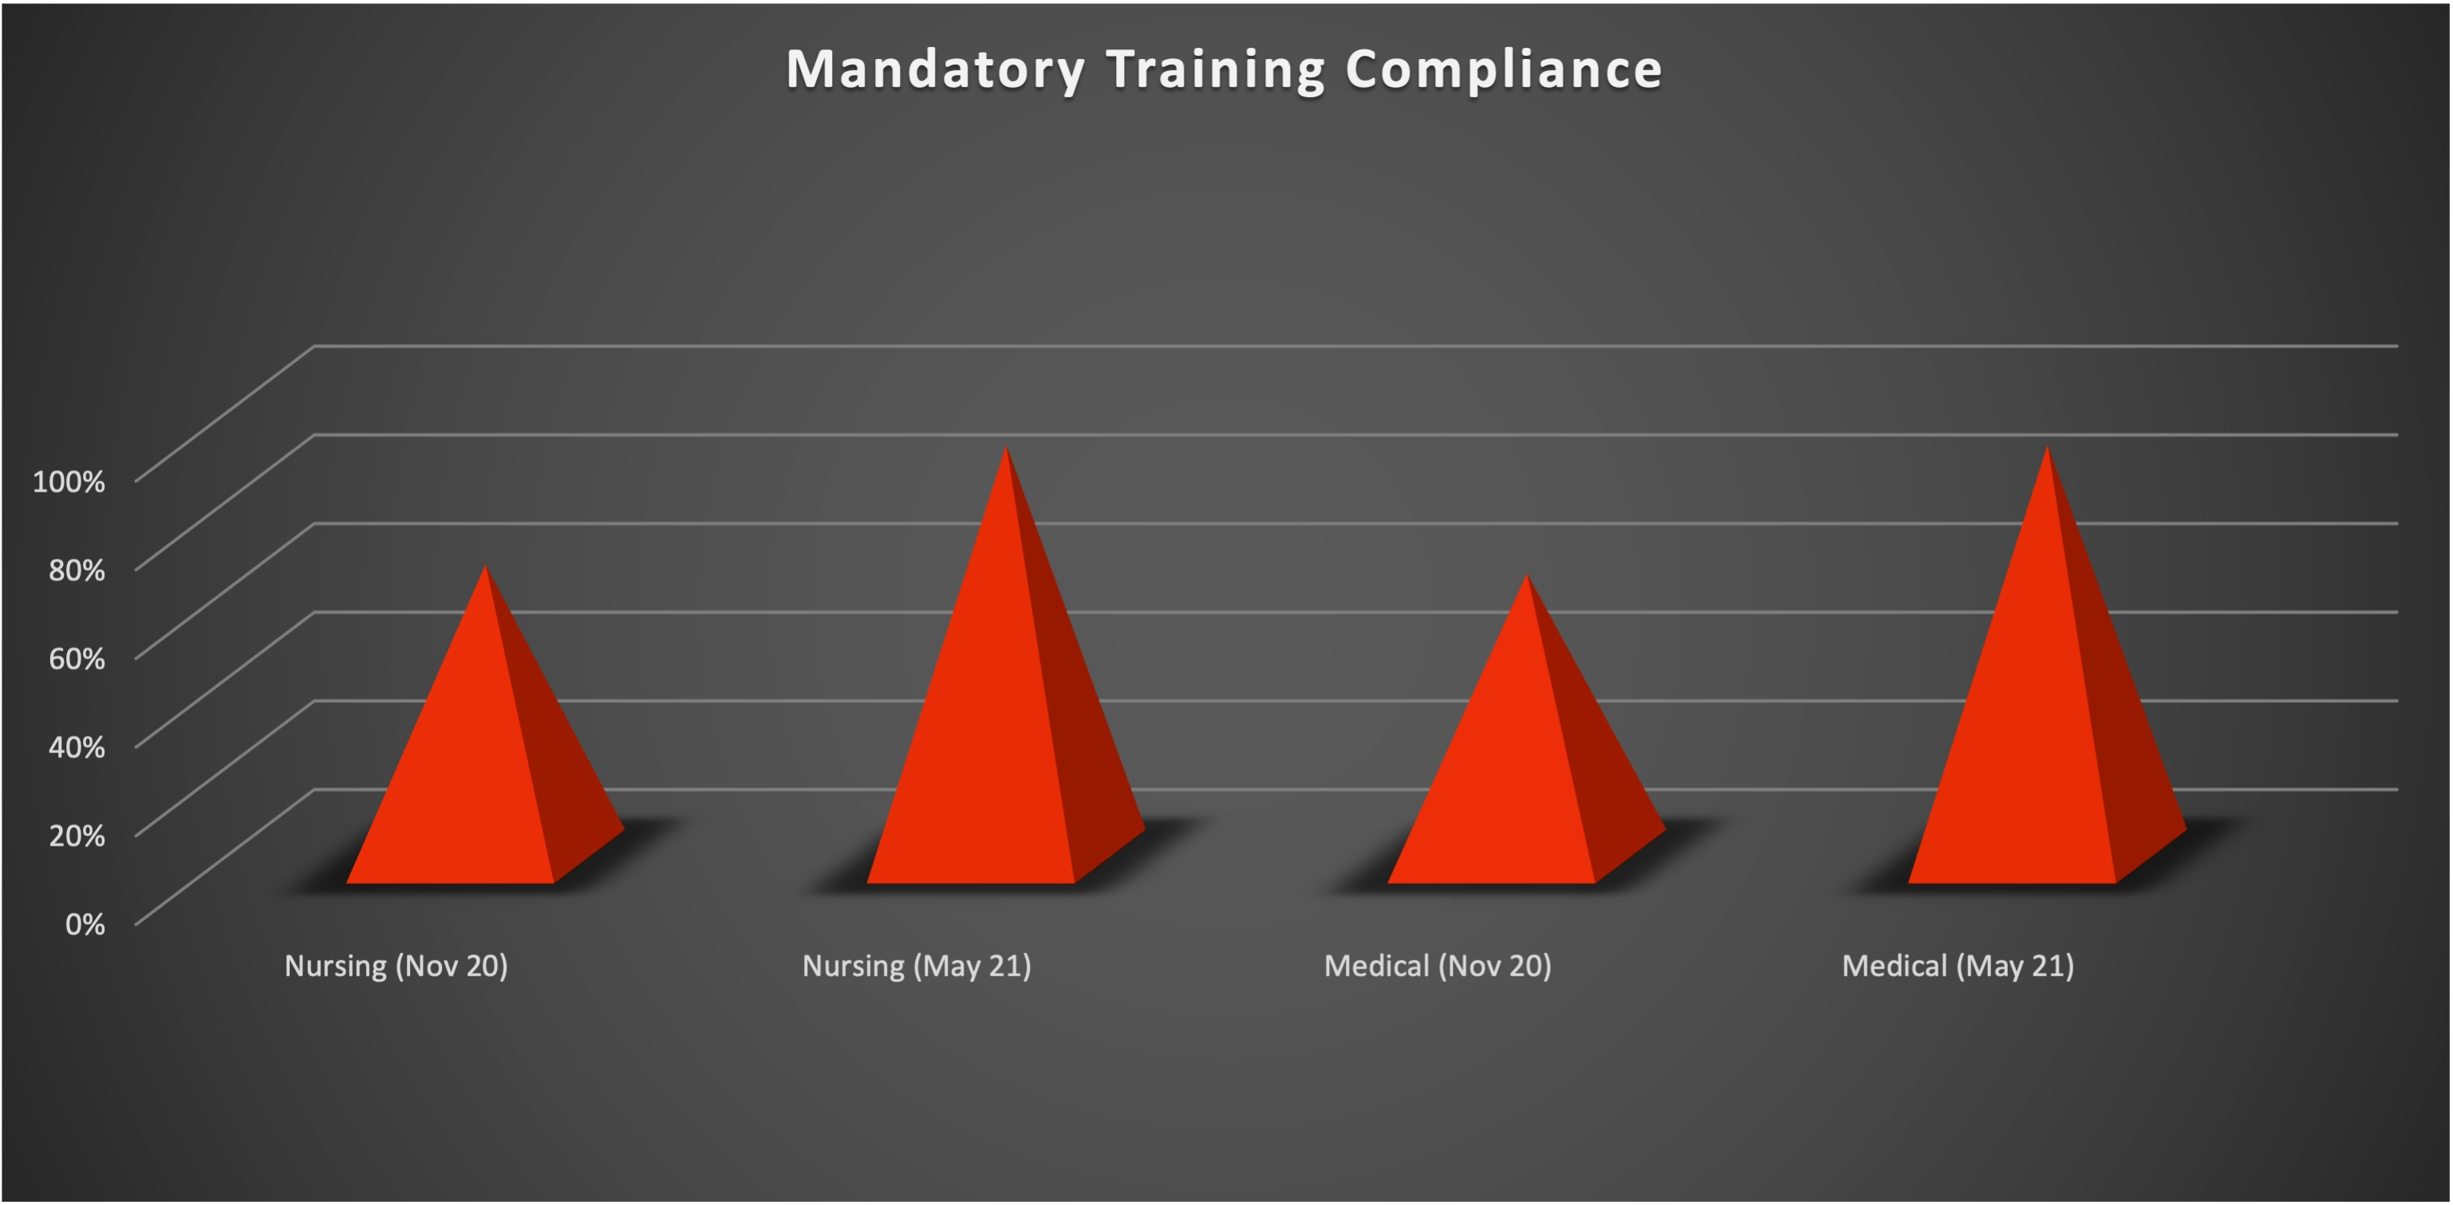
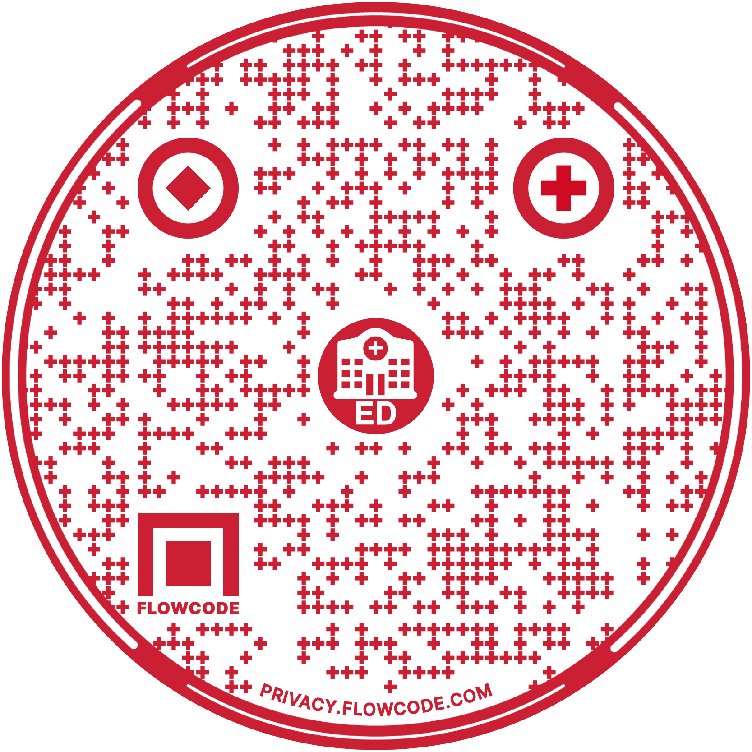
The Ask EARL Project
Andrew Foot / ED Consultant, Benjamin McWalter / Senior ACP, Leigh Rogers / Senior ACP.
The problem: The Emergency Department treats a wide range of conditions and as such is heavily reliant on clinical guidelines and support services. Previously, guidelines were hosted on the ED intranet which is only accessible on a hospital computer. The information was difficult to find, often out of date and spread over multiple different intranet pages. It was often found that staff did not follow guidelines as they were not easy to find, and there was often a long delay getting new information uploaded to the intranet as the ED team did not have direct control over the page. There was minimal information on how to contact support services to avoid potential hospital admissions, such as arranging a same day diabetic review in the ED, or arranging clinic follow up.
Educational opportunities for trainees such as training courses, departmental teaching and simulation training was also not displayed online, and learning from these was not disseminated.
Previous studies have shown that time to access guidelines can be significantly reduced by enabling clinicians to access to guidelines and support services on smartphones.
The aim: The three pillars of the Ask EARL project were:
To ensure clinicians have access to the most up-to-date Clinical Guidelines
To ensure access and knowledge of Support Services to prevent avoidable hospital admissions, to facilitate safe patient discharge and follow-up
To improved Education for staff and patients through easy-access to teaching opportunities, training courses and discharge leaflets.
The solution: After approval by Communications and IT, an external web page; AskEarl.co.uk was created to officially host the ED guidelines, support services and educational activities. The site could be accessed by smartphones or any desktop via the internet and subsequently a smartphone app was developed. The Ask EARL project aimed to improve the following areas:
Guidelines: Up to date local and national guidelines relevant to ED were reviewed by the ED clinical steering group and uploaded to the Ask Earl website. A robust governance structure was implemented to ensure content was regularly reviewed to stay up-to-date and relevant. Having control over our own guidelines page enabled us to quickly upload new guidelines, this was especially critical during the COVID pandemic when information changed on a weekly basis.
Supported discharge and clinics: Specialities were contacted to provide up to date information for what services and clinics could support the early discharge and follow up of patients and how to contact them.
Patient information: All patient discharge leaflets were uploaded and were accessible via hardcopy or QI codes to download on a patient’s phone.
Education: ED teaching dates, training videos on how to use equipment and perform procedures were uploaded. ED teaching opportunities including local teaching, ED Simulation dates and times were displayed so trainees knew what teaching was available. Simulation learning points and recording of departmental teaching was uploaded so trainees could view this at a later date. Availability outside of the intranet allowed these learning opportunities to be distributed via social media. The website also allowed us to display clinical updates, safety information and departmental ED news letters that were then widely sharable via social media.
Clinicians were also able to book training course and mandatory training via the AskEARL app.
Results: The introduction to the Ask EARL platform has been very well-received by staff of all grades. It now incorporates both a web-based resource and a smartphone app.
Staff feel Ask EARL is a phenomenal improvement for the department. Staff feel it has improved timely access to guidelines, allowed safer discharges through the use of support services and improved relationships between the ED and specialities.
Staff have been much more engaged in simulation participation, and the key learning points from our last ED simulation have been viewed 133 times.
The Education page has been accessed 269 times in the last month alone.
In the last month, 267 patient leaflets have been distributed to patients, which is many more than when only hard-copies were available.
In the last 28 days, the app and website combined have been used 2014 times.
Since the launch of the app in November 2020:
It has been used 3600 times
248 courses have been booked through the app
There has been a tremendous improvement in mandatory training compliance (fig. 2)
To see the website in action; visit askearl.co.uk from any smartphone or computer
Or download the app using the QR code.
Emergency Department

