Slide 1
Making “learning” core to “doing” in the NHS Leading and Learning in the time of COVID
Fab Change Day
James Mountford
@mountfordjames
21 October 2020

Slide 2
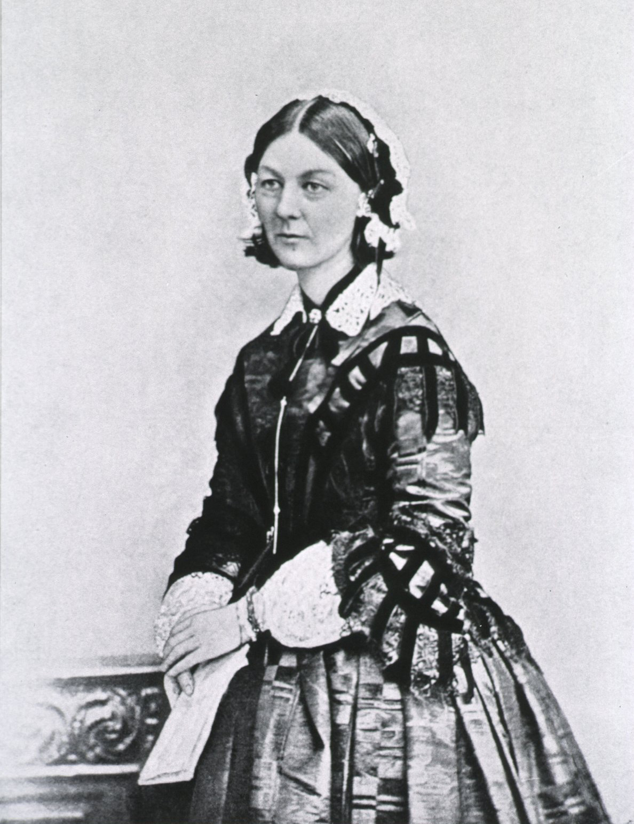

Slide 3
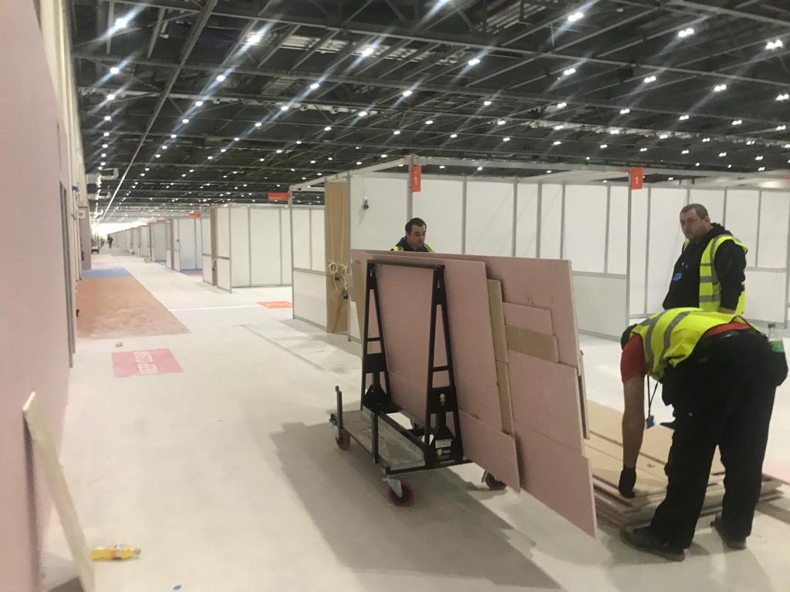
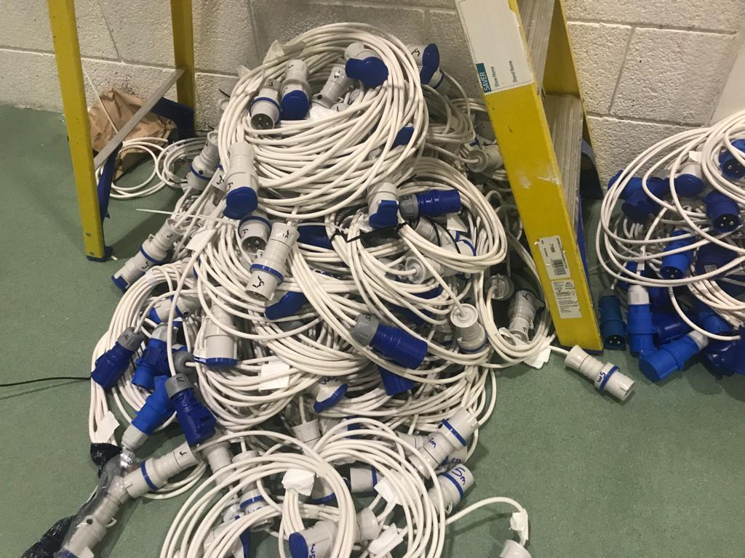
Turning a conference centre into an ICU

Slide 4
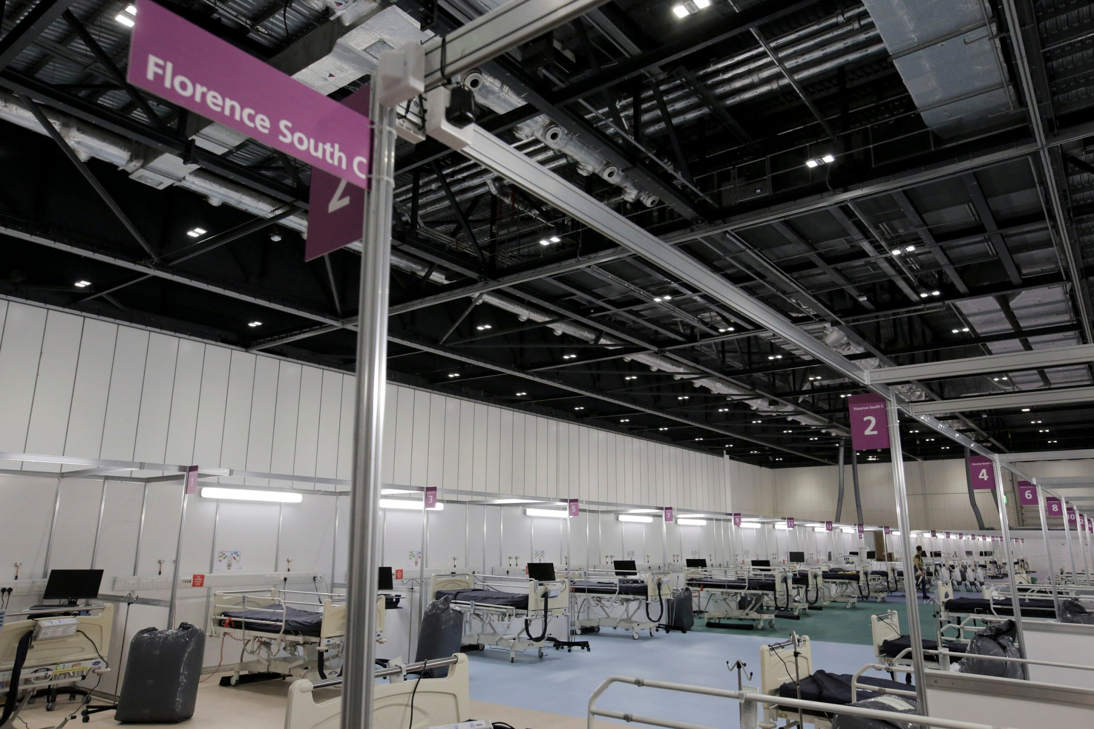
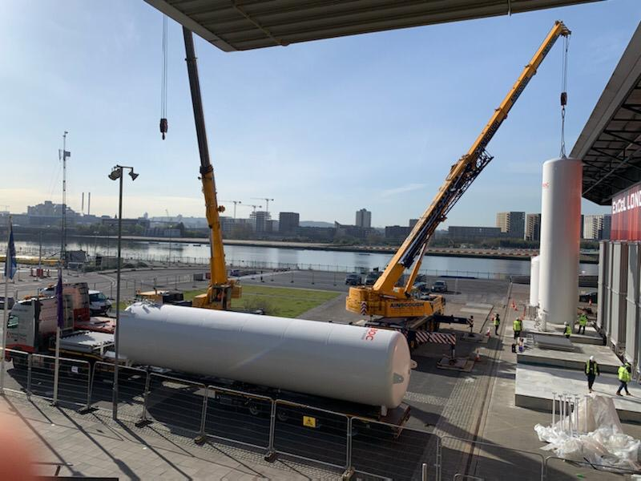
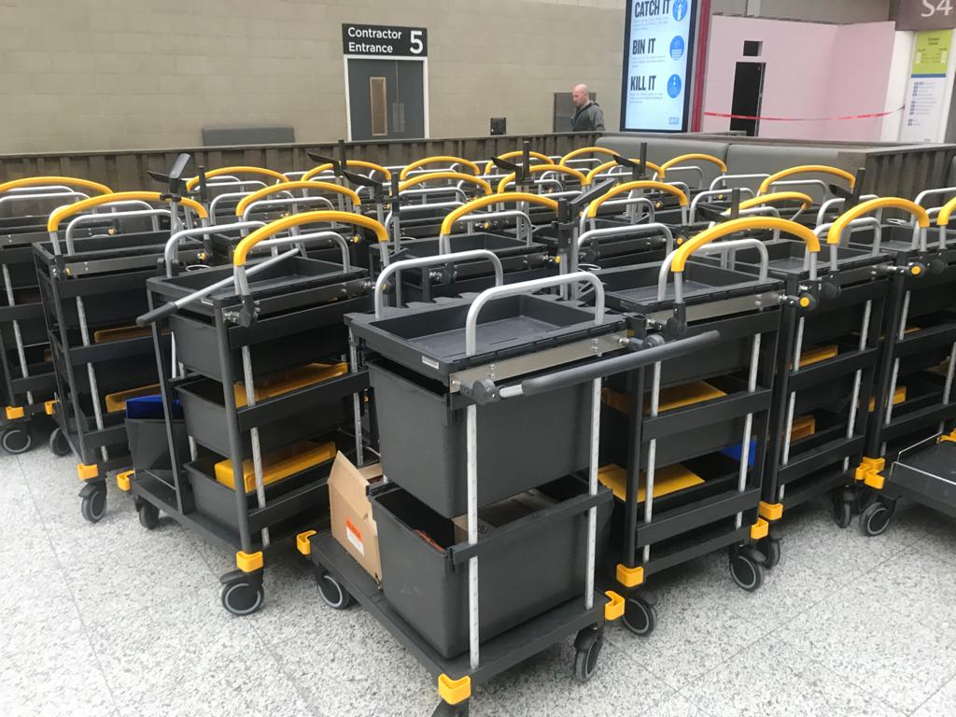
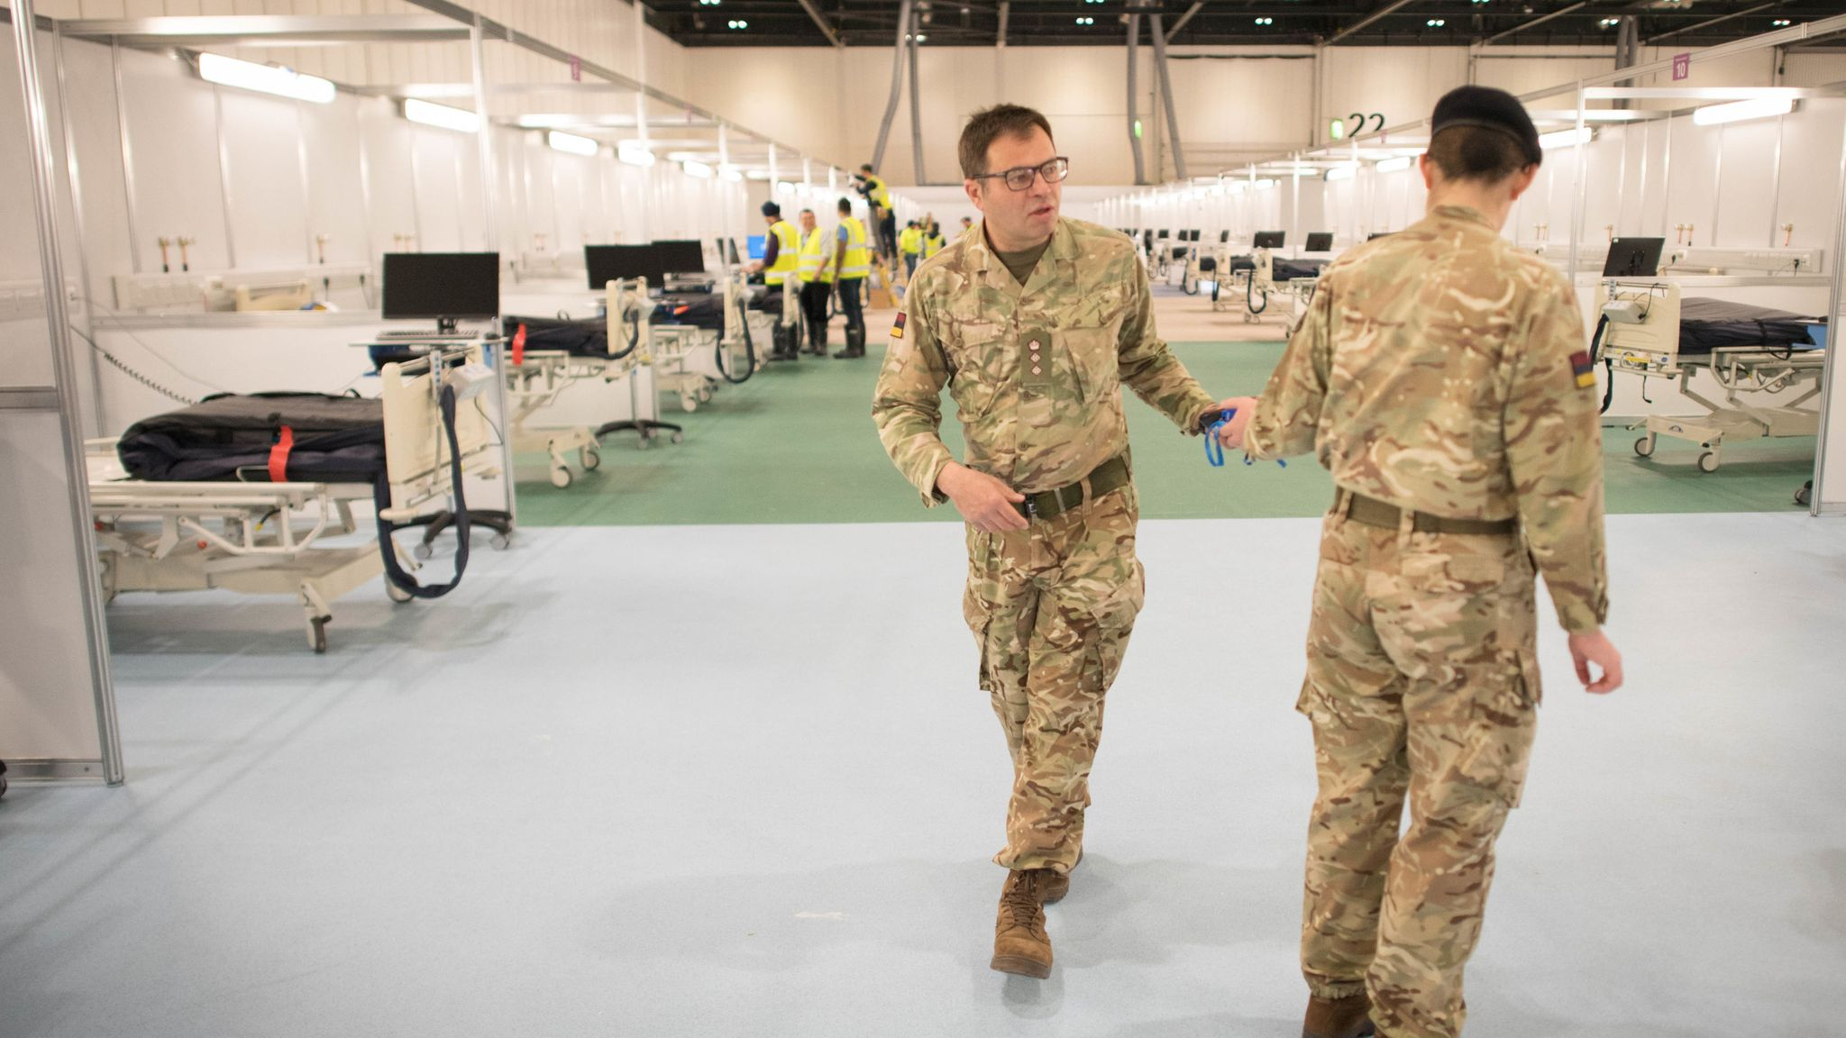
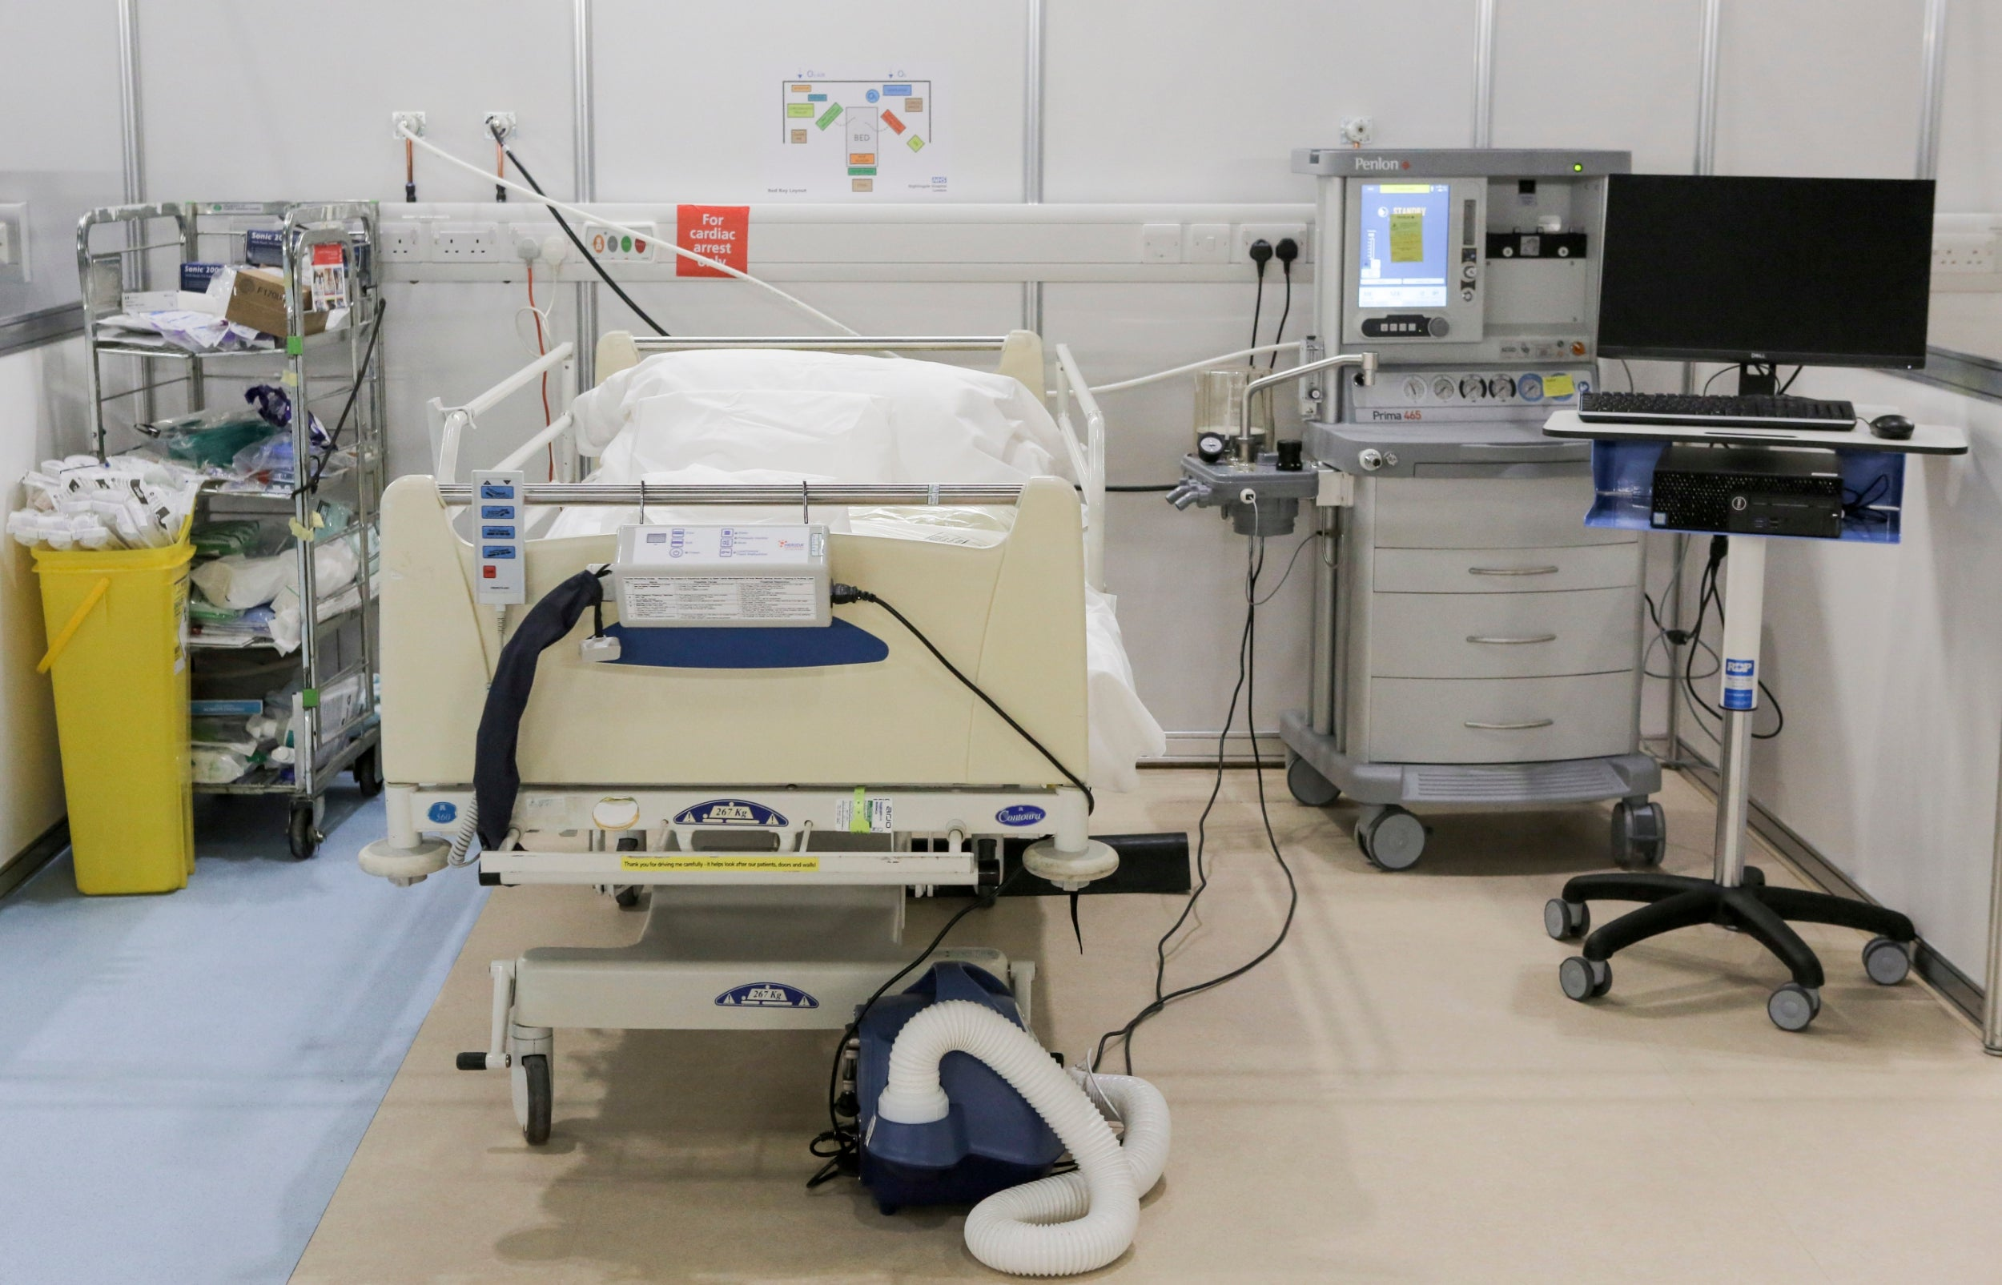
Turning a conference centre into an ICU

Slide 5
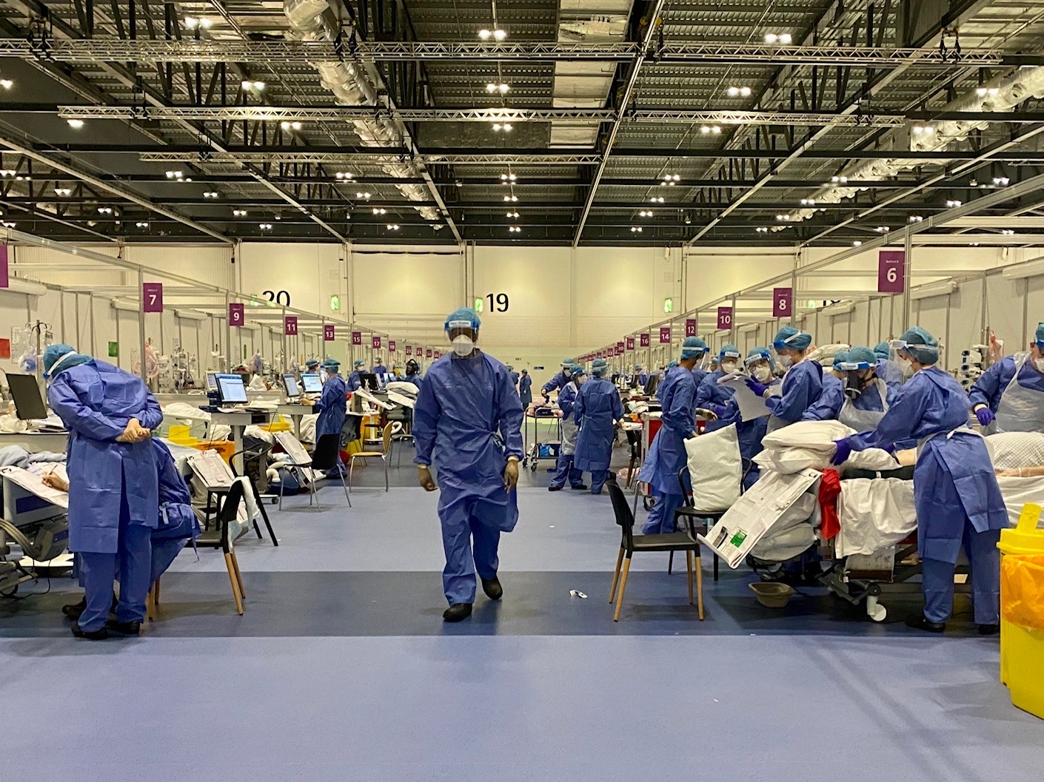
The Nightingale ICU

Slide 6
Five core elements to the Learning System
2. Integration and Analysis
3. Decisions
External Advisory Group
Quality and Learning Team
Specialist Decision Forums
4. Implement
Internal Data
Clinical Forum
Change implementation
1. Data
Simulation, testing and research
Bedside
5. Closure

Slide 7
Diverse streams of data coming ‘in’
2. Hospital dashboard
3. Reported Incidents
1. Bedside Learning Coordinator insights
4. Admission volumes and changes to criteria
5. Staff suggestions and experience
6. National and local clinical audit
7. Mortality Reviews
8. Complaints
9. External Evidence Synthesis

Slide 8
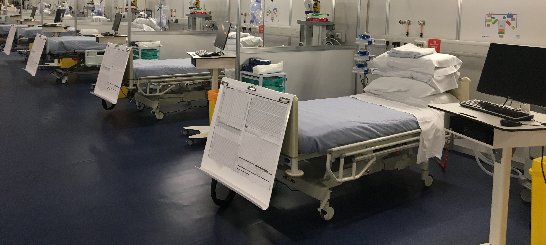
The “Bedside Learning Coordinator”
Return changes to the bedside
Gather data and ideas from the bedside

Slide 9
Five core elements to the Learning System
2. Integration and Analysis
3. Decisions
External Advisory Group
Quality and Learning Team
Specialist Decision Forums
4. Implement
Internal Data
Clinical Forum
Change implementation
1. Data
Simulation, testing and research
Bedside
5. Closure

Slide 10
Three categories of action
Fix
Improve
Change
Actions to be implemented immediately
Finding new ways to do things that are better than we currently do
Substantive changes to the care we deliver
e.g. Stock levels on the floor
e.g. Day 0 simulation training
e.g. new VTE protocol

Slide 11
Applying the learning system principles in a regular setting: example from Chase Farm Hospital
Notes:
Examples of changes made
Changed process for use of endoscopy procedure rooms
Implemented multiple changes to process for staff and patient entrances
Pathways for entering building
Process for screening
Signage
Implemented changes for process for swab pod
Anticipate areas that may require additional review
Following incidents/complaints
Implementing new processes
Additional aims of the system
Promoting and encouraging incident reporting
Promoting service improvement to all staff
Actively seeking patient and staff opinions and suggestions for improvements
Proactive monitoring of safety standards
Quicker identification of and reaction to risks
Staff comments
“Its good to get an integrated view of services so that we can work together towards a common goal”
“If I have an issue either operational or clinical I know that it will be listened to and actioned quickly because all the right people are in the forum”
“Being a part of the feedback forum allows us to work on urgent facilities and estates changes for clinics and to pathways to support the clinical services and provide a better patient experience”

Slide 12
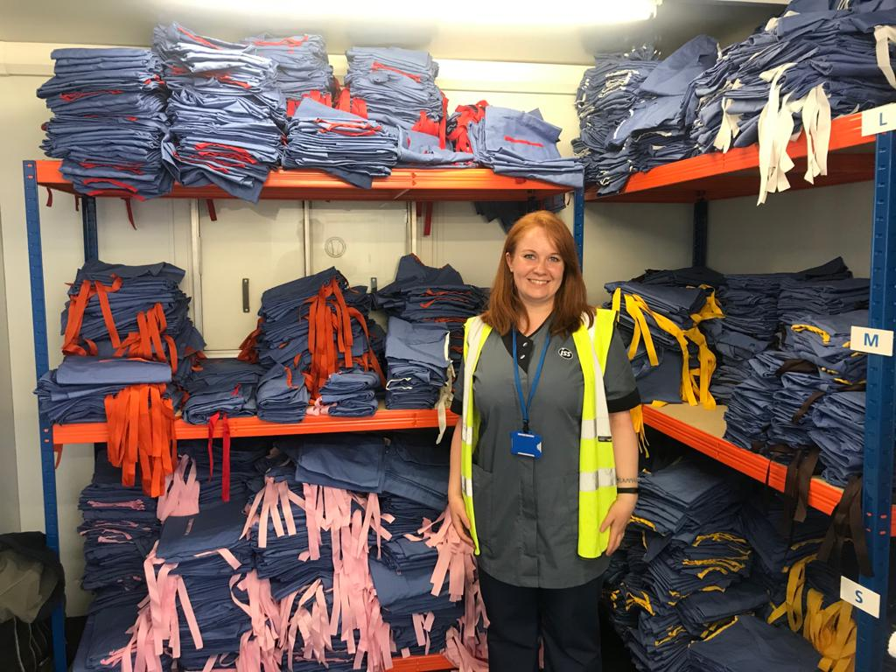
A closing word, from Aldis – #oneteam

