Slide 1
Introduction to the FOCUS Model Operational site management principles
4th Nov 2019

Slide 2
The FOCUS Model – guiding principles for operational site management
F
Front door position and triggers - current position and actions
O
Operational oversight and management of whole hospital constraints
FOCUS principles
C
Challenge patient plans and pathways
U
Understand actions required and agree accountability
s
Site plans, escalation and report

Slide 3
Front door position
Today’s performance - current and predicted.
Oversight of capacity, demand and current waits in ED, SDEC, frailty, assessment areas.
Use of locally defined triggers.
Speciality delays and response to the emergency department (how are we doing against agreed internal professional standards?)
Are patients being assessed and have a plan in place to avoid four hour breaches?
Are patients at risk of twelve hour breaches? Ensure they are discussed individually.
Senior nurse and medical coordination i.e. board rounds at agreed times.
Ambulance arrivals and offload position.

Slide 4
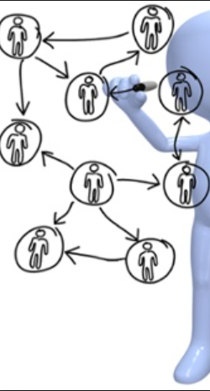
Operational oversight of whole hospital constraints
Outlier areas - ensure all patients have been reviewed. Prioritise which areas should be closed first.
Staffing issues.
ITU / HDU capacity and escalation plan.
Tertiary referral and repatriation position.
Infection control i.e. side room capacity and decontamination.
Understand demand and capacity of all diagnostics.
Unresolved delays – communicate Red day problems (including complex discharge issues) that can’t be sorted at ward level and ensure action is taken.
Today’s ACTUAL and POTENTIAL discharges (risks identified e.g. transport, pharmacy, clinical decision making).
Confirm that board / ward rounds happened on all wards.
Any service continuity challenges and impact on flow.

Slide 5
Challenge
Is the capacity to assess patients in the same place as the demand?
Is the patient on the right pathway or could they be managed using an alternative pathway e.g. hot clinics, day case, same day emergency care?
Can the patient be appropriately managed as short stay or do they require a speciality specific bed?
Is the bed request appropriate? Has a senior review taken place?
Are specialty and support teams working to agreed internal professional standards?

Slide 6
Understand actions & agree accountability
Site meeting should generate specific actions for individuals. Are actions allocated to a named individual with an agreed response time?
Actions should be logged and circulated to relevant teams.
Actions should be monitored for progress and reported back to the site team.
Agree OPEL (operational pressures escalation levels) level.

Slide 7
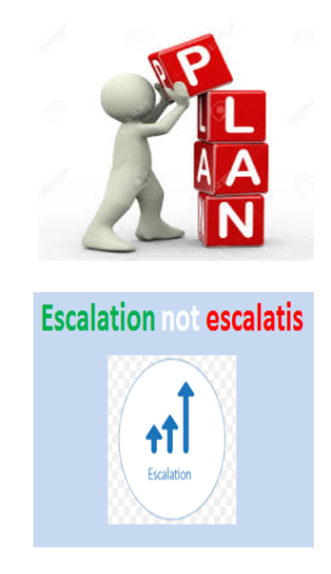
Site plan, report & escalation
Be proactive not reactive. Always have a plan for the next two hours, eight hours and the following day.
Clear documented actions and identify responsible colleagues responsible for delivery.
Each OPEL (escalation) level should trigger specific actions to prevent further deterioration.
System wide escalation, support and response monitoring.
Avoid ‘escalitis’ – use SBAR (situation, background, assessment, recommendation) to communicate.

Slide 8
Thanks for listening
For more information, contact andy.aldridge@nhs.net or t.gillatt@nhs.net

