Slide 1
Interpreter On Wheels (IOW)
Presented By Patient Experience Team
Maria Finch (Head of Patient Experience)
Alex Papp (Linguistic and Interpretation Service Coordinator)

Slide 3
What required improvement?
Improve the patient experience
Trust strategic goal
Promoting equality and addressing health inequalities
Reduce reliance on face-to-face (FTF) interpreter’s
Increase ease of access to a greater pool of interpreters
Reduce number of cancelled/rescheduled
Reduce waiting times for patients
Reduce health inequalities and ensure seldom-listened-to groups are heard, by identifying the barriers to improving their representation on our patient groups and through the work of our patient experience and equality and diversity leads
Notes:
Improve the patient experience for those that communicate differently
Promoting equality and addressing health inequalities - increasing usage of remote interpreting in the Trust (April 2023 to March 2024) by 5%
Trust Targets: reduce health inequalities and ensure seldom-listened-to groups are heard, by identifying the barriers to improving their representation on our patient groups and through the work of our patient experience and equality and diversity leads
Reduce reliance on Face to Face interpreter’s availability
Increase ease of access to a greater pool of interpreters in a wider variety of languages (including rare languages and BSL)
Reduce number of cancelled/rescheduled appointments and increase interactions with patients for whom English is not their fist language
Reduce waiting times for patients with a language barrier, or sensory impairment
Targeted training to increase skillsets for staff in effectively handling language barriers
Identify gaps in the service and collect feedback from end users to improve the service

Slide 4
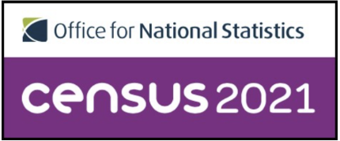
What were the main contributing factors to this problem?
Local demographics
Peterborough's population
6.6% increase
High local population growth
mainly driven by overseas immigration
Reduction of pool of local interpreters for face-to-face assignments
Poor sound quality on existing Trust mobile devices for remote services
Notes:
(High Immigration)- increasing demand for interpreters when engaging with non-English speaking patients
Peterborough's population saw one of the highest increases compared to the national average for population change in England of 6.6%. The main driving factor for this rise was immigration from overseas.
High local population growth mainly driven by overseas immigration and slow responsiveness from the F2F market for sudden spikes in languages that were not previously in demand, are also contributing factors to the current shortfall of interpreters.
Pool of local interpreters for face-to-face assignments, with languages in high demand, has greatly reduced as the result of the UK exiting the EU and wider world events. In the previous financial year 2022/23, approximately 64% of requests for face to face interpreters were filled by the Language Service Provider which resulted in 36% of appointments that required an interpreter being either cancelled or rescheduled, causing further delays and associated costs
Reduced sound quality on existing Trust mobile devices (iPads) that utilise the interpreting application InSight & Sign Live
Highlighted need, by staff, for a hands free interpreting device to be made available
With a relatively limited amount of interpreters joining the profession and the lengthy timeline to achieve the desired qualifications, for the past several years the demand for interpreters has surpassed the supply.

Slide 5
What was the aim for the improvement?
Improve the patient experience
By increasing the number of available options for accessing interpreters
Support local minority communities
Provide additional support for clinical staff in communicating effectively with non-English speaking patients
Offering increased mobility and the single interpreting functionality
Notes:
By increasing the number of available options for accessing interpreters, the expectation is to reduce the number of canceled or rescheduled appointments due to the lack of language support. The Trust is committed to develop a hybrid multifunctional interpreting service, subject to patients’ and clinicians’ individual needs and preferences.
Support local minority communities with communication and access to healthcare by providing a sustainable and robust interpreting service (device)
Provide additional support for medical staff in communicating effectively with non-English speaking patients, as an innovative way of helping to reduce waiting times, streamline triaging and help reduce associated costs associated with delays and cancelled appointments
By offering increased mobility and the single interpreting functionality, we believe these devices will be extremely useful for medical staff that need support with communicating effectively with non-English speaking patients

Slide 6
Who were the team working on the improvement, and what wider support was available?
Patient Experience Team
PCH and Hinchingbrooke IT Teams
Communications Team
Assigned IT Project Manager
Language Service Provider Project Manager
Notes:
Patient Experience Team
PCH and Hinchingbrooke IT Teams
Communications Team
Assigned IT Project Manager
Language Service Provider Project Manager

Slide 7
Who were the team working on the improvement and what wider support was available?
QGOC
IT TDA
CAP
DSG
Pre-Trial Approvals
Notes:
QGOC- Mobile App approval clinical authorisation
IT TDA- IT Tech solution Approval
CAP- Change approval Board (All IT Systems changes in the trust)
DSG- Digital Steering Group- Corporate directorate approval

Slide 8
What measures were used to determine success?
Language Service Provider KPI’s
Feedback collected from stakeholders used to improve the service
Datix platform to monitor the number of complaints
Targeted training delivered
Monitoring levels of engagement and adoption rates
£
Notes:
Language Service Provider KPI’s (Usage Data)
Feedback from end users used to improve the service (IOW’s can now be used to contact patients and family members, remotely)
Datix platform to monitor the number of complaints recorded regarding the provision of interpreters
Targeted training delivered to users and non users of remote interpreting in the Trust and collected feedback
Monitoring levels of engagement and adoption rates of (IOW’S) from staff and patients

Slide 9
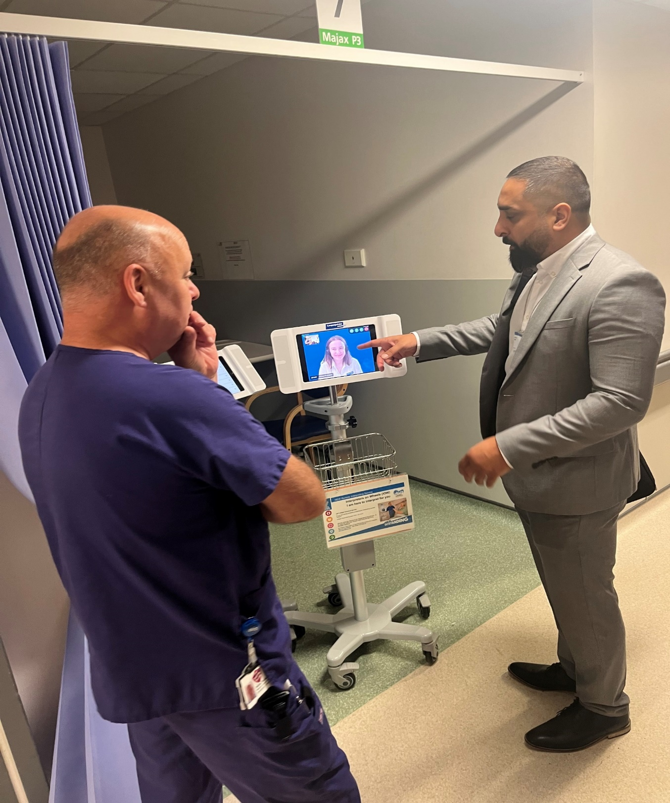
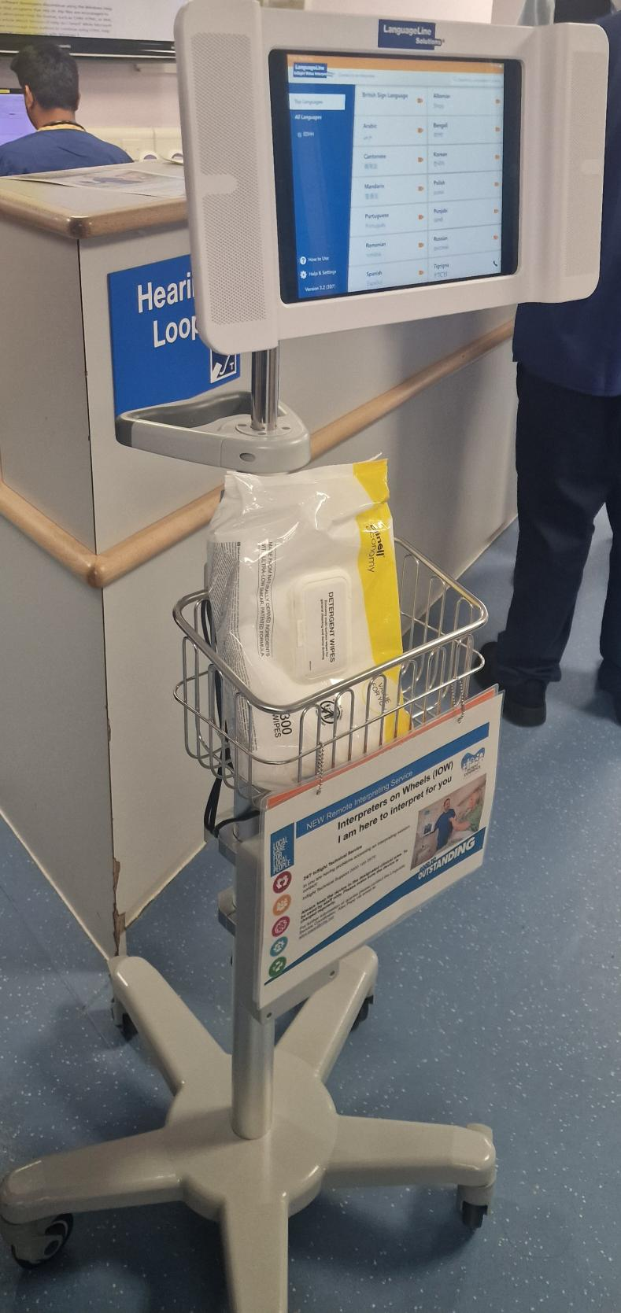
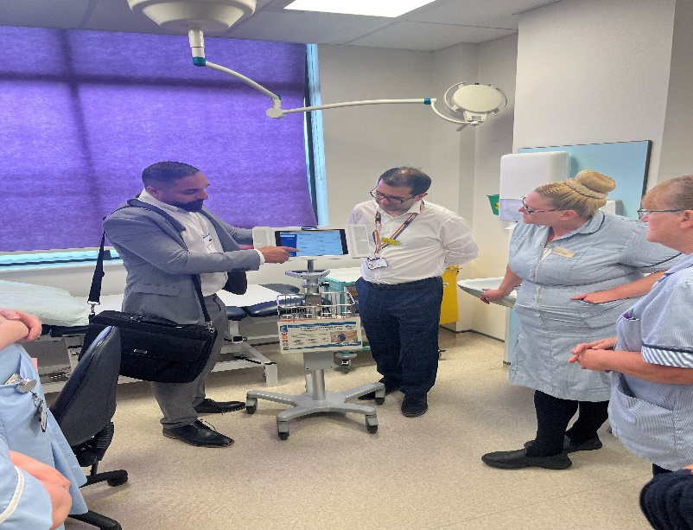
What changes were made or actions taken as part of the improvement?
Staff engagement and promotion equals success
High footfall clinics are best suited for on demand services (UEC)
Feedback led to an additional communication App being added
Expand and deploy
Notes:
As a result of the broad range of promotional activity and expressions of interest from stakeholders, the Patient Experience Team was delighted with the reception and large numbers of medical staff present at launch day. Training on use of the IOWs was provided at the launch, feedback collected from both sets of end users and usage data captured for the duration of the trial.
For inpatients that require interpreters to effectively communicate with staff, the availability of interpreters is equally paramount. Interactions between staff and inpatients are frequent and necessitate language support that can be readily available at short notice, and at all hours. IOWs are best suited to handle the majority of communication requirements in wards so it was only natural to trial and deploy them.
In Q3, IOWs include the Sign Live BSL interpreting application. In collaboration with IT, the new build for the iPads is available on all Trust IOWs from Q3.
Medical staff are now able to switch between two applications, InSight (for spoken languages) and Sign Live (for BSL users only). With this additional feature, the Patient Experience team aims to increase the use of IOWs in the Trust.
Patient Experience successfully trialled IOWs in Ward areas across the Trust. Trialled areas in Q3: B14 PCH, Daisy HH, Amazon Ward PCH, and A15 PCH. Following on from the successful trial, the plan is for the Patient Experience team to expand and deploy IOWs in ward areas in Q4.
Remote interpreting services training has been delivered on Ward days and is now part of the Trust HCA induction training. Training includes live demos and introduction to IOWs as an integral part of the interpreting services

Slide 10
How were patients, staff and others involved in shaping the project?
Local patient Survey
Patient & Public Voice Partnership (PPVP)
Staff Survey
Site Visit
4-week trial
Notes:
Patient Survey and PPVP
A staff survey was launched to understand why clinicians and non-medical staff are resistant to using remote interpreting service, so to understand barriers, service challenges and/or training needs. Feedback collected from 61 respondents.
Site Visit (Birmingham Women’s and Children’s)
4 week trial in the Trust
Patient Survey and PPVP
A staff survey was launched to understand why clinicians and non-medical staff are resistant to using remote interpreting service, so to understand barriers, service challenges and/or training needs. Feedback collected from 61 respondents.
Site Visit (Birmingham Women’s and Children’s)
4 week trial in the Trust

Slide 11
What were the results?
6468 VRI calls
30 IOWs deployed
Increased availability of professional interpreters
Increased exposure and improved skill set for staff
Reduced number of FTF requests
Reduction in rescheduled/cancelled appointments
Reduced number of complaints
Notes:
Since the launch of the IOWs in August 2023 a total of 6468 calls placed up until February 2024
From the initial trial of 4 units in Q2, in Q3 the IOW network has grown to having 30 units deployed across the Trust. The majority of clinics across the Trust, with a high number of patients seen every day, and a significant interpreting demand, have know joined the IOW network
With increased availability of professional interpreters on this remote platform, the ability to service a high volume of calls in various different languages on demand, the high adoption rates are expected to continue
Reduced number of Face to Face (F2F) requests with approx. 619 requests less than the pervious year
Trust Remote Interpreting on all platforms year on year increase of 40%
Reduction in rescheduled/cancelled appointments incurred due to the limitations of available F2F interpreters and subsequent substitution to remote interpreting
Increased exposure and improved skillsets for staff to new technologically advanced methods of utilising interpreters on remote platforms
Reduced number of complains reported on Datix regarding the lack of an interpreter during a patient appointment

Slide 12
What are the planned next steps?
Identify and target existing or new areas for the use of remote interpreting services
Continue to monitor levels of engagement and type of interpreting used by staff
The Patient Experience team will continue to educate clinical teams on the benefits of remote interpreting services, targeting high users of FTF to understand why they are reluctant to convert to remote platforms where appropriate
Continue to work with language service providers to strengthen the remote service platforms as a viable option, including increasing the number of IOWs in the Trust
Continue to support individuals for whom English is not their first language, to promote and manage their own health

Slide 13
Thank You
Questions?

